Slide 1

Premium Corporate Business Strategy
A board-ready framework for turning strategic intent into measurable execution — designed for leadership teams who demand clarity, accountability, and results.
LIGHT PROFESSIONAL
BOARD-READY
STRATEGY 2024–2025

Slide 2

Why This Strategy Exists: The Decision Moment
Every high-performing organization reaches a point where uncertainty must be converted into a single, measurable direction. This strategy exists to create that alignment — giving every stakeholder a shared understanding of what will change, why now, and how success will be proven.
Board-Ready Alignment
Audience Promise
The Decision Moment
Replace ambiguity with a unified strategic narrative. Every leader leaves this room with the same priorities, the same language, and the same definition of success for the next planning cycle.
This strategy commits to three things: what will change in the organization, why the timing is critical right now, and the specific metrics that will validate whether we are on track.
Markets are shifting. Competitors are moving. The window to act with advantage is open — but only for those who commit to a clear path and execute with discipline from day one.

Slide 3
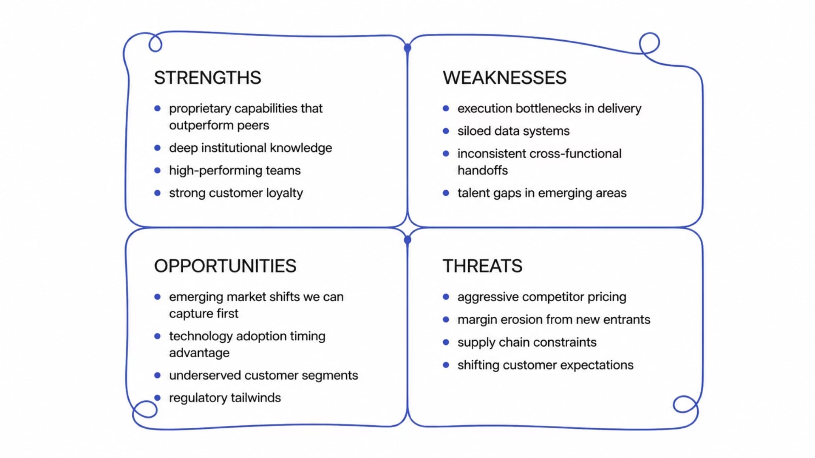

SWOT Snapshot: What We Can Win With
Before mapping threats, we must be honest about where we already lead. This quadrant captures the internal capabilities and external openings that form the foundation of our competitive advantage — the assets we can deploy immediately.
Strategic Lens: Strengths and Opportunities are your offensive playbook. Weaknesses and Threats are your defensive priorities. The goal is to deploy strengths against opportunities faster than competitors can respond.

Slide 4

SWOT Snapshot: What Could Break Us
Threats & Risk Posture
Quick Visual Payoff
Threats are not abstract — they are specific competitive and external forces actively eroding margin or growth. Each threat requires a named mitigation action, not a passive "we'll monitor it" stance.
The SWOT is only valuable when it converts into a focused strategic choice. Use this quadrant to answer one question: where do we place our biggest bets?
Competitive Pressure
Match strengths to the highest-value opportunities
Address weaknesses that block those opportunities
Build defenses against the most dangerous threats
Eliminate initiatives that don't connect to this grid
New entrants and aggressive incumbents compressing pricing power and customer acquisition costs.
External Constraints
Regulatory shifts, supply chain fragility, and macroeconomic volatility requiring proactive scenario planning.
Mitigation Actions
Each threat maps to a named owner, a trigger threshold, and a pre-defined response — eliminating reactive decision-making.

Slide 5

Timeline Milestones: From Plan to Proof
A strategy without a timeline is an intention, not a plan. These three milestones establish the operating rhythm, build the capabilities required for delivery, and generate the early evidence that validates our strategic assumptions.
Milestone 1 — Strategy Launch
1
Month 1–2: Establish operating rhythm with named owners, meeting cadence, and scorecards. Every workstream has a lead, a target, and a reporting structure from day one.
2
Milestone 2 — Capability Build
Month 3–5: First cross-functional delivery completed within a time-boxed sprint. Teams demonstrate ability to collaborate across silos and produce integrated outcomes.
Milestone 3 — Early Wins
3
Month 6: Measured outcomes validate strategic assumptions. These wins are not anecdotal — they are quantified results that build organizational confidence and unlock the next phase of investment.
Each milestone includes a go/no-go gate. If assumptions are not validated by Milestone 3, the strategy is adjusted — not continued on faith.

Slide 6



Milestone Flow: The Engine Room
CAPABILITIES → VALUE
The first three milestones set the foundation. Milestones 4 through 6 are where the strategy generates compounding returns — scaling what works, optimizing performance, and locking in durable competitive advantage through disciplined execution.
Milestone 6 — Lock In Competitive Advantage
Milestone 5 — Optimize Cost-to-Serve
Milestone 4 — Scale What Works
Execution discipline becomes a structural moat. Competitors can copy the plan — they cannot copy the organizational muscle built through six milestones of consistent, measured delivery.
Targeted performance levers are pulled to improve efficiency without sacrificing quality. Cost-to-serve metrics are tracked by segment, revealing where to invest and where to streamline.
Proven playbooks are replicated across teams and regions. Success is no longer isolated — it becomes the organizational standard, reducing variance and accelerating time-to-value in every market.

Slide 7

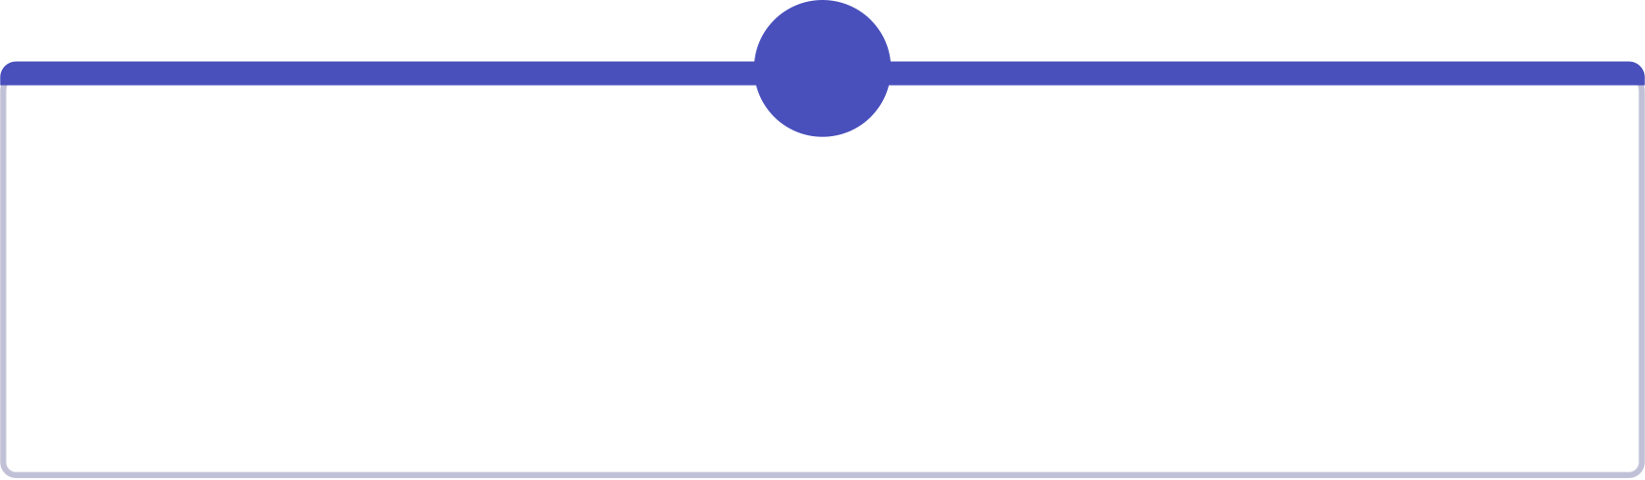
Two-Column Strategy: Objectives, Investments & Metrics
Strategy clarity lives in the connection between what we do and how we measure it. This framework maps every execution theme to a named owner, an investment commitment, and a KPI structure that makes performance visible at every level of the organization.
Objectives & Execution Themes
Investment Roadmap & KPI Structure
What we do — and who owns it.
How performance is tracked and funded.
1
Market Expansion
2
Operational Excellence
1
2
Owner: CRO. Enter two new segments with tailored go-to-market playbooks by Q3.
Owner: COO. Reduce cost-to-serve by 12% through process automation and vendor consolidation.
Capital Allocation
KPI Architecture
Investment tied to milestone gates — funding releases only when prior-phase outcomes are validated.
Three tiers: outcome KPIs (board), driver KPIs (leadership), and activity KPIs (teams). All visible in a single scorecard.
3
Talent & Capability
Owner: CHRO. Close critical skill gaps with targeted hiring and upskilling programs.
3
Review Cadence
Monthly operational reviews, quarterly board updates, and annual strategy refresh — each with defined escalation thresholds.

Slide 8

Push to the Finish: Near-Term Results & Next Call to Action
Strategy is only as valuable as its execution. The commitments below represent the most critical deliverables for the immediate horizon — and the governance structure that ensures they land on time, on target, and with full accountability.
Top 3 Deliverables
Governance Close
Call to Action
Launch operating rhythm — Owners, cadence, and scorecards live by end of Month 1
First cross-functional win — Integrated delivery completed and measured by Month 5
Validated assumptions — Early outcome data presented to board by Month 6
Review Cadence: Monthly workstream reviews, quarterly leadership check-ins
Escalation Path: Named escalation owner for each workstream with 48-hour response SLA
Success Thresholds: Pre-defined go/no-go criteria at each milestone gate
Approve this roadmap today so implementation begins immediately. Every week of delay is a week of competitive advantage surrendered. The plan is ready. The owners are named. The metrics are defined.
The only remaining decision is to begin.
Board approval of this strategy triggers immediate activation of Milestone 1. All workstream owners are briefed and ready to execute within 5 business days of sign-off.

