Slide 1

Stark-Tech: Architecting the Future
[Company Name] — [Vision Statement: One sentence that defines your mission and the future you are building]
INVESTOR PITCH DECK · 2024

Slide 2

The Current Landscape: A System in Flux
The Problem We're Solving
Industries are held back by legacy infrastructure, fragmented data, and costly inefficiencies. The gap between what technology promises and what it delivers has never been wider.
[Pain Point 1] — [Specific inefficiency or market gap]
[Pain Point 2] — [Cost, speed, or scalability bottleneck]
[Pain Point 3] — [Competitive or operational disadvantage]

Slide 3



The Stark-Tech Solution: Precision Engineering
Three interconnected pillars form the foundation of our proprietary platform — each designed to eliminate a critical failure point in the current market.
[Pillar 1 — Core Technology]
[Pillar 2 — Platform Intelligence]
[Pillar 3 — Enterprise Reliability]
[Describe the first value proposition: what it does, why it's unique, and the direct impact on the user or system]
[Describe the second value proposition: how it connects, automates, or scales beyond existing solutions]
[Describe the third value proposition: trust, security, compliance, or uptime guarantees that de-risk adoption]

Slide 4


Technical Architecture: The Engine Room
Proprietary Stack
Our architecture is built from the ground up — not a patchwork of third-party tools. Every layer is owned, optimized, and defensible.
[Layer 1 — Core Engine]
[Layer 2 — Data Pipeline]
[Layer 3 — API & Integrations]
[Proprietary technology or algorithm name and function]
[Real-time processing, latency, throughput specs]
[Enterprise connectivity, partner ecosystem, SDK details]

Slide 5

Market Opportunity: Scaling the Frontier
We are targeting a rapidly expanding market with a clear path from initial beachhead to full-scale capture.
$[XX]B
$[XX]B
$[XX]M
TAM — Total Addressable Market
SAM — Serviceable Available Market
SOM — Serviceable Obtainable Market
[Global market size across all segments and geographies we could eventually serve]
[Segment we can realistically reach with current product and go-to-market strategy]
[Near-term capture within 24–36 months based on pipeline and traction]
Market data sourced from [Source Name, Year]. CAGR of [XX]% projected through [Year].

Slide 6

Traction: The Velocity of Adoption
Early momentum validates product-market fit. Our pilots and launches have generated measurable results ahead of schedule.
[XX]%
[XX]%
[XX]%
[Metric 1 — e.g., Pilot Conversion Rate]
[Metric 2 — e.g., Month-over-Month Growth]
[Metric 3 — e.g., Customer Retention / NPS]
[Context: number of pilots run, industries, or enterprise logos]
[Context: user acquisition, ARR growth, or engagement uplift]
[Context: renewal rates, satisfaction scores, or referral data]

Slide 7
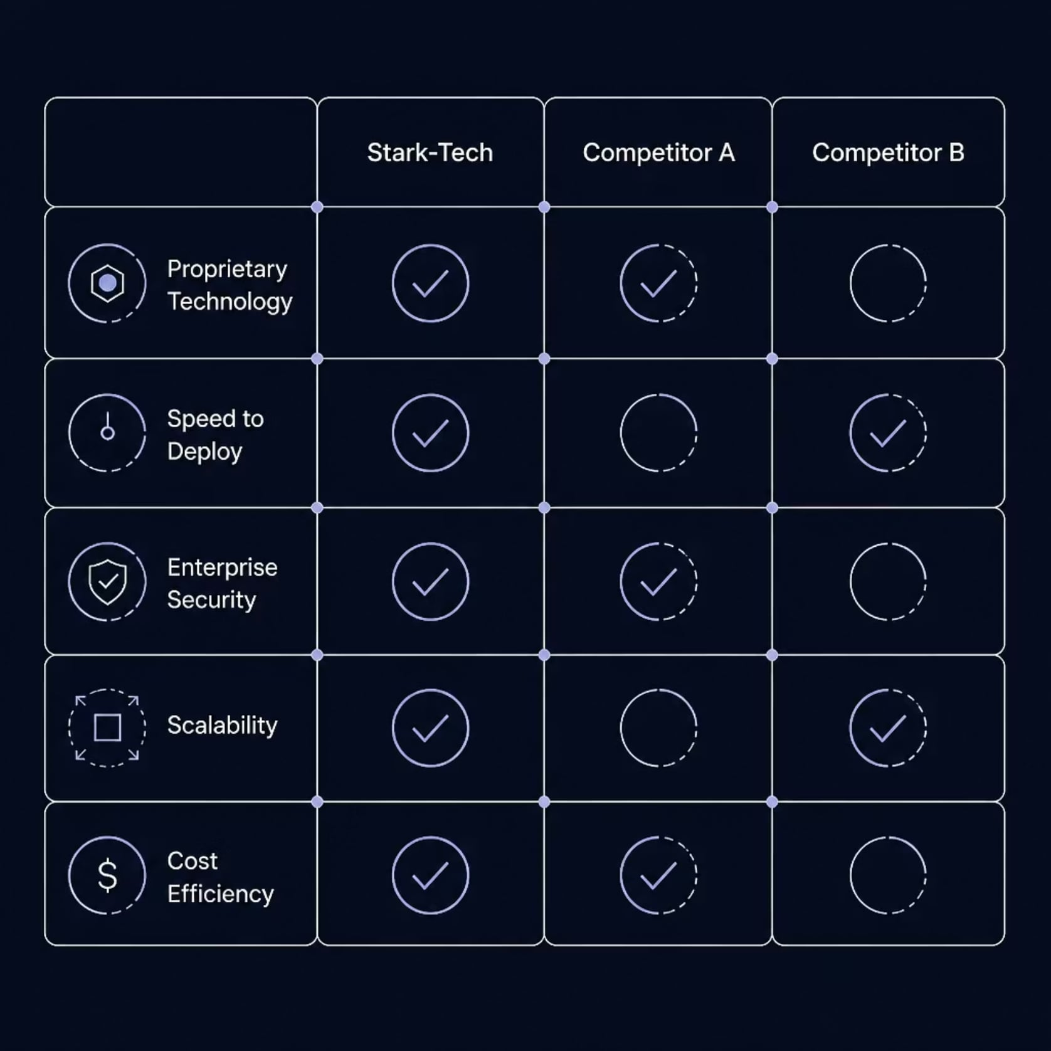
Competitive Moat: Defying Industry Norms
Why Stark-Tech Wins
Competitors rely on legacy architectures, fragmented toolchains, or manual workflows. Our integrated, proprietary stack creates structural advantages that compound over time — and are nearly impossible to replicate quickly.
[Differentiator 1] — [Specific technical or operational edge]
[Differentiator 2] — [IP, patents, data network effects, or partnerships]
[Differentiator 3] — [Speed, cost, or accuracy advantage vs. incumbents]

Slide 8
Go-to-Market: Tactical Execution
A phased rollout strategy designed to maximize early wins, validate unit economics, and scale with precision.
Phase 1 — [Launch]
1
[Target segment, pilot customers, initial geography — Months 1–6]
2
Phase 2 — [Expand]
[New verticals, enterprise partnerships, channel development — Months 7–12]
Phase 3 — [Scale]
3
[International expansion, platform APIs, ecosystem growth — Year 2]
4
Phase 4 — [Dominate]
[Category leadership, M&A activity, full market capture — Year 3+]

Slide 9



The Team: Architects of Innovation
World-class operators and engineers with deep domain expertise, prior exits, and the execution track record to deliver.
[Founder & CEO]
[Co-Founder & CTO]
[Key Executive — e.g., COO / CRO]
[Prior company / exit, years of experience, domain expertise — e.g., "Ex-[Company], 10+ years in [sector]"]
[Technical background, patents, architecture experience — e.g., "Led engineering at [Company], scaled to [X]M users"]
[Go-to-market, operations, or fundraising experience — e.g., "Former [Role] at [Company], drove $[X]M ARR"]

Slide 10


The Ask: Powering the Next Phase
💰 Funding Request
🎯 Use of Funds
$[XX]M — [Seed / Series A / Series B]
[Instrument: Equity, SAFE, Convertible]
[XX]% — Product & Engineering
[XX]% — Go-to-Market
[XX]% — Operations & Talent
🏁 Milestones
[Milestone 1 — e.g., $X ARR by Q4]
[Milestone 2 — e.g., X enterprise logos]
[Milestone 3 — e.g., International launch]
Ready to build the future together? Contact us at [email@stark-tech.io] or schedule a follow-up at [calendly.com/stark-tech]

