Slide 1
Task : Wolf Predation
Language : Python
Name : Darshit Purohit
Neptun ID : M4BE6L

Slide 2
Task Detail
Wolf → Find the shortest path to sheep and Surround it.
Sheep → 1) Static
2) Move Randomly
3) Maximize Distance from nearest sheep
4) If distance(Sheep,Nearest wolf)<=Minimum distance:
Move away & Maintain Minimum distance
Else:
Move Linearly
Distance → distance(Sheep,wolf) - K*sum(distance(wolf,wolfs)), K=repulsion force
Game ends when sheep is surrounded →
W | W | W
W | S | W
W | W | W

Slide 3

Demo

Slide 4
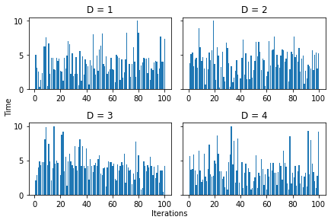
How different values of D ‘minimum distance’ to maintain affects the capturing time for wolf or survival of Sheep?
Gird size = 100
No of wolfs = 8
> Simulation was executed for 100 times for different values of D.
> Then average time is compared for different values of D.

Slide 5
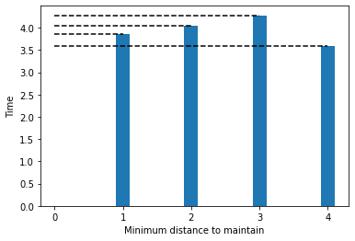
Comparing & Observations
> As sheep moves linearly until the minimum distance, in case of D=1 it get very close to wolves before it starts moving away and wolves can easily corner it.
> Time increases for D =2 & 3 as sheep starts getting away before wolves get too close.
> But with D=4, sheep starts running away too early and hits the border and gets cornered quickly than before.

Slide 6
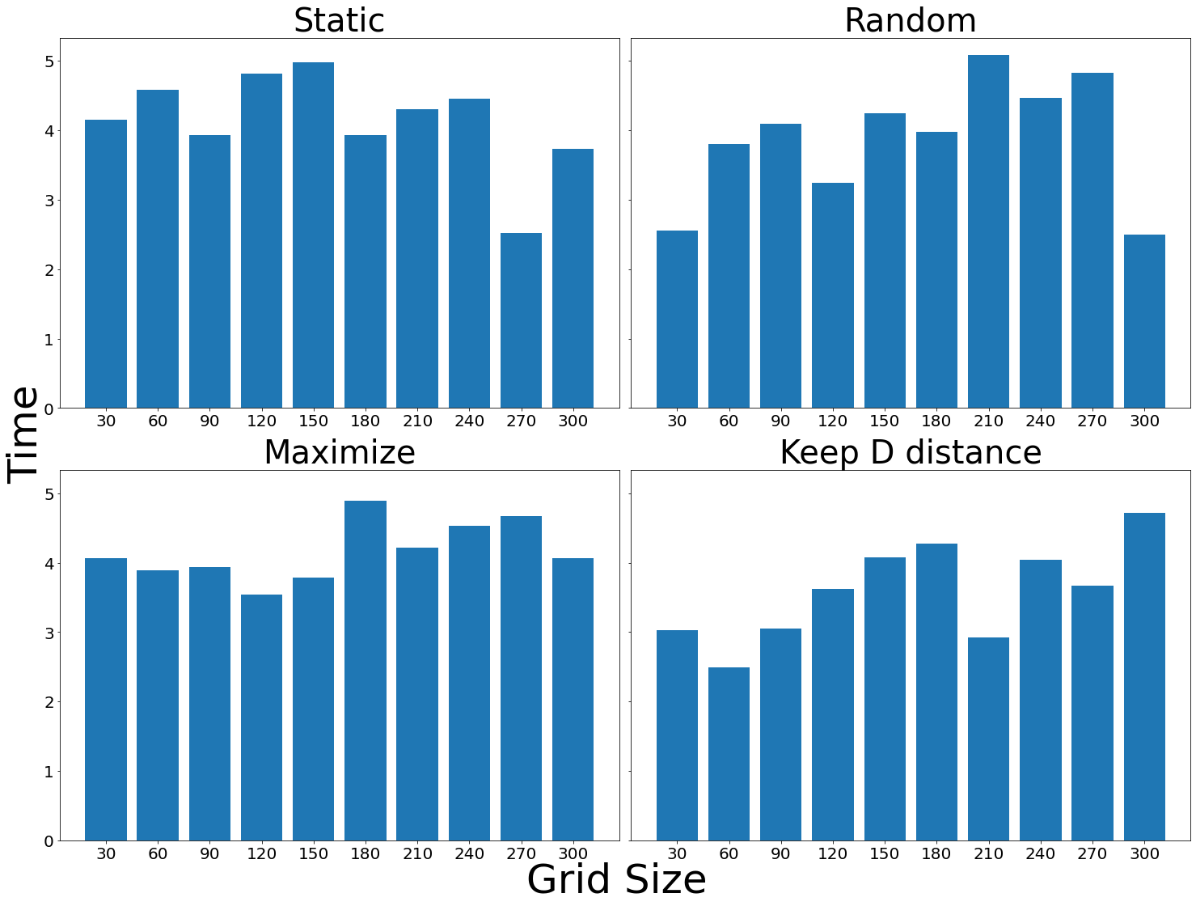
How Grid size affect different Sheep movements?
Parameters:
D = 3
Wolves = 8
> Time varies randomly with different grid size when Sheep chooses to move randomly or being static (it largely depends on initialisation of wolves location).
> While maximizing distance from wolves shows less variance in capturing time. As it starts moving away from start, it hits the border pretty quickly and gets cornered.
> GS has the most effect on method 4, as we see time increase gradually with increase in GS. Sheep could maintain D distance for long period for large grids.

Slide 7
Thank you For your attention.

