Slide 1
Task: Foraging Ants
Language: Python
Name: Darshit Purohit
Neptun: M4BE6L

Slide 2
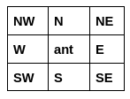
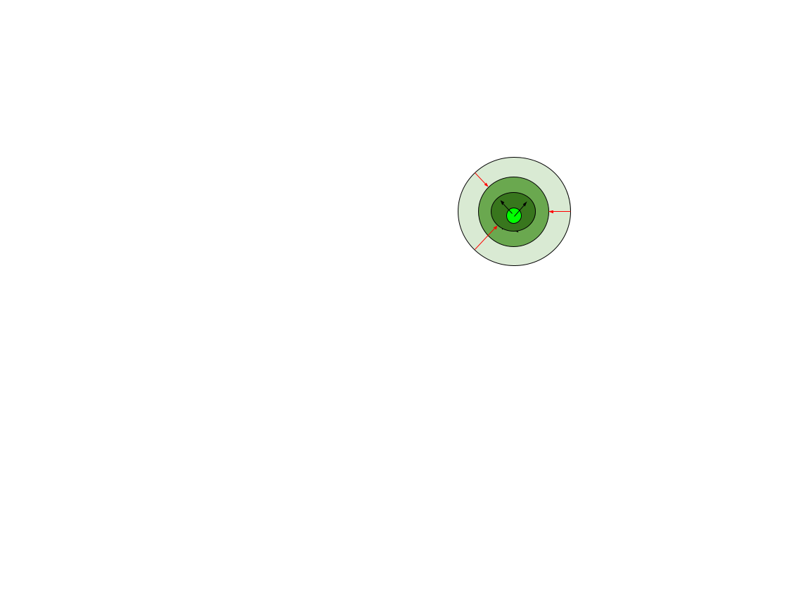
State : { Information about surrounding pheromones }
Action: { E, SE, S, SW, W, NW, N, NE, Dispose pheromones}
Goal: { Find and Gather required food from the different food sources }
Pheromones are diffused based on the diffusion rate : (Rate / 100)*Pheromone value
Pheromones are evaporated base on the evaporation rate: (100-Rate)/100 * Pheromone value

Slide 3
Algorithm
Initialise state with given parameters
While ant at nest and not carrying food → find food( follow Pheromone-2) , else → drop food
While ant at food source and not carrying food → pick up food, else → go to nest( follow pheromone-1)
While moving dispose Pheromones (1 or 2 based on the role)
Pheromones are diffused based on the diffusion rate : (Rate / 100)*Pheromone value
Pheromones are evaporated base on the evaporation rate: (100-Rate)/100 * Pheromone value
State is terminated If specified amount of food is gathered or reached the number of given iteration.

Slide 4

Visualization

Slide 5
Exploring effects of different Diffusion and Evaporation rate. For each combination program was ran for 1000 iterations.
Parameters:
Number of ants = 50
Number of food source = 2
Amount of food (per source) = 50
Grid size = 40
Location of the Nest and Food source were static for all the experiments.

Slide 6
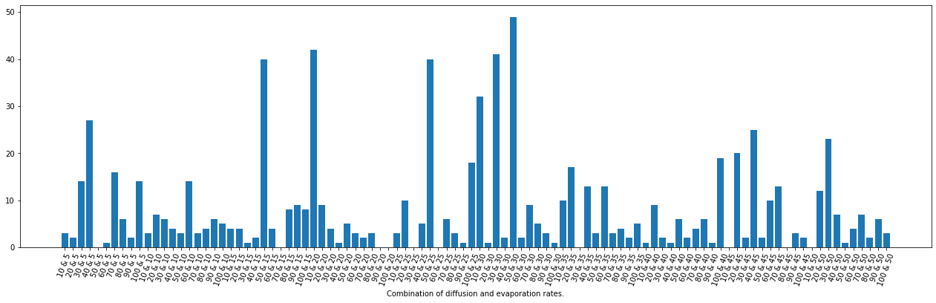
Number of food gathered is mostly higher when Diffusion rate > Evaporation rate.
Total of 21 combinations have counter>10, out of which 15 combinations have Diffusion rate > Evaporation rate.
Total of 9 combinations have counter>20, out of which 8 combinations have Diffusion rate > Evaporation rate.
And all the 6 combinations with counter value >=30 also have Diffusion rate > Evaporation rate.
To identify the ratio (difusion rate : evaporation rate) which can be outputs good result most of the time, further experiments are needed.

Slide 7
Thank you

