Slide 1
Team : DeBurgerz
Problem statement : Milk Basket

Slide 2
Aim
To generate innovative insights from order dataset and also to increase the average order value (AOV).

Slide 3
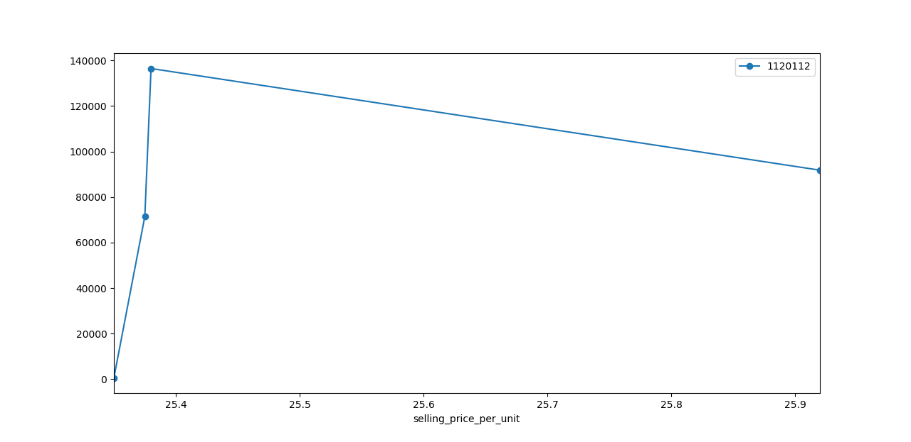
Insights – Price fluctuation impact on Subscription

Slide 4
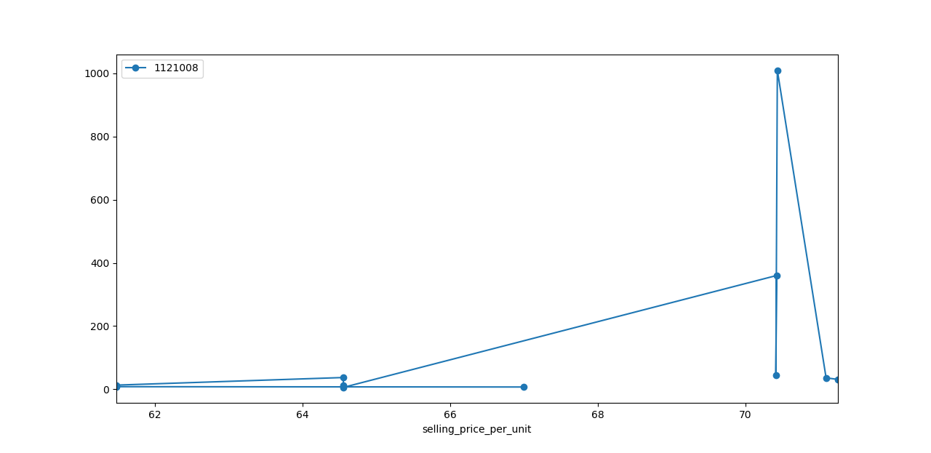

Slide 5
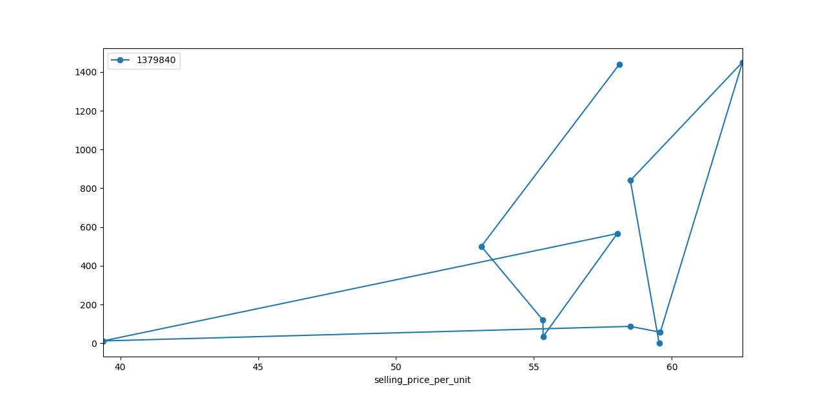

Slide 6
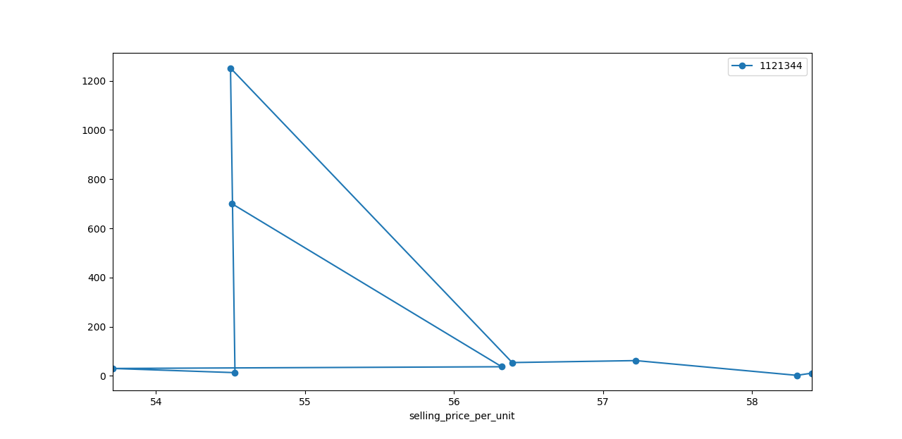

Slide 7
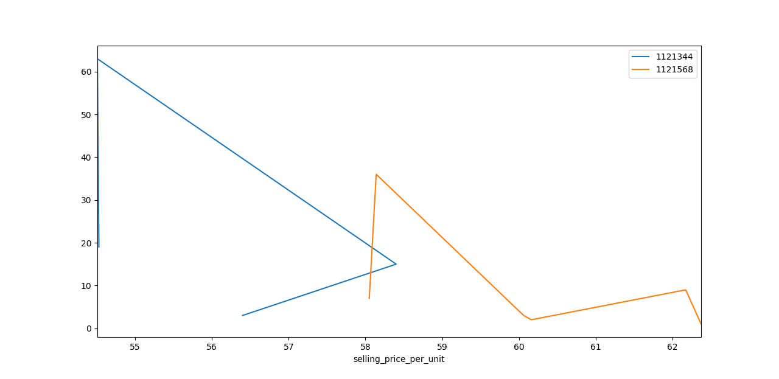
Insights – Impact of price fluctuation on un-subscribed customers

Slide 8
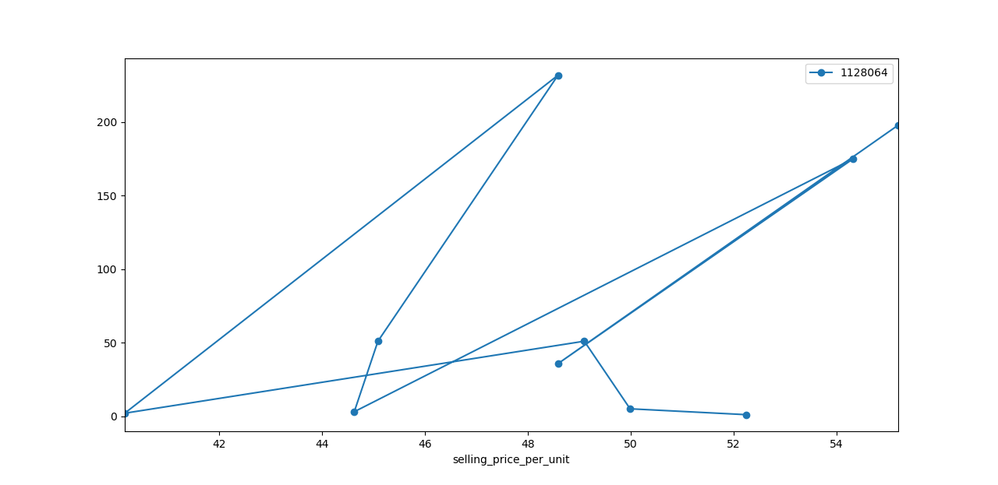

Slide 9
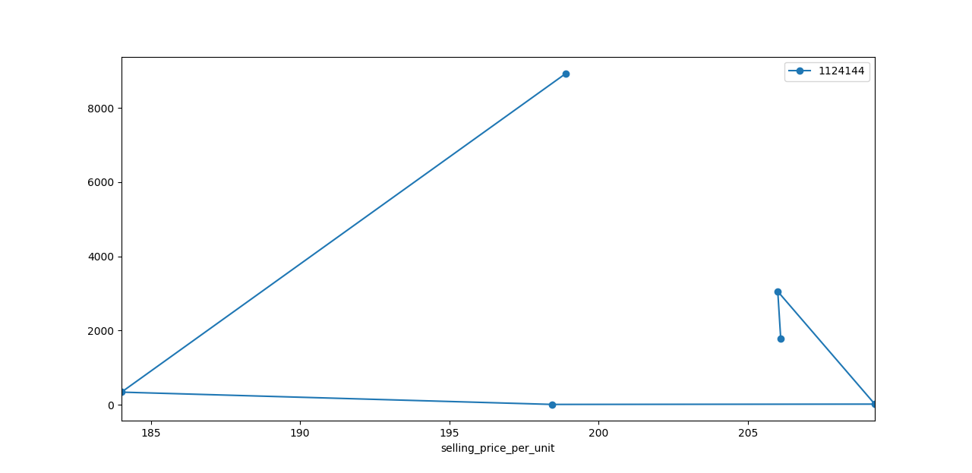

Slide 10
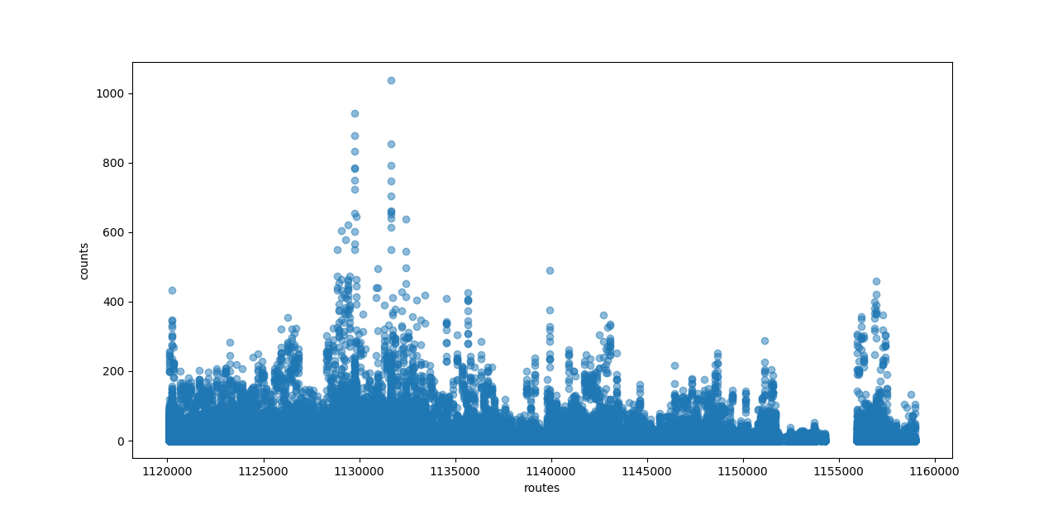
Insights on order per route

Slide 11
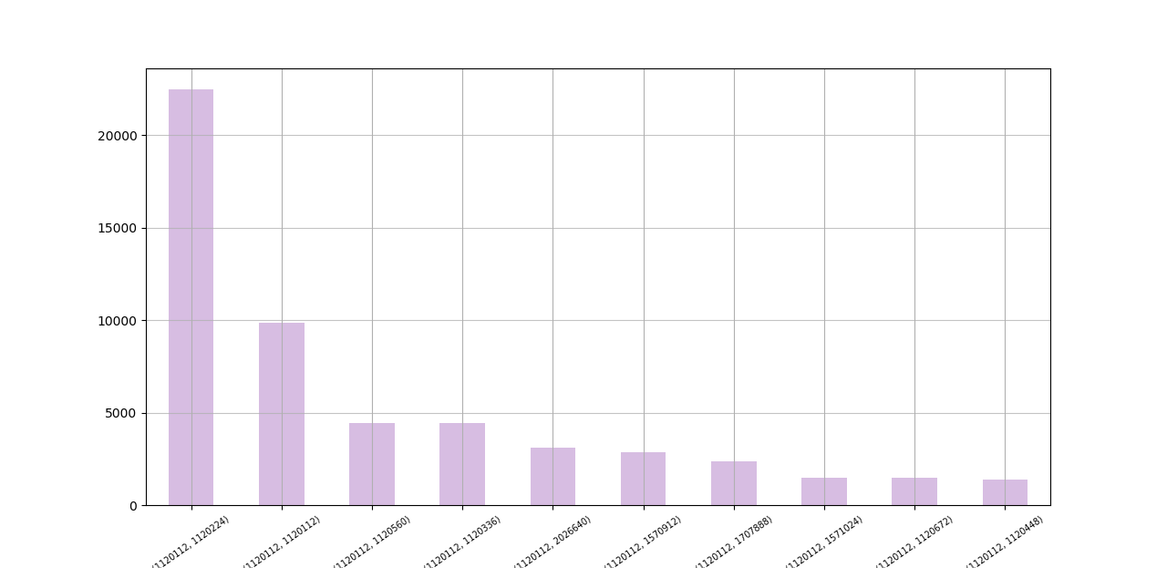
Insights : City vs Product Trending

Slide 12
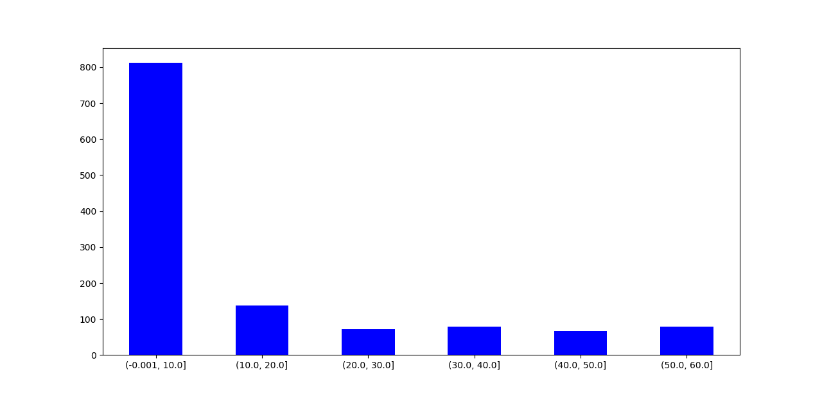
Insights :- AVG Item in a Basket vs Families

Slide 13
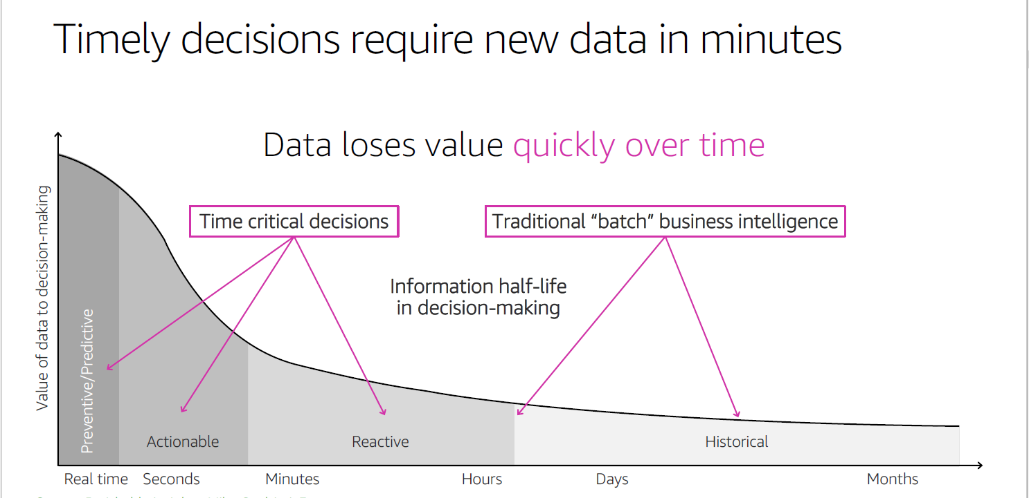
Classification of data to be used

Slide 14
Insights : Consistency of Subscription
 | Subscribers
1120112 | 59156
1120224 | 111007
1120336 | 22228

