Slide 1



CSUDH Health App
An Initiative by Satish Divvi and Darshit Shah

Slide 2
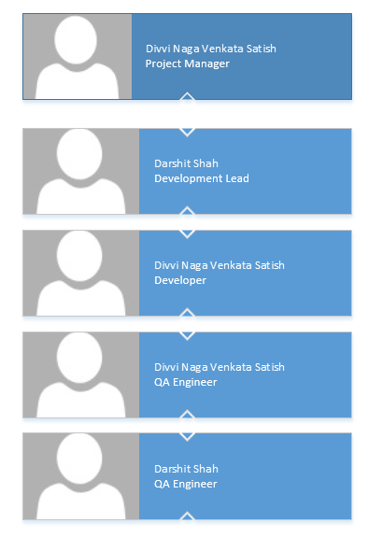


Slide 3

CSUDH Health App?
To facilitate all individuals of CSU-Dominguez Hills to notify group of other individuals in case of any type of blood is required.
For whom and how it will work?
Scope
All the members of CSU-Dominguez Hills
With One-Click, Notification will be sent to respective members who are having the application.
Device Support?
(Android)
Minimum Version: Android 4.4, “Kitkat”

Slide 4


Slide 5

Inbuilt Emulator
Real Time Experience
API Integrations
Why
Freeware
User Interface
Android Forums

Slide 6
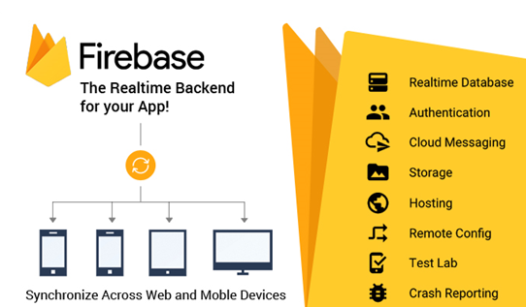
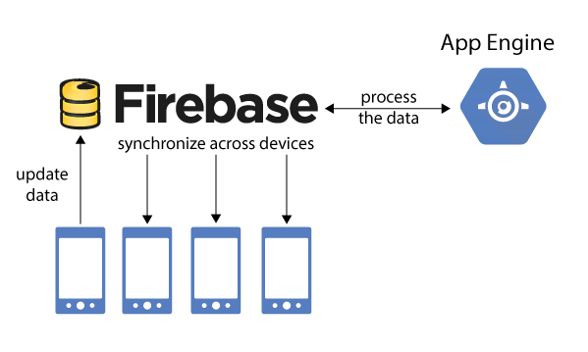
Reference: firebase.google.com

Slide 7
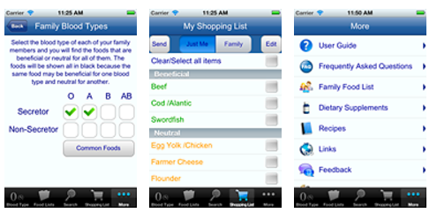
Blood Type Diet iPhone App
Lists beneficial, neutral and avoid foods for each of the 4 blood types
For Grocery shopping
Meal Planning
Eating in Restaurant
Reference: iOS App Store

Slide 8
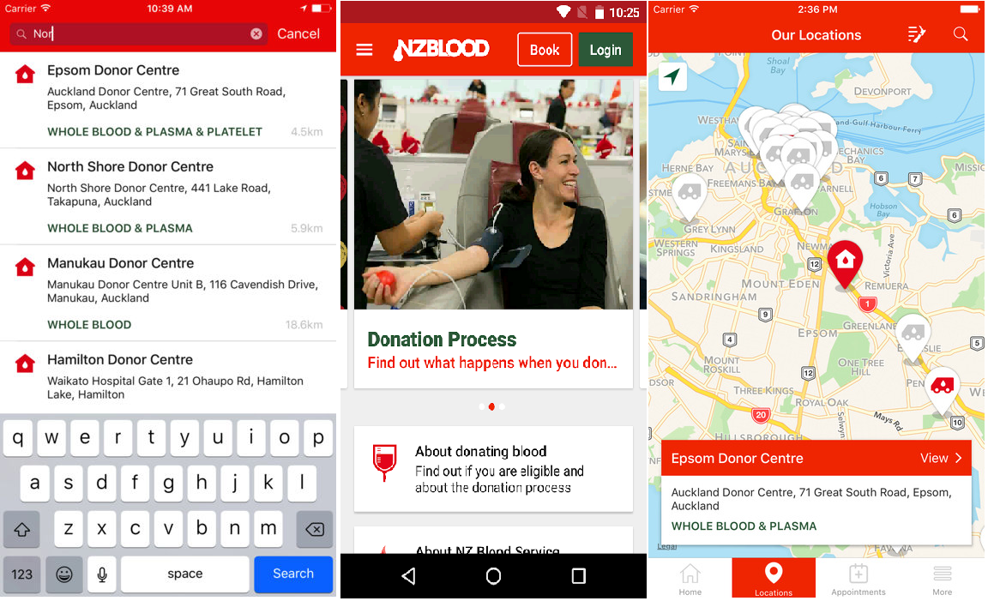
NZ Blood Service Donor App
Book, reschedule or cancel an appointment for Blood Donation
Search for a place to donate
Look up your Donation History
Reference: iOS App Store

