Slide 1
Spock – A Space Odyssey
"Putting Adventure back into text-based adventure games"​
​
-A Group Project

Slide 2
The Lore…
█████████ █████
███░░░░░███ ░░███
░███ ░░░ ████████ ██████ ██████ ░███ █████
░░█████████ ░░███░░███ ███░░███ ███░░███ ░███░░███ ██████████
░░░░░░░░███ ░███ ░███░███ ░███░███ ░░░ ░██████░ ░░░░░░░░░░
███ ░███ ░███ ░███░███ ░███░███ ███ ░███░░███
░░█████████ ░███████ ░░██████ ░░██████ ████ █████
░░░░░░░░░ ░███░░░ ░░░░░░ ░░░░░░ ░░░░ ░░░░░
░███
█████
░░░░░
█████████ █████████
███░░░░░███ ███░░░░░███
░███ ░███ ░███ ░░░ ████████ ██████ ██████ ██████
░███████████ ░░█████████ ░░███░░███ ░░░░░███ ███░░███ ███░░███
░███░░░░░███ ░░░░░░░░███ ░███ ░███ ███████ ░███ ░░░ ░███████
░███ ░███ ███ ░███ ░███ ░███ ███░░███ ░███ ███░███░░░
█████ █████ ░░█████████ ░███████ ░░████████░░██████ ░░██████
░░░░░ ░░░░░ ░░░░░░░░░ ░███░░░ ░░░░░░░░ ░░░░░░ ░░░░░░
░███
█████
░░░░░
███████ █████
███░░░░░███ ░░███
███ ░░███ ███████ █████ ████ █████ █████ ██████ █████ ████
░███ ░███ ███░░███ ░░███ ░███ ███░░ ███░░ ███░░███░░███ ░███
░███ ░███░███ ░███ ░███ ░███ ░░█████ ░░█████ ░███████ ░███ ░███
░░███ ███ ░███ ░███ ░███ ░███ ░░░░███ ░░░░███░███░░░ ░███ ░███
░░░███████░ ░░████████ ░░███████ ██████ ██████ ░░██████ ░░███████
░░░░░░░ ░░░░░░░░ ░░░░░███ ░░░░░░ ░░░░░░ ░░░░░░ ░░░░░███
███ ░███ ███ ░███
░░██████ ░░██████
░░░░░░ ░░░░░░
"Spock: A Space Odyssey" is an interstellar epic where Commander Spock embarks on a cosmic journey to interpret nine ancient tales, preventing the awakening of the universe-threatening entity, Azathoth. Each realm houses a unique narrative, and Spock's choices determine the fate of Earth and the cosmos. Will he succeed in ensuring Azathoth's continued slumber, or will the universe face a cataclysmic obliteration? The destiny of the cosmos rests in Spock's hands.

Slide 3
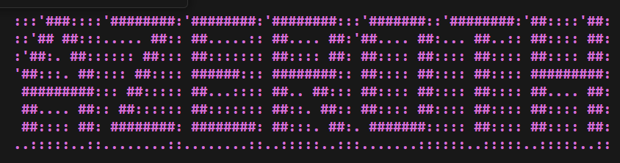
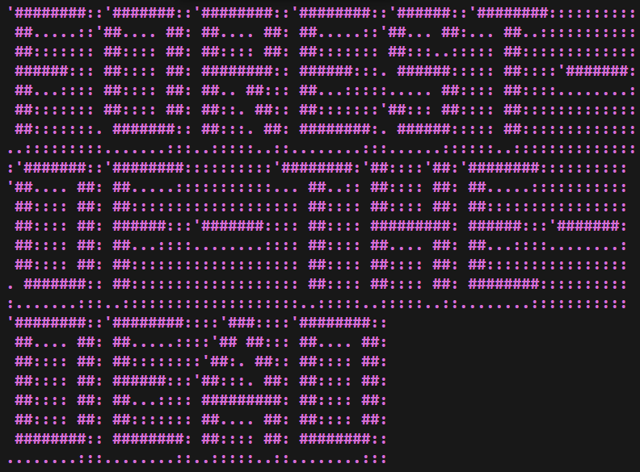
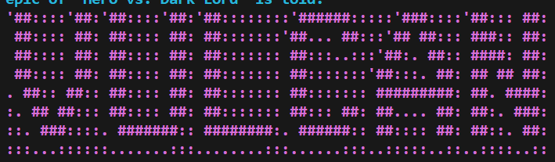
Visuals
The imported library “Termcolor” provides a vibrant plethora of text colours, encapsulating the ever-diminishing attention spans of modern day gamers.
State of the art ASCII Art has been implemented, with animations.
“Pyfiglet” allows for Stylized location names, transforming mundane titles into captivating, decorative art.
Sound effect initialization via “Pygame” library.

Slide 4
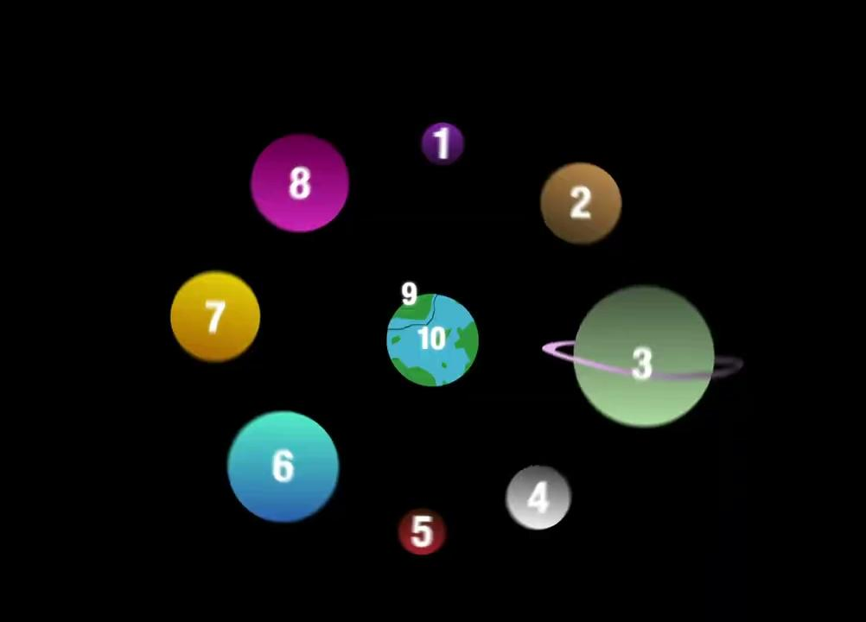
Game map… .
Locations:
Azeroth
Zygar
Garden
Eclipsis
Clion
Gorton
Fffire
Vulcan
Forest of the dead
Earth

Slide 5



Our Game Mechanics….
We have implemented several mechanics that leads to better player engagement and immersion. These include……
Fuel : Once depleted, results in a game over, requiring the player to carefully manage their resources.
Food and Water : Survival elements that once again demands careful resource management.
Treasury and Currency : Implemented trading system for acquiring various resources and items.
Decisions: The player will be presented with different scenarios where their decisions will have an impact on the world.

Slide 6
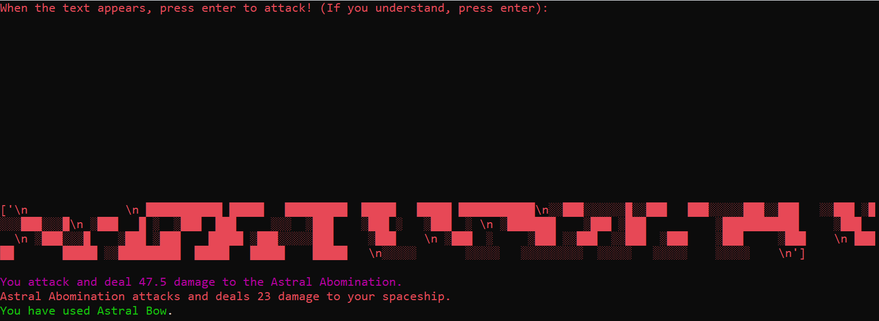
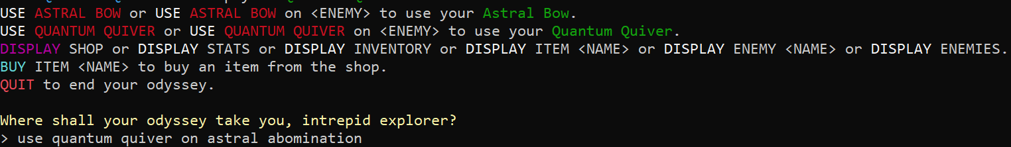
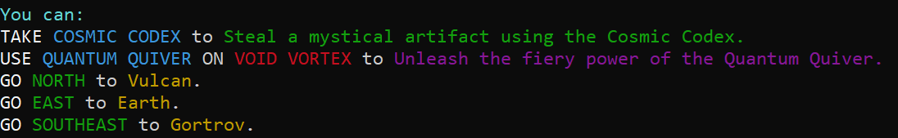
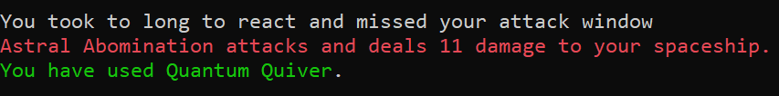

In-game Combat
Thinking of bypassing the mechanics by spamming Enter? Not going to work! If you try it, you’ll be met with shame and deal 0 damage.
The combat sequence revolves around the player’s reaction speed. After the text appears, depending on how long the player takes to hit Enter, an amount of damage is dealt to the enemy accordingly.
The player can choose what item to use on whatever enemies are encountered, with each item dealing unique amounts of damage.
The ingame menu will notify the player of any enemy encounters, where it gives you an item suggestion of what to use on said encounter.
Just like in most games, the player’s attack can miss. In this case, if the player takes too long to react, they miss their attack window, dealing 0 damage.

Slide 7
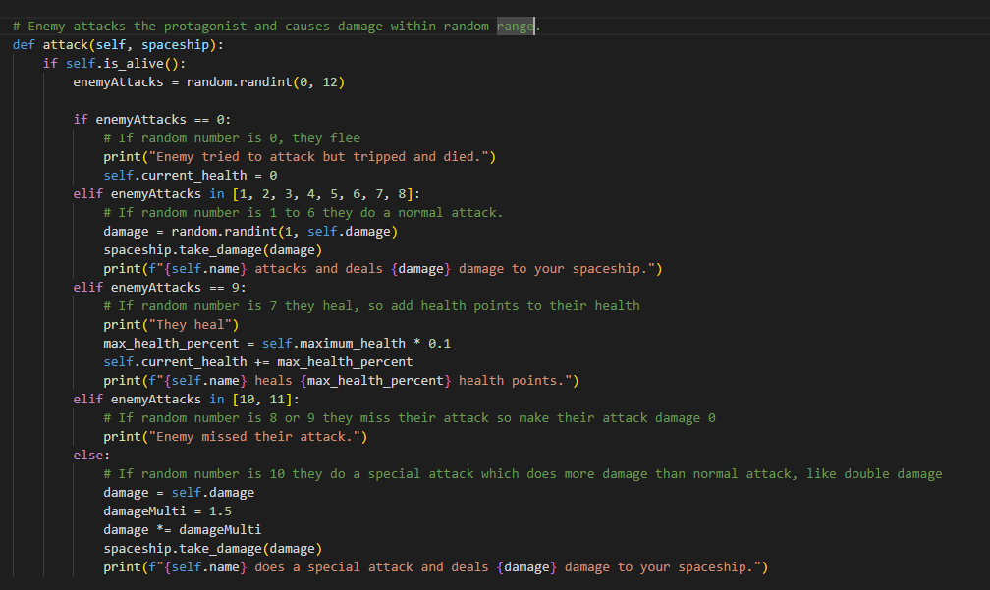
Enemy Attack System:
Encounter Varied Enemies: Face foes with diverse actions, making battles exciting.
Realistic Combat: Experience unpredictable enemy moves for added challenge.
Make Strategic Choices: Adapt to enemy behaviors, including potent special attacks.
Thrilling Space Showdowns: Test your skills in unique and intense battles.

Slide 8
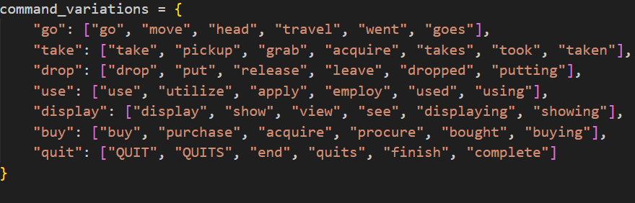
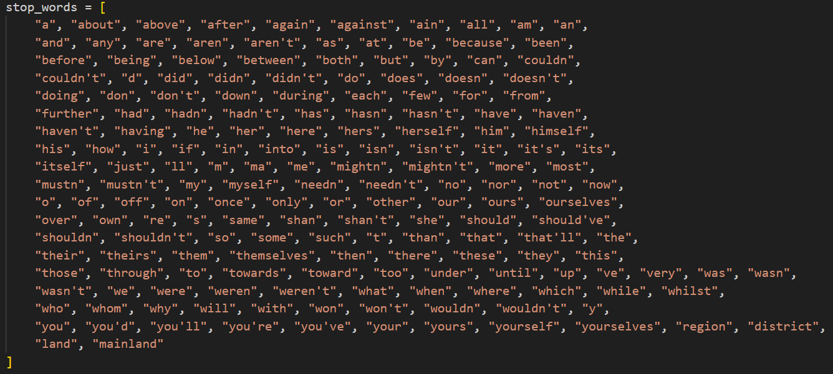
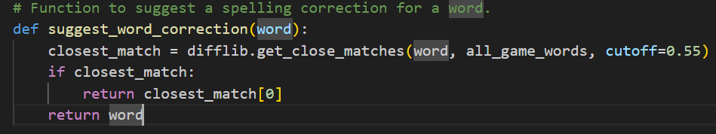
Game Parser
Our game features a state-of-the-art game parser, which filters out words from a list of “stop-words”.
And finally, the pride and joy of our parser…
This function reads the user input, and if it has a 55% similarity to a runnable command input, it will suggest the closest match.
It also processes synonyms of command words, so if you were to type “travel to garden”, you would go to Garden.

Slide 9
Game Inventory
We’ve created multiple items with different effects that the player can collect while playing the game and store them in their Inventory. A few examples of inventory that can be obtained during the game is:
Cosmic Scepter: Cosmic scepter inflicts serious damage to one's enemy.
Celestial Shield: A shield made of celestial energy that protects from enemy attacks.
Elixir of Life: A magical potion that can restore health.
Starlight Sword: A sword made of starlight, deals significant damage to enemies.
Stellar Staff: A staff that can be used to cast powerful spells.
Cosmic Cloak: A cloak that can make the wearer invisible.
Elixir of Endurance: A magical potion that can restore a large amount of health.

Slide 10
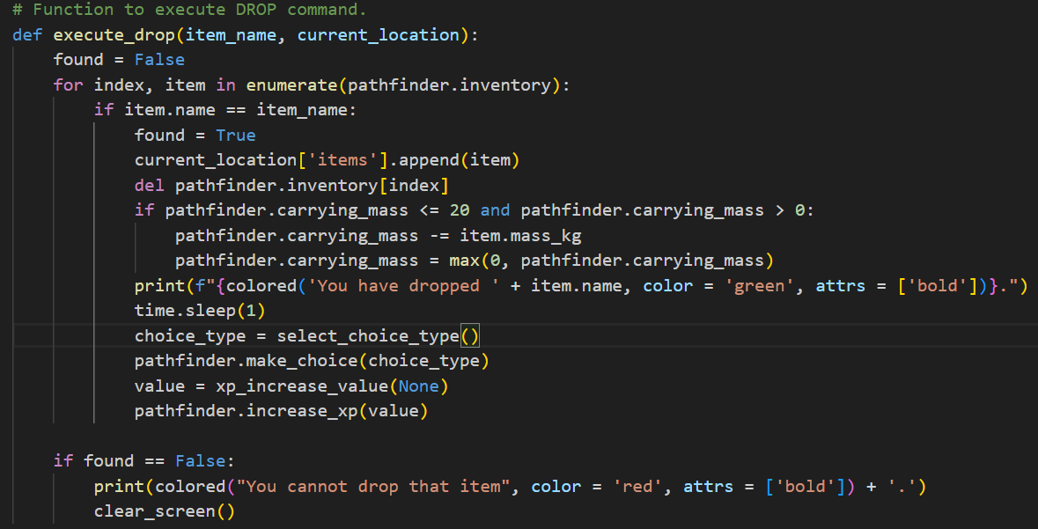
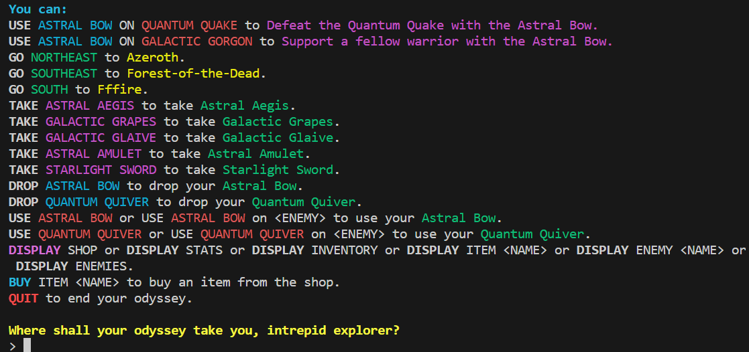
Executing Commands
Execute Functions allow for a user-friendly, easy-to-understand interface. “USE”, “GO”, “TAKE” etc..
The modular design allows for easy implementation of new game mechanics in future updates.
Replayability: The functions enable multiple playthroughs with different outcomes based on the different types of player choice: good, bad, neutral.

Slide 11
Debugging
Goal: Keep the code bug-free to prevent slowdowns or breakdowns.
Strategy: Created a shared bug-tracking file.
Benefit: Enabled efficient identification and resolution of issues during testing.
Bug #1: (Phil)
When menu is displayed from Zygar and Garden, displays "SOUTHEAST" as
one word rather than as "SOUTH EAST", with every direction. This then
requires the player to type their input as one word, otherwise it is seen as
invalid input
Bug #3: (ziyi)
When a player inputs an item name like "STARLIGHT SWORD" into
the game interface without preceding action verbs such as "take" or
"drop", the game interface will reload. It won't display prompt messages
Bug #2: (Phil) like "What is your intention?" or "Please enter your next action."
when attempting to head west to Gortrov from CLion, no variation
of west is a valid input
#FIXED, In CLion's dictionary exits, "West" had a capital W when it shouldve been lowercase.
#FIXED, Zygar and Garden's definitions of their directions had no spaces. #NOT A BUG_.
#FIXED, the execute functions have now been implemented, letting the user to do these

Slide 12
Testing
Objective: Regular and diverse testing approaches to enhance program stability and functionality.
Testing Methods:
Boundary Testing: Checked game parser with various input
combinations for flexibility and accuracy.
Unit Testing: Verified individual code segments for functionality before integration.
Error Handling: Tested the program's response to incorrect inputs to improve robustness.

Slide 13
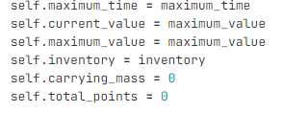
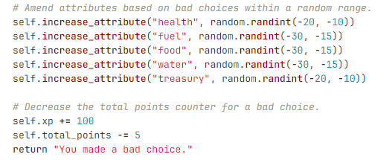
Make your own ending
Player Interaction: Your choices during various events determine the game's ending.
Points System: Decisions contribute to a hidden stat influencing the final outcome.
******NEED TO FIND CODE THAT TRIGGERS THE RELEVANT ENDING

Slide 14
THANK YOU!

Slide 15
Credits:
Group Leader and our saint - Darsh Kanjani
Game Mechanics - Morgan, Darsh
Game Parser - Darsh
Items - Hamood, Philip
Locations - Morgan, Darsh, Andrien
Story - Anurag, Morgan, Ziyi
Testing and debugging - Philip, Ziyi
User Interface - Darsh
Presentation - Darsh, Morgan, Hamood, Philip, Anurag, Andrien, Thejana, Ziyi

