Slide 1


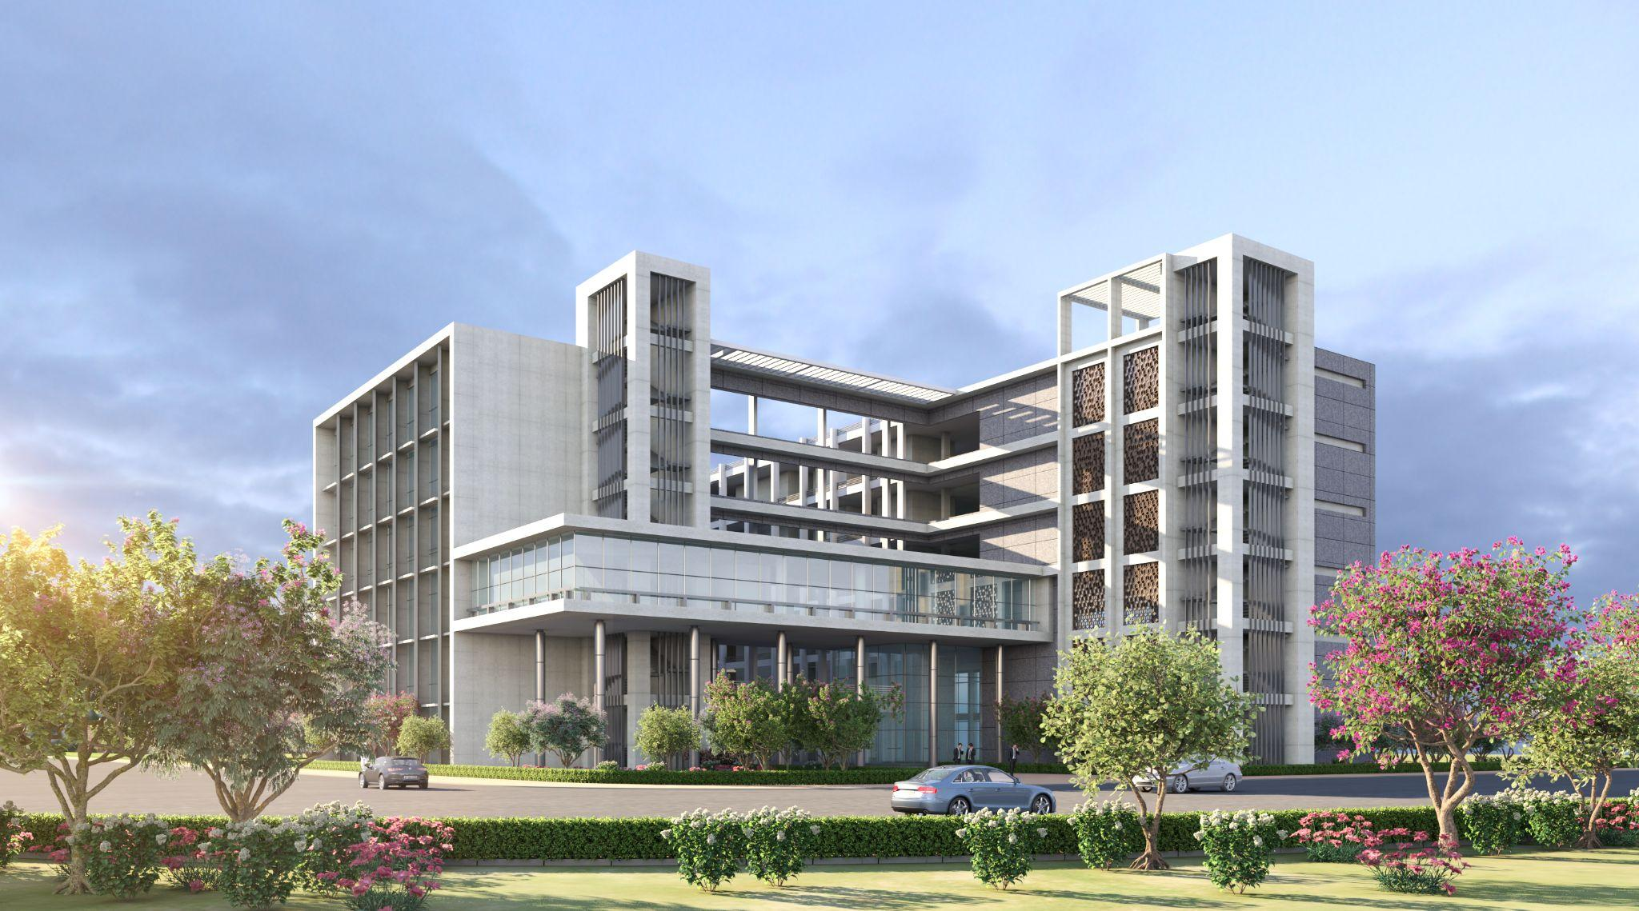
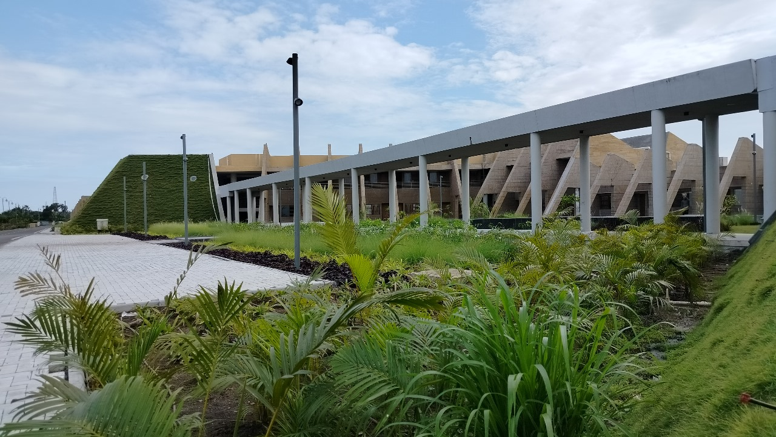

(GenAI-Health – 2026)
ANRF-PAIR Sponsored
Karyashala on LLMs and GenAI: Foundations, Python Implementation, and Healthcare Applications
February 28 & March 1, 2026
Hands-on Session on
Foundations of LLMs:
From Tokens to In-Context Learning
Understanding Tokenization, Embeddings, Attention, and Prompting in Modern Generative AI

Slide 2

Topics to be covered
Large Language Models (LLMs) processing pipeline
Tokenization fundamentals
Embedding space intuition
Transformer self-attention
Prompt engineering
In-context learning
Retrieval Augmented Generation (RAG) overview
(GenAI-Health – 2026)

Slide 3
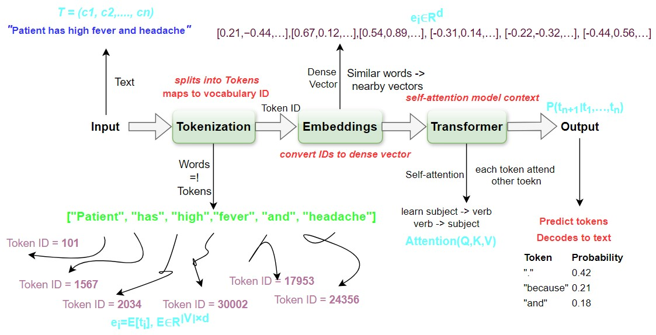
LLMs Processing Pipeline

Slide 4
Tokenization Fundamentals
Process of dividing text into a set of meaningful units.
Enables machines to understand and process human language
Text Processing
Enables effective analysis and feature extraction
Language Understanding
Helps in understanding semantics and structure of language
Information Retrieval
Efficient information retrieval and text mining
Helps in various NLP tasks such as analysis, classification and more.

Slide 5
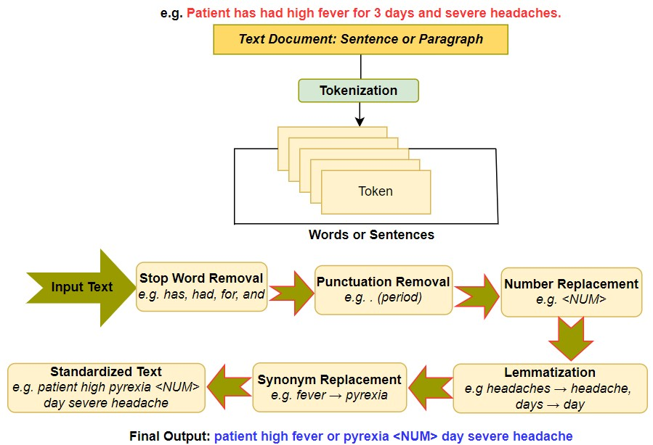
Tokenization Pipeline

Slide 6
Tokenization Techniques
1) Word Tokenization
Splits text into full words
Intuitive and human-readable
Suffers from large vocabulary and OOV issues
Example: “Patient has high fever and headache." → [“Patient", “has", “high", “fever", “and“, “headache”, “.”]
3) Subword-Level Tokenization
Splits words into meaningful sub-units
Handles rare and morphologically complex words
Used by most modern LLMs
Example: thrombocytopenia → ["thrombo", "cyto", "penia"]
2) Character-Level Tokenization
Splits text into individual characters
Very small vocabulary
Produces very long sequences
Example: → [“P", “a", “t", “i", “e", “n", “t", “ ”, “h”, …]

Slide 7
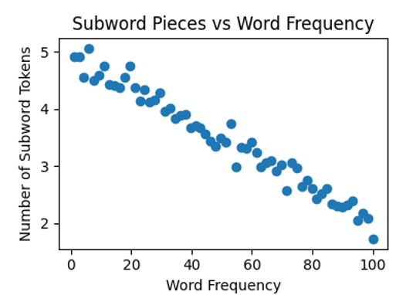
Empirical Behavior of Subword Tokenization
Method | Vocabulary | Sequence Length | OOV Risk
Word | Very large | Short | High
Character | Very small | Very long | None
Subword (BPE) | Moderate | Moderate | Low
Table 1. Comparison of various tokenization techniques
Conceptual trend: rarer words require more subword pieces.

Slide 8
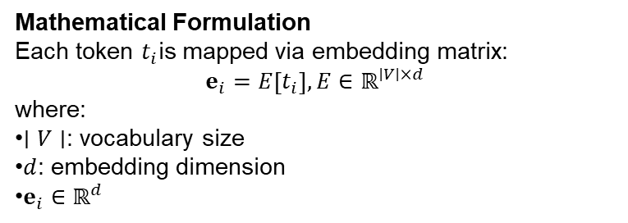
Embeddings: Mapping Tokens to Semantic Space
What are Embeddings?
Embeddings are dense, continuous vector representations that map discrete token IDs into a semantic vector space.
Why Embeddings are Needed?
Token IDs are arbitrary integers (no semantic meaning)
Neural models require continuous representations
Embeddings capture distributional semantics
Enable similarity computation in vector space
Mathematical Formulation
Each token $t_{i}$is mapped via embedding matrix:
$$e_{i}=E\left[t_{i}\right], E∈ℝ^{∣V∣×d}$$
where:
$∣V∣$: vocabulary size
$d$: embedding dimension
$e_{i}∈ℝ^{d}$
Example
Token IDs: [101, 1821, 1126, 17953]
Embedding vectors (illustrative): → high-dimensional dense vectors
Semantic intuition:
researcher ≈ scientist → close
researcher ≠ banana → far

Slide 9
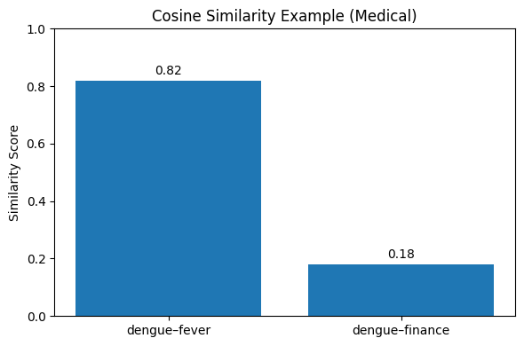
Semantic Similarity in Embedding Space
Semantically similar sentences produce higher cosine similarity.

Slide 10
Transformer and Self-Attention Mechanism
Why Transformers?
Traditional sequence models (RNNs/LSTMs):
process tokens sequentially
struggle with long-range dependencies
limited parallelization
Transformers address these limitations using self-attention.
Self-Attention: Core Idea
Self-attention allows each token to:
attend to all other tokens
compute contextual relevance
build context-aware representations
Intuition Example
Sentence:
Patient has high fever and headache.
Self-attention helps model:
“Patient” ↔ “has” → subject–verb relation
“fever” ↔ “headache” → symptom co-occurrence
“high” ↔ “fever” → modifier–symptom relation
RNNs – Recurrent Neural Network
LSTMs – Long Short-Term Memory

Slide 11
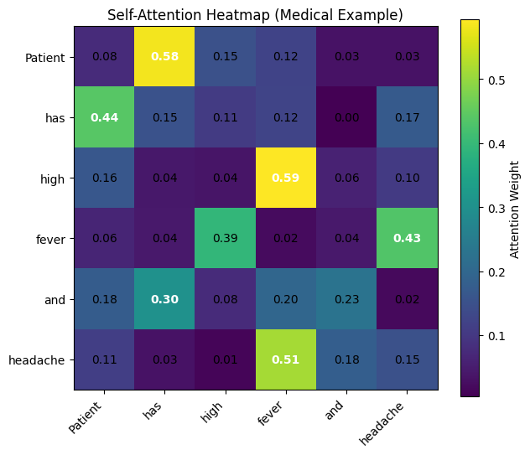
Transformer and Self-Attention Mechanism
Heatmap illustrates how tokens attend to each other.
Note: Strongest attention per row is bold + white.

Slide 12
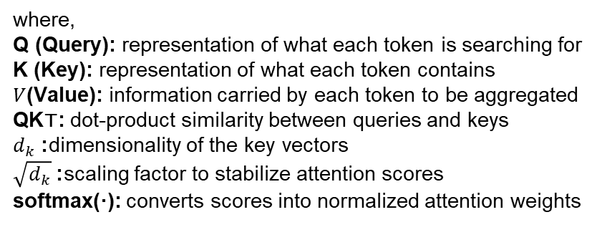
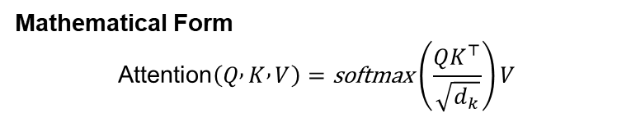
Transformer and Self-Attention Mechanism
Mathematical Form
$$\text{Attention}\left(Q , K , V\right)=\text{softmax}\left(\frac{QK^{⊤}}{\sqrt{d_{k}}}\right)V$$
where,
Q (Query): representation of what each token is searching for
K (Key): representation of what each token contains
$V$(Value): information carried by each token to be aggregated
QK⊤: dot-product similarity between queries and keys
$d_{k}$: dimensionality of the key vectors
$\sqrt{d_{k}}$: scaling factor to stabilize attention scores
softmax(·): converts scores into normalized attention weights

Slide 13
Prompt Engineering: Controlling LLM Behavior
What is Prompt Engineering?
Prompt engineering is the practice of designing structured inputs to guide a Large Language Model toward desired outputs.
Key Prompting Techniques
Role specification (e.g., “You are an expert…”)
Clear instructions
Delimiters for structured input
Output formatting constraints
Chain-of-Thought prompting (when needed)
Why Prompting Matters
LLMs are next-token predictors
Output depends heavily on input formulation
Well-designed prompts improve reliability
Helps reduce hallucinations
Enables task adaptation without retraining
Example
Weak prompt: Explain dengue.
Improved prompt: Explain dengue in 3 bullet points for a non-medical audience.

Slide 14
In-Context Learning (ICL)
What is In-Context Learning?
In-Context Learning (ICL) is the ability of a Large Language Model to perform new tasks by conditioning on examples provided within the prompt — without updating model parameters.
Modes of In-Context Learning
Zero-shot
One-shot
Few-shot
Why ICL is Powerful
No retraining required
Rapid task adaptation
Works at inference time
Enables flexible task generalization
Core capability of modern LLMs

Slide 15
Prompt Engineering: Controlling LLM Behavior
1) Zero-shot
Definition: Task described only via instructions (no examples).
Prompt:
Identify the disease from the symptom: high fever
Model output:
dengue
2) One-shot
Definition: Single demonstration provided.
Prompt:
Symptom → Disease
fever → dengue
cough → ?
Model output:
tuberculosis
3) Few-shot
Definition: Multiple demonstrations provided.
Prompt:
Symptom → Disease
high fever → dengue
persistent cough → tuberculosis
high blood sugar → diabetes
severe headache → ?
Model output:
migraine

Slide 16
Prompt Engineering: Controlling LLM Behavior
Mode | Examples | Adaptation Strength | Output Reliability | Prompt Length | Token Cost | Typical Use Case
Zero-shot | 0 | Limited | Moderate | Short | Low | Simple, well-known tasks
One-shot | 1 | Moderate | Good | Medium | Medium | Moderately complex tasks
Few-shot | ≥2 | Strong | Highest (usually) | Long | High | Complex or structured tasks
Table 2. Comparison of In-Context Learning Modes

Slide 17
Putting It All Together: Retrieval-Augmented Generation (RAG)
What is RAG?
Retrieval-Augmented Generation (RAG) is a hybrid framework that combines:
external knowledge retrieval
with LLM-based text generation
to produce grounded and factual responses
RAG Pipeline
User query is embedded
Relevant documents are retrieved
Retrieved context is appended to prompt
LLM generates grounded response
Example
Query:
Symptoms of dengue
RAG behavior:
retrieve medical passages
inject into prompt
generate evidence-grounded answer
Why RAG is Needed
Reduces hallucinations
Incorporates domain knowledge
Keeps information up to date
Improves factual grounding

Slide 18
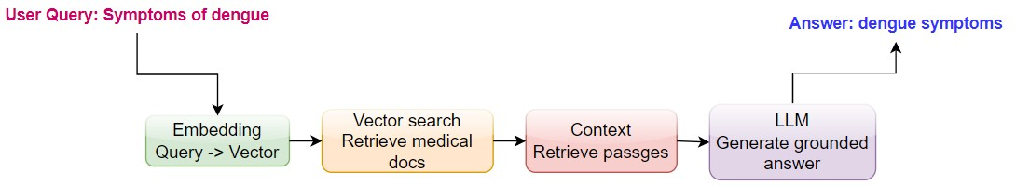
RAG Pipeline
User submits a query (e.g., “Symptoms of dengue”).
The query is converted into a vector using an embedding model.
Vector search retrieves the most relevant medical documents.
Relevant context passages are selected from retrieved results.
The LLM uses this context to generate a grounded answer.
RAG improves factual accuracy and reduces hallucinations by using external knowledge.

Slide 19
Key Takeaways
LLMs operate through a structured mathematical pipeline
Tokenization enables numerical processing of language
Embeddings encode semantic meaning geometrically
Attention enables deep contextual understanding
Prompting and ICL control model behaviour at inference time

Slide 20
Thank You All…..
Any Questions?
Email Id: darshna.parmar@iiitvadodara.ac.in

