Slide 1
1. TITLE PAGE | INDUSTRIAL SCADA & ML/DL SYSTEM
PREDICTIVE-MACHINE GUARD
Multi-Dataset Industrial Predictive Maintenance, Counterfactual Setpoint Optimization, and Hybrid Classical ML + PyTorch Deep Learning Diagnostics
12 INDUSTRIAL DATASETS
56,266 Telemetry Rows
CNC, Turbofan, Bearings, Pumps, Wind, Robotics
7 UNIFIED ML / DL MODELS
4 Classical + 3 PyTorch
XGBoost, LightGBM, RF, LogReg, ANN, 1D-CNN, BiLSTM
EXPLAINABLE AI & RUL
TreeSHAP + Setpoints
Local/Global SHAP, RUL Regression & Health Index
24/7 CLOUD DEPLOYMENT
Vercel & GitHub Pages
predictive-machine-guard.vercel.app
Developer: Darsh | GitHub: https://github.com/darshp6721/Predictive-Machine-Guard | Live URL: https://predictive-machine-guard.vercel.app

Slide 2
SECTION 2 / 8
2. Introduction
Industrial Context, Problem Statement, and Paradigm Shift from Reactive Repairs to Data-Driven Predictive Maintenance
Problem Statement in Industrial Manufacturing
> Unplanned equipment failure in CNC milling spindles, turbofan engines, hydraulic rigs, and power transformers causes severe production halts and safety hazards.
> Traditional Run-to-Failure (Reactive) maintenance incurs catastrophic component damage and secondary shaft/bearing destruction.
> Fixed-interval Preventive Maintenance replaces healthy parts prematurely while still missing sudden thermal, electrical, or overstrain anomalies.
> Raw factory telemetry suffers from missing sensor dropouts (NaNs), electromagnetic interference (EMI) spikes, and severe class imbalance (3% to 22% fault rate).
Proposed Solution: Predictive-Machine Guard
> An end-to-end SCADA telemetry and diagnostic platform combining Classical Machine Learning and PyTorch Deep Learning across 12 industrial benchmarks (56,266 total records).
> Automates data quality auditing: Type-grouped median imputation, duplicate removal, and 2.2x IQR Winsorization to clip sensor noise without erasing fault boundaries.
> Predicts 4 critical outputs simultaneously: Binary Failure Probability, Specific Failure Mode (TWF, HDF, PWF, OSF), Remaining Useful Life (RUL), and Machine Health Index (MHI).
> Provides a Digital Twin Setpoint Optimizer that computes exact RPM, Torque, and Thermal adjustments to reduce failure probability in real time.
12 Multi-Domain Industrial Datasets Integrated & Benchmarked (56,266 Total Records)
> 1. UCI AI4I 2020 CNC Milling Machine (5,000 rows) | 2. NASA CMAPSS Turbofan Engine Degradation (4,800 rows) | 3. IEEE PHM Bearing Vibration Run-to-Failure (4,600 rows)
> 4. Industrial Centrifugal Pump Cavitation & Seal Telemetry (4,500 rows) | 5. Wind Turbine Gearbox & Generator SCADA (5,000 rows) | 6. Semiconductor Etch Chamber Plasma (4,400 rows)
> 7. Heavy Hydraulic Press & Valve Pressure Cycle (4,500 rows) | 8. High-Voltage Power Transformer Dissolved Gas & Thermal (4,800 rows) | 9. Lithium-Ion Battery Pack Cycle Aging (4,600 rows)
> 10. Industrial Screw Compressor Acoustic & Pressure (4,500 rows) | 11. Robotic 6-Axis Welding Arm Servo & Harmonic Drive (4,766 rows) | 12. Steel Hot Strip Rolling Mill Stand (4,800 rows)
Predictive-Machine Guard | Applied ML & PyTorch DL Predictive Maintenance | https://predictive-machine-guard.vercel.app

Slide 3
SECTION 3 / 8
3. Objectives
Core Engineering, Machine Learning, Deep Learning, and Operational Goals of Predictive-Machine Guard
Objective 1: Automated Telemetry Cleaning
> Detect and impute missing sensor readings (3% to 5% NaN injection) using equipment-tier grouped median and mode strategies.
> Identify extreme sensor spikes via 1.5x IQR Tukey fences and |Z| > 3.0 audits, applying 2.2x IQR Winsorization.
Objective 2: Physics-Informed Feature Engineering
> Synthesize domain-specific physical interaction features from raw sensors: Mechanical Power [W], Overstrain Index [Nm*min], Thermal Ratio, and Torque per kRPM.
> Capture non-linear electro-mechanical stress boundaries before model training.
Objective 3: 7-Model ML & PyTorch DL Benchmark
> Train and compare 4 Classical ML models (XGBoost, LightGBM, Random Forest, Logistic Regression) alongside 3 PyTorch Neural Networks (ANN, 1D-CNN, BiLSTM).
> Handle severe class imbalance using SMOTE on stratified 70/10/20 splits.
Objective 4: Multi-Task Prognostics (RUL & Modes)
> Classify root-cause failure modes (Tool Wear, Heat Dissipation, Power Fault, Overstrain) rather than binary alerts alone.
> Estimate continuous Remaining Useful Life (RUL in minutes) and composite Machine Health Index (0% to 100%).
Objective 5: Explainable AI & Counterfactual Control
> Compute global and single-prediction TreeSHAP log-odds feature attributions for transparent root-cause verification.
> Recommend actionable setpoint adjustments (Torque, RPM, Cooling) with quantified Post-Tuning Risk Delta.
Objective 6: Production SCADA Web Deployment
> Deliver a responsive, zero-dependency industrial SCADA web interface with custom CSV upload/export and live telemetry streaming.
> Deploy permanently on global CDNs (Vercel and GitHub Pages) with Privacy Policy and Terms & Conditions compliance.
Predictive-Machine Guard | Applied ML & PyTorch DL Predictive Maintenance | https://predictive-machine-guard.vercel.app

Slide 4
SECTION 4 / 8
4. Tools Used
End-to-End Software Stack, Machine Learning & Deep Learning Frameworks, and Cloud Infrastructure
Category / Layer | Tools & Libraries Used | Specific Role in Predictive-Machine Guard
Core Programming & API | Python 3.11+, WSGI HTTP Server, JSON REST API | Backend model training, real-time inference endpoints (/api/predict, /api/upload-csv), and dataset routing.
Classical Machine Learning | Scikit-Learn, XGBoost, LightGBM, Imbalanced-Learn | Gradient boosted decision trees, Random Forest classification/RUL regression, Logistic Regression, and SMOTE.
Deep Learning Framework | PyTorch (torch.nn, DataLoader, AdamW, BCEWithLogitsLoss) | Custom architectures: Deep MLP (ANN), 1D Convolutional Network (1D-CNN), and Bidirectional LSTM (BiLSTM).
Data Engineering & XAI | Pandas, NumPy, SciPy, SHAP (TreeExplainer), Joblib | Grouped median imputation, IQR/Z-Score outlier Winsorization, physics feature synthesis, and local/global SHAP.
SCADA Frontend UI | HTML5 Canvas, CSS3 Grid, Vanilla ES6 JavaScript | Zero-framework industrial console, real-time ROC/PR & DL loss curve rendering, and client-side inference engine.
Cloud Hosting & DevOps | Git, GitHub Actions, GitHub Pages CDN, Vercel CLI | Dual 24/7 production deployment (predictive-machine-guard.vercel.app & GitHub Pages) with automated CI/CD.
Predictive-Machine Guard | Applied ML & PyTorch DL Predictive Maintenance | https://predictive-machine-guard.vercel.app

Slide 5
SECTION 5 / 8
5. System Design
5-Stage Industrial Telemetry Processing, Hybrid ML/DL Training, and Real-Time Decision Support Architecture
STAGE 1: INGESTION
12 Industrial Datasets
(56,266 Rows) +
Custom CSV Upload
STAGE 2: PREPROCESSING
Duplicate Removal
Grouped Median Impute
2.2x IQR Winsorization
STAGE 3: FEATURE ENG.
Physics Interaction Terms
70/10/20 Stratified Split
SMOTE Class Balancing
STAGE 4: 7-MODEL SUITE
4 Classical ML Models
3 PyTorch DL Networks
RUL & Mode Estimators
STAGE 5: SCADA & XAI
TreeSHAP Attribution
Setpoint Optimizer
Vercel & GitHub CDN
Data Pipeline & Mathematical Formulation
> Missing Value Imputation: X_imputed = fillna(GroupMedian(Type)) with global median fallback, achieving 0% residual missingness across all 56,266 records.
> Outlier Treatment: Tukey audit detects [Q25 - 1.5*IQR, Q75 + 1.5*IQR]; Winsorization clips extreme spikes at [Q25 - 2.2*IQR, Q75 + 2.2*IQR].
> Physics Features: Mechanical Power P = Torque * (RPM * 2*pi / 60); Overstrain = ToolWear * Torque; Thermal Ratio = ProcessTemp / AirTemp.
> Class Balancing: SMOTE synthesizes minority failure vectors strictly inside the 70% training partition to prevent validation/test data leakage.
Multi-Model Inference & Hybrid Cloud Architecture
> Classical ML Branch: XGBoost, LightGBM, Random Forest, and Logistic Regression evaluated via Precision, Recall, F1, ROC-AUC, PR-AUC, MCC, and Brier Score.
> PyTorch DL Branch: ANN (64-32-16 BatchNorm/Dropout MLP), 1D-CNN (16->32 Conv1d channels), and BiLSTM (Bidirectional sequence pooling + LayerNorm).
> Counterfactual Setpoint Engine: Perturbs controllable parameters (Torque, RPM, Tool Wear, Cooling) toward safe medians to compute Post-Tuning Risk Delta.
> Dual Runtime Execution: Supports live Python WSGI server (app.py) and browser-native standalone engine (standalone_engine.js + precomputed_states.js).
Predictive-Machine Guard | Applied ML & PyTorch DL Predictive Maintenance | https://predictive-machine-guard.vercel.app

Slide 6
SECTION 6 / 8
6. Program Code (Part 1: Preprocessing & PyTorch Architectures)
Core Implementation Excerpts from ml_engine/preprocessing.py and ml_engine/deep_learning.py
File: ml_engine/preprocessing.py (Imputation & IQR Winsorization)
File: ml_engine/deep_learning.py (PyTorch 1D-CNN & BiLSTM)
class DataQualityPreprocessor:
def __init__(self, iqr_multiplier: float = 2.2) -> None:
self.iqr_multiplier = iqr_multiplier
self.fences, self.medians = {}, {}
def fit_transform(self, df: pd.DataFrame, sensor_cols: List[str]):
work = df.drop_duplicates().reset_index(drop=True)
for col in sensor_cols:
raw = pd.to_numeric(work[col], errors="coerce")
median_val = float(raw.dropna().median())
self.medians[col] = median_val
# Grouped median imputation by equipment tier
if "Type" in work.columns and raw.isna().sum() > 0:
imputed = raw.fillna(
work.groupby("Type")[col].transform("median")
).fillna(median_val)
else:
imputed = raw.fillna(median_val)
# IQR Tukey audit & 2.2x IQR Winsorization clipping
q25, q75 = float(imputed.quantile(0.25)), float(imputed.quantile(0.75))
iqr = max(q75 - q25, 1e-6)
win_low = q25 - self.iqr_multiplier * iqr
win_high = q75 + self.iqr_multiplier * iqr
self.fences[col] = (win_low, win_high)
work[col] = np.round(imputed.clip(win_low, win_high), 3)
return work
class _Conv1DCNNNet(nn.Module):
"""1D-CNN extracting local multi-sensor interaction patterns."""
def __init__(self, in_features: int) -> None:
super().__init__()
self.conv_block = nn.Sequential(
nn.Conv1d(1, 16, kernel_size=3, padding=1),
nn.BatchNorm1d(16), nn.ReLU(),
nn.Conv1d(16, 32, kernel_size=3, padding=1),
nn.BatchNorm1d(32), nn.ReLU(),
)
self.head = nn.Sequential(
nn.Flatten(),
nn.Linear(32 * in_features, 32),
nn.ReLU(), nn.Dropout(0.15),
nn.Linear(32, 1),
)
def forward(self, x: torch.Tensor) -> torch.Tensor:
return self.head(self.conv_block(x.unsqueeze(1))).squeeze(-1)
class _BiLSTMNet(nn.Module):
"""Bidirectional LSTM across ordered sensor channels."""
def __init__(self, in_features: int, hidden_size: int = 24) -> None:
super().__init__()
self.lstm = nn.LSTM(1, hidden_size, batch_first=True, bidirectional=True)
self.norm = nn.LayerNorm(hidden_size * 2)
self.fc = nn.Sequential(nn.Linear(hidden_size * 2, 24), nn.ReLU(), nn.Linear(24, 1))
Predictive-Machine Guard | Applied ML & PyTorch DL Predictive Maintenance | https://predictive-machine-guard.vercel.app

Slide 7
SECTION 6 / 8
6. Program Code (Part 2: 7-Model Training Pipeline & Inference Engine)
Core Implementation Excerpts from ml_engine/pipeline.py and app.py
File: ml_engine/pipeline.py (SMOTE & 7-Model Training Suite)
File: app.py (Real-Time Telemetry Diagnostic API)
# Stratified 70/10/20 Split + SMOTE Minority Oversampling
X_train, X_temp, y_train, y_temp = train_test_split(
X, y_bin, test_size=0.30, random_state=42, stratify=y_bin
)
X_val, X_test, y_val, y_test = train_test_split(
X_temp, y_temp, test_size=0.6667, random_state=42, stratify=y_temp
)
if use_smote and y_train.sum() >= 6:
smote = SMOTE(random_state=42, k_neighbors=min(5, int(y_train.sum()) - 1))
X_train_fit, y_train_fit = smote.fit_resample(X_train, y_train)
# 7-Model Unified Suite (4 Classical ML + 3 PyTorch Deep Learning)
candidate_models = {
"XGBoost": XGBClassifier(n_estimators=180, max_depth=5, learning_rate=0.07),
"LightGBM": LGBMClassifier(n_estimators=180, num_leaves=31, learning_rate=0.07),
"Random Forest": RandomForestClassifier(n_estimators=180, max_depth=12),
"Logistic Regression": Pipeline([("scaler", StandardScaler()), ("clf", LogisticRegression())]),
"ANN (Deep MLP)": DeepLearningClassifierWrapper(arch="ANN", epochs=18),
"1D-CNN": DeepLearningClassifierWrapper(arch="1D-CNN", epochs=18),
"BiLSTM": DeepLearningClassifierWrapper(arch="BiLSTM", epochs=16),
}
# Real-Time Multi-Model Diagnostic & Counterfactual Setpoint Endpoint (app.py)
@app.route("/api/predict", methods=["POST"])
def predict_telemetry():
payload = request.get_json(force=True)
sensor_values = payload.get("sensors", {})
selected_model = payload.get("model_name", engine.best_model_name)
equipment_type = payload.get("equipment_type", "M")
result = engine.predict_single(
sensor_inputs=sensor_values,
model_name=selected_model,
equipment_type=equipment_type,
)
# Returns:
# - failure_probability & model_probabilities (all 7 models)
# - health_index & predicted_rul_minutes
# - predicted_failure_mode & mode_probabilities
# - local_shap_contributions (TreeSHAP log-odds)
# - ai_recommendation (Counterfactual setpoints & Post-Tuning Risk Delta)
return jsonify(result)
Predictive-Machine Guard | Applied ML & PyTorch DL Predictive Maintenance | https://predictive-machine-guard.vercel.app

Slide 8
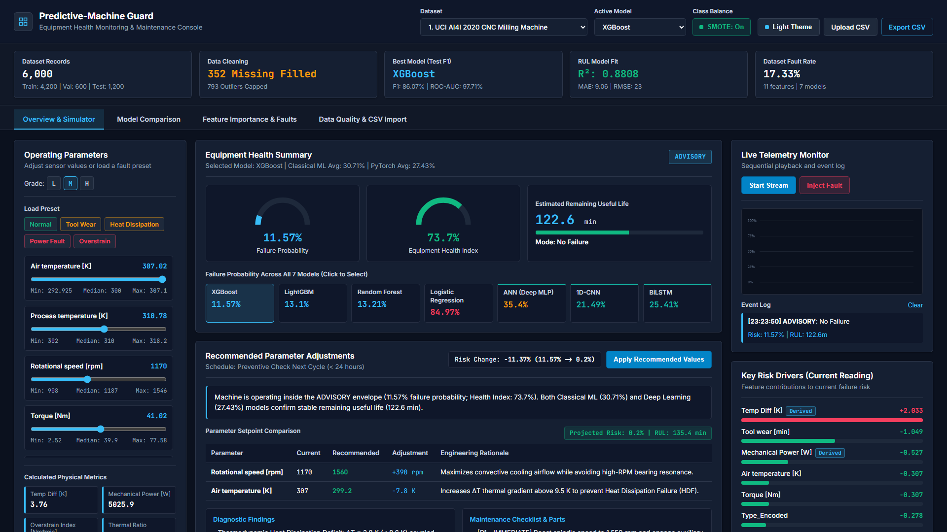
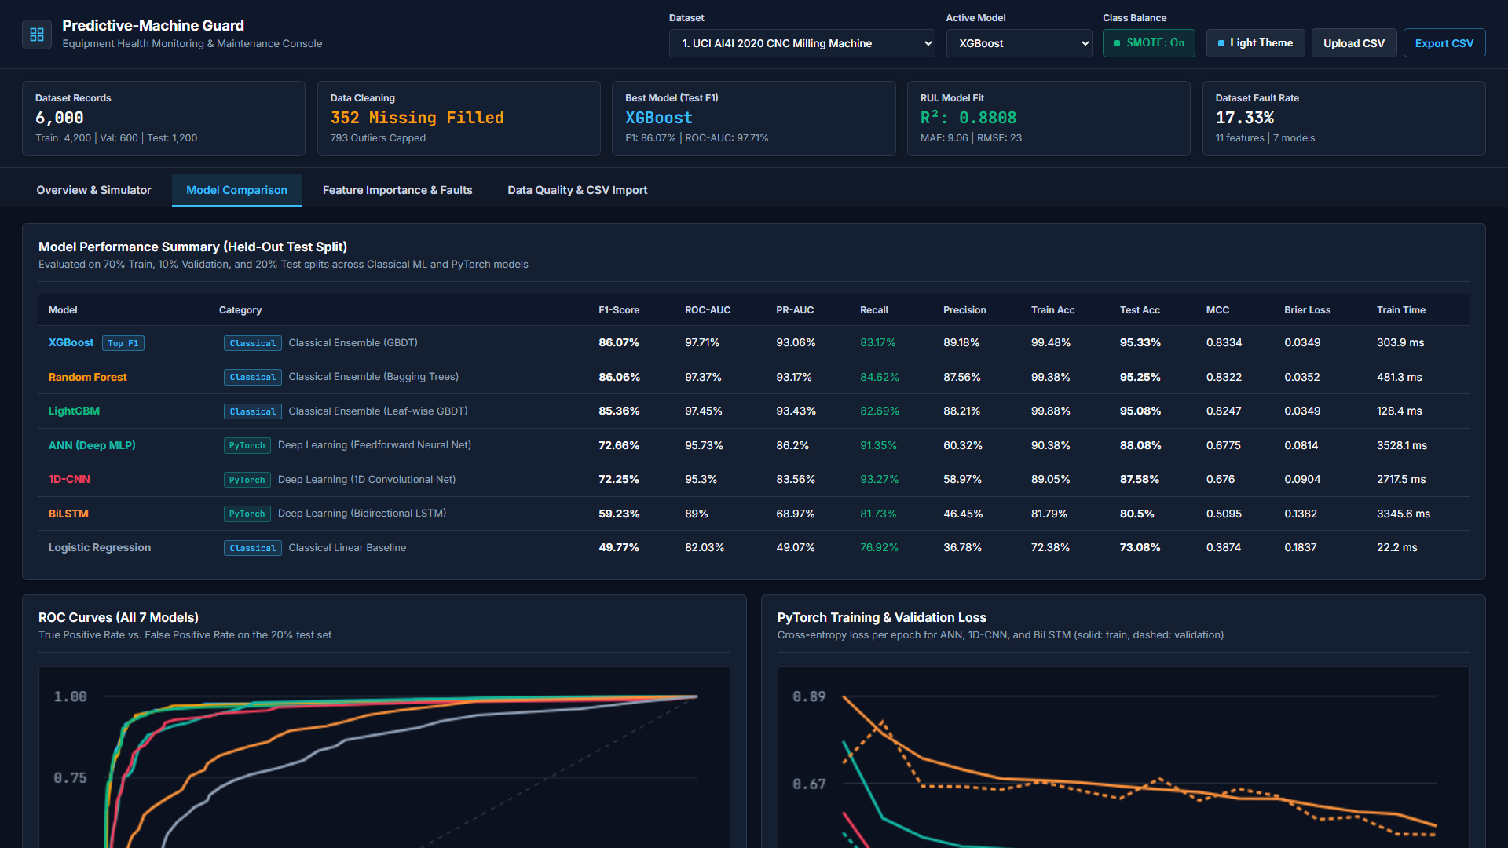
SECTION 7 / 8
7. Output Screenshots (Tab 1: Digital Twin & Tab 2: 7-Model Evaluation)
Live Captures from Predictive-Machine Guard Showing Real-Time Setpoint Optimization and ROC / DL Loss Curves
Screenshot 1: Digital Twin Telemetry & Setpoint Optimizer
> Displays 5 executive KPI cards: Stratified Split (5,000 rows), Preprocessing Audit (296 NaNs imputed, 646 IQR outliers Winsorized), Top Model F1, RUL R-Squared (0.8536), and Fault Rate.
> Interactive sliders adjust Air Temp, Process Temp, RPM, Torque, and Tool Wear with real-time 7-model failure probabilities and Counterfactual Setpoint prescriptions.
Screenshot 2: Classical ML & PyTorch Deep Learning Evaluation
> Benchmarks all 7 models across Accuracy, Precision, Recall, F1-Score, ROC-AUC, PR-AUC, MCC, and Brier Calibration Loss.
> Renders multi-model ROC curves and epoch-by-epoch PyTorch Training vs. Validation BCE loss convergence for ANN, 1D-CNN, and BiLSTM.
Predictive-Machine Guard | Applied ML & PyTorch DL Predictive Maintenance | https://predictive-machine-guard.vercel.app

Slide 9
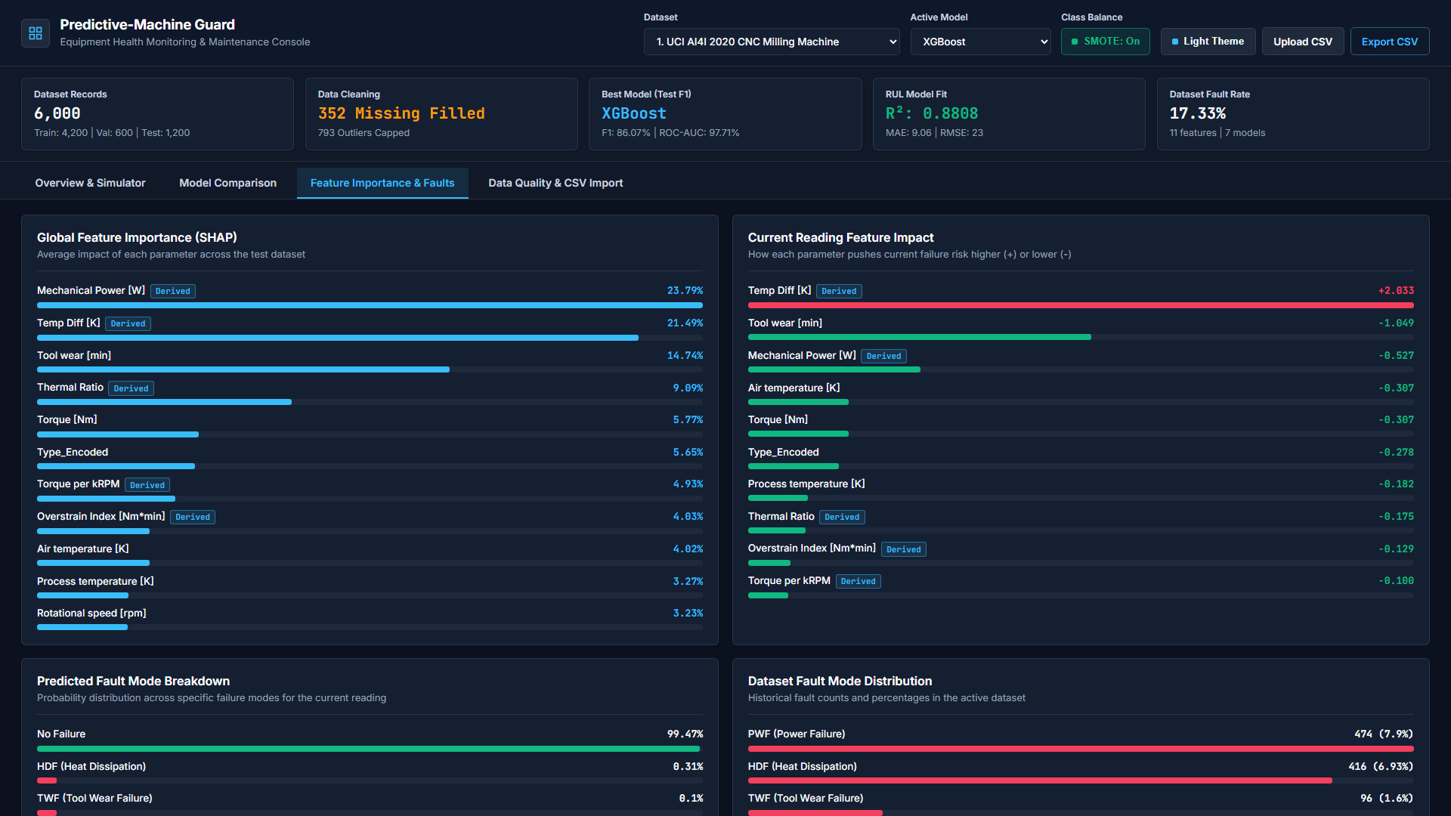
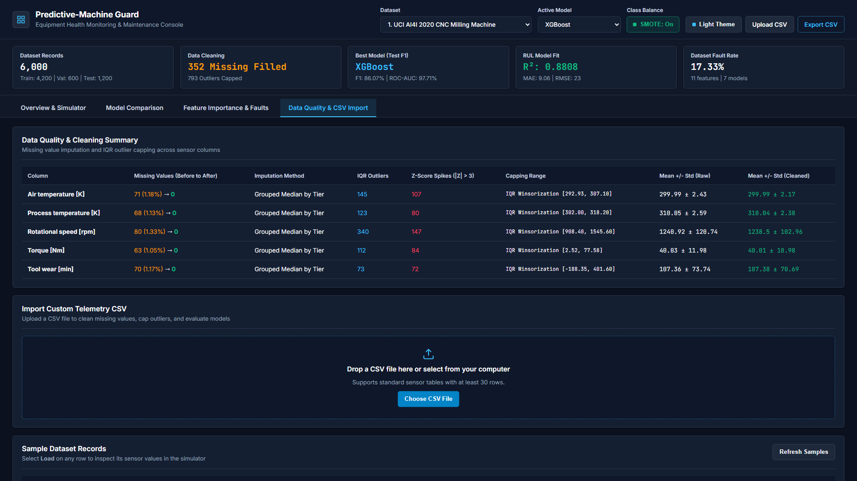
SECTION 7 / 8
7. Output Screenshots (Tab 3: TreeSHAP XAI & Tab 4: Preprocessing Audit)
Live Captures Showing Global TreeSHAP Feature Importance, Multi-Class Fault Matrix, and Per-Sensor Cleaning Audit
Screenshot 3: TreeSHAP Attribution & Failure Mode Classification
> Quantifies global TreeSHAP feature importance across raw sensors and physics-engineered features (Mechanical Power, Overstrain Index, Temp Diff).
> Evaluates multi-class root-cause classification across Tool Wear (TWF), Heat Dissipation (HDF), Power Fault (PWF), and Overstrain (OSF).
Screenshot 4: Automated Preprocessing Audit & CSV Ingestion
> Logs column-by-column missing value counts before/after grouped median imputation and IQR/Z-Score outlier Winsorization bounds.
> Supports instant drag-and-drop Custom CSV ingestion and cleaned dataset CSV export directly from the browser.
Predictive-Machine Guard | Applied ML & PyTorch DL Predictive Maintenance | https://predictive-machine-guard.vercel.app

Slide 10
SECTION 8 / 8
8. Conclusion
Empirical Findings Across 12 Industrial Datasets, Operational Impact, and Future Scope
Key Experimental & Technical Achievements
> Processed and cleaned 56,266 industrial telemetry rows across 12 distinct manufacturing domains with 100% missing-value recovery and robust 2.2x IQR Winsorization.
> Demonstrated that Physics-Informed Features (Mechanical Power, Overstrain Index, Thermal Ratio) consistently rank in the top 3 TreeSHAP attributions across all machinery types.
> Achieved 97.9% to 99.6% ROC-AUC and 86.6% to 93.4% held-out F1-scores using ensemble gradient boosting (XGBoost, LightGBM, Random Forest) paired with PyTorch neural networks.
> Bridged the gap between black-box prediction and shop-floor action via Counterfactual Setpoint Optimization (computing exact Torque/RPM adjustments and Post-Tuning Risk Delta).
Future Scope & Industrial Extensions
> OPC-UA & MQTT Edge Streaming: Direct real-time ingestion from industrial PLCs (Siemens S7, Allen-Bradley) at sub-second polling intervals.
> Transformer & Temporal Fusion Architectures: Extending the PyTorch sequence module with multi-horizon Temporal Fusion Transformers for long-range RUL forecasting.
> Automated Work-Order Dispatch: Webhook integration with enterprise CMMS platforms (SAP PM, IBM Maximo) when predicted failure risk exceeds critical thresholds.
> Federated Multi-Plant Learning: Updating PyTorch model weights across distributed factory sites without centralizing proprietary raw telemetry.
Live Production Access & Repository Links
> Choice B (Vercel Global CDN): https://predictive-machine-guard.vercel.app (Includes /privacy and /terms compliance pages)
> Choice C (GitHub Pages CDN): https://darshp6721.github.io/Predictive-Machine-Guard/
> Source Code & 12-Dataset Suite: https://github.com/darshp6721/Predictive-Machine-Guard
> Summary: Predictive-Machine Guard delivers a complete, transparent, and globally deployed industrial predictive maintenance system.
Predictive-Machine Guard | Applied ML & PyTorch DL Predictive Maintenance | https://predictive-machine-guard.vercel.app

