Slide 1



AI Powered CRM Sales Management System
Summer Internship Project | Infotact Solutions
DARSNA S | 810023104001
B.E. Computer Science and Engineering, 2026-2027
University College of Engineering (BIT Campus), Anna University, Tiruchirappalli
Notes:
Good morning. My project is an AI powered CRM that helps a sales team manage customers, track deals through a pipeline and ask questions about their data. I built it during my internship at Infotact Solutions.

Slide 2




The Problem Today
Scattered data
No pipeline view
Customers and deals spread over files, chats and notebooks
Hard to see how many deals sit at each stage
Manual reports
Privacy risk
Weekly summaries take hours and invite errors
Sending business data to online AI tools exposes it
Notes:
Most small teams still use spreadsheets and chats. Data is scattered, there is no live view of deals, reports are manual, and online AI tools put customer data at risk.

Slide 3
Project Objectives
Secure JWT login with BCrypt password hashing
Full create, read, update, delete for customers and leads
1
2
Six-stage sales pipeline with one-click moves
Live dashboard: customers, leads and won revenue
3
4
AI assistant for questions on CRM data (Gemini or Ollama)
Excel and PDF report export
5
6
Notes:
These are the six main goals of the project.

Slide 4



Proposed Solution
Customers
Leads
Pipeline
Add, edit, search, delete
Value, stage, customer
Six stages, one-click move
Dashboard
AI Assistant
Reports
Live counts and revenue
Natural-language answers
Excel and PDF export
Notes:
One web application with six modules that work together on the same MySQL data.

Slide 5
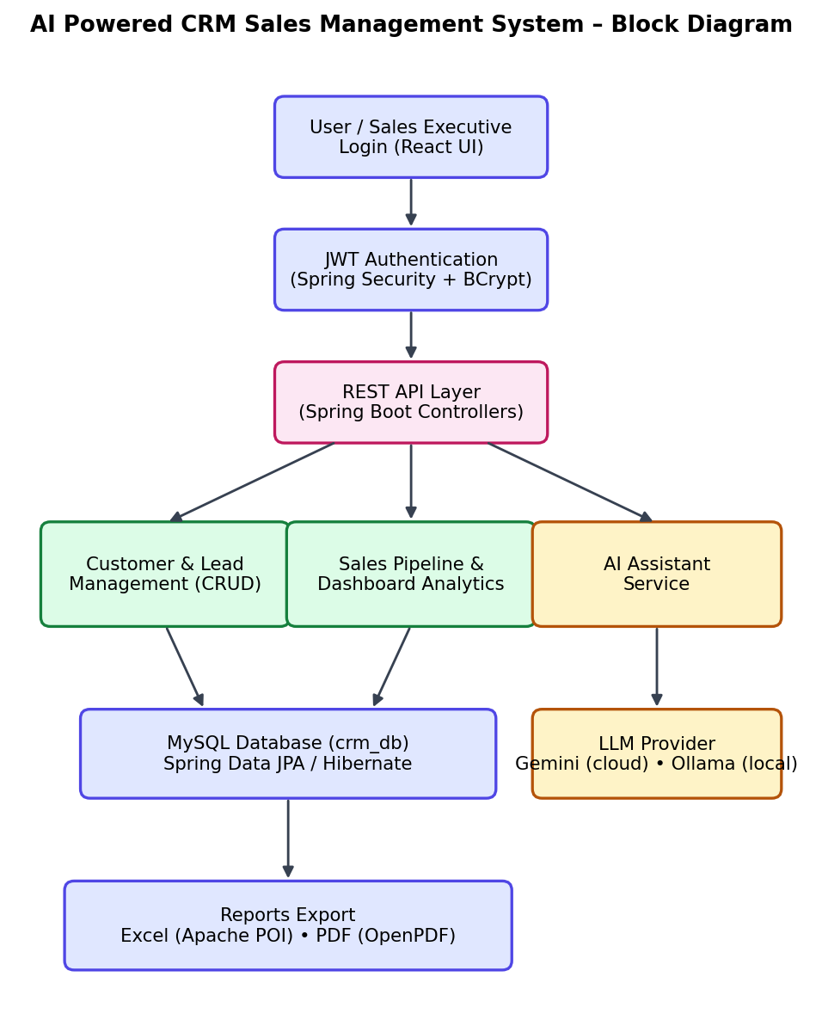
System Architecture
Presentation
React 18 + Vite, Recharts
Application
Spring Boot REST + Spring Security (JWT)
Data
MySQL 8 via Spring Data JPA
AI and reports
Gemini or Ollama, Apache POI, OpenPDF
Notes:
The React frontend calls Spring Boot REST APIs. Spring Security checks the JWT. Data is stored in MySQL through JPA. The AI service talks to Gemini or Ollama, and the report service uses Apache POI and OpenPDF.

Slide 6



Technology Stack
Backend
Frontend
Data and auth
AI and reports
Java 17
Spring Boot 3.2
Spring Data JPA
Spring Security
React 18
Vite
React Router
Axios, Recharts
MySQL 8
JWT (jjwt)
BCrypt
Gemini API
Ollama + Mistral
Apache POI
OpenPDF
Notes:
Backend is Java 17 with Spring Boot, frontend is React, database is MySQL, and AI uses Gemini or Ollama.

Slide 7
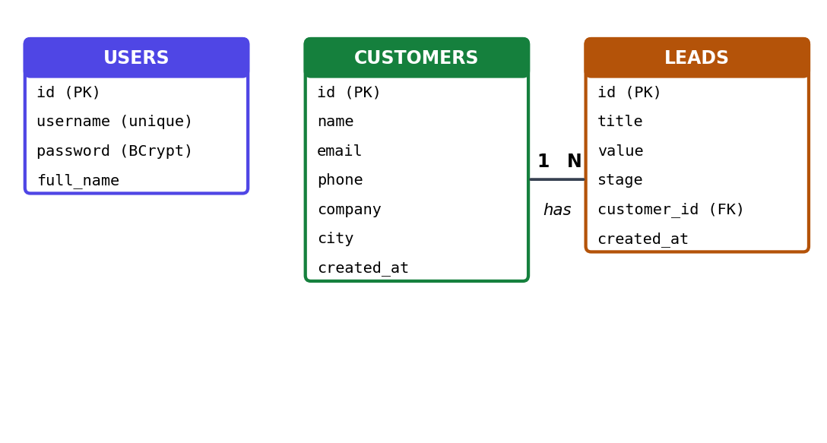
Database Design
3 tables: users, customers, leads
One customer has many leads
Stage is an enum: NEW to LOST
Tables auto-created by Hibernate
Notes:
Three tables. One customer can have many leads. The lead stage is stored as an enum. Hibernate creates the tables automatically.

Slide 8
Secure Login with JWT
1
2
3
4
5
Login
Verify
Token
Request
Validate
User sends username and password
BCrypt hash is checked in MySQL
Server signs a JWT with expiry
Axios adds the Bearer token to every call
JwtFilter allows it or returns 401
Stateless sessions | CORS limited to the frontend | No plain-text passwords
Notes:
The password is checked against a BCrypt hash. If it matches, the server signs a token with an expiry. The browser sends that token on every request and the filter validates it. Without a valid token the API returns 401.

Slide 9
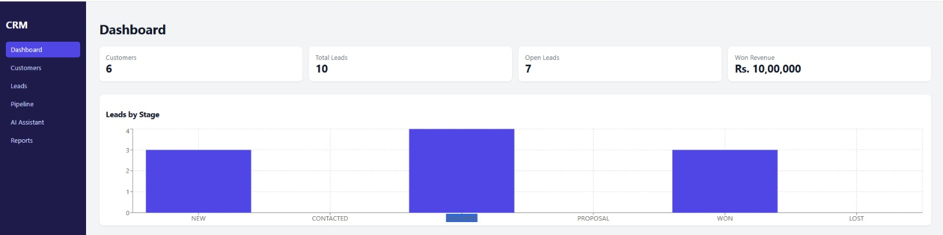
Live Dashboard
6
10
Rs. 10,00,000
Customers
Total leads, 7 open
Won revenue
Notes:
The dashboard reads one endpoint and shows totals plus a leads-by-stage chart. In my data there are 6 customers, 10 leads, 7 open, and 10 lakh rupees of won revenue.

Slide 10
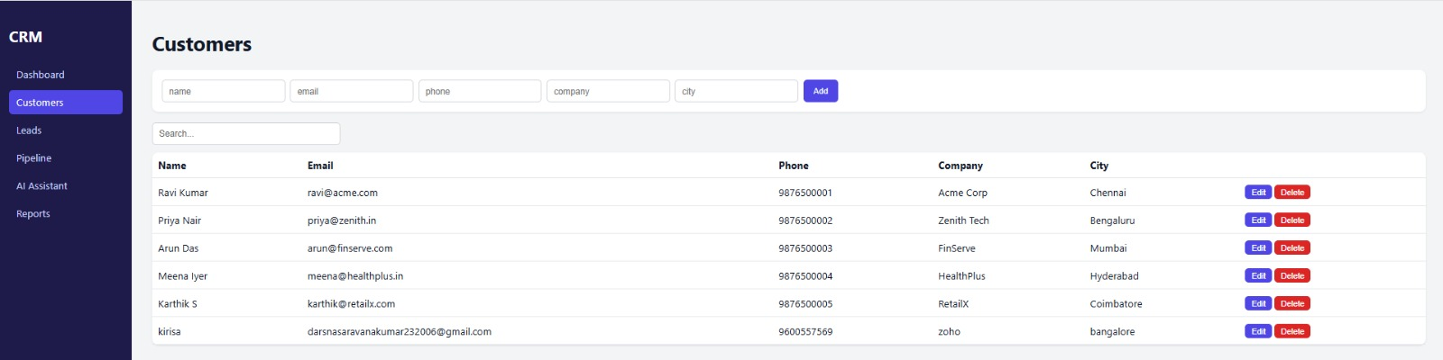


Customer Management
Add, edit and delete customers
Instant search box
Delete also removes its leads
Notes:
Customers can be added, edited, searched and deleted. Deleting a customer also deletes their leads inside one transaction.

Slide 11
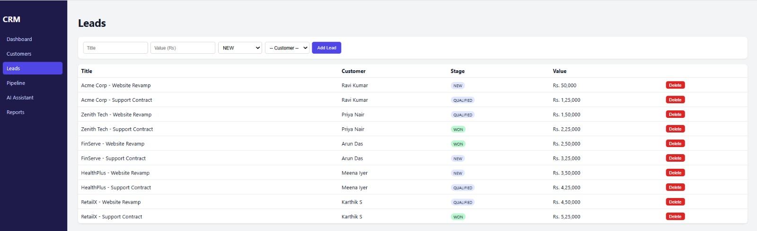


Lead Management
Lead linked to a customer
Stage tag on every lead
Value stored in rupees
Notes:
Every lead has a title, a value in rupees, a stage and a linked customer.

Slide 12
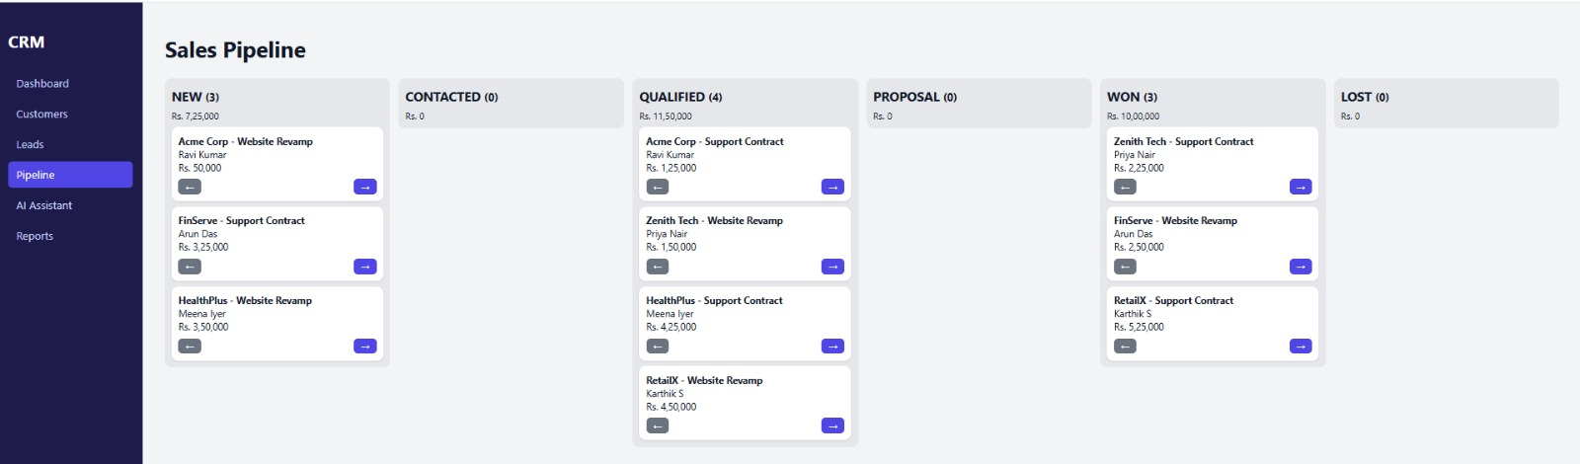


Sales Pipeline
Six stage columns
Count and value per stage
Arrow buttons move leads
Notes:
The board groups leads by stage with a count and a total value. The arrow buttons call one endpoint to change the stage.

Slide 13
AI Assistant
Read live CRM data: counts, stages, revenue, top leads
Aspect | Gemini | Ollama
Speed | Fast | Hardware-bound
Privacy | Cloud | On-device
Internet | Needed | Not needed
1
Build a prompt: data summary plus the question
2
Send to Gemini (cloud) or Ollama + Mistral (local)
3
One property switches provider
ai.provider = gemini | ollama
Show the answer as a chat message
4
Notes:
The assistant first builds a summary of live CRM data, adds the question, and sends it to the chosen provider. Gemini is fast, Ollama keeps data on the machine. One property switches between them.

Slide 14

Reports and Testing
13
functional test cases
customers.xlsx
Apache POI workbook of all customers
Login and token checks
Customer and lead CRUD
Pipeline stage moves
Dashboard totals
AI answers and error handling
Excel and PDF downloads
leads.pdf
OpenPDF table of all leads
Notes:
Excel and PDF reports are generated on the server. I wrote thirteen functional test cases covering login, CRUD, pipeline, dashboard, AI and reports.

Slide 15
Conclusion and Future Work
Conclusion
Future work
One secure place for customers, leads and revenue
AI answers with a choice of speed (Gemini) or privacy (Ollama)
Layered, configurable design that is easy to extend
Role-based access control
Drag-and-drop pipeline
Email and SMS follow-ups
Lead scoring and sales forecasting
Docker and cloud deployment
Notes:
The system gives a sales team one secure place for customers, deals and insights, with AI on top. Future work includes roles, drag and drop, email integration, forecasting and cloud deployment.

Slide 16

Thank You
Questions?
DARSNA S | 810023104001
Notes:
Thank you. I am happy to answer questions or give a live demo.

