Slide 1
Sharon & connor ETL
Mini project of awesome
HAIL Data ETL

Slide 2
Project proposal
We wanted to collect data on hail across the continental USA.
Here we go…

Slide 3
Team Effort
We picked 3 data sources (both CSV’s), two from NOAA and one from NWS.
Two consisted of Hail data for the year 2017 and 2018, and the other contained the state and city of the location of the Radar arrays.

Slide 4
Finding data
Step 1
Gathered data from 2 different sources.
Grabbed 2 different years of Hail data CSV’s, and one CSV on county locations within the USA.
Step 2
Understood that the geo-coordinates from the csv labeled counties was a center point, and not a bounding box that was able to hold/show the data we collected from the hail csv file, so we decided to find another csv.

Slide 5
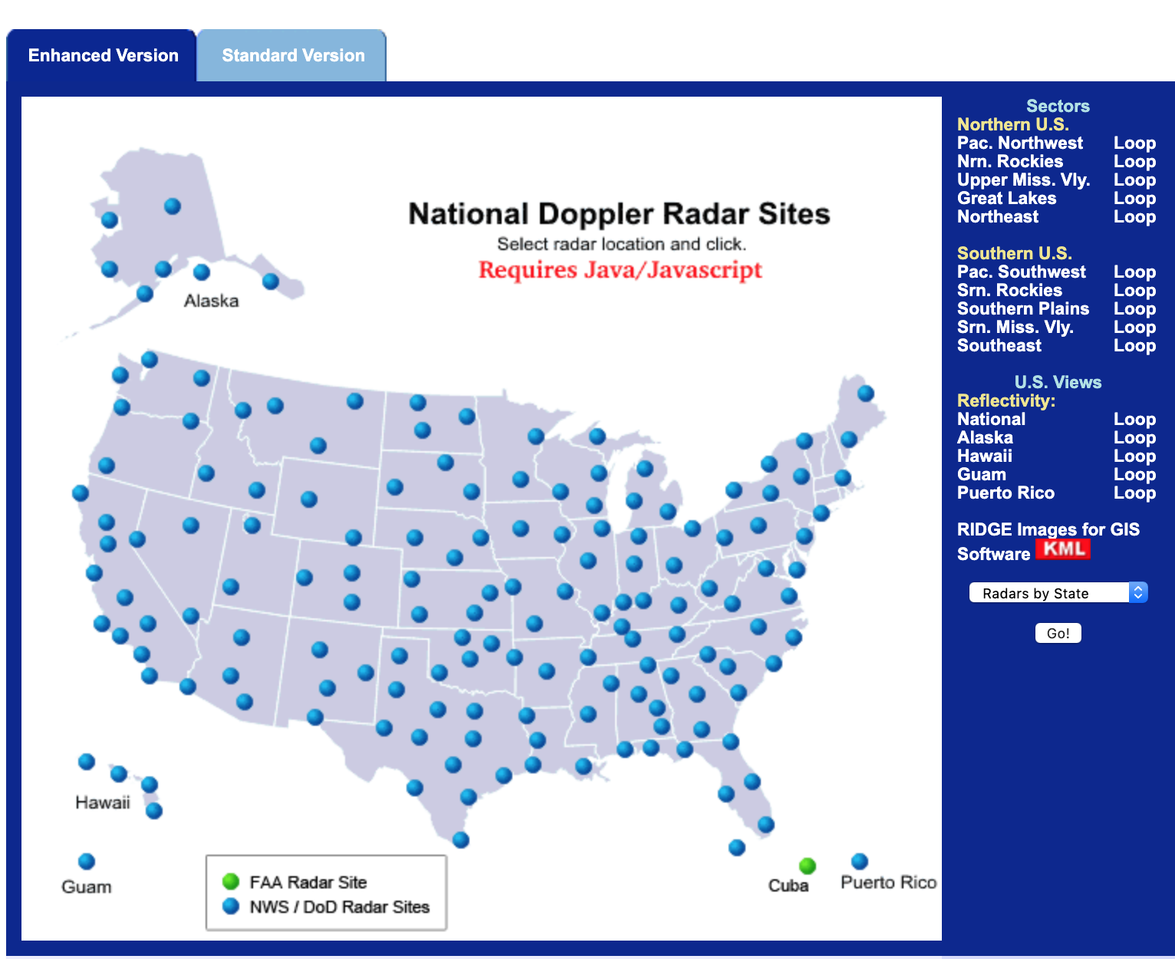
This.

Slide 6
Project report
E: Extracted Data from the 3 csv’s mentioned earlier
T: Transferred it into data frame and made better
L: Loaded into SQL

Slide 7
Data cleanup & analysis/lessons learned 1/3
We attempted to use web-scrapping, but were unable to take apart a map, from the Javascript used, so we found a list csv, and used that data that had city names for the location of the radars.
We eliminated ‘test data’ that was the entirety of the 2018 csv file. We were left with 2017 hail data, and radar-geolocation csv.
Theses are the 2 csv files that we're joining.
A lot of the naming conventions and labels broke our code consistently; ‘time’ in SQL, strings/decimals/floats, naming convention of times, (year, month, days)

Slide 8
Data cleanup & analysis/lessons learned 2/3
Dates were the biggest problem, looking at the data from the CSV it loaded the time-zone and time as a one number in 1970, but when loaded into Microsoft excel, it loaded the data as a DTG in 2017. We were up until the last minute attempting to change the DTG to an accurate number. ISO 8601 solved the problem with some rearranging.

Slide 9
Data cleanup & analysis/lessons learned 3/3
Used (SQL) and joined our data on an outer join to keep as much different data referencing the radar systems in our DB.
Attempted to take KML's and convert in csv's
Web scraping is hard. pulling pretty data from things that work, is very difficult.
If these processes were automated, any little change in the frame/structure of the websites we utilized would potentially render the process useless.
End of step 2, we broke out the date, cleaned a couple of the columns, deleted a couple of useless columns as well.
Checked the length of all the columns, Matched.

Slide 10
end
Thanks!

