Slide 1
Preliminary results from assimilation of GPS radio occultation data in WRF using an ensemble filter
H. Liu, J. Anderson, B. Kuo, C. Snyder, A. Caya
IMAGe / COSMIC / MMM
NCAR / UCAR
Acknowledgement: S. Sokolovskiy (COSMIC)

Slide 2
GPS Radio Occultation observations
atmosphere
ray
GPS receiver on Low Earth Orbit (LEO) satellite
GPS satellite
• Ray is bent due to refractivity of the atmosphere.
• RO refractivity can be obtained from the bending angle profile and it contains T, Q, and P information.
• Q and T can be retrieved through assimilation of the RO data.

Slide 3
GPS Radio Occultation observations
Major features:
• RO data is not affected by cloud.
• Potential valuable data over oceans and polar regions in addition to MW and IR satellite data, especially in cloudy situations.
• May have potential to improve forecast of hurricane and landfalling cyclone (to be explored).
Current and coming GPS RO missions:
• Two active GPS RO Missions: CHAMP and SAC-C
Both have primitive hardware and software.
• Upcoming COSMIC/UCAR GPS RO Mission:
Hardware and software are much improved.

Slide 4
Background
• As so far, most studies of assimilation of GPS RO data were done by variational approach,
e.g., ECMWF 4D-Var for RO refractivity/bending angle
NCEP/3DVAR for RO refractivity/bending angle
WRF-3DVAR for RO refractivity
• Positive impact of the RO data on T analysis and forecast in the upper troposphere was demonstrated in some of the studies.
• Obtaining positive impact of GPS RO data on moisture in the lower troposphere is still a challenge.

Slide 5
Background (cont.)
Possible reasons for the challenge:
1. Current CHAMP and SAC-C GPS RO observations have relatively large errors in the lower troposphere.
2. Time-averaged forecast error variances of Q and T were used to “optimally” retrieve Q and T from RO refractivity and bending angle.
Forecast error correlation of Q with T was not used.
In reality, the forecast error correlation may be significant due to dynamical and physical processes involved.

Slide 6
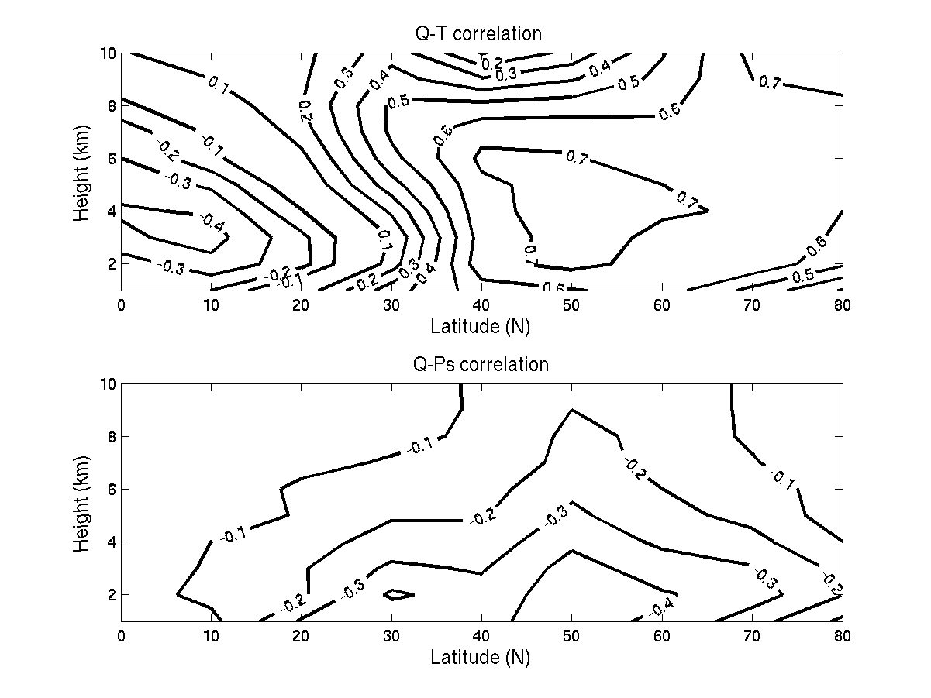
Background (cont.)
Zonal mean forecast error correlations of Q with T and Ps in CAM T42, Jan 2003
Recent study suggests these correlations may likely improve assimilation of RO data (Liu, et al., 2005)

Slide 7
Using ensemble filters
for assimilation of RO data
1. Forecast error correlations of Q with T and Ps can be used and the correlations are flow dependent, which is especially important for Q related variables.
Allows more ”optimal” separation/retrieval of T and Q information from RO refractivity/bending angle.
2. Models and observation operators can be implemented easily. No tangent linear model and adjoint needed.
Many observation operators can be tested easily.

Slide 8
Ensemble Adjustment Filter (Anderson, 2003)
(It is really simple. Only two steps.)
Assumption: Each observation can be handled sequentially.
1st step: Update forecast estimates of the observation
*
*
*
*
*
*
*
*
*
*
º
*
*
*
*
*
*
*
*
*
*
N (refractivity)
ΔN₁
ΔN₁₀
• By combining the observation and forecast ensemble, we can reduce uncertainty of the forecast estimates of the observation; and shift their mean closer to the observation’s value.
• Get analysis increments by differencing the forecast and updated ensemble members.

Slide 9
Ensemble Adjustment Filter (cont.)
2nd step: Update ensemble members of each model variable at each model grid point sequentially.
Lat
Key: Regress the analysis increments of the observation to nearby model variables using a joint ensemble statistics of q_{j} with N(T,q,Ps).
q_{j}
•
•
•
•
•
•
o
•
•
•
•
•
•
•
•
Lon

Slide 10
Ensemble Adjustment Filter (cont.)
2nd step: Update ensemble members of each model variable sequentially.
q_{j}
*
*
Δq_{j,10}
*
*
*
*
*
*
*
*
*
Forecast error correlation of q with T is used here.
*
*
*
*
*
*
*
*
*
*
Δq_{j,1}
*
*
*
*
*
*
*
*
*
*
o
N (refractivity)
ΔN₁
ΔN ₁₀

Slide 11
NCAR Data Assimilation Research Testbed (DART)
• Includes the Ensemble Adjustment Filter and other filters
• Major models are implemented:
WRF and CAM model
• Many observation types can be assimilated:
Conventional observations (radiosonde, aircrafts, satellite wind, etc.)
Radar and GPS RO observations.
• Other models and specific observation types can be added easily.

Slide 12
Assimilation of RO data with WRF/DART
• Recently, we began study of assimilation of GPS RO refractivity using WRF/DART.
The goal is to explore the potential of GPS RO observations to improve regional weather analysis and forecast, especially in conventional data sparse areas and the lower troposphere.
• This work focuses on re-examining the impact of CHAMP GPS RO data on analyses of Q and T in the troposphere to see if positive impact can be obtained with WRF/DART.

Slide 13
Assimilation of RO data with WRF/DART (cont.)
One more issue:
In the lower troposphere, there may exist small-scale variations in the refractivity field, especially in high resolution WRF. The variations may cause error when RO refractivity is treated as local refractivity.
A number of approaches were proposed to reduce the error. Here we compare:
1. Assimilating RO refractivity as local refractivity.
2. Assimilating excess phase (transformed RO refractivity) using a non-local excess phase operator.

Slide 14
Assimilation of RO refractivity
Assimilate RO refractivity as local refractivity:
Just linearly interpolates (vertical and horizontal) 3-D modeled refractivity on WRF model grid (N_{mod}) to any RO observation perigee location to approximate RO refractivity (N_{RO}).
• May be sufficiently accurate above the lower troposphere.
• May have large error in the lower troposphere.

Slide 15
Assimilation of RO refractivity (cont.)
2. Assimilating excess phase S_{obs} using an excess phase operator (Sokolovskiy et al., 2005):
Where r is r_{c} + z. r_{c} is local curvature radius of earth, and z is height above earth surface.
• It was demonstrated the modeling error of S_{obs} is much less than modeling the N_{RO} as local refractivity.

Slide 16
CHAMP GPS RO data
• Continental US domain
• Winter: Jan 1-10, 2003; 123 profiles
• Summer: June 18-27, 2003; 136 profiles
• Raw data are thinned to ~70m and ~300m interval in the lower and upper troposphere.
• Observations between 2 -12km assimilated.
• Observation below 2km are excluded.
• Only COSMIC quality control is applied.

Slide 17
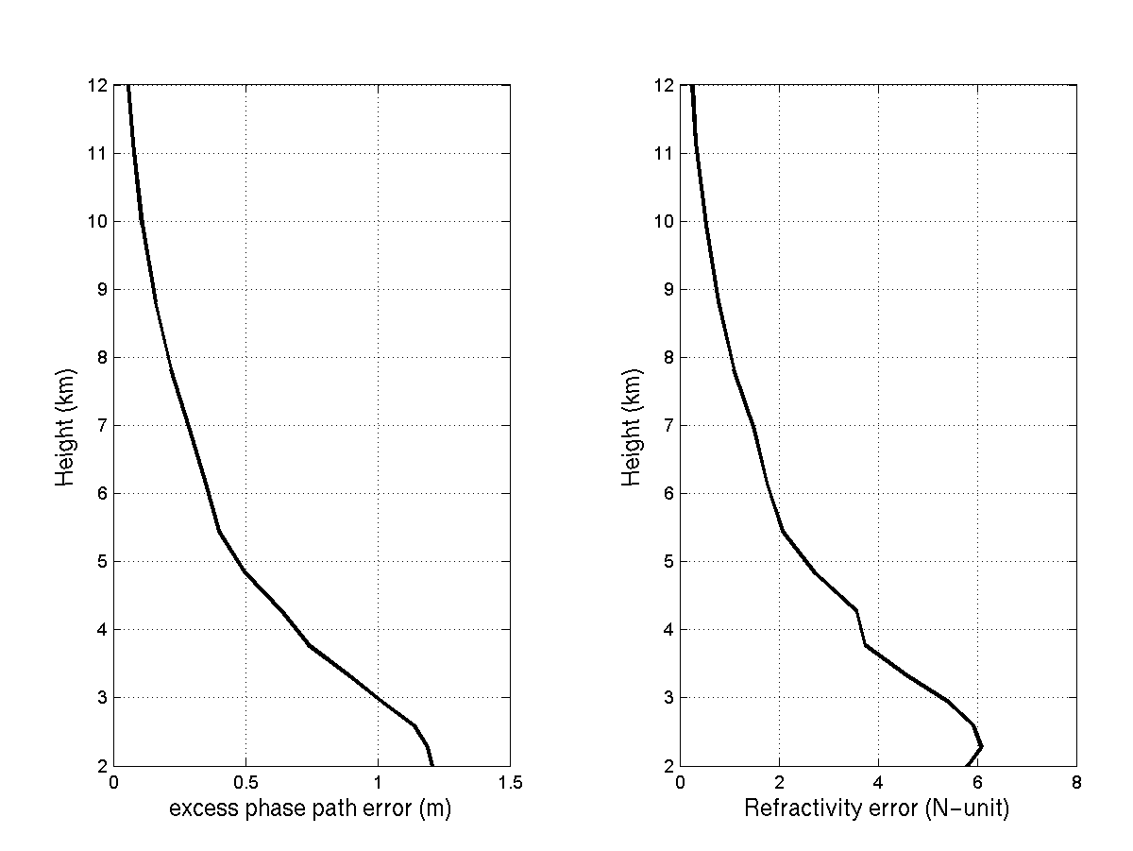
CHAMP observations error estimates
(Kuo, et al., 2005)
These error estimates are based on OBS in NW Pacific.
Assimilating RO N as local N in CONUS domain might have larger error due to the complex topography.

Slide 18
Experimental setup
• GPS RO data and radiosonde data are assimilated in 6 hour window at 00Z, 06Z, 12Z, and 18Z in cycling mode.
• 50km WRF model (27 levels) is used to get 6-hour forecast ensemble.
• Initial (Jan 1st 00Z, and June 18th 12Z) and boundary ensemble mean conditions are from 1°x1° AVN analysis.
• 40 ensemble members are used. Initial and boundary ensembles are generated using WRF/3D-Var error statistics.

Slide 19
Experimental setup(cont.)
Exp 1: Partial radiosonde OBS
U/V, T, and Q below 250 hPa
Radiosondes within 640km and +/- 3 hour of RO OBS are withheld to
reduce redundant OBS information at the GPS RO locations.
Exp 2: Partial radiosonde OBS + RO excess delay
Exp 3: Partial radiosonde OBS + RO refractivity
(assimilated as local refractivity)

Slide 20
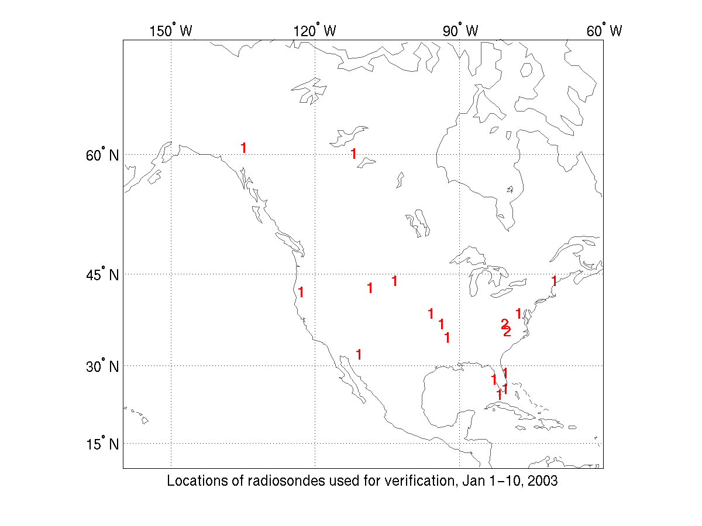
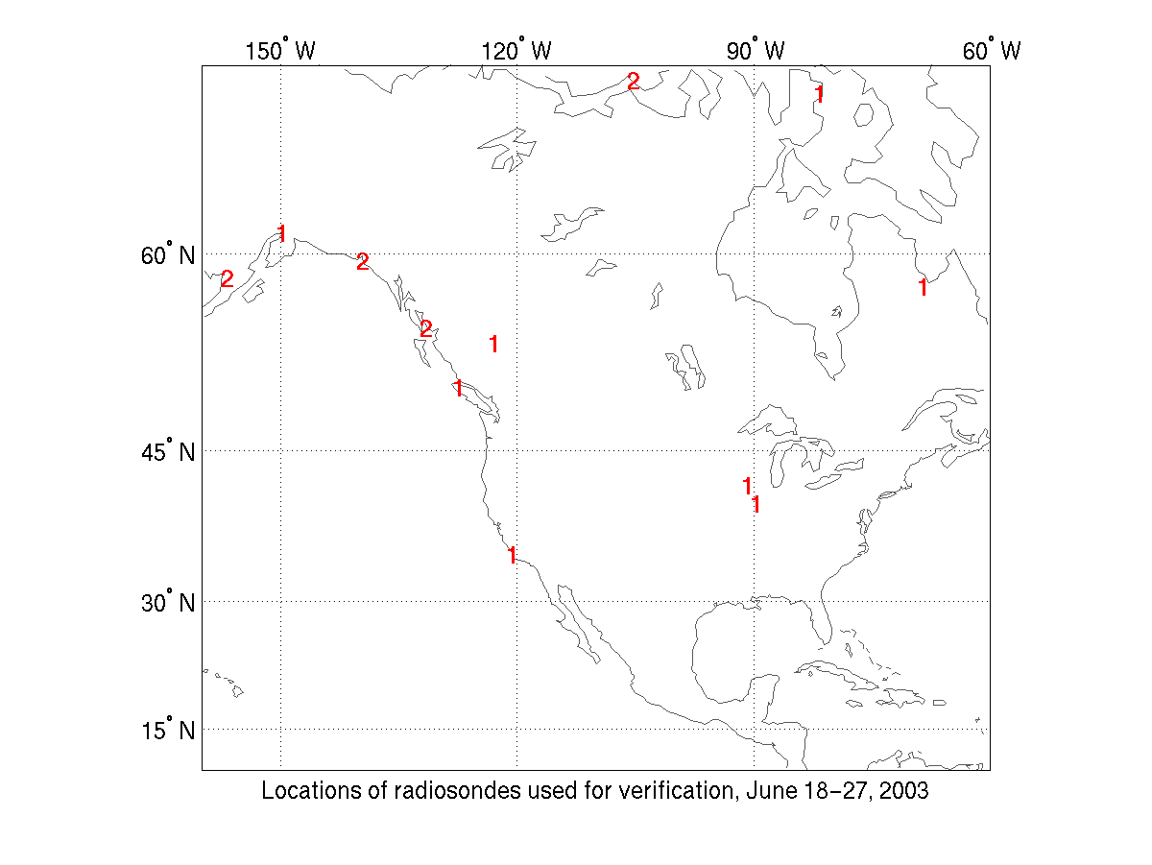
Verification of the analyses
• Analyses are verified to the co-located radiosonde OBS which are within 200km and +/- 3 hour of GPS data.

Slide 21
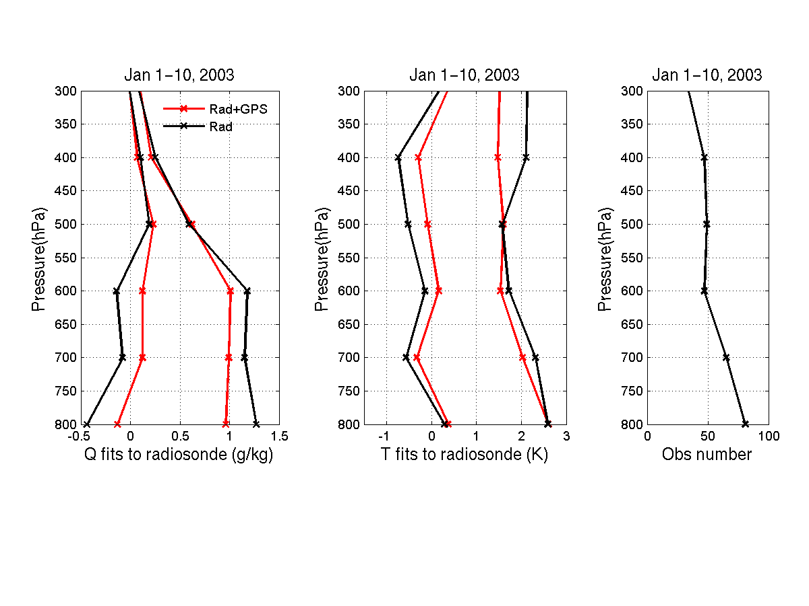
Impact of CHAMP RO excess phase delay
Red line: Radiosonde only
Black line: Radiosonde + RO excess phase
Radiosonde number
Bias pair
RMS fit pair

Slide 22
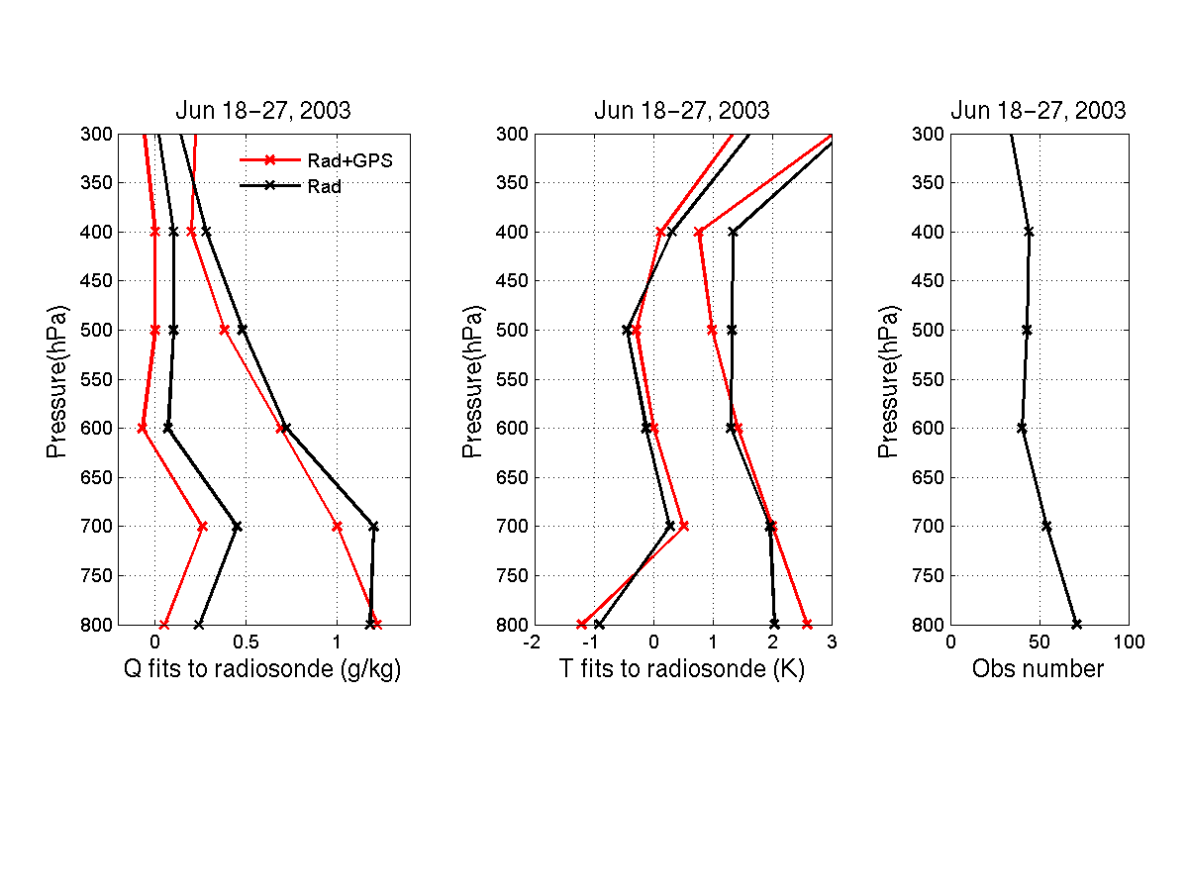
Impact of CHAMP RO excess phase delay
Red line: Radiosonde only
Black line: Radiosonde + RO excess phase

Slide 23
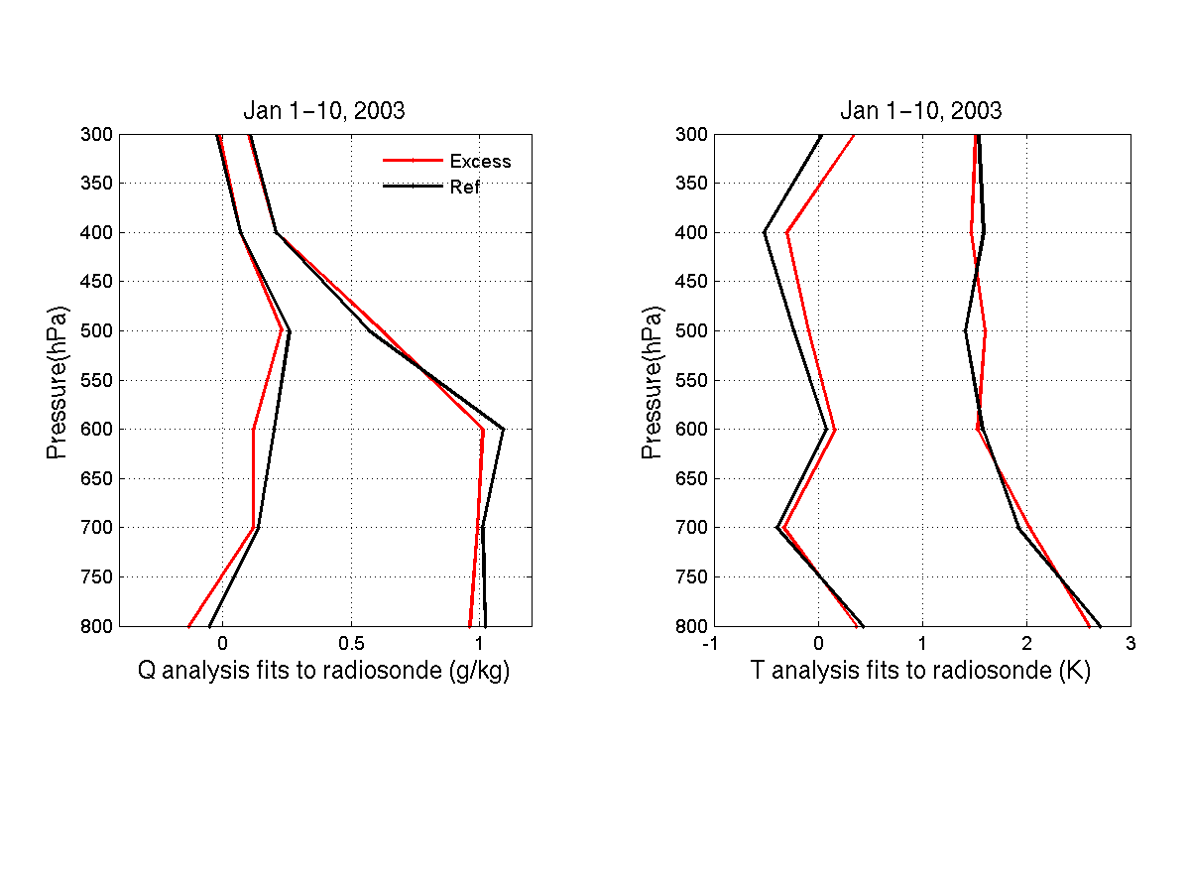
Comparison of excess phase and refractivity operator
Red line: Radiosonde + RO excess phase
Black line: Radiosonde + RO refractivity
Indications on positive impact of assimilating excess phase in the lower troposphere

Slide 24
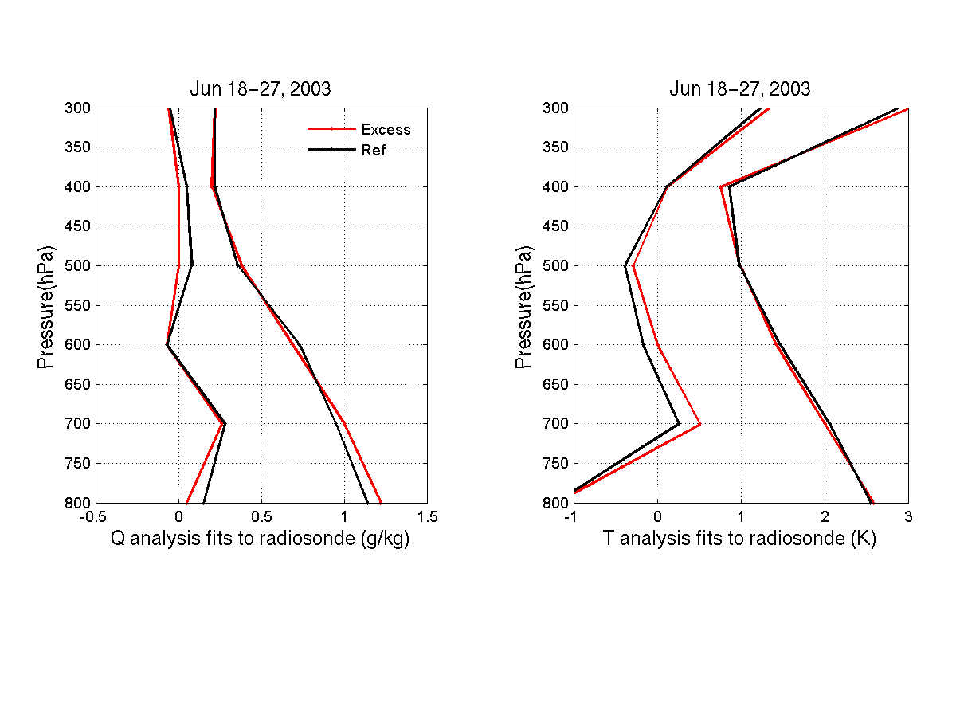
Comparison of excess phase and refractivity operator
Red line: Radiosonde + RO excess phase
Black line: Radiosonde + RO refractivity
Suggestions on positive impact of assimilating excess phase.

Slide 25
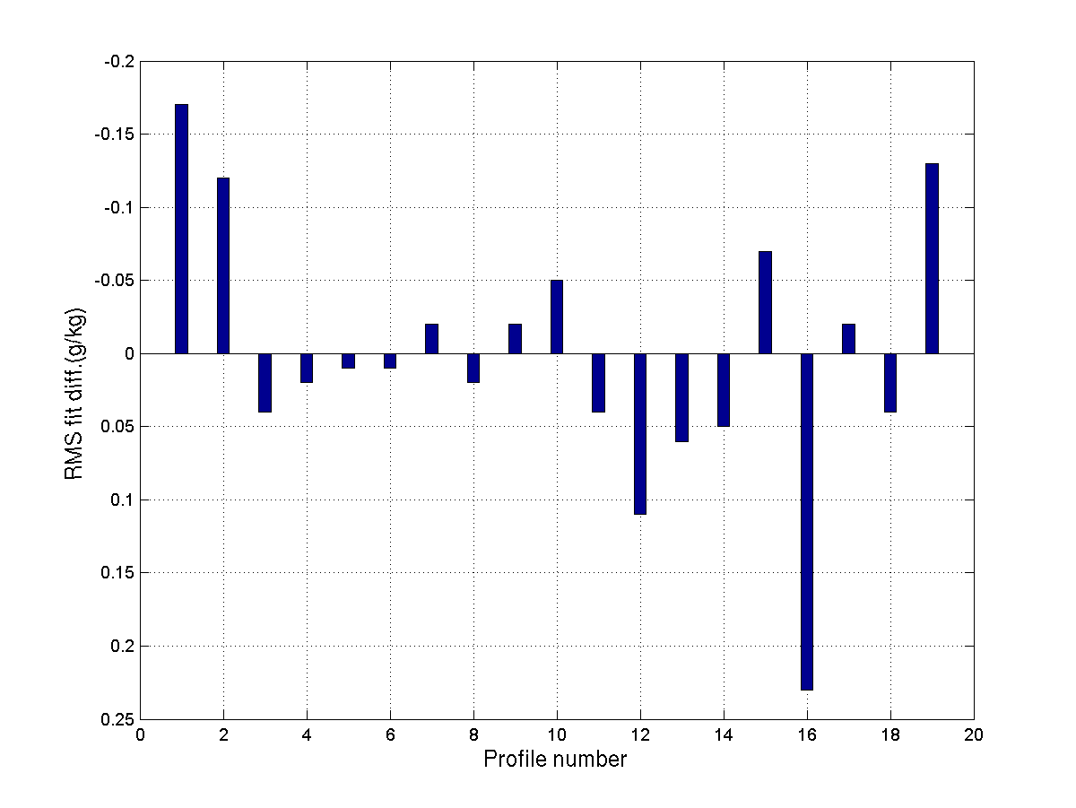
RMS fit diff. for Q: (verified to individual radiosonde profile)
Exp 2 (Excess phase) - Exp 3 (refractivity)
Jan 1-10, 2003

Slide 26
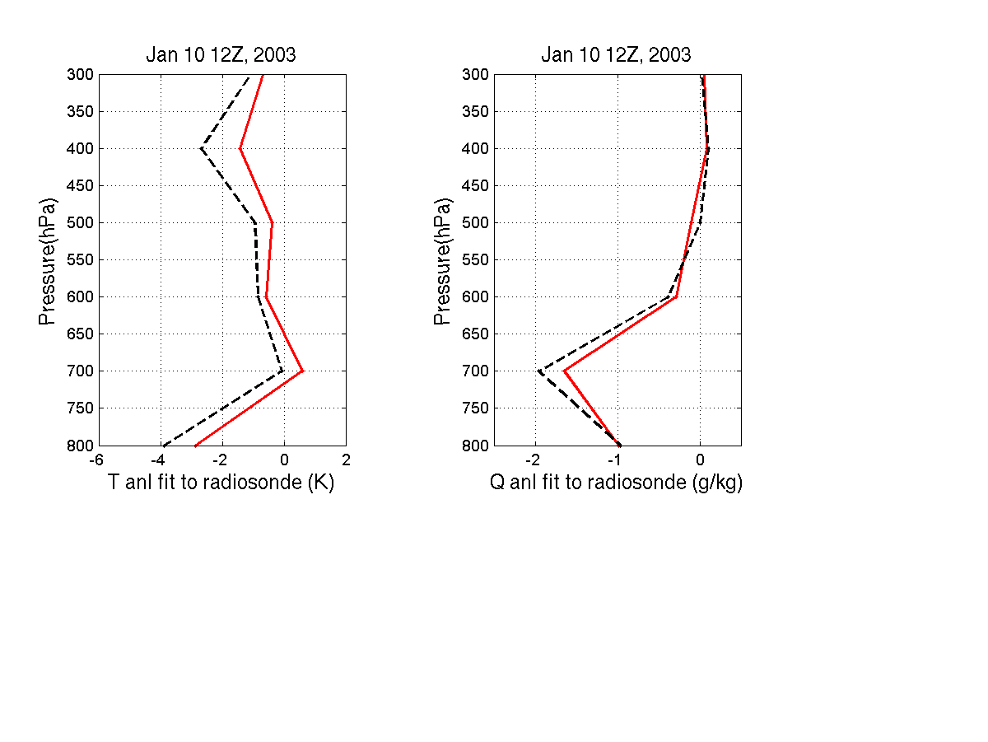
Comparison of excess phase and refractivity operator
Verified to one radiosonde profile in Jan 10 12Z
Red line: Radiosonde + RO excess phase
Black line: Radiosonde + RO refractivity
The fits of assimilating excess phase are closer to the nearby radiosonde.

Slide 27
Conclusions
The preliminary results suggest:
• Positive impact of GPS RO data especially on moisture analysis in the lower troposphere are obtained in winter and summer with WRF/DART.
• Impact of assimilating the excess phase in the 50km resolution is generally positive, compared with assimilating RO refractivity as local refractivity.

Slide 28
Future work
• Examine impact of upcoming COSMIC GPS RO data, which is expected to have better quality and much better spatial and time coverage.
• Explore impact of GPS RO data over oceans and polar regions, especially on hurricane and landfalling cyclone forecasts, where conventional observations are sparse and MW and IR satellite data have larger errors.

