Slide 1

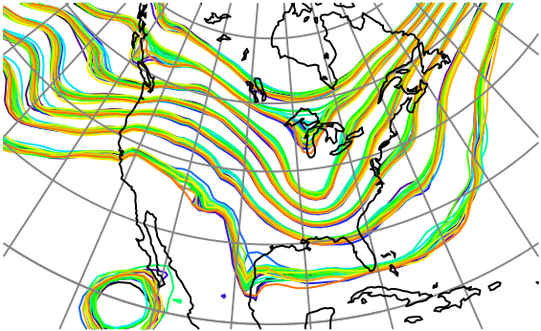

Nonlinear, Nongaussian Ensemble Data Assimilation with Rank Regression and a Rank Histogram Filter
Jeff Anderson, NCAR Data Assimilation Research Section

Slide 2
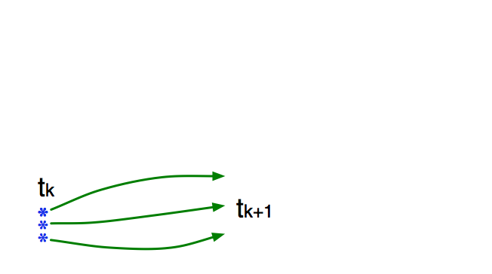
Schematic of a Sequential Ensemble Filter
Use model to advance ensemble (3 members here) to time at which next observation becomes available.
Ensemble state estimate after using previous observation (analysis)
Ensemble state at time of next observation (prior)

Slide 3
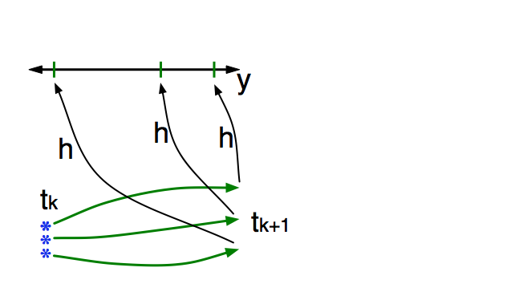
Schematic of a Sequential Ensemble Filter
Get prior ensemble sample of observation, y = h(x), by applying forward operator h to each ensemble member.
Theory: observations from instruments with uncorrelated errors can be done sequentially.
Can think about single observation without (too much) loss of generality.

Slide 4
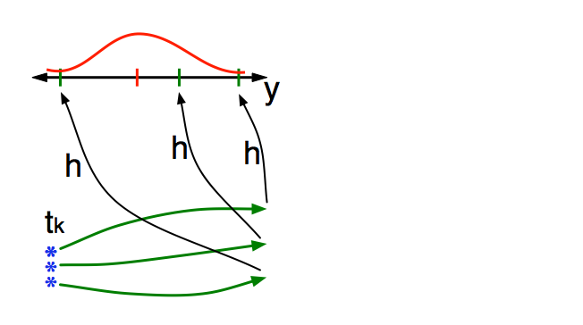
Schematic of a Sequential Ensemble Filter
Get observed value and observational error distribution from observing system.

Slide 5
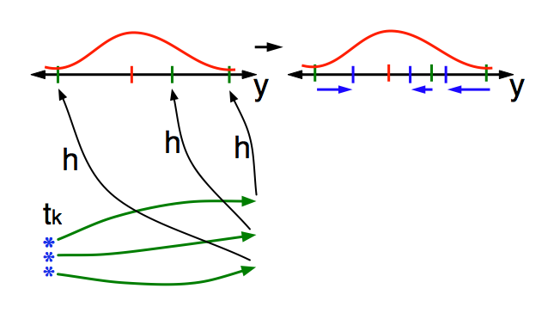
Schematic of a Sequential Ensemble Filter
Find the increments for the prior observation ensemble (this is a scalar problem for uncorrelated observation errors).
Ensemble Kalman filters assume Gaussianity for this problem.
Can compute increments without Gaussian assumptions. (Old news).

Slide 6
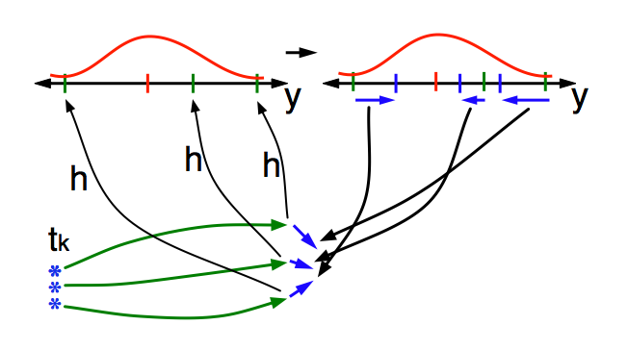
Schematic of a Sequential Ensemble Filter
Use ensemble samples of y and each state variable to linearly regress observation increments onto state variable increments.
Theory: impact of observation increments on each state variable can be handled independently!

Slide 7
Schematic of a Sequential Ensemble Filter
Use ensemble samples of y and each state variable to linearly regress observation increments onto state variable increments.
Can solve this bivariate problem in other ways. Topic of this talk.

Slide 8
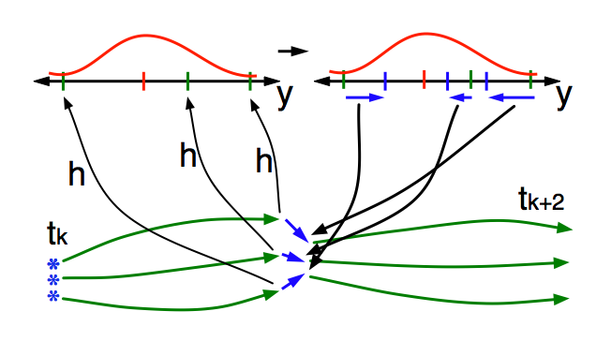
Schematic of a Sequential Ensemble Filter
When all ensemble members for each state variable are updated, there is a new analysis. Integrate to time of next observation …

Slide 9
Focus on the Regression Step
Standard ensemble filters just use bivariate sample linear regression to compute state increments.
Δx_{i,n}=bΔy_{n,}
n=1,…N.
N is ensemble size.
b is regression
coefficient.

Slide 10
Focus on the Regression Step
Examine another way to increment state given observation increments; still bivariate.

Slide 11
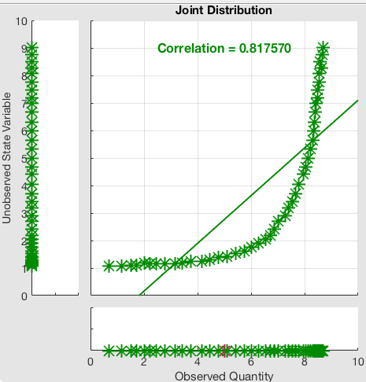
Nonlinear Regression Example
Try to exploit nonlinear prior relation between a state variable and an observation.
Example: Observation y~log(x).
Also relevant for variables that are log transformed for boundedness (like concentrations).

Slide 12
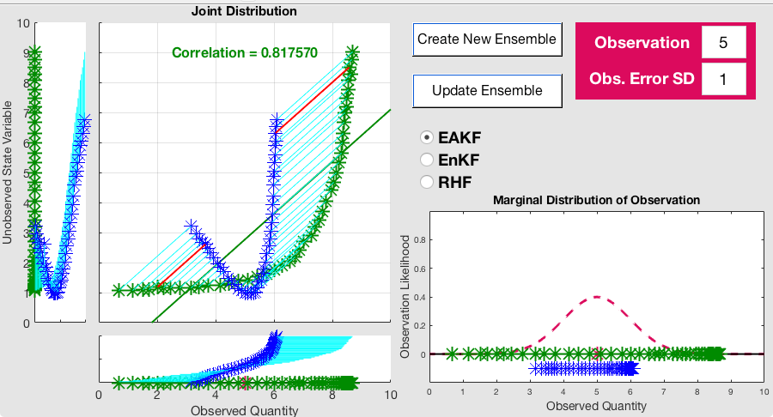
Standard Ensemble Adjustment Filter (EAKF)
Try to exploit nonlinear prior relation between a state variable and an observation.
Example: Observation y~log(x).
Also relevant for variables that are log transformed for boundedness (like concentrations).

Slide 13
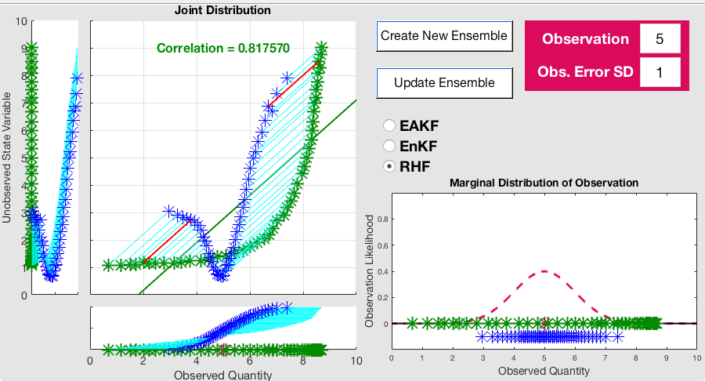
Standard Rank Histogram Filter (RHF)
Try to exploit nonlinear prior relation between a state variable and an observation.
Example: Observation y~log(x).
Also relevant for variables that are log transformed for boundedness (like concentrations).

Slide 14
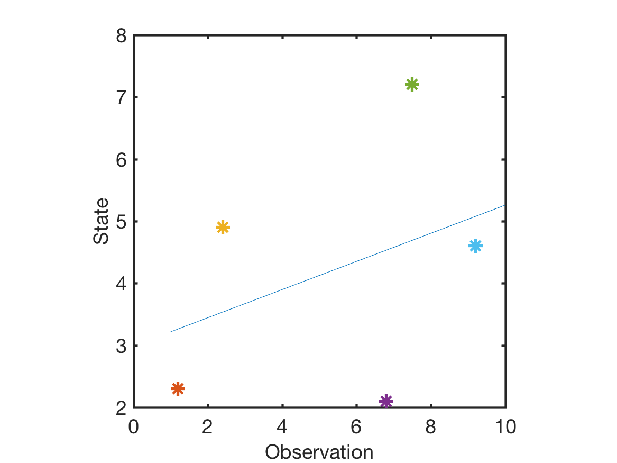
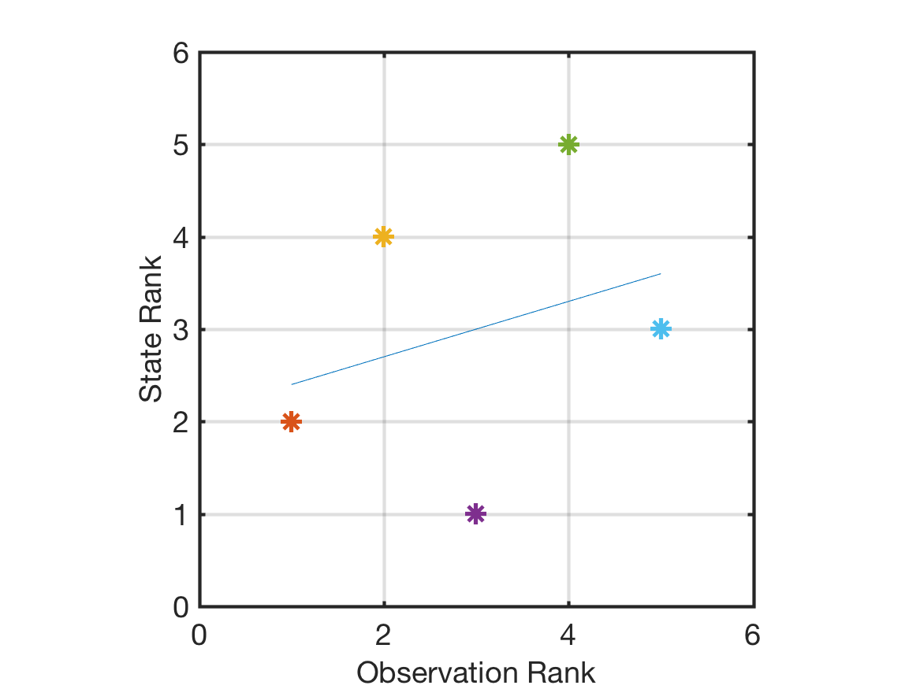
Rank Regression
Convert bivariate ensemble to bivariate rank ensemble.
Do least squares on bivariate rank ensemble.
Standard regression
Rank regression
Noisy
Relation.

Slide 15
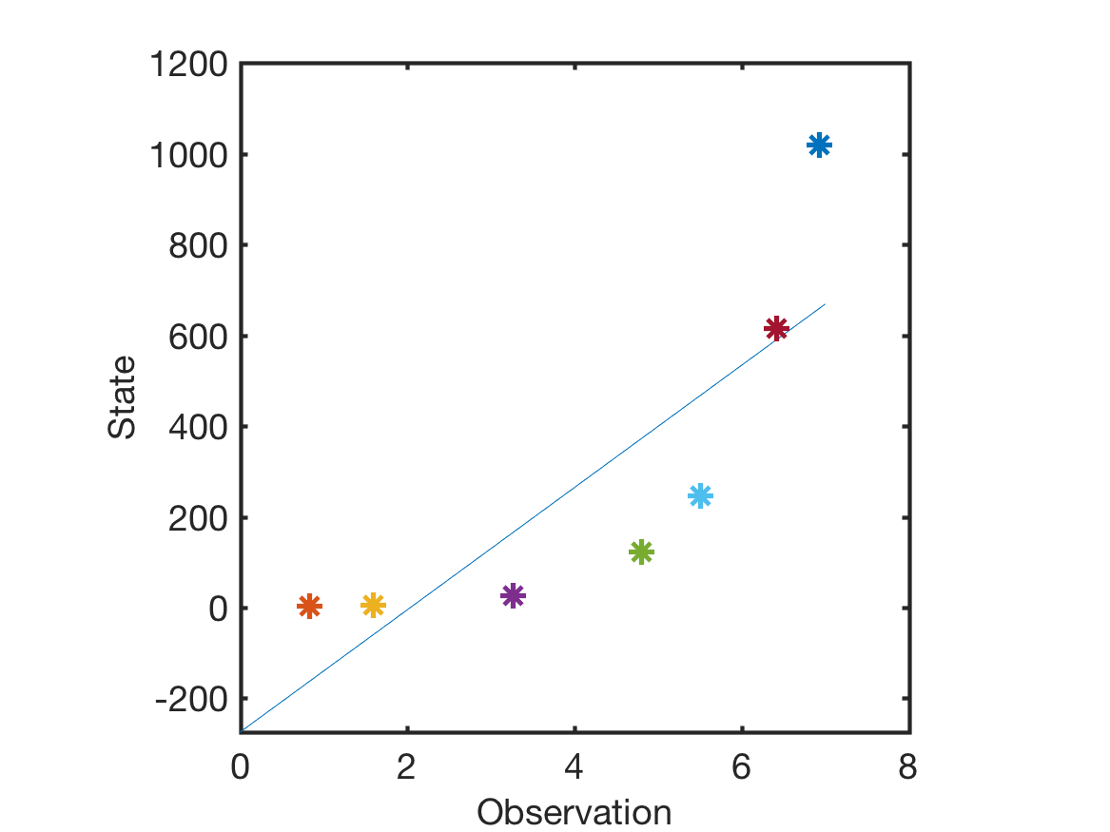
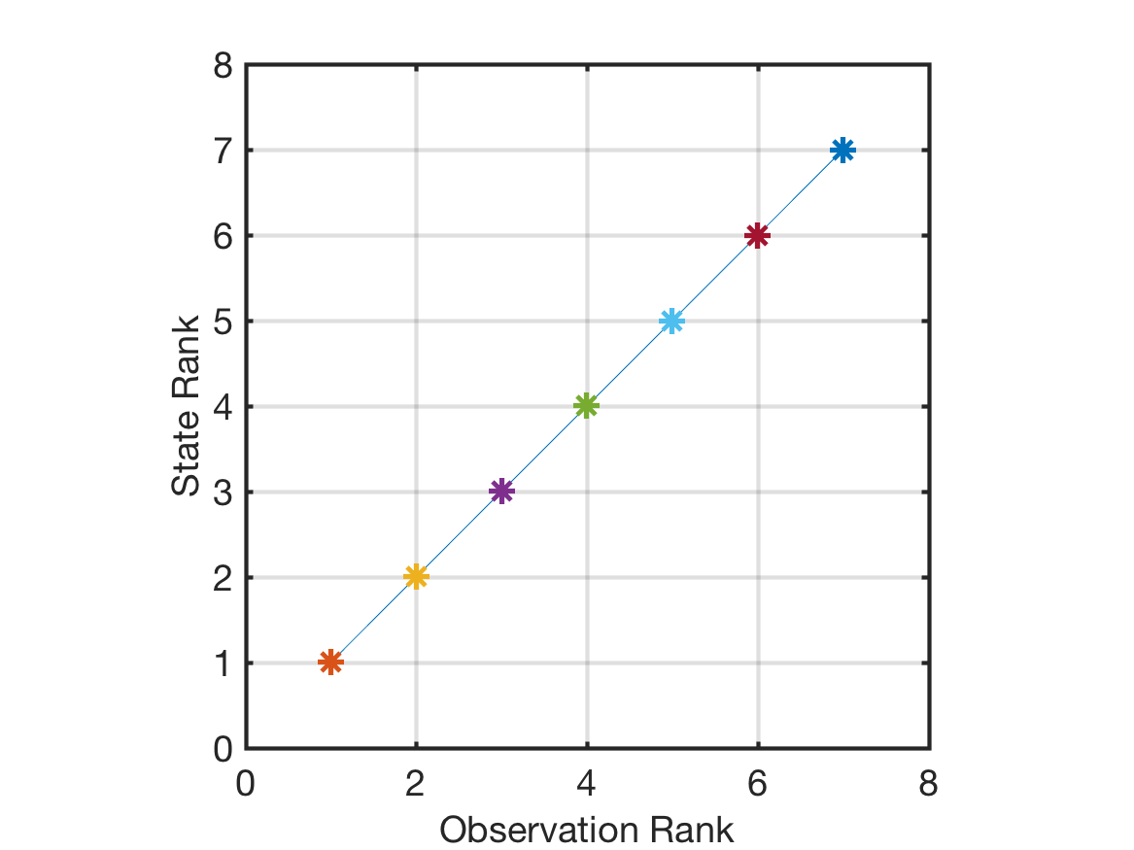
Rank Regression
Convert bivariate ensemble to bivariate rank ensemble.
Do least squares on bivariate rank ensemble.
Standard regression
Rank regression
Monotonic relation.

Slide 16
Rank Regression
Convert bivariate ensemble to bivariate rank ensemble.
Do least squares on bivariate rank ensemble.
Convert observation posteriors to rank.
Regress rank increments onto state ranks.

Slide 17
Rank Regression
Convert bivariate ensemble to bivariate rank ensemble.
Do least squares on bivariate rank ensemble.
Convert observation posteriors to rank.
Regress rank increments onto state ranks.
Convert posterior state ranks to state values.

Slide 18
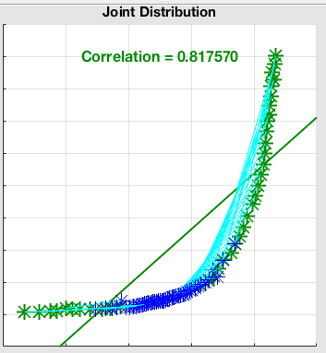
Rank Regression Example
Rank regression with RHF for observation marginal.
Follows monotonic ensemble prior ‘exactly’.

Slide 19
Compare Six ‘Treatments’
Each ‘treatment’ pairs an observation space method:
1. Deterministic Ensemble Adjustment Kalman Filter (EAKF),
2. Stochastic Ensemble Kalman Filter (EnKF),
3. Non-Gaussian Rank Histogram Filter (RHF)
With a regression method:
A. Standard linear regression,
B. Rank regression.

Slide 20
Empirically Tuned Localization and Inflation
Select the Gaspari Cohn localization half-width:
0.125 0.15, 0.175, 0.2, 0.25, 0.4, infinite.
and fixed multiplicative inflation:
1.0, 1.02, 1.04, 1.08, 1.16, 1.32, 1.64.
that gives minimum time mean posterior RMSE.
(7x7=49 possibilities checked).
Find best localization/inflation pair for each of the six treatments.

Slide 21

Lorenz-96 Tests
40 state variables.
40 randomly located ‘observing stations’ around unit circle.
($x_{o}$ is state interpolated to a station location).
Explored 4 different forward operators:
Identity: $y_{o}=x_{o}$,
Square root: $y_{o}=sgn\left(x_{o}\right)\sqrt{\left|x_{o}\right|}$ ,
Square: $y_{o}=x_{o}^{2}$ ,
Cube: $y_{o}=x_{o}^{3}$ .

Slide 22
Lorenz-96 Tests: Statistical Significance
Select rank regression treatment with lowest RMSE:
This picks inflation, localization, and observation space filter (EAKF, EnKF, or RHF).
Select linear regression treatment with lowest RMSE.
Apply each to ten 5000-step assimilation cases.
Result is 10 pairs of RMSE for rank versus linear regression.
Paired T-test used to establish significance of RMSE differences.

Slide 23
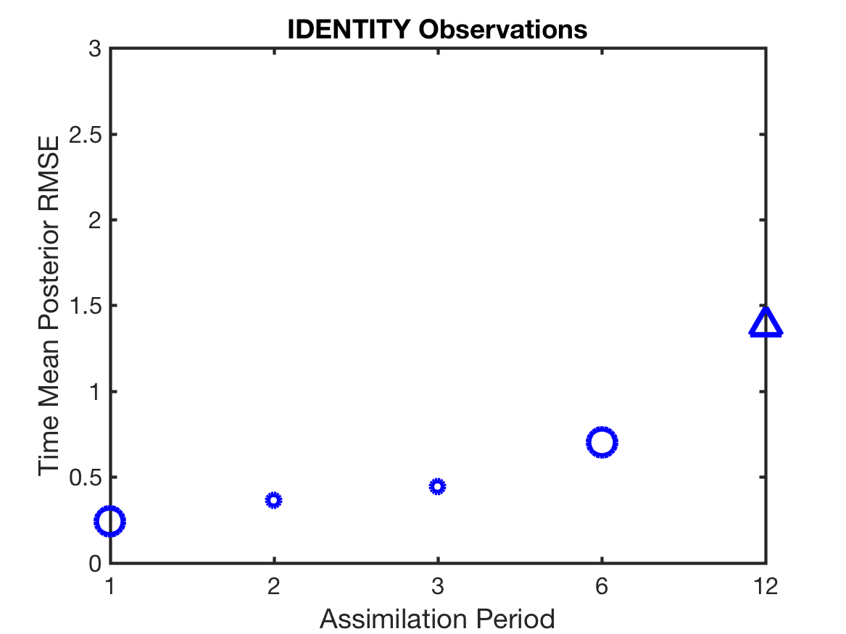
Identity Forward Operator Results
Observation error variance 1.0

Slide 24
Identity Forward Operator Results
Observation error variance 1.0
Circle:
EnKF best

Slide 25
Identity Forward Operator Results
Observation error variance 1.0
Triangle:
RHF best
Circle:
EnKF best

Slide 26
Identity Forward Operator Results
Observation error variance 1.0
Small Marker:
P-value > 0.01,
Not significant

Slide 27
Identity Forward Operator Results
Observation error variance 1.0
Large Marker:
P-value < 0.00001
Small Marker:
P-value > 0.01
Not significant

Slide 28
Identity Forward Operator Results
Observation error variance 1.0
Triangle:
RHF best
Circle:
EnKF best

Slide 29
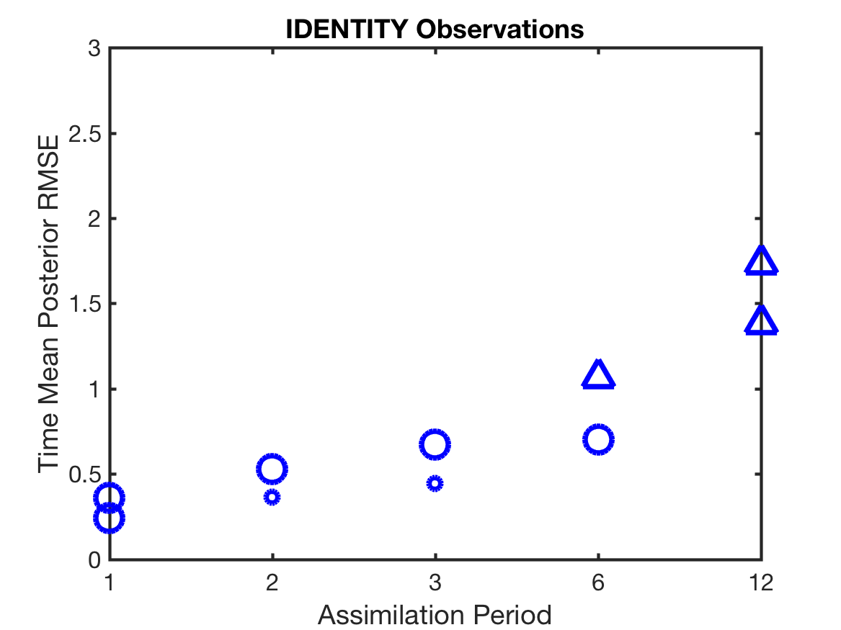
Identity Forward Operator Results
Observation error variance 2.0
Triangle:
RHF best
Circle:
EnKF best

Slide 30
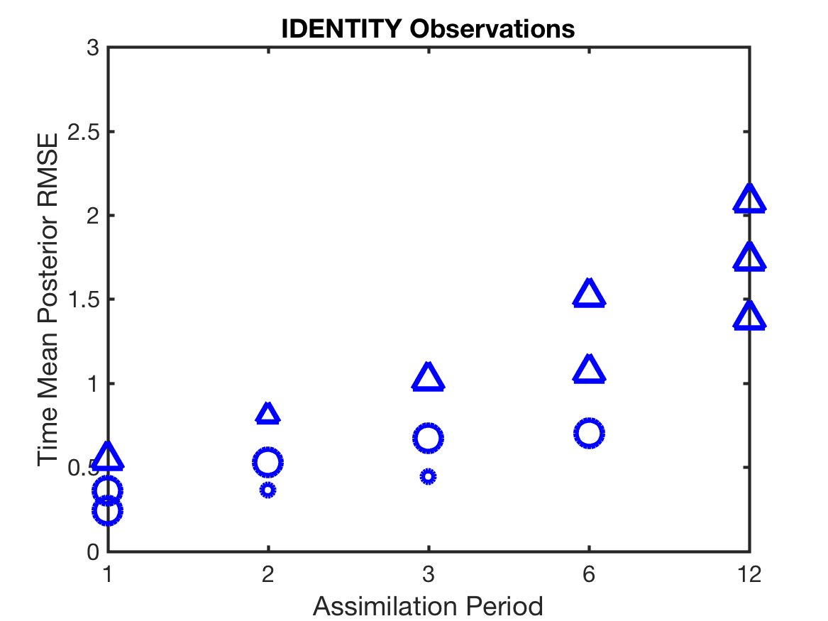
Identity Forward Operator Results
Observation error variance 4.0
Triangle:
RHF best
Circle:
EnKF best

Slide 31
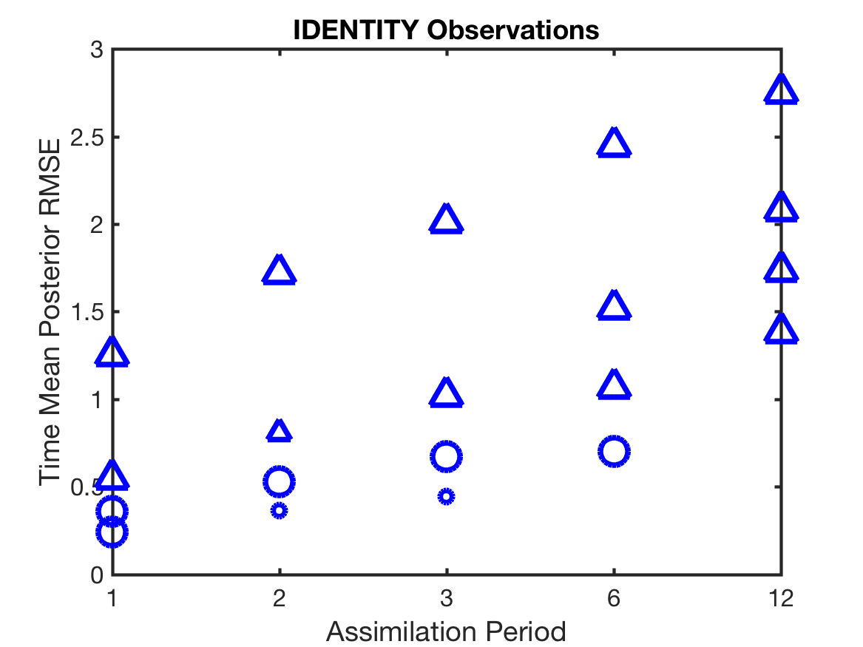
Identity Forward Operator Results
Observation error variance 16.0
Triangle:
RHF best
Circle:
EnKF best

Slide 32
Summary: Identity Forward Operator Results
RHF better for larger RMSE, EnKF for smaller.
Linear regression always better than rank regression.
Triangle:
RHF best
Circle:
EnKF best

Slide 33
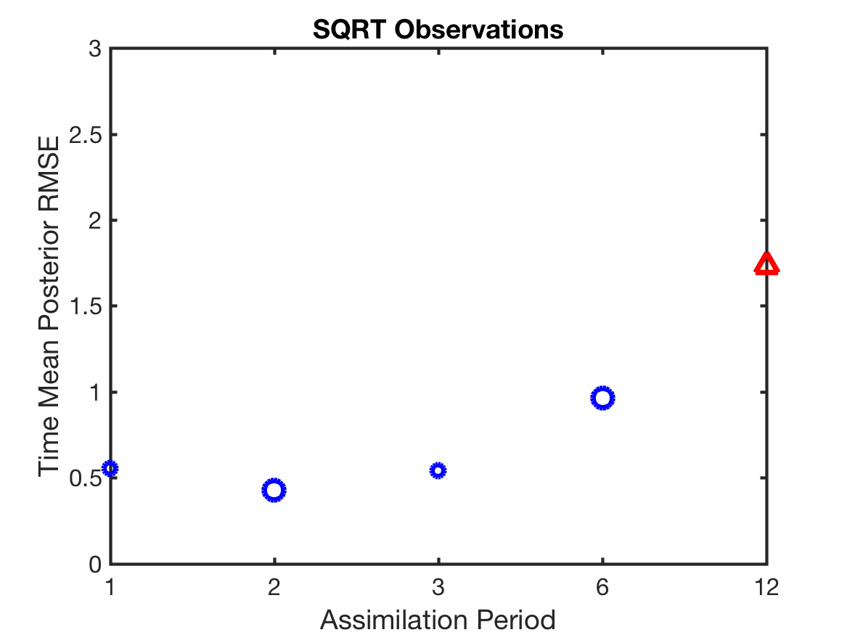
Square Root Forward Operator Results
Observation error variance 0.25
Triangle:
RHF best
Circle:
EnKF best

Slide 34
Square Root Forward Operator Results
Observation error variance 0.25
Red: Rank regression best
Blue: Linear
regression best

Slide 35
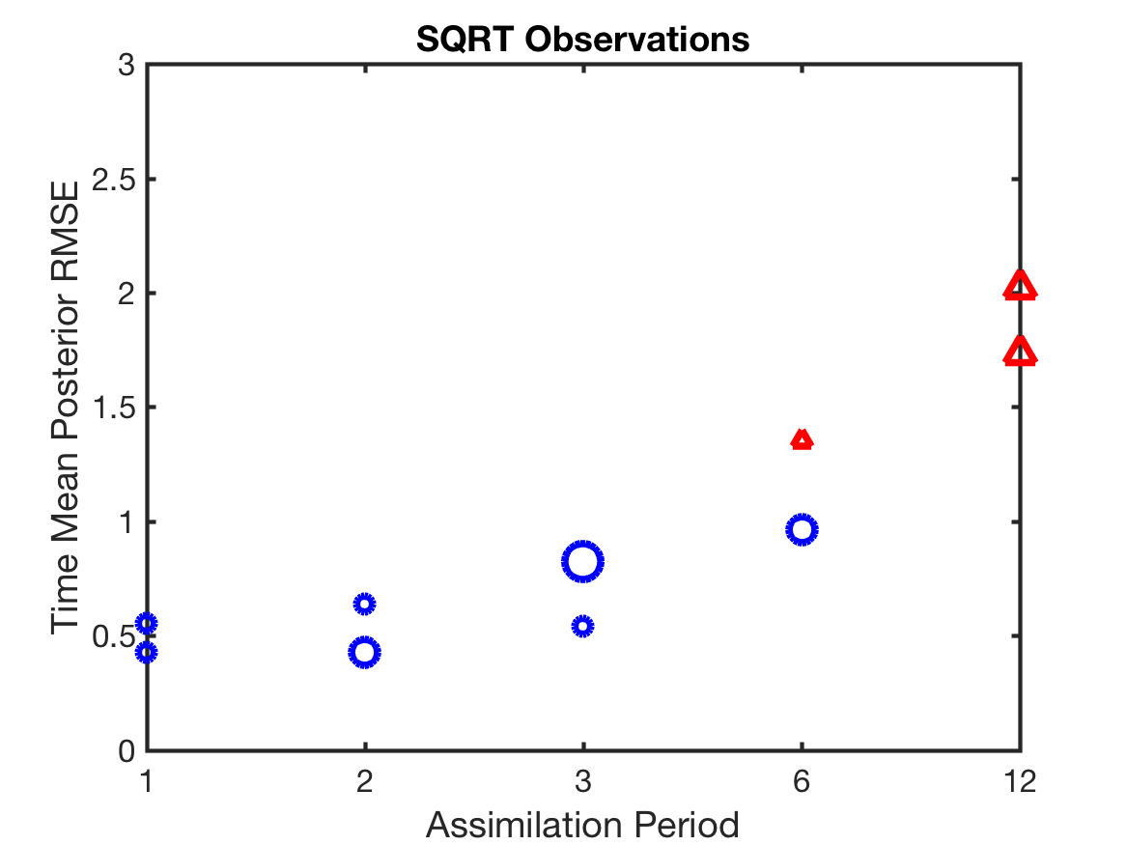
Square Root Forward Operator Results
Observation error variance 0.5

Slide 36
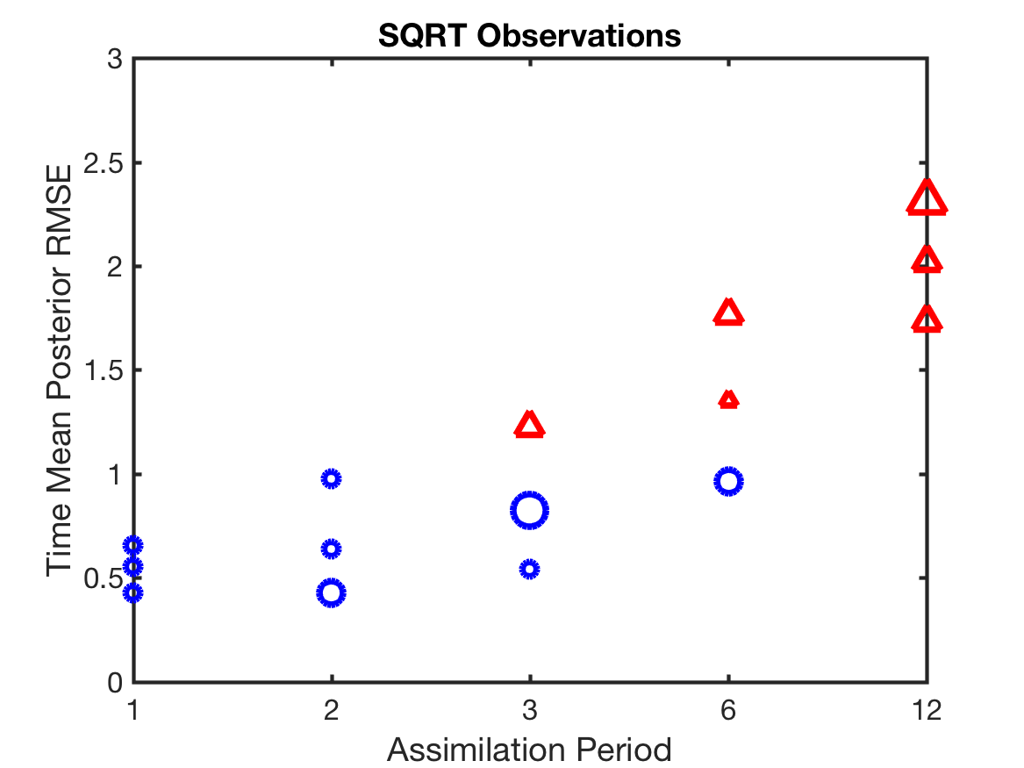
Square Root Forward Operator Results
Observation error variance 1.0

Slide 37
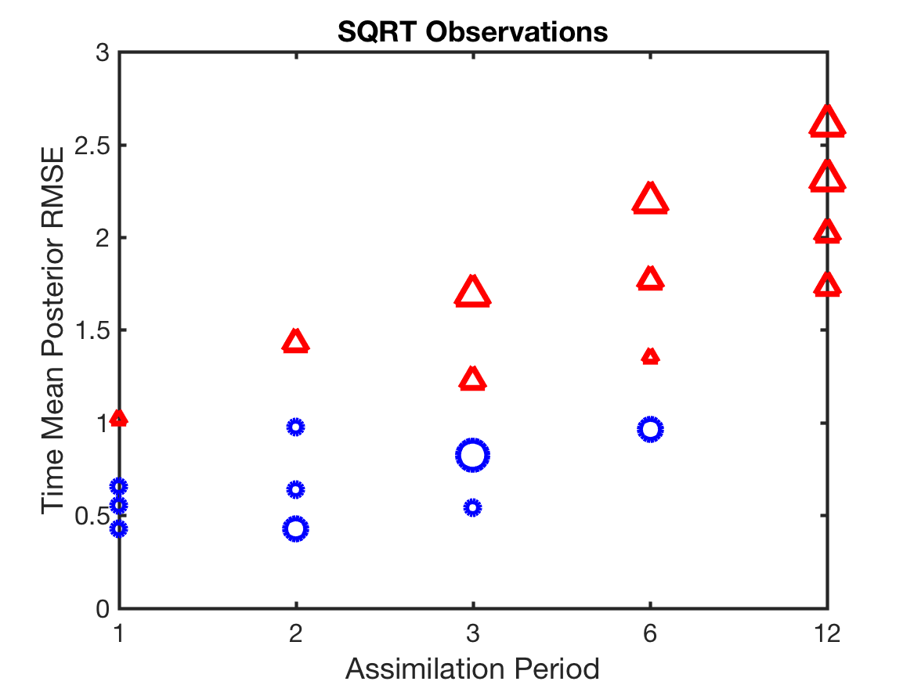
Square Root Forward Operator Results
Observation error variance 2.0

Slide 38
Summary: Square Root Forward Operator Results
RHF with rank regression better for larger RMSE.
EnKF with linear regression better for smaller RMSE.
Red Triangle:
RHF with rank regression best
Blue Circle:
EnKF with linear regression best

Slide 39
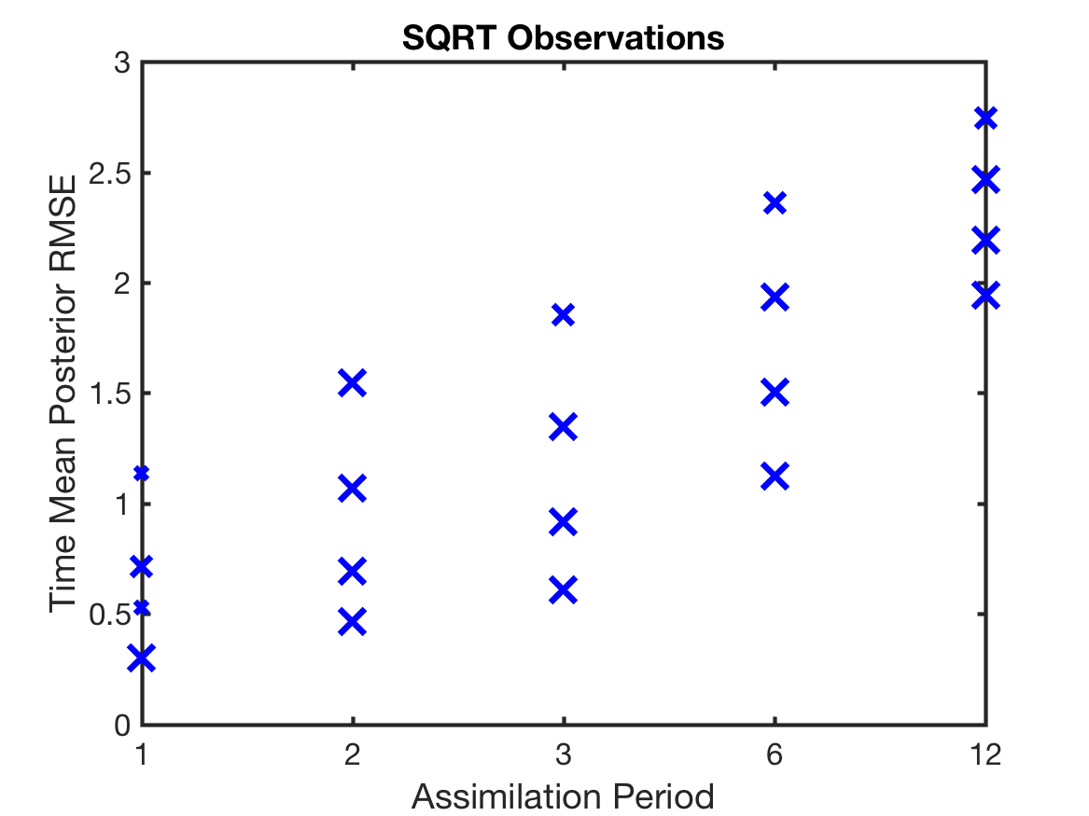
Square Root Forward Operator: Ensemble Size
20 Members: EAKF with linear regression always best.
Blue ‘x’:
EAKF with linear regression best

Slide 40
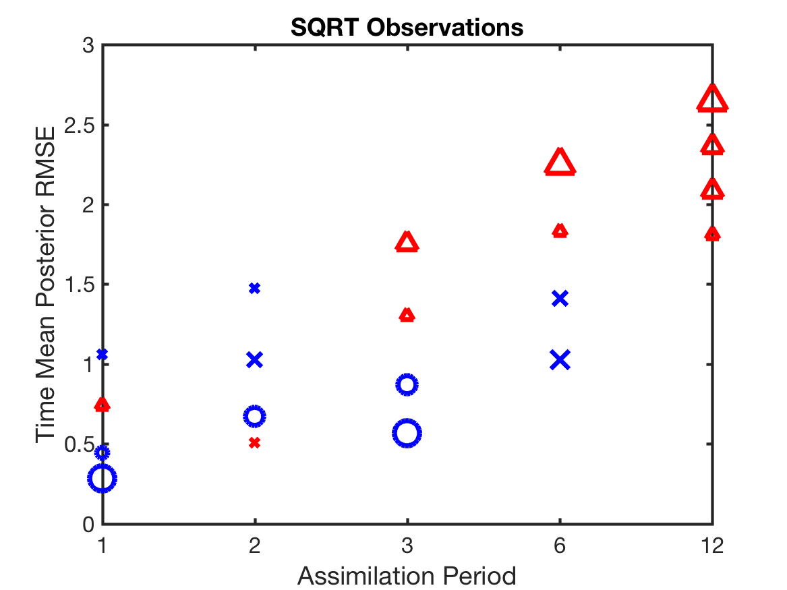
Square Root Forward Operator: Ensemble Size
40 Members: RHF with rank regression for large RMSE.
EAKF/linear regression for intermediate RMSE.
EnKF/linear for smaller RMSE.

Slide 41
Square Root Forward Operator: Ensemble Size
80 Members: RHF with rank regression for large RMSE.
EnKF/linear for smaller RMSE.

Slide 42
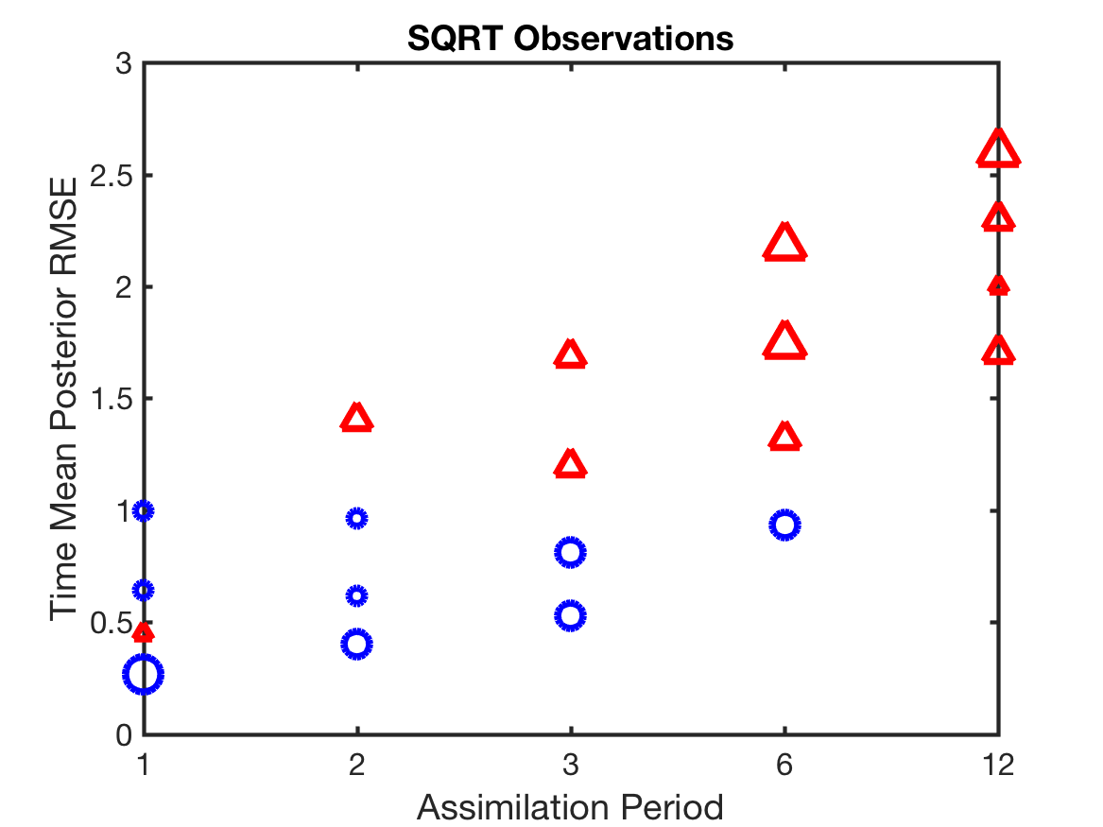
Square Root Forward Operator: Ensemble Size
160 Members: RHF with rank regression for large RMSE.
EnKF/linear for smaller RMSE.

Slide 43
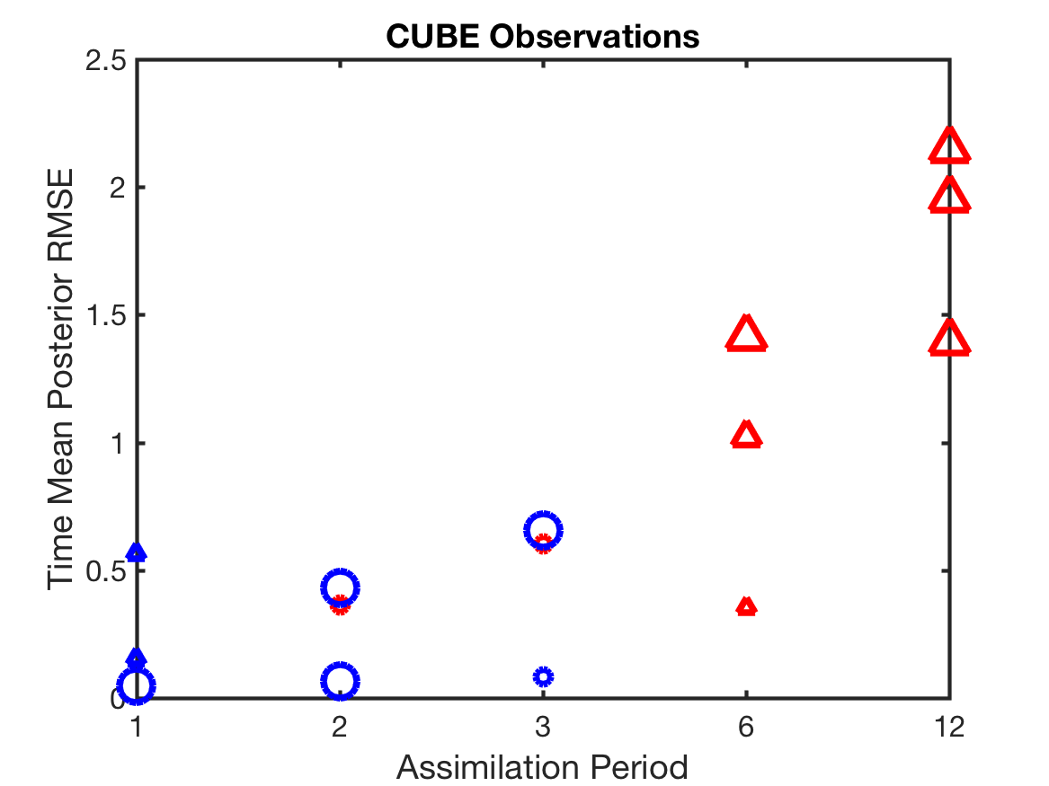
Summary: Cube Forward Operator Results
RHF with rank regression better for larger RMSE.
EnKF with linear regression better for smaller RMSE.
Red Triangle:
RHF with rank regression best
Blue Circle:
EnKF with linear regression best

Slide 44
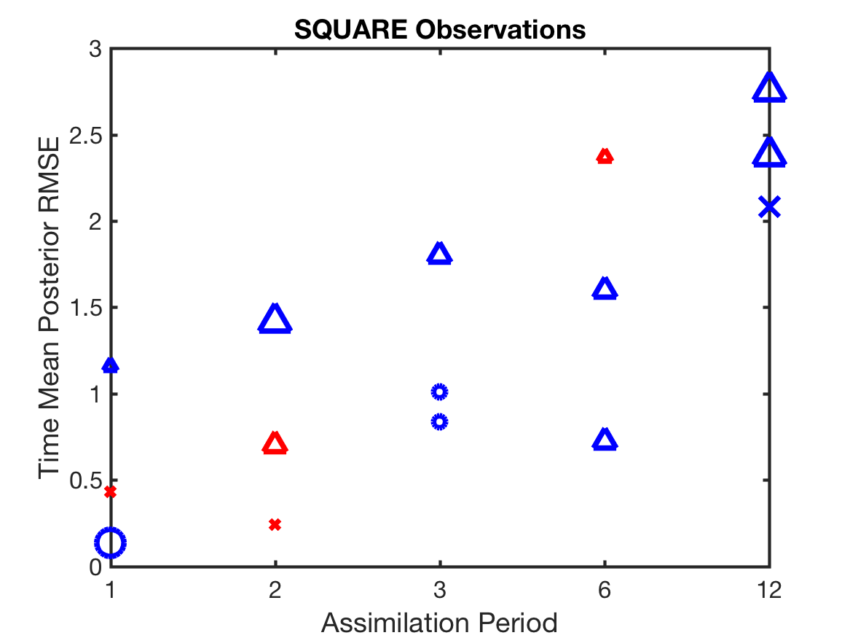
Summary: Square Forward Operator Results
RHF/linear better for larger RMSE.
Mixed for smaller RMSE.

Slide 45
Summary: Square Forward Operator Results
RHF/linear better for larger RMSE.
Mixed for smaller RMSE.
Observation operator is not invertible!

Slide 46
Computational Cost
Computational cost for the state variable update:
Base regression: O(m²n)
Rank regression: O(m²nlogn)
m: sum of state size plus number of observations,
n: ensemble size.
Average rank cost can be made O(m²n) with some work
(smart sorting and searching).
Good for GPUs (more computation per byte).

Slide 47
Conclusions
Non-Gaussian observation space methods can be superior to Gaussian.
Nonlinear regression can be superior in cases of strong nonlinearity.
Other nonlinear regressions (e.g. polynomial) can be effective.
Ensemble method details make significant differences in performance.
NWP applications should be carefully developed.
Notes:
Slide 7: GPS occultation forward operators
Non-local refractivity : (Sokolovskiy et al., MWR 133, 2200-2212)
NEED DETAILS OF ALGORITHM step size???
upper limits
grid pictures for different latitudes
Three pictures exist: ~jla/talks_and_meetings/2009/ams/cam_gps_talk/gps_lat*
Expect minor differences with coarse grid, larger near poles

Slide 48
All results with DART/DARTLAB tools freely available in DART.
www.image.ucar.edu/DAReS/DART
Anderson, J., Hoar, T., Raeder, K., Liu, H., Collins, N., Torn, R., Arellano, A., 2009: The Data Assimilation Research Testbed: A community facility.
BAMS, 90, 1283—1296, doi: 10.1175/2009BAMS2618.1

Slide 49
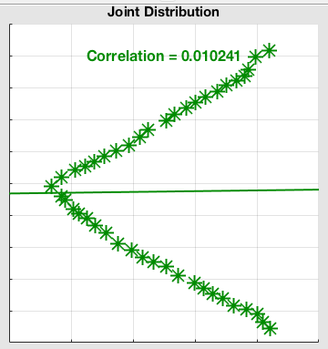
Multi-valued, not smooth example.
Similar in form to a wind speed observation with state velocity component.

Slide 50
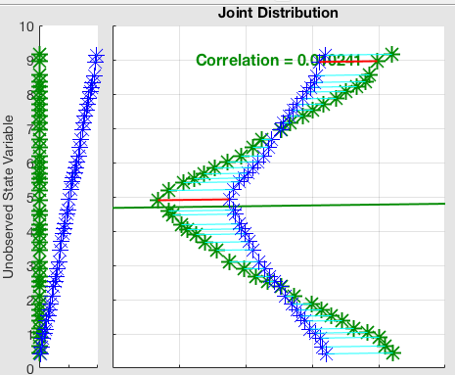
Multi-valued, not smooth example.
Standard regression does not capture bimodality of state posterior.

Slide 51

Multi-valued, not smooth example.
Rank regression nearly identical in this case.

