Slide 1
AI Agents from Scratch
Jonathan Crossett

Slide 2
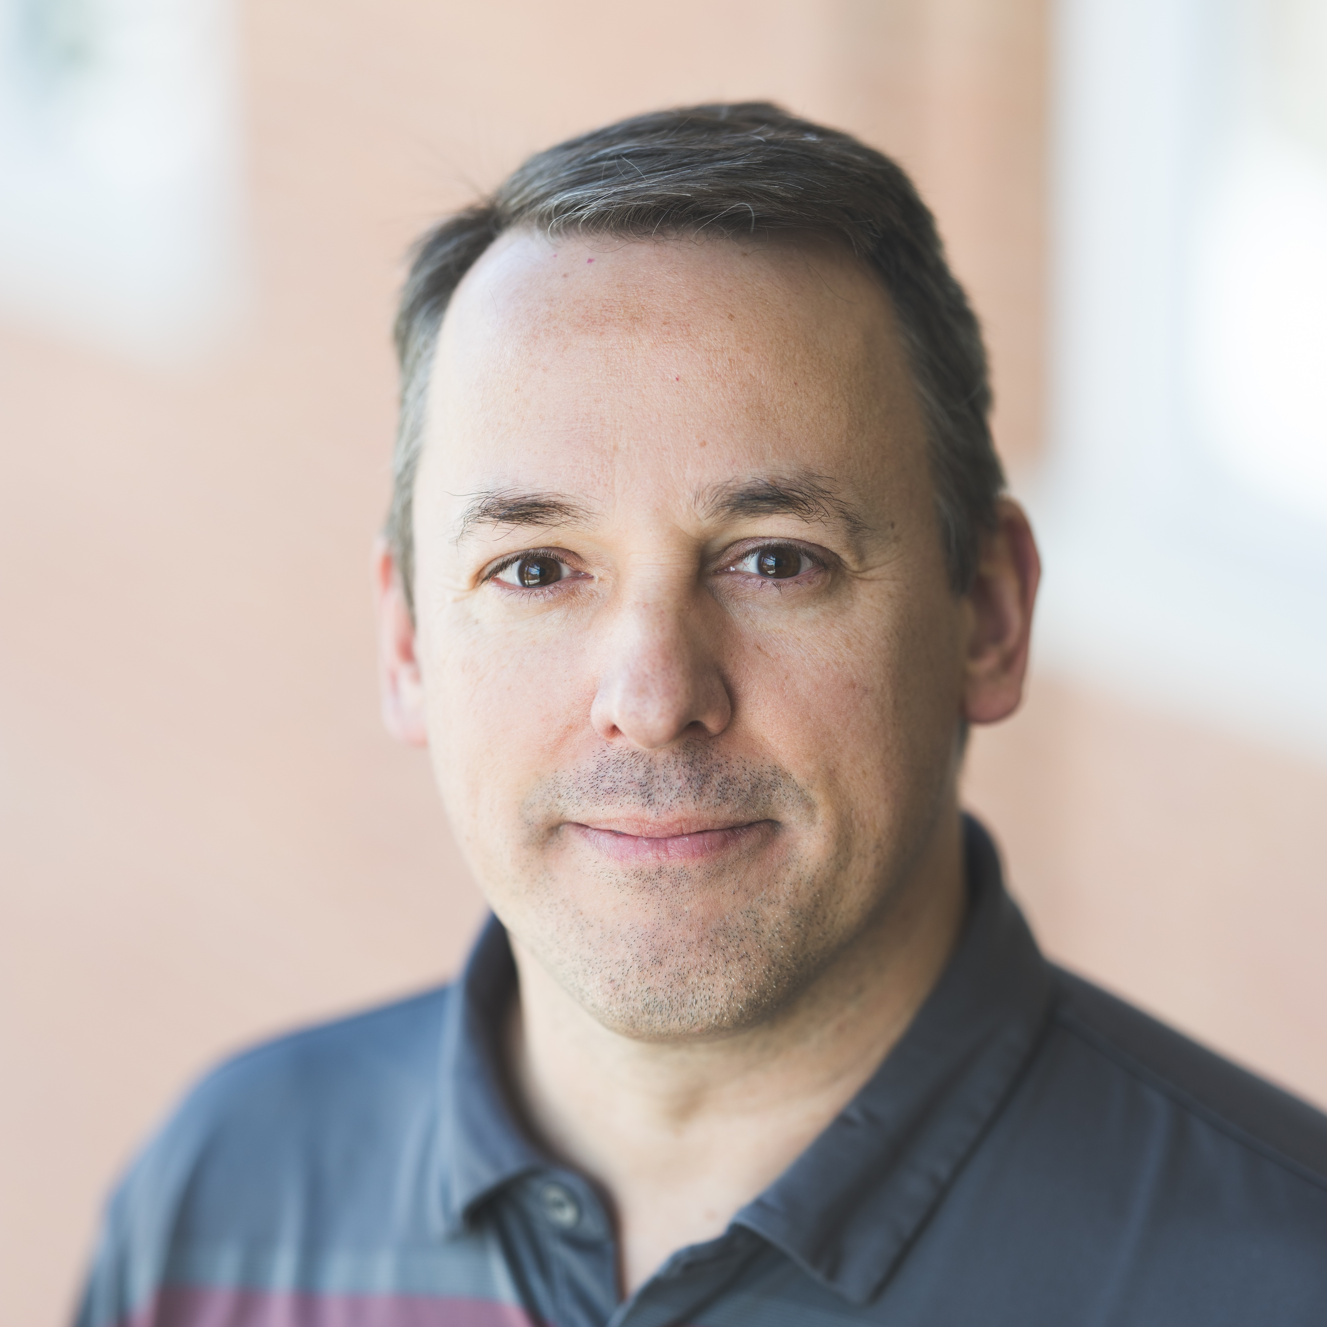
Who am I?
Started at Dartmouth in 2006
Work in Research Computing & Data in Research Cyberinfrastructure
Part of the team that setup and manages Dartmouth Chat

Slide 3
What to expect
LLM communication protocol overview
Define an agent
Build-up an agent from scratch
Get the agent running on your computer

Slide 4
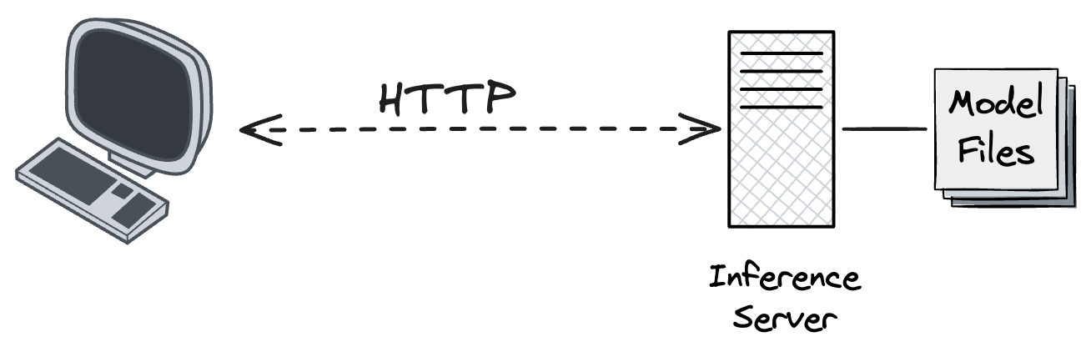
Architecture

Slide 5
HTTP Protocol
POST REQUEST:
POST /api/chat/completions HTTP/1.1
Host: chat.dartmouth.edu
Authorization: Bearer sk-API-KEY-HERE
Content-Type: application/json
Content-Length: 283
{"model":"llama3","messages":[{"role":"system","content":"You are a helpful assistant."},{"role":"user","content":"Hello!"}]}
HTTP Overview
GET REQUEST:
GET /api/v1/models HTTP/1.1
Host: chat.dartmouth.edu
GET RESPONSE:
HTTP/1.1 200 OK
Date: Tue, 02 Jun 2026 10:11:12 GMT
Server: nginx/1.31.1
Content-Length: 24194
Content-Encoding: zstd
Content-Type: application/json
{"data":[{"id”..
POST RESPONSE:
HTTP/1.1 200 OK
Content-Type: application/json
Date: Tue, 02 Jun 2026 10:39:41 GMT
Content-Length: 1276
{"id":"chatcmpl-379","object":"chat.completion",..

Slide 6
Inference server APIs
Chat Completions API
OpenAI Chat Completions
Responses API
OpenAI Responses
OpenResponses Reference
Message API
Claude Message API

Slide 7
Agent
System Prompt
User Prompt
Tools
The code that does the work
Definition of the tool (spec)
Agent loop

