Slide 1


(Soft)ware (Sol)utions
The idea was to develop an extension for the browser for providing smarter, better and more precise options to the user for downloading the software of his choice
Live Life the Easy Way .. Its a one stop app for all your software solutions

Slide 2
It will reach out to new and first time users. It will help them find the best software suited for their requirements.
We have hoped that the extension would help beginners get the optimum usage with their systems

Slide 3
The app will be free but the softwares it provides can be either freeware or paid. The user can download the extension and browse through the list of software solutions provided by our app.

Slide 4
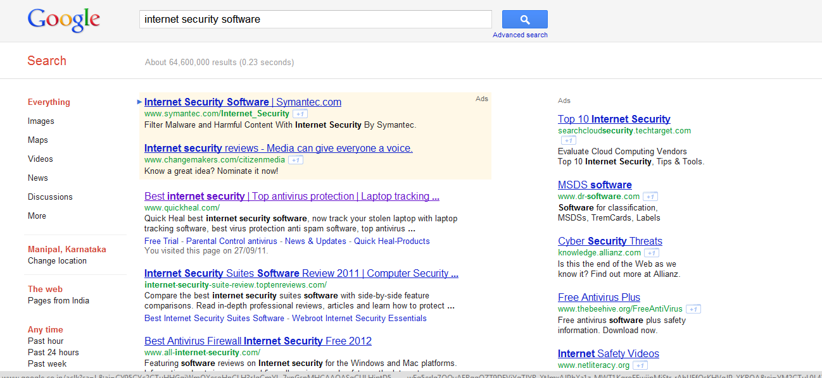

Slide 5
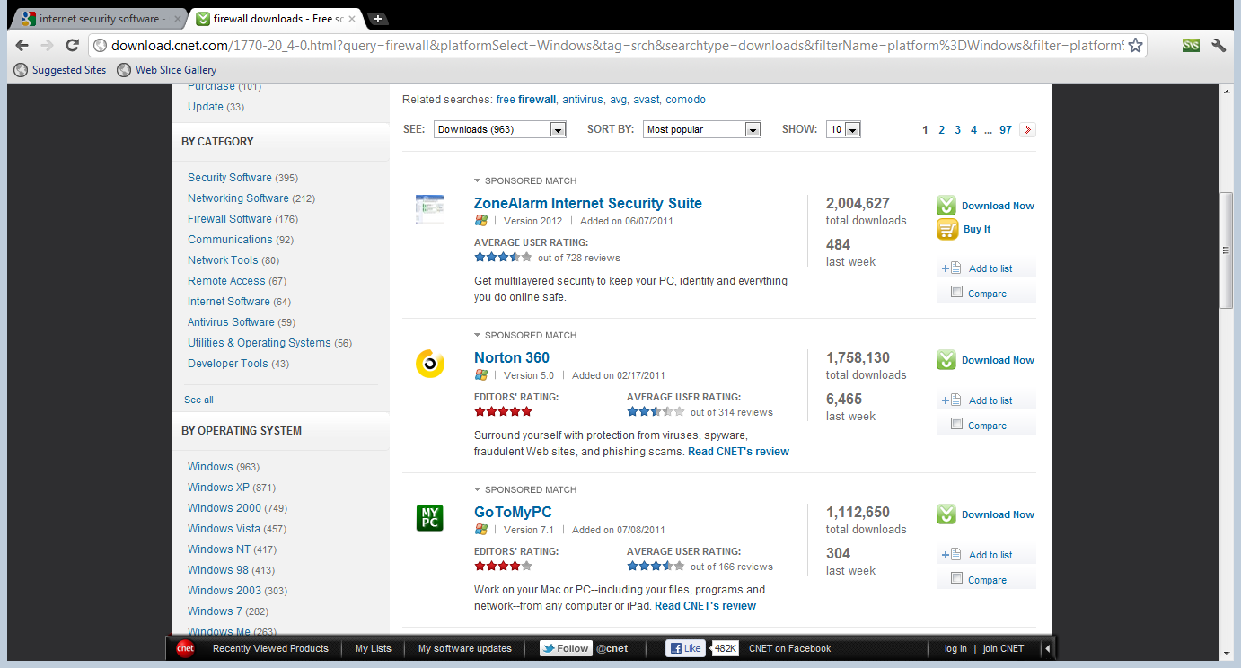

Slide 6
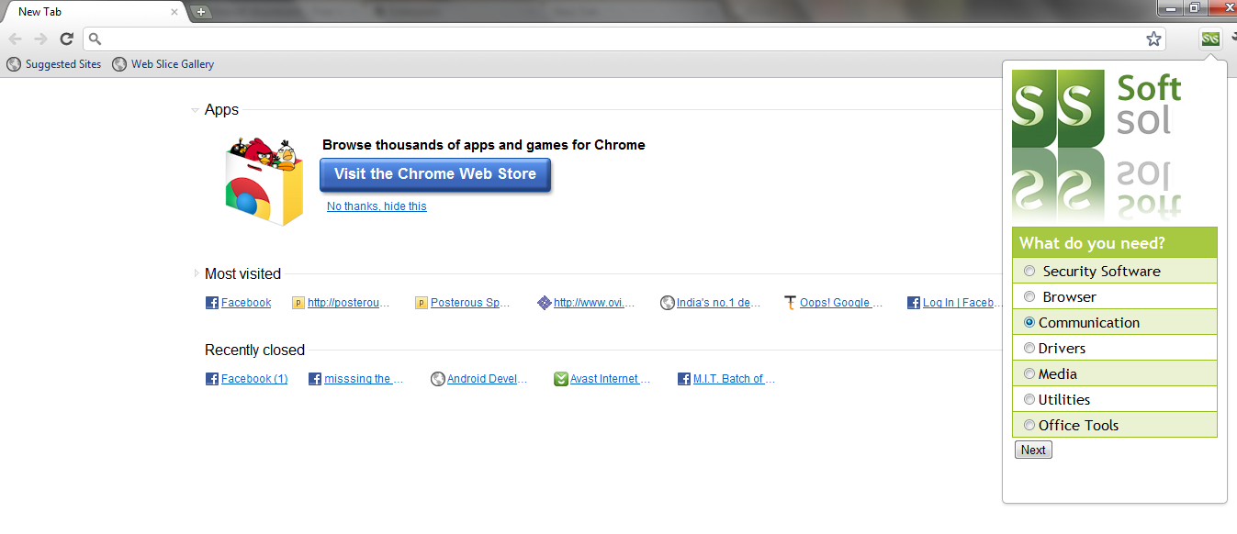
Soft Sol displays all the types of software the user would need. It would display each category , and inside each category are sub heads also.

Slide 7
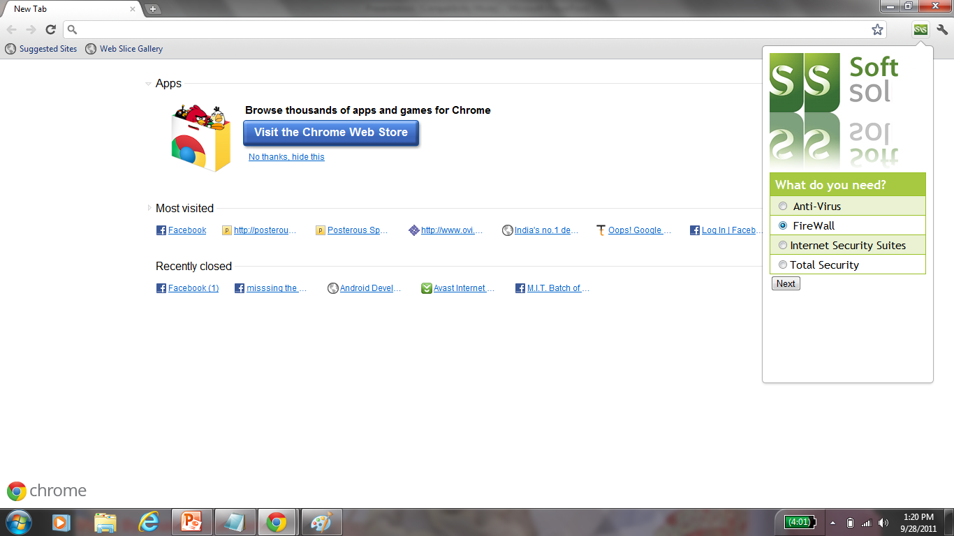

Slide 8
Finally SoftSol will display Top 5 softwares of the user’s desired category and he can choose the software he wants from the list. The list is a comprehensive compilation of all the best software arranged according to user ratings which the beginner can download.

Slide 9
We made the app in under 24 hrs, so we couldn’t put up our 100% best
We needed to add a back button also, which unfortunately could not be done due to lack of time

Slide 10


