Slide 1


Davide Molinelli
Emanuele Falzone

Slide 2




THE TEAM
Emanuele Falzone
Computer Engineering Student
Master in Computer Science
Politecnico di Milano
Davide Molinelli
Computer Engineering Student
Master in Computer Science
Politecnico di Milano

Slide 3
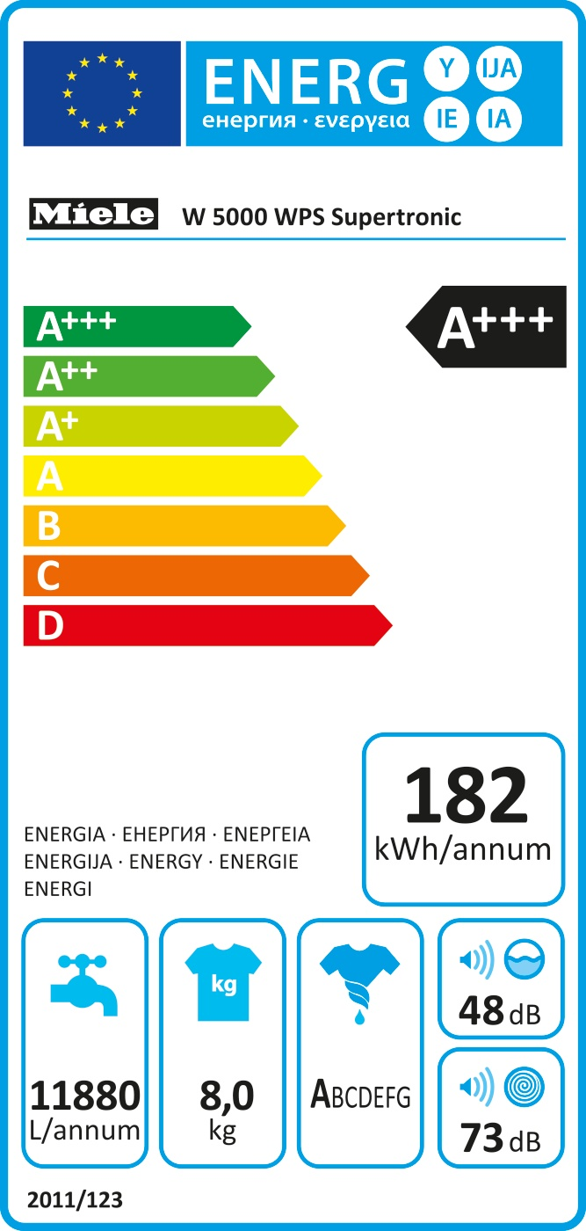
THE CHALLENGE - INTRODUCTION
Energy Label is a very useful indicator of the energetic performance of a new domestic appliance.
In particular, it reports:
The energy class of the appliance, indicating the energy efficiency of the device, among those on the market
The consumptions of the appliance, reported in kWh/annum
Everything nice! But in simple terms…
…How much it costs me to use that device every day, every year?

Slide 4
THE CHALLENGE - PROBLEM
When you go to a store with the intention of buying any device, your first intention is to buy the best appliance at the minimum price.
In the case of a domestic appliance we have to face with another non-negligible and additional cost: the energy consumptions.
Buy a domestic appliance which is cheaper it could turn out to be a bargain, yes…
... But for the electricity supplier!

Slide 5
THE CHALLENGE - GOAL
How to make the user aware of the real costs of an appliance?
Our goal is to create a system that would guarantee the ability to read the information on an energy label and calculate the cost per day and per year, based on the use reported by the user.
Moreover, the system have to be able to:
Register a user
Storage the information of the devices built
Estimate the cost of all the domestic appliance per day and year

Slide 6





HOW THE SYSTEM WORKS

Slide 7
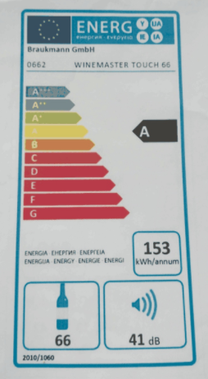
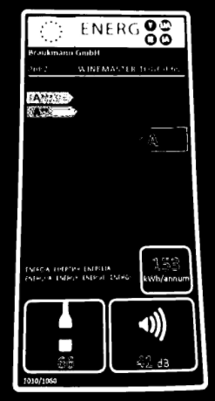
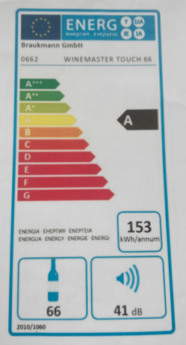
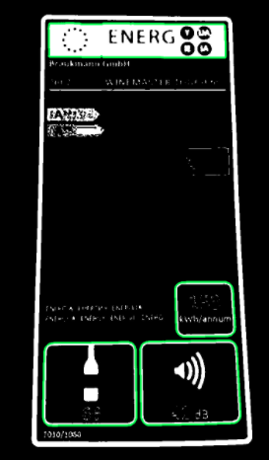
THE IMAGE PROCESSING
Phase 2: Image acquisition, X-Ray and Contours Extraction
The image is acquired and flattened to reduce the color noise.
Then, the system create of a black and white image that highlights the contours of the image and erosion of the resulting image in order to remove impurities

Slide 8
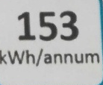

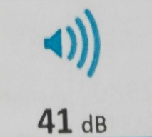

THE IMAGE PROCESSING
Phase 3: Cropping
The highlighted rectangles are cropped from the original image in order to be analyzed

Slide 9
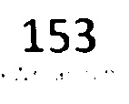



THE IMAGE PROCESSING
Phase 5: Binary Image and image to text transformation
A mask and a threshold are applied in order to eliminate all that does not correspond to the text of the rectangle
An image to text library is uses to recognize the the text present in the image.
A file with all the information is returned to the client application.

Slide 10
THE BUSINESS
The creation of the presented system cover the following problems:
Make users aware of how much it costs to consume energy and how it is important to evaluate the energy class and the energy consumptions and not only the cost of the product they want to buy
Collect information about the usage of the domestic appliances of the user
Possibility to create a community in which the information saved on the user profile are compared with the ecological behaviors of similar users in order to train the users and give advices to improve their habits and decrease the consumptions

