Slide 1

Davide Molinelli
Cognitive Robotics

Slide 2
WARNING: THIS IS A LIVE DEMO!
You can compare this presentation to the official presentation of a new Apple product…
… there is only a 50% chance that everything goes according to plan!
BUT DON’T PANIC
If something goes wrong, there should be fire doors somewhere in this room!

Slide 3
FIRST QUESTION : HAVE YOU DONE A SEMINAR OR A PROJECT?
This is a Pro-Seminar: it’s obvious!!!
The reasons of this choice are simple:
I absolutely need to present public works to overcome my shyness and learn to speak English
I want to share with you my project experience and the knowledge acquired in this months

Slide 4
THE IDEA
Wizard Chessboard stems from the desire to create intelligent objects capable of recognizing vocal commands and executing consequent actions.
Yes, but why a chessboard?
Why not a coffeepot to which you command to make a good cappuccino?
Simply because I love Harry Potter and the evening when the inspiration was born I was looking at the first chapter of the saga, not a documentary on how to make a good cappuccino.

Slide 5
THE PARADIGM
Plan
Env
Sense
Act
The project is implemented through a deliberative approach, according to the sense-plan-act scheme:
Sense - The system acquires a signal from the environment, through a wireless communication
Perception - The signal is processed in order to extract information, i.e. a voice command
Model – A representation of the chessboard is realized to have an internal model of the world
Plan – Compute the sequence of actions to be performed
Act – Execute the actions and update the model

Slide 6
HARDWARE COMPONENTS
A homemade wooden chessboard
Magnetized pieces
Two stepper motors Nema 17
An electromagnet controlled in voltage
An Arduino Mega 2560 Rev3 microcontroller
A CNC Shield V3
An HC-05 Bluetooth module
An Android smartphone
Notes:
A homemade wooden chessboard made of plywood and waste materials, as well as a plexiglass table
Magnetized pieces taken from an old travel chessboard
The stepper motors Nema 17 are mostly used in the 3D printer
The electromagnet is controlled in voltage: when a voltage is applied the current circulates inside a coil, generating a magnetic field.
Initially I try to use a solenoid plus a magnet. The principle was: when you want to take a pawn extend the solenoid and when you arrive at the destination, retract the solenoid. Unfortunately this simple procedure does not work because the magnetic field generated by the magnet interferes with the magnetic field generated by the solenoid.
Initially I decide to use an Arduino Uno microcontroller to control the logic of the game, the most simple microcontroller to program and manage the motors and the modules. But soon I discover it was affected by instability because of lack of volatile memory for dynamic variable. So I try to place it with the more powerful Nucleo STM32 L476RG (the portability is relatively simple because both the microcontrollers adopt the c++ programming language). But unlike the Arduino community, very active and great in its global dimension, the Nucleo community is very restricted. So, I did not found any help about how to control the Bluetooth communication. Fortunately I found in my garage an Arduino Mega 2560 V3 so that I could have the facilities of the Arduino microcontroller and the sufficient memory space at the same time. If you pay you can have everything!
CNC is the acronym of Computer Numerical Control and refers to the electronic device present inside the cutting machine to control the movements and the degrees of freedom of itself. I use this shield, perfectly compatible with Arduino, in order to manage the movements of the stepper motors.
Bluetooth HC-05 is a common module to establish a Bluetooth communication among Arduino and another device (in my case an android smartphone).

Slide 7


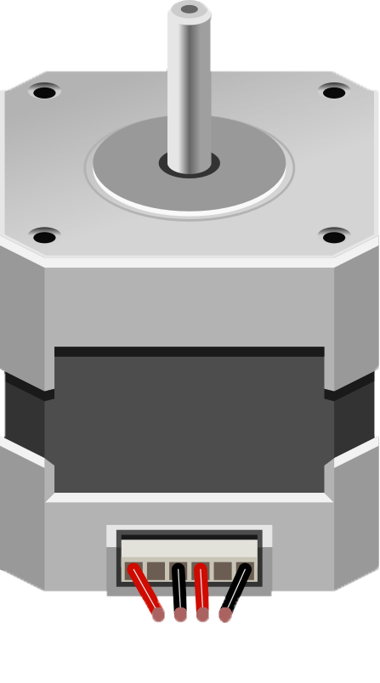
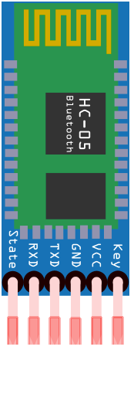
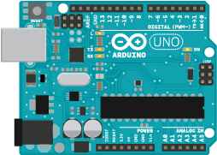
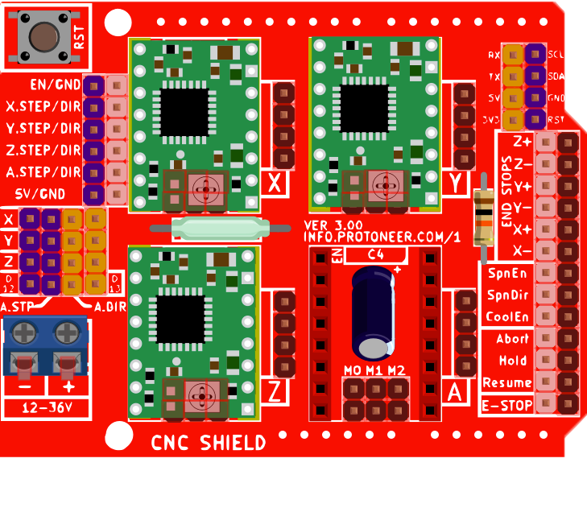
THE SYSTEM
Notes:
A smartphone use the Google speech-to-text API in order to create a string representing the command and to send it to the Arduino microcontroller. This is performed through the HC-05 Bluetooth module that establish a communication with the smartphone and receive the string command.
The string is parsed by the microcontroller and key words are extracted.
The key words are used to plan the move and if it is licit the CNC is activated through a relay, in order to act on the stepper motors.
When the position of the piece that has to be moved is reached the electromagnet is activate and the attracted piece is moved from the destination cell.
Finally, the electromagnet is returned to the default position (A1) and the state of the model is updated.

Slide 8
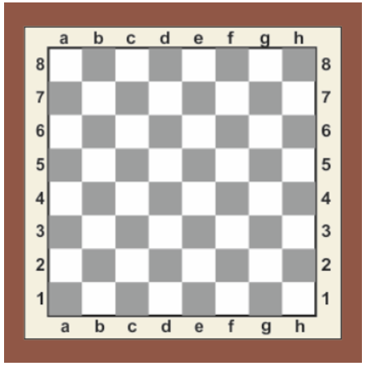
THE VOICE COMMAND
The system is able to recognize two type of command:
If there is no ambiguity and only a single piece can reach the destination cell you can simply express a generic command like the following:
PEDINA IN A3
The system recognize which of the pawns is the only
candidate and perform the move on it.
If there are more than one piece that can reach the destination cell it is necessary to express also the coordinates of the source cell to be moved. An example of this type of command is the follow:
ALFIERE DA B3 A D5
Notes:
Make a joke example like the command works also for the presentation.
Say: “PEDINA da C7 a C5”, activate the animation and say in a surprised way “oh, it works! Fine!”

Slide 9
THE KNIGHT PARADOX
A not negligible problem is represented by the Knight piece:
IT CAN JUMP… BUT IT CAN’T JUMP!
When a Knight has to be moved but there are other pieces in front of it could be impossible to move it. So, move the Knight is a nightmare!
The functionality has not been implemented yet, but considering that a Knight moves two positions relative to an axis and one position relative to the other axis, there are different possibility to perform the move. The following is an example.
CAVALLO IN E6
Notes:
There are many cases to manage. It is not simple!

Slide 10
Are not you hungry?
The same goes for the eaten pawns: we need to build an algorithm that can handle the movements of the pawns eaten towards the exit of the chess board.
Manage all the cases is a difficult task…
PEDINA IN E3
Manage a single case could be easy, but manage all the case with a general algorithm requires a lot more effort

Slide 11
I DON’T REMEMBER
Microcontrollers are very interesting devices: they opened the doors of the imagination to all the makers of the world.
But there are terrible problems to keep in mind for a programmer used to working on machines with great computing capacity: microcontrollers are exactly the opposite.
One of these is the limited dynamic memory that can make the program instable.
Program with 4GB of RAM is one thing, program with 32KB of RAM available is another thing.
YOU HAVE TO TRY!... AND CRY!

Slide 12


ARE YOU READY FOR A LIVE DEMO?

Slide 13
CONCLUSION
This project opened my eyes to the following, no longer negligible aspects:
Made a project alone is nice, but doing it together is much better. If you make a project alone you can manage your time, you can code with your style. But when there is a problem you can only count on your brain, i.e. one calculator, not two, not three. When you work in a team, instead, you can rely on more brain, i.e. more than one calculator!
Writing code does not mean being a programmer: writing good code means becoming one.
Notes:
If you make a project alone you can manage your time, you can code with your style. But when

Slide 14
THANKS
A special thanks to:
Luca Vecchi, master degree student in Data Science at Statale di Milano
Alessandro Castiglioni, master degree student at Politecnico di Milano
Emanuele Falzone, master degree student at Politecnico di Milano
For the thousand tips and the concrete support

