Slide 1








µKino
Christian Harders Danny Steinbrecher
Notes:
-1min

Slide 2




µKino
Film
Service
Vorführung
Service
Kinosaal
Service
Standort Service
Notes:
https://www.youtube.com/playlist?list=PLNmsVeXQZj7oea6IDCLzpKe5XfLmWCwgr

Slide 3
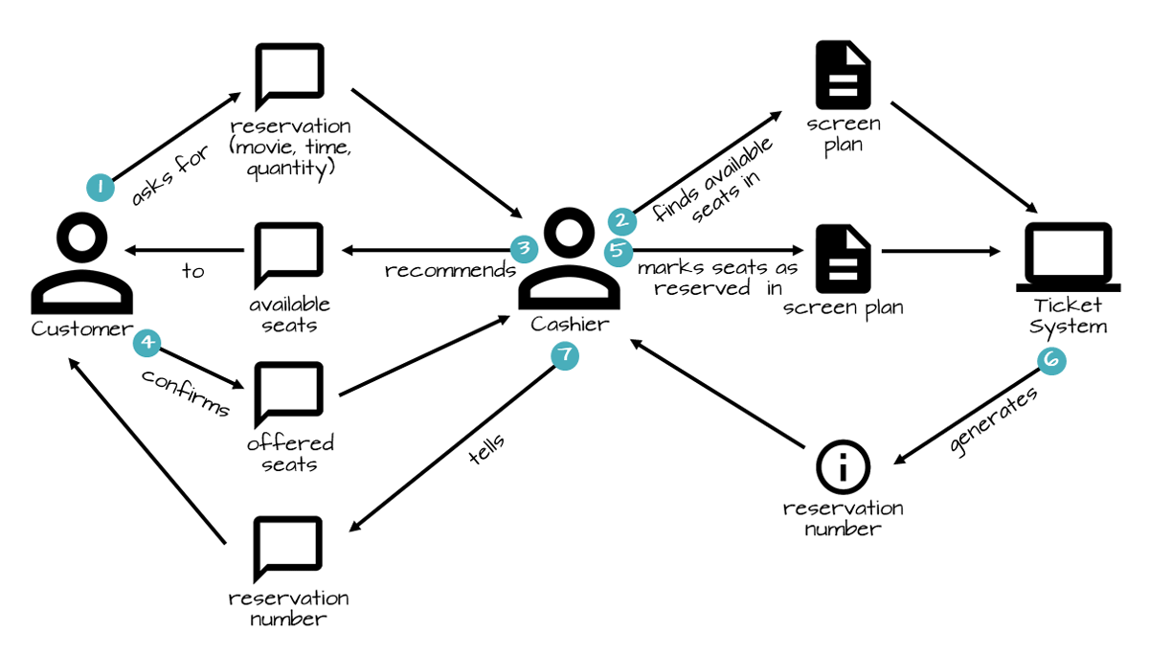
Domain Story
https://domainstorytelling.org/quick-start-guide

Slide 4






Frameworks

Slide 5
Bildnachweise
https://www.docker.com/wp-content/uploads/2022/03/vertical-logo-monochromatic.png
https://spring.io/trademarks
https://commons.wikimedia.org/wiki/File:Traefik.logo.png
https://docs.vmware.com/en/VMware-Tanzu-Toolkit-for-Kubernetes/images/GUID-A3897B1B-822E-410C-96C7-93FBD7AF61A5-low.png
https://www.jaegertracing.io/img/jaeger-logo.png
https://en.wikipedia.org/wiki/Grafana#/media/File:Grafana_logo.svg

