Slide 2
The chapter discusses the mechanisms, morphologic patterns, and outcomes of inflammation, focusing on acute and chronic inflammation and their mediators.

Slide 3
The chapter provides an overview of the inflammatory process, detailing the roles of various mediators and the morphologic patterns observed in different types of inflammation. It emphasizes the importance of understanding these processes for clinical practice.

Slide 4
Vasoactive amines cause vasodilation and increased vascular permeability. Arachidonic acid metabolites are involved in vascular reactions and leukocyte chemotaxis. Cytokines mediate effects mainly in leukocyte recruitment and migration. Complement proteins activation leads to leukocyte chemotaxis and opsonization. Kinins mediate vascular reaction and pain. Redundancy of mediators ensures robust protective response. Antagonists to these molecules highlight importance to medical practice.

Slide 5
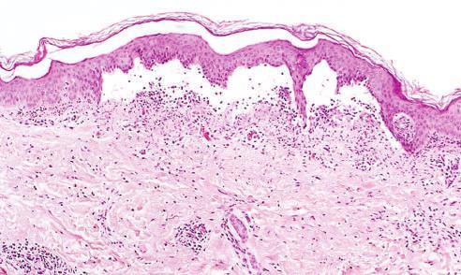
Image 1 from page 1

Slide 6
Serous inflammation is marked by cell-poor fluid exudation. Fibrinous inflammation is characterized by fibrin deposition. Purulent inflammation involves the production of pus consisting of neutrophils and necrotic debris. These patterns are critical for diagnosing and understanding the underlying processes of inflammation.

Slide 7
The outcomes of acute inflammation can vary, ranging from complete resolution to progression to chronic inflammation. Understanding these outcomes is essential for predicting the clinical course and potential complications of inflammatory diseases.

Slide 8
Vasoactive amines are responsible for vasodilation and increased vascular permeability. Arachidonic acid metabolites play a role in vascular reactions and leukocyte chemotaxis. Cytokines are crucial in mediating effects in leukocyte recruitment and migration. These concepts are fundamental to understanding the inflammatory response.

Slide 9

Image 2 from page 1

Slide 10
Understand the actions of principal mediators of inflammation. Identify morphologic patterns of acute inflammation. Recognize outcomes of acute inflammation. These objectives guide the learning process and ensure a comprehensive understanding of the topic.

Slide 11
The content is based on the chapter 'Inflammation and Repair' from the specified PDF document. Figures referenced include Fig. 3.12 showing serous inflammation and Fig. 3.13 depicting fibrinous pericarditis.

Slide 12
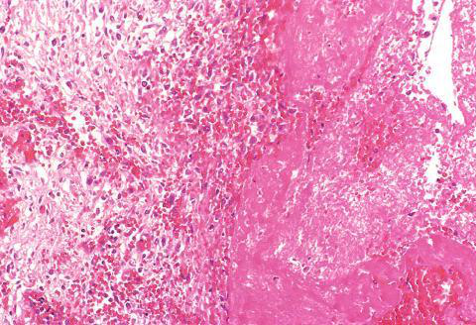
Image 1 from page 2

Slide 13
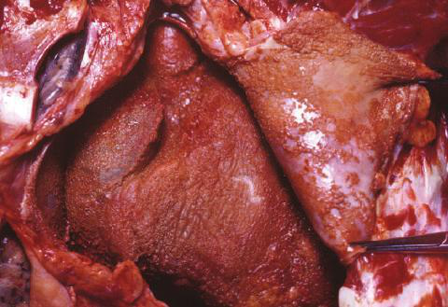
Image 2 from page 2

Slide 14
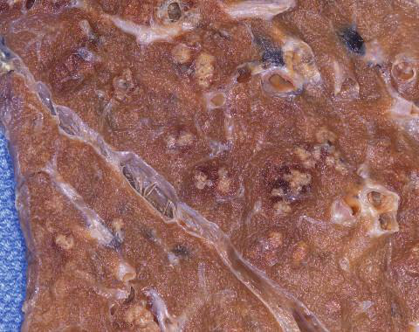
Image 3 from page 2

Slide 15
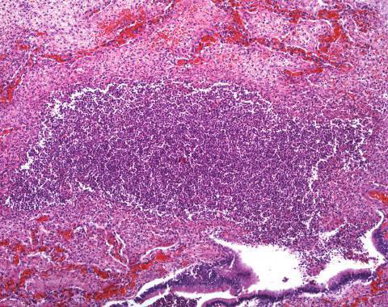
Image 4 from page 2

Slide 16
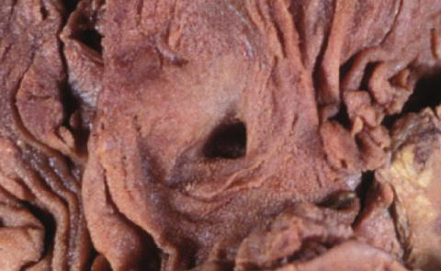
Image 1 from page 3

Slide 17
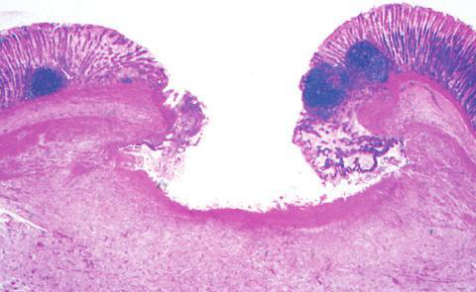
Image 2 from page 3

Slide 18
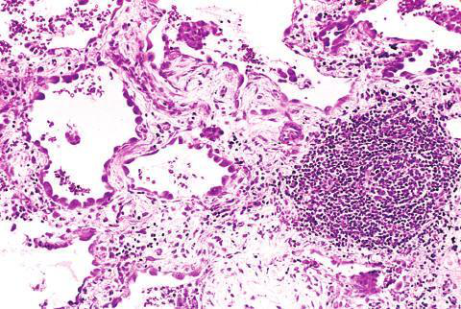
Image 1 from page 4

Slide 19
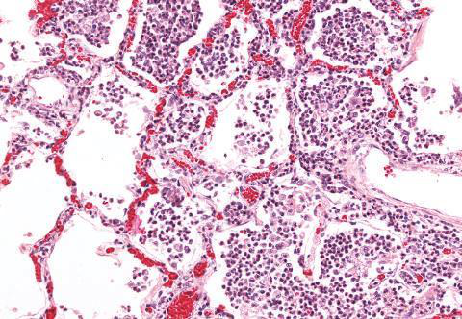
Image 2 from page 4

