Slide 2
No content available

Slide 3
The chapter discusses the mechanisms and outcomes of inflammation, focusing on the actions of principal mediators, morphologic patterns of acute inflammation, and the transition to chronic inflammation. It covers serous, fibrinous, and purulent inflammation, as well as the outcomes of acute inflammation and the characteristics of chronic inflammation.

Slide 4
Vasoactive amines, mainly histamine: vasodilation and increased vascular permeability. Arachidonic acid metabolites (prostaglandins and leukotrienes): several forms exist and are involved in vascular reactions, leukocyte chemotaxis, and other reactions of inflammation; antagonized by lipoxins. Cytokines: proteins produced by many cell types; usually act at short range; mediate multiple effects, mainly in leukocyte recruitment and migration; principal ones in acute inflammation are TNF, IL-1, and chemokines.
Complement proteins: Activation of the complement system by microbes or antibodies leads to the generation of multiple breakdown products, which are responsible for leukocyte chemotaxis, opsonization and phagocytosis of microbes and other particles, and cell killing. Kinins: produced by proteolytic cleavage of precursors; mediate vascular reaction, pain.

Slide 5
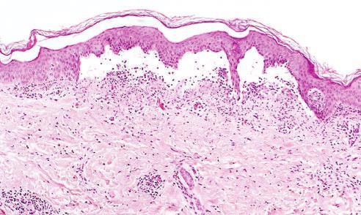

Low-power view of a cross section of a skin blister showing the epidermis separated from the dermis by a focal collection of serous effusion
Fibrinous Inﬂammation A �brinous e�udate develops �hen the vascular lea�s are large or there is a local procoagulant sti�ulus

Slide 6
The morphologic hallmarks of acute inflammatory reactions are dilation of small blood vessels and accumulation of leukocytes and fluid in the extravascular tissue. The vascular and cellular reactions account for the signs and symptoms of the inflammatory response. Increased blood flow to the injured area and increased vascular permeability lead to the accumulation of extravascular fluid rich in plasma proteins (edema) and account for the redness (rubor), warmth (calor), and swelling (tumor) that accompany acute inflammation. Leukocytes that are recruited and activated by the offending agent and by endogenous mediators may release toxic metabolites and proteases extracellularly, causing tissue damage and loss of function (functio laesa). During the damage, and in part as a result of the liberation of prostaglandins, neuropeptides, and cytokines, one of the local symptoms is pain (dolor).

Slide 7
Serous inflammation is marked by the exudation of cell-poor fluid into spaces created by injury to surface epithelia or into body cavities lined by the peritoneum, pleura, or pericardium. Typically, the fluid in serous inflammation is not infected by destructive organisms and does not contain large numbers of leukocytes (which tend to produce purulent inflammation, described later). In body cavities the fluid may be derived from the plasma (as a result of increased vascular permeability) or from the secretions of mesothelial cells (as a result of local irritation); accumulation of fluid in these cavities is called an effusion. (Effusions consisting of transudates also occur in noninflammatory conditions, such as reduced blood outflow in heart failure, or reduced plasma protein levels in some kidney and liver diseases.) The skin blister resulting from a burn or viral infection represents accumulation of serous fluid within or immediately beneath the damaged epidermis of the skin.

Slide 8
The outcomes of acute inflammation can vary depending on the nature of the injury, the tissue involved, and the response of the host. The possible outcomes include complete resolution with restoration of normal tissue architecture, healing by connective tissue replacement (fibrosis or scarring), and progression to chronic inflammation. Complete resolution is the usual outcome when the injury is limited or short-lived, or when there has been little tissue destruction and the damaged parenchymal cells can regenerate. Healing by fibrosis occurs after substantial tissue destruction or when inflammation occurs in tissues that do not regenerate. In these cases, connective tissue grows into the area of damage or exudate, converting it into a mass of fibrous tissue, a process also called organization. Progression to chronic inflammation may follow acute inflammation if the acute response cannot be resolved, owing either to the persistence of the injurious agent or to some interference with the normal process of healing.

Slide 9
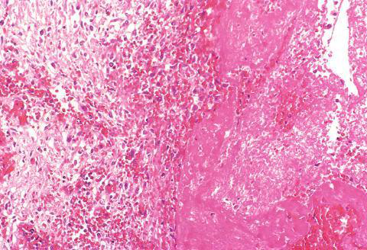
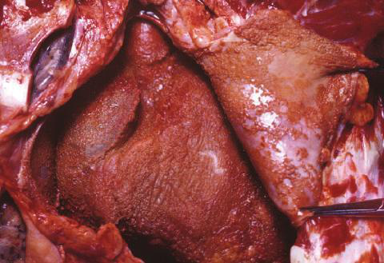
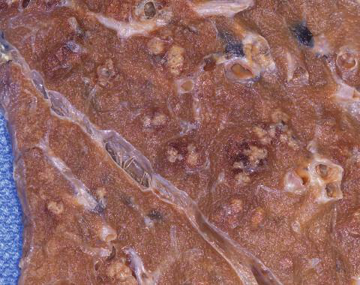
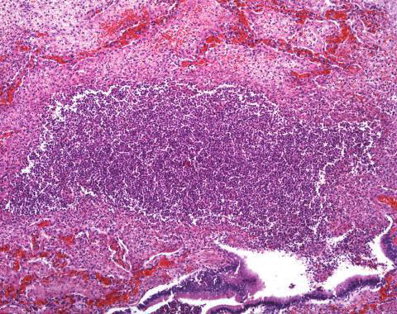
�lcer- ation can occur only when tissue necrosis and resultant in�ammation exist on or near a surface
Abscesses have a central region that appears as a mass of necrotic leukocytes and tissue cells
(A) Deposits of ﬁbrin on the pericardium
(A) Multiple bacterial abscesses (arrows) in the lung in a case of bronchopneumonia

Slide 10
Understanding the actions of the principal mediators of inflammation, including vasoactive amines, arachidonic acid metabolites, cytokines, complement proteins, and kinins, is crucial for comprehending the inflammatory response. Recognizing the morphologic patterns of acute inflammation and the associated clinical signs and symptoms helps in diagnosing and managing inflammatory conditions. Differentiating between types of inflammation, such as serous, fibrinous, and purulent, is essential for predicting tissue damage and healing outcomes. The redundancy of the mediators and their actions ensures that this protective response remains robust and is not readily subverted, highlighting the importance of basic biology to the practice of medicine.

Slide 11
The content for this presentation was extracted from the chapter on Inflammation and Repair, which discusses the mechanisms and outcomes of inflammation, focusing on the actions of principal mediators, morphologic patterns of acute inflammation, and the transition to chronic inflammation. It covers serous, fibrinous, and purulent inflammation, as well as the outcomes of acute inflammation and the characteristics of chronic inflammation.

Slide 12
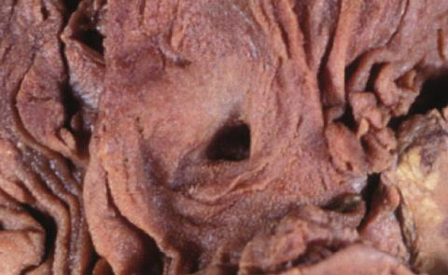
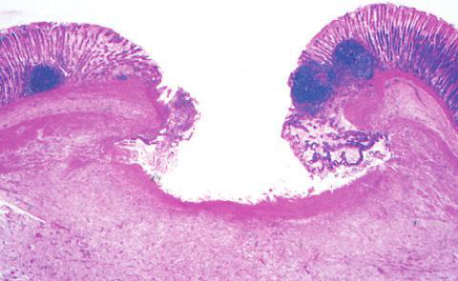
In a perfect world, all in�amma- tory reactions, after they have succeeded in eliminating the offending agent, should end with restoration of the site of acute in�ammation to normal
(A) A chronic duodenal ulcer

Slide 13
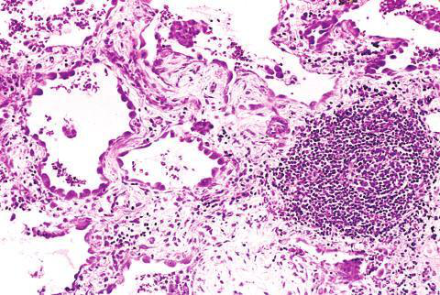
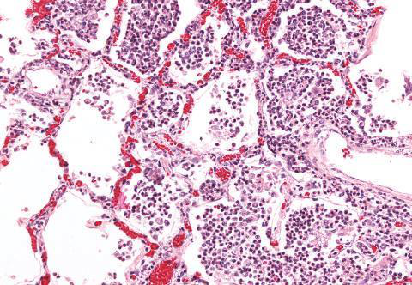
Acute to chronic transition occurs when the acute in�ammatory response cannot be resolved, as a result of either the persistence of the injurious agent or some interference with the normal process of healing
(B) In contrast, in acute inﬂammation of the lung (acute bronchopneumonia), neutrophils ﬁll the alveolar spaces and blood vessels are congested

