Slide 2
The chapter discusses the mechanisms, mediators, and morphological patterns of acute inflammation, as well as the outcomes and progression to chronic inflammation. It covers the actions of principal mediators, morphologic patterns of acute inflammation, and specific types of inflammation such as serous, fibrinous, and purulent inflammation. The chapter also details the outcomes of acute inflammation, including resolution, healing by fibrosis, and progression to chronic inflammation, and describes the characteristics and causes of chronic inflammation.

Slide 3
Vasoactive amines, mainly histamine: vasodilation and increased vascular permeability. Arachidonic acid metabolites (prostaglandins and leukotrienes): several forms exist and are involved in vascular reactions, leukocyte chemotaxis, and other reactions of inflammation; antagonized by lipoxins. Cytokines: proteins produced by many cell types; usually act at short range; mediate multiple effects, mainly in leukocyte recruitment and migration; principal ones in acute inflammation are TNF, IL-1, and chemokines. Complement proteins: Activation of the complement system by microbes or antibodies leads to the generation of multiple breakdown products, which are responsible for leukocyte chemotaxis, opsonization and phagocytosis of microbes and other particles, and cell killing. Kinins: produced by proteolytic cleavage of precursors; mediate vascular reaction, pain.
The redundancy of the mediators and their actions ensures that this protective response remains robust and is not readily subverted.
The observed anti-inflammatory effects of antagonists to these molecules highlight the importance of basic biology to the practice of medicine.

Slide 4
The morphologic hallmarks of acute inflammatory reactions are dilation of small blood vessels and accumulation of leukocytes and fluid in the extravascular tissue. The vascular and cellular reactions account for the signs and symptoms of the inflammatory response. Increased blood flow to the injured area and increased vascular permeability lead to the accumulation of extravascular fluid rich in plasma proteins (edema) and account for the redness (rubor), warmth (calor), and swelling (tumor) that accompany acute inflammation. Leukocytes that are recruited and activated by the offending agent and by endogenous mediators may release toxic metabolites and proteases extracellularly, causing tissue damage and loss of function (functio laesa). During the damage, and in part as a result of the liberation of prostaglandins, neuropeptides, and cytokines, one of the local symptoms is pain (dolor).

Slide 5
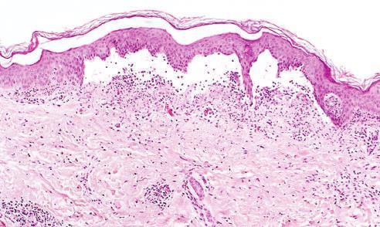

Low-power view of a cross section of a skin blister showing the epidermis separated from the dermis by a focal collection of serous effusion
Fibrinous Inﬂammation A �brinous e�udate develops �hen the vascular lea�s are large or there is a local procoagulant sti�ulus

Slide 6
Serous inflammation is marked by the exudation of cell-poor fluid into spaces created by injury to surface epithelia or into body cavities lined by the peritoneum, pleura, or pericardium. Typically, the fluid in serous inflammation is not infected by destructive organisms and does not contain large numbers of leukocytes (which tend to produce purulent inflammation, described later). In body cavities the fluid may be derived from the plasma (as a result of increased vascular permeability) or from the secretions of mesothelial cells (as a result of local irritation); accumulation of fluid in these cavities is called an effusion.

Slide 7
A fibrinous exudate develops when the vascular leaks are large or there is a local procoagulant stimulus. With a large increase in vascular permeability, higher-molecular-weight proteins such as fibrinogen pass out of the blood, and fibrin is formed and deposited in the extracellular space. A fibrinous exudate is characteristic of inflammation in the lining of body cavities, such as the meninges, pericardium, and pleura.

Slide 8
Purulent inflammation is characterized by the production of pus, an exudate consisting of neutrophils, the liquefied debris of necrotic cells, and edema fluid. The most frequent cause of purulent (also called suppurative) inflammation is infection with bacteria that cause liquefactive tissue necrosis, such as staphylococci; these pathogens are referred to as pyogenic (pus-producing) bacteria. A common example of an acute suppurative inflammation is acute appendicitis.

Slide 9
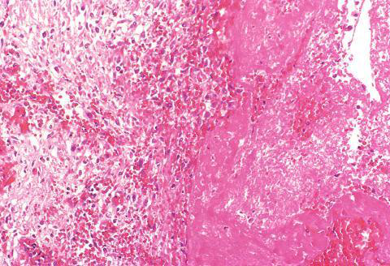
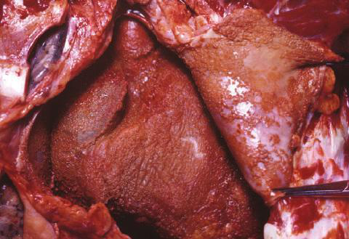
�lcer- ation can occur only when tissue necrosis and resultant in�ammation exist on or near a surface
Abscesses have a central region that appears as a mass of necrotic leukocytes and tissue cells

Slide 10
The outcomes of acute inflammation include resolution, healing by fibrosis, and progression to chronic inflammation. Resolution occurs when the offending agent is eliminated and the inflammatory response has subsided, allowing the tissue to return to its normal state. Healing by fibrosis involves the replacement of damaged tissue with fibrous scar tissue, which can lead to a loss of function. Progression to chronic inflammation occurs when the acute response fails to eliminate the offending agent, leading to ongoing inflammation and tissue damage.

Slide 11
Chronic inflammation is characterized by prolonged inflammation, tissue destruction, and attempts at repair. It can result from persistent infections, prolonged exposure to toxic agents, or autoimmune reactions. The morphologic features of chronic inflammation include infiltration with mononuclear cells, tissue destruction, and attempts at healing through fibrosis and angiogenesis.

Slide 12
The causes of chronic inflammation include persistent infections, prolonged exposure to potentially toxic agents, and autoimmune diseases. Persistent infections can lead to a chronic inflammatory response due to the inability of the immune system to clear the pathogen. Prolonged exposure to toxic agents, such as silica or asbestos, can also lead to chronic inflammation. Autoimmune diseases occur when the immune system mistakenly attacks the body's own tissues, leading to chronic inflammation.

Slide 13
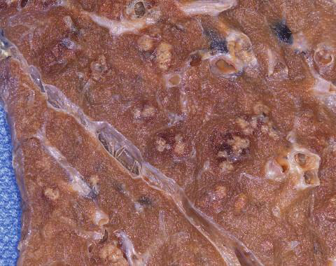
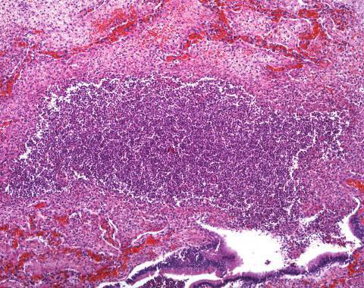
(A) Deposits of ﬁbrin on the pericardium
(A) Multiple bacterial abscesses (arrows) in the lung in a case of bronchopneumonia

Slide 14
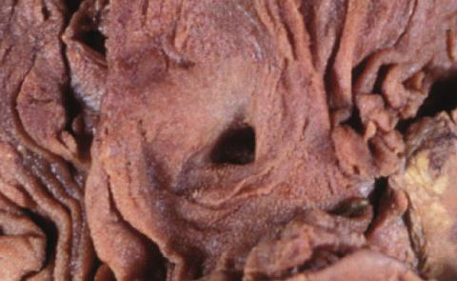
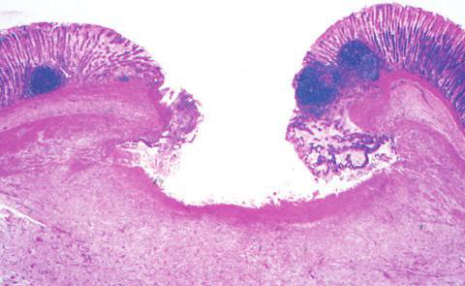
In a perfect world, all in�amma- tory reactions, after they have succeeded in eliminating the offending agent, should end with restoration of the site of acute in�ammation to normal
(A) A chronic duodenal ulcer

Slide 15
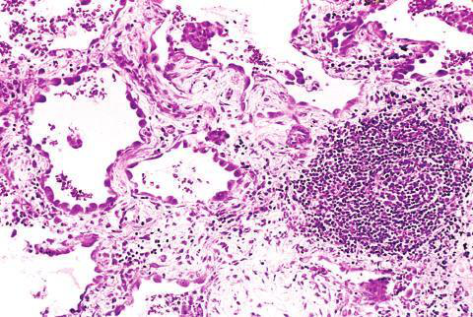
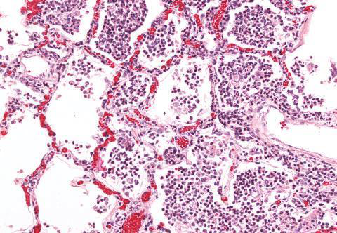
Acute to chronic transition occurs when the acute in�ammatory response cannot be resolved, as a result of either the persistence of the injurious agent or some interference with the normal process of healing
(B) In contrast, in acute inﬂammation of the lung (acute bronchopneumonia), neutrophils ﬁll the alveolar spaces and blood vessels are congested

