Slide 2
No content available

Slide 3
The chapter discusses the mechanisms, mediators, and morphologic patterns of inflammation, including serous, fibrinous, and purulent inflammation, as well as the outcomes of acute inflammation and the characteristics of chronic inflammation.
ACTIONS OF THE PRINCIPAL MEDIATORS OF INFLAMMATION: Vasoactive amines, mainly histamine: vasodilation and increased vascular permeability. Arachidonic acid metabolites (prostaglandins and leukotrienes): several forms exist and are involved in vascular reactions, leukocyte chemotaxis, and other reactions of inflammation; antagonized by lipoxins. Cytokines: proteins produced by many cell types; usually act at short range; mediate multiple effects, mainly in leukocyte recruitment and migration; principal ones in acute inflammation are TNF, IL-1, and chemokines. Complement proteins: Activation of the complement system by microbes or antibodies leads to the generation of multiple breakdown products, which are responsible for leukocyte chemotaxis, opsonization and phagocytosis of microbes and other particles, and cell killing. Kinins: produced by proteolytic cleavage of precursors; mediate vascular reaction, pain.
MORPHOLOGIC PATTERNS OF ACUTE INFLAMMATION: The morphologic hallmarks of acute inflammatory reactions are dilation of small blood vessels and accumulation of leukocytes and fluid in the extravascular tissue. The vascular and cellular reactions account for the signs and symptoms of the inflammatory response. Increased blood flow to the injured area and increased vascular permeability lead to the accumulation of extravascular fluid rich in plasma proteins (edema) and account for the redness (rubor), warmth (calor), and swelling (tumor) that accompany acute inflammation. Leukocytes that are recruited and activated by the offending agent and by endogenous mediators may release toxic metabolites and proteases extracellularly, causing tissue damage and loss of function (functio laesa). During the damage, and in part as a result of the liberation of prostaglandins, neuropeptides, and cytokines, one of the local symptoms is pain (dolor).

Slide 4
Vasoactive amines, mainly histamine: vasodilation and increased vascular permeability. Arachidonic acid metabolites (prostaglandins and leukotrienes): several forms exist and are involved in vascular reactions, leukocyte chemotaxis, and other reactions of inflammation; antagonized by lipoxins. Cytokines: proteins produced by many cell types; usually act at short range; mediate multiple effects, mainly in leukocyte recruitment and migration; principal ones in acute inflammation are TNF, IL-1, and chemokines. Complement proteins: Activation of the complement system by microbes or antibodies leads to the generation of multiple breakdown products, which are responsible for leukocyte chemotaxis, opsonization and phagocytosis of microbes and other particles, and cell killing. Kinins: produced by proteolytic cleavage of precursors; mediate vascular reaction, pain.
The redundancy of the mediators and their actions ensures that this protective response remains robust and is not readily subverted.
Observed anti-inflammatory effects of antagonists to these molecules, thus highlighting the importance of basic biology to the practice of medicine.

Slide 5
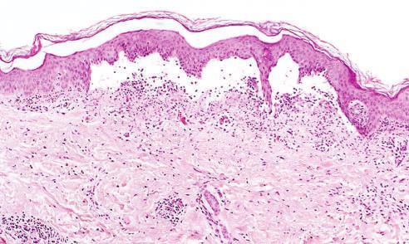

Low-power view of a cross section of a skin blister showing the epidermis separated from the dermis by a focal collection of serous effusion
Fibrinous Inﬂammation A �brinous e�udate develops �hen the vascular lea�s are large or there is a local procoagulant sti�ulus

Slide 6
The morphologic hallmarks of acute inflammatory reactions are dilation of small blood vessels and accumulation of leukocytes and fluid in the extravascular tissue. The vascular and cellular reactions account for the signs and symptoms of the inflammatory response. Increased blood flow to the injured area and increased vascular permeability lead to the accumulation of extravascular fluid rich in plasma proteins (edema) and account for the redness (rubor), warmth (calor), and swelling (tumor) that accompany acute inflammation. Leukocytes that are recruited and activated by the offending agent and by endogenous mediators may release toxic metabolites and proteases extracellularly, causing tissue damage and loss of function (functio laesa). During the damage, and in part as a result of the liberation of prostaglandins, neuropeptides, and cytokines, one of the local symptoms is pain (dolor).

Slide 7
Serous inflammation is marked by the exudation of cell-poor fluid into spaces created by injury to surface epithelia or into body cavities lined by the peritoneum, pleura, or pericardium. Typically, the fluid in serous inflammation is not infected by destructive organisms and does not contain large numbers of leukocytes (which tend to produce purulent inflammation, described later). In body cavities the fluid may be derived from the plasma (as a result of increased vascular permeability) or from the secretions of mesothelial cells (as a result of local irritation); accumulation of fluid in these cavities is called an effusion. (Effusions consisting of transudates also occur in noninflammatory conditions, such as reduced blood outflow in heart failure, or reduced plasma protein levels in some kidney and liver diseases.) The skin blister resulting from a burn or viral infection represents accumulation of serous fluid within or immediately beneath the damaged epidermis of the skin.

Slide 8
A fibrinous exudate develops when the vascular leaks are large or there is a local procoagulant stimulus. With a large increase in vascular permeability, higher-molecular-weight proteins such as fibrinogen pass out of the blood, and fibrin is formed and deposited in the extracellular space. A fibrinous exudate is characteristic of inflammation in the lining of body cavities, such as the meninges, pericardium, and pleura. Histologically, fibrin appears as an eosinophilic meshwork of threads or sometimes as an amorphous coagulum. Fibrinous exudates may be dissolved by fibrinolysis and cleared by macrophages. If the fibrin is not removed, with time, it may stimulate the ingrowth of fibroblasts and blood vessels and thus lead to scarring. Conversion of the fibrinous exudate to scar tissue (organization) within the pericardial sac leads to opaque fibrous thickening of the pericardium and epicardium in the area of exudation and, if the fibrosis is extensive, obliteration of the pericardial space.

Slide 9
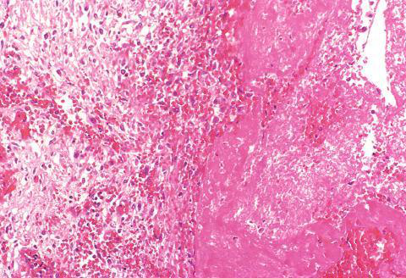
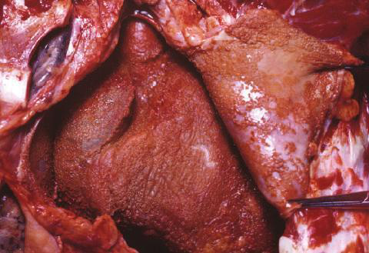
�lcer- ation can occur only when tissue necrosis and resultant in�ammation exist on or near a surface
Abscesses have a central region that appears as a mass of necrotic leukocytes and tissue cells

Slide 10
Purulent inflammation is characterized by the production of pus, an exudate consisting of neutrophils, the liquefied debris of necrotic cells, and edema fluid. The most frequent cause of purulent (also called suppurative) inflammation is infection with bacteria that cause liquefactive tissue necrosis, such as staphylococci; these pathogens are referred to as pyogenic (pus-producing) bacteria. A common example of an acute suppurative inflammation is acute appendicitis. Abscesses are localized collections of pus caused by suppuration buried in a tissue, an organ, or a confined space. They are produced by seeding of pyogenic bacteria into a tissue. Abscesses have a central region that appears as a mass of necrotic leukocytes and tissue cells. There is usually a zone of preserved neutrophils around this necrotic focus, and outside this region there may be vascular dilation and parenchymal and fibroblastic proliferation, indicating chronic inflammation and repair. In time the abscess may become walled off and ultimately replaced by connective tissue. When persistent or at critical locations (such as the brain), abscesses may have to be drained surgically.

Slide 11
Fig. 3.16 Outcomes of acute inflammation: resolution, healing by fibrosis, or chronic inflammation. The components of the various reactions and their functional outcomes are listed.

Slide 12
Recognize the outcomes of acute inflammation and the transition to chronic inflammation.
Explain the causes and morphologic features of chronic inflammation.

Slide 13
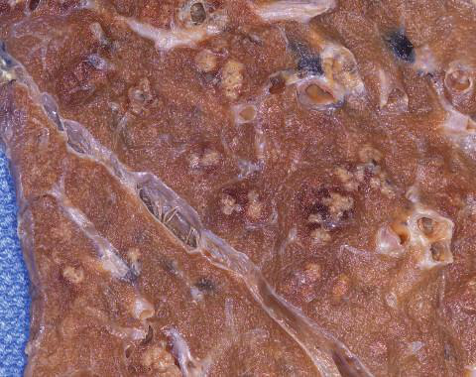
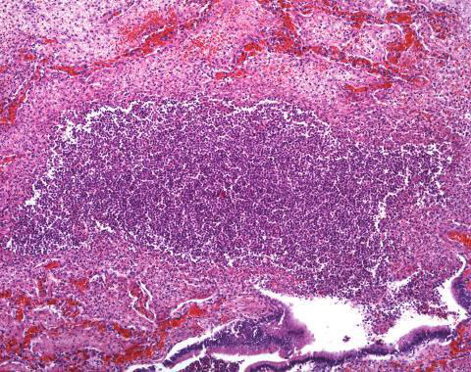
(A) Deposits of ﬁbrin on the pericardium
(A) Multiple bacterial abscesses (arrows) in the lung in a case of bronchopneumonia

Slide 14
Understand the actions of the principal mediators of inflammation.
Identify the morphologic patterns of acute inflammation.
Describe the characteristics and causes of serous, fibrinous, and purulent inflammation.

Slide 15
Fig. 3.12 Serous inflammation: Low-power view of a cross section of a skin blister showing the epidermis separated from the dermis by a focal collection of serous effusion.
Fig. 3.13 Fibrinous pericarditis: (A) Deposits of fibrin on the pericardium. (B) A pink meshwork of fibrin exudate overlies the pericardial surface.
Fig. 3.14 Purulent inflammation: (A) Multiple bacterial abscesses in the lung in a case of bronchopneumonia. (B) The abscess contains neutrophils and cellular debris, and is surrounded by congested blood vessels.

Slide 16
Fig. 3.15 The morphology of an ulcer: (A) A chronic duodenal ulcer. (B) Low-power cross-section view of a duodenal ulcer crater with an acute inflammatory exudate in the base.

Slide 17
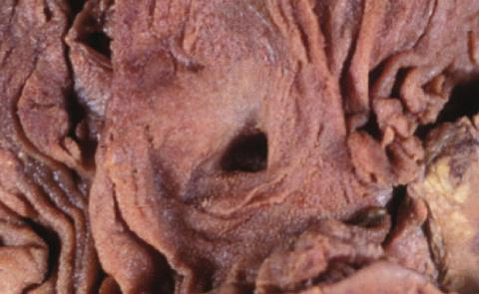
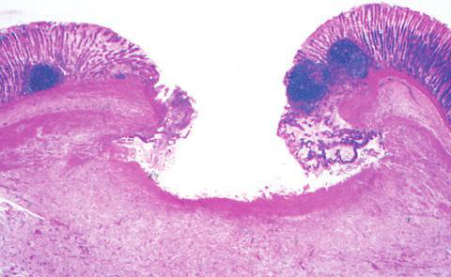
In a perfect world, all in�amma- tory reactions, after they have succeeded in eliminating the offending agent, should end with restoration of the site of acute in�ammation to normal
(A) A chronic duodenal ulcer

Slide 18
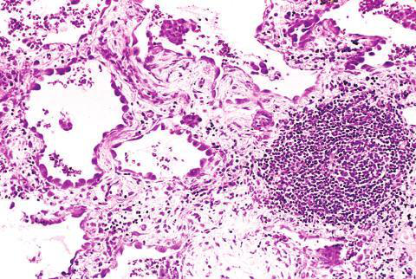
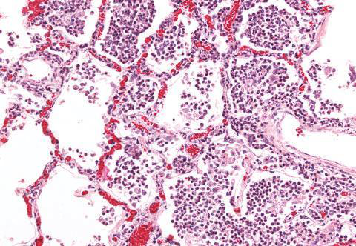
Acute to chronic transition occurs when the acute in�ammatory response cannot be resolved, as a result of either the persistence of the injurious agent or some interference with the normal process of healing
(B) In contrast, in acute inﬂammation of the lung (acute bronchopneumonia), neutrophils ﬁll the alveolar spaces and blood vessels are congested

