Slide 2
This chapter discusses the mechanisms and outcomes of inflammation, highlighting the actions of principal mediators, morphologic patterns of acute inflammation, and the transition to chronic inflammation. It covers serous, fibrinous, and purulent inflammation, as well as the outcomes of acute inflammation, including resolution, fibrosis, and progression to chronic inflammation. The chapter also explores the causes and morphologic features of chronic inflammation.

Slide 3
Vasoactive amines, mainly histamine: vasodilation and increased vascular permeability; Arachidonic acid metabolites (prostaglandins and leukotrienes): several forms exist and are involved in vascular reactions, leukocyte chemotaxis, and other reactions of inflammation; antagonized by lipoxins; Cytokines: proteins produced by many cell types; usually act at short range; mediate multiple effects, mainly in leukocyte recruitment and migration; principal ones in acute inflammation are TNF, IL-1, and chemokines; Complement proteins: Activation of the complement system by microbes or antibodies leads to the generation of multiple breakdown products, which are responsible for leukocyte chemotaxis, opsonization and phagocytosis of microbes and other particles, and cell killing; Kinins: produced by proteolytic cleavage of precursors; mediate vascular reaction, pain.
The redundancy of the mediators and their actions ensures that this protective response remains robust and is not readily subverted.

Slide 4
The morphologic hallmarks of acute inflammatory reactions are dilation of small blood vessels and accumulation of leukocytes and fluid in the extravascular tissue. The vascular and cellular reactions account for the signs and symptoms of the inflammatory response. Increased blood flow to the injured area and increased vascular permeability lead to the accumulation of extravascular fluid rich in plasma proteins (edema) and account for the redness (rubor), warmth (calor), and swelling (tumor) that accompany acute inflammation.
Leukocytes that are recruited and activated by the offending agent and by endogenous mediators may release toxic metabolites and proteases extracellularly, causing tissue damage and loss of function (functio laesa). During the damage, and in part as a result of the liberation of prostaglandins, neuropeptides, and cytokines, one of the local symptoms is pain (dolor).

Slide 5
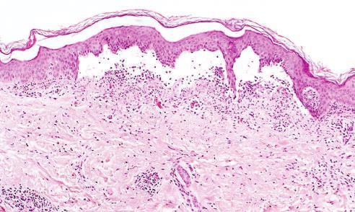

Bir kaplamanın enine kesitinin düşük güç gücüyle görünümü Epidermisin dermisten fokal bir koleksiyonla ayrıldığını gösteren kabarcık seröz efüzyon
Fibrinöz inflamasyon Vasküler damarlar oluştuğunda brinöz bir eudat gelişir büyük veya lokal bir prokoagülan sti ulus var

Slide 6
Serous inflammation is marked by the exudation of cell-poor fluid into spaces created by injury to surface epithelia or into body cavities lined by the peritoneum, pleura, or pericardium. Typically, the fluid in serous inflammation is not infected by destructive organisms and does not contain large numbers of leukocytes (which tend to produce purulent inflammation, described later). In body cavities the fluid may be derived from the plasma (as a result of increased vascular permeability) or from the secretions of mesothelial cells (as a result of local irritation); accumulation of fluid in these cavities is called an effusion.

Slide 7
A fibrinous exudate develops when the vascular leaks are large or there is a local procoagulant stimulus. With a large increase in vascular permeability, higher-molecular-weight proteins such as fibrinogen pass out of the blood, and fibrin is formed and deposited in the extracellular space. A fibrinous exudate is characteristic of inflammation in the lining of body cavities, such as the meninges, pericardium, and pleura.

Slide 8
Purulent inflammation is characterized by the production of pus, an exudate consisting of neutrophils, the liquefied debris of necrotic cells, and edema fluid. The most frequent cause of purulent (also called suppurative) inflammation is infection with bacteria that cause liquefactive tissue necrosis, such as staphylococci; these pathogens are referred to as pyogenic (pus-producing) bacteria.

Slide 9
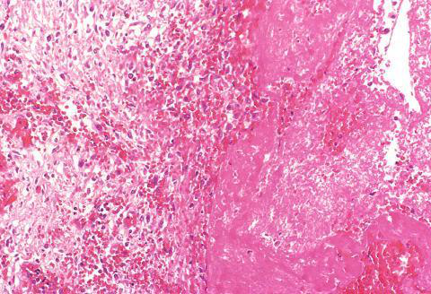
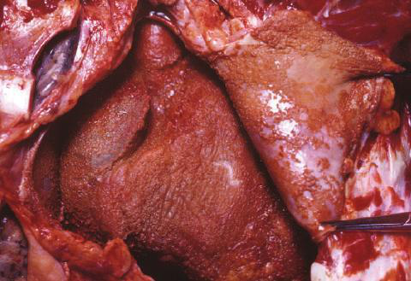
lcer- ation ancak doku nekrozu ve bunun sonucunda ortaya çıktığında ortaya çıkabilir. bir yüzeyin üzerinde veya yakınında bulunan ammation
Apselerin bir nekrotik lökosit kütlesi olarak görünen merkezi bölge ve doku hücreleri

Slide 10
The outcomes of acute inflammation include resolution, fibrosis, and progression to chronic inflammation. Resolution involves the restoration of normal tissue architecture and function. Fibrosis occurs when there is substantial tissue destruction or when inflammation occurs in tissues that do not regenerate. Progression to chronic inflammation occurs when the acute inflammatory response fails to eliminate the offending agent.

Slide 11
Chronic inflammation is a prolonged inflammatory response that involves active inflammation, tissue destruction, and attempts at repair. It may follow acute inflammation or arise de novo. Chronic inflammation is characterized by the presence of lymphocytes and macrophages, the proliferation of blood vessels, fibrosis, and tissue necrosis.

Slide 12
Chronic inflammation can be caused by persistent infections, prolonged exposure to potentially toxic agents, and autoimmune diseases. Persistent infections by microbes that are difficult to eradicate, such as mycobacteria and certain viruses, fungi, and parasites, can lead to chronic inflammation. Prolonged exposure to toxic agents, either exogenous or endogenous, can also result in chronic inflammation. Autoimmune diseases, in which the immune system attacks the body's own tissues, are another cause of chronic inflammation.

Slide 13
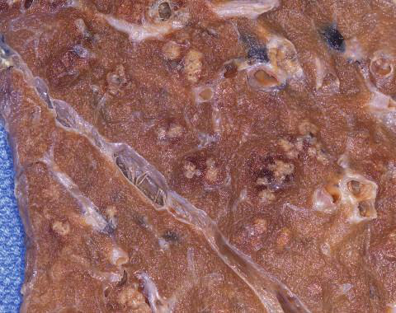
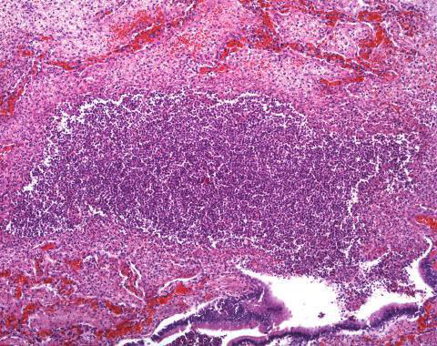
(A) Perikard üzerinde fibrin birikintileri
(A) Bronkopnömoni durumunda akciğerde çoklu bakteriyel apseler (oklar)

Slide 14
The morphologic features of chronic inflammation include the infiltration of mononuclear cells, tissue destruction, and attempts at healing by connective tissue replacement of damaged tissue, accomplished by angiogenesis and fibrosis. The infiltration of mononuclear cells, including macrophages, lymphocytes, and plasma cells, is a hallmark of chronic inflammation. Tissue destruction, induced by the persistent offending agent or by the inflammatory cells, is another characteristic of chronic inflammation. Attempts at healing include the proliferation of small blood vessels (angiogenesis) and, in particular, fibrosis.

Slide 15
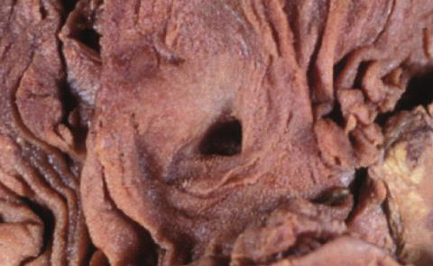
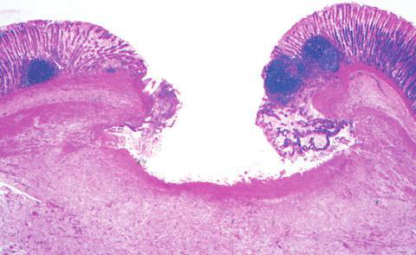
Mükemmel bir dünyada, hepsi amma- Tory tepkileri, ortadan kaldırmayı başardıktan sonra Suçlu ajan, restorasyon ile sona ermelidir. Akut bölgenin normale dönmesi
(A) Kronik duodenum ülseri

Slide 16
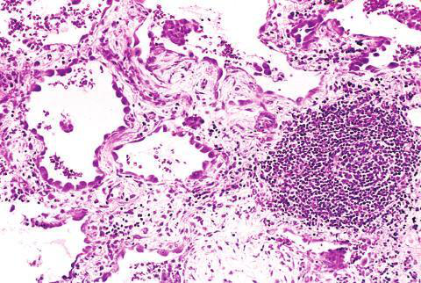
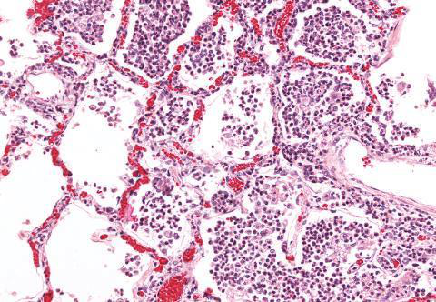
Akuttan kroniğe geçiş, akut olduğunda meydana gelir. sonuç olarak amatatory yanıt çözülemez ya zararlı ajanın ısrarı ya da bazıları normal iyileşme sürecine müdahale
(B) Buna karşılık, akciğerin akut iltihabında (akut bronkopnömoni), nötrofiller alveolar boşlukları ve kan damarlarını doldurur sıkışık

