Slide 1
What’s new in iOS 10
And what we can start to use in our projects

Slide 2
Agenda
Most important changes
Decentralisation of apps
User Privacy and Security
Visual Debugging with Xcode
Impact with our current projects?

Slide 3
Decentralisation of apps

Slide 4
iMessage plugins
Notification Widgets
Siri integration
MapKit extensions
Watch Complications
Proactive Suggestions
more and more App Extensions

Slide 5
All these small extensions set iOS up to do something similar to Google Instant Apps.
Safari 10, on macOS, will support App Extensions built from a combination of JavaScript, CSS and native code written in Objective-C or Swift.

Slide 6
User Privacy and Security
App Transport Security Requirement.
App transport security is a function that requires your app to use HTTPS instead of HTTP when it sends messages back and forth to the web server.

Slide 7
Visual Debugging with Xcode
One of the coolest new features for me was Xcode 8’s new memory debugger.
This is a built-in tool that lets you view the entire memory object graph of your running application, so you can quickly isolate leaks and circular references.
Even more, the new memory debugger can automatically detect memory leaks and help you quickly diagnose the problem.

Slide 8
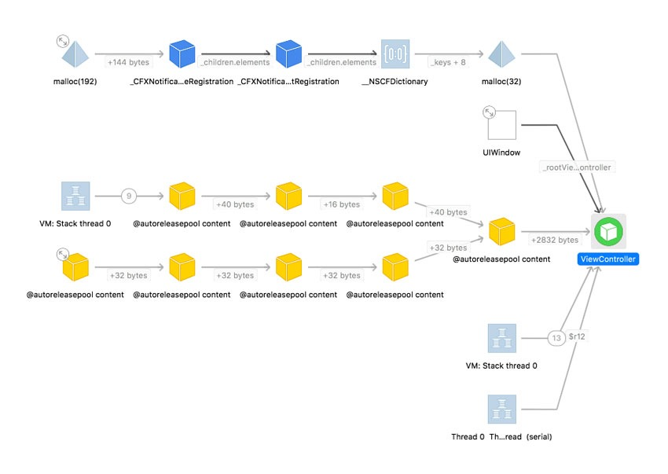
Notes:
Show Xcode example

Slide 9
Can we start to use?

Slide 10
SiriKit
Only 5 application types:
Ride Sharing
Payment
Photo Search
VoiP
Messages
Workout

Slide 11
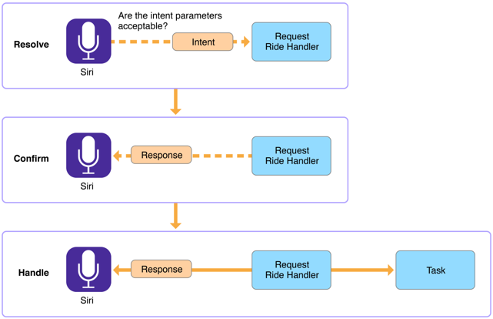
SiriKit
Intents and Intents UI Extensions

Slide 12
SiriKit & MapKit
However, Maps also uses SiriKit to integrate data from specific types of apps into the overall Maps experience. In both cases, the process for adding SiriKit support to your app is the same.

