Slide 1


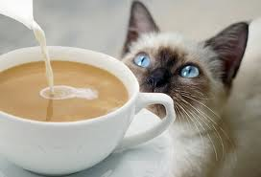


CoffeeScript is a little language that
compiles into JavaScript.

Slide 2


Gemfile

Slide 3











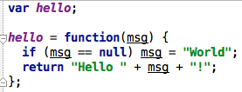
Functions
CoffeeScript
JavaScript

Slide 4


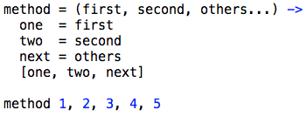
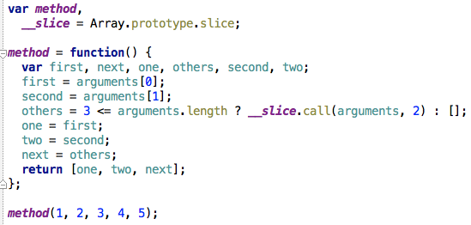
Arguments
CoffeeScript
JavaScript

Slide 5


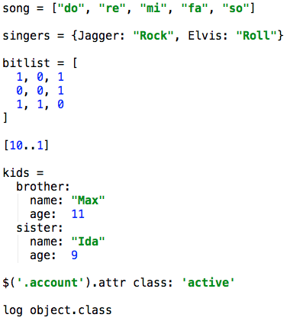
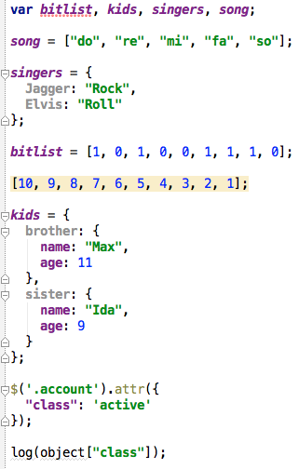
Objects and Arrays
CoffeeScript
JavaScript

Slide 6




Slice
CoffeeScript
JavaScript

Slide 7


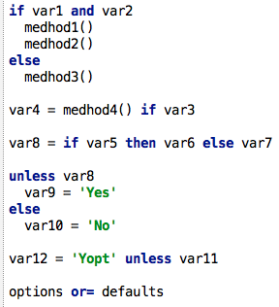
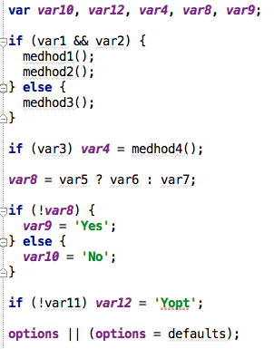
If, Else, Unless
CoffeeScript
JavaScript

Slide 8


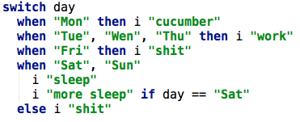
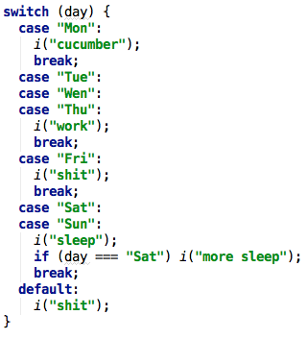
Switch/When/Else
CoffeeScript
JavaScript

Slide 9


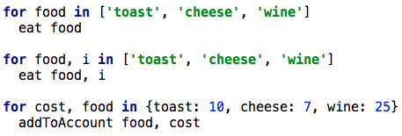
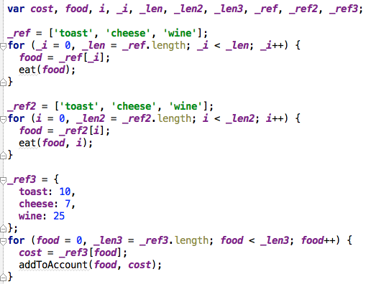
Loops
CoffeeScript
JavaScript

Slide 10


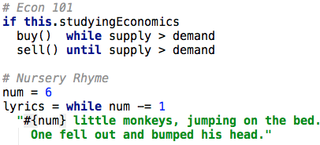
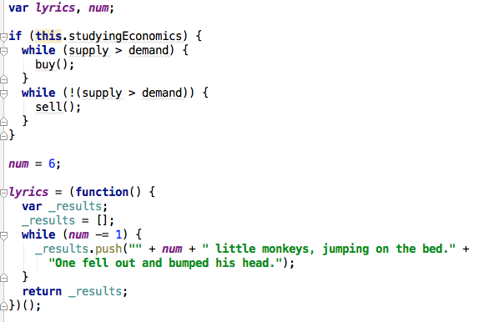
Loops
CoffeeScript
JavaScript

Slide 11

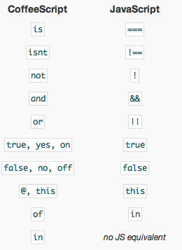
Operators

Slide 12




Operators
CoffeeScript
JavaScript

Slide 13

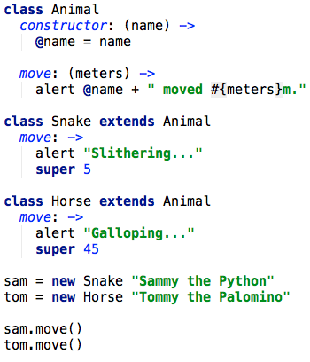
Classes, Inheritance, and Super
CoffeeScript

Slide 14

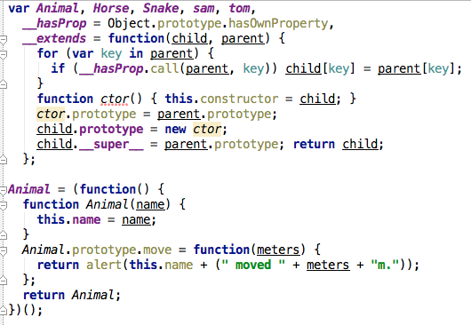

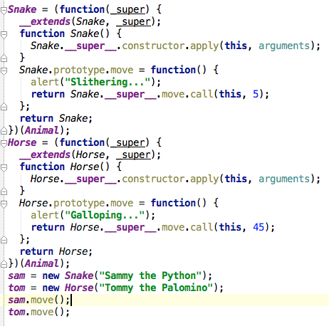
Classes, Inheritance, and Super
JavaScript

Slide 15




Extends - ::
CoffeeScript
JavaScript

Slide 16







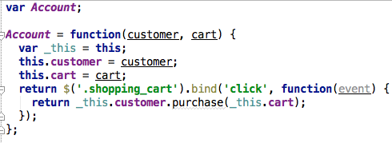
Binding
CoffeeScript
JavaScript

Slide 17



CoffeeScript
JavaScript

