Slide 1




Slide 2
Models
Migrations

Slide 3

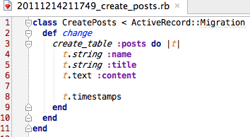

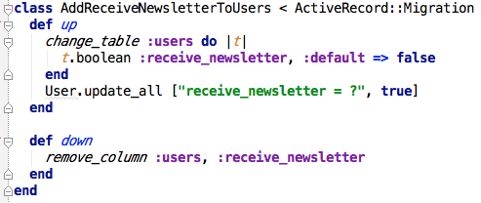
Migrations
id, created_at, updated_at

Slide 4

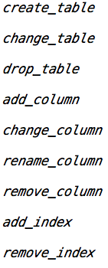
Methods for changing DB structure

Slide 5

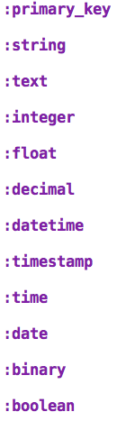
Column Types

Slide 6

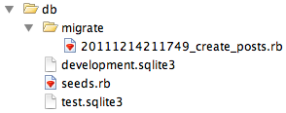
File name of migration
YYYYMMDDHHMMSS UTC timestamp

Slide 7



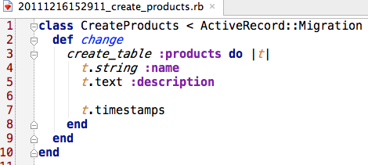
Creating a Model

Slide 8







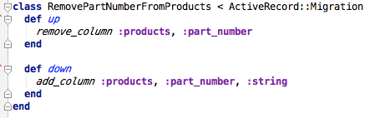
Creating a Standalone Migration

Slide 9


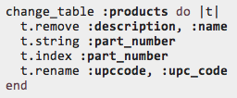

Changing Tables

Slide 10

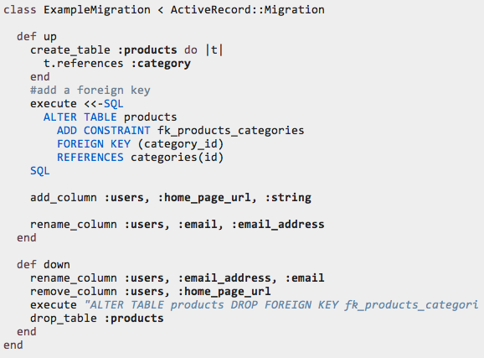

Slide 11
Changing Migrations
rake db:rollback
rake db:rollback STEP=3
rake db:migrate:down VERSION=20111214211749
rake db:migrate:up VERSION=20111214211749

Slide 12
Models
ActiveRecord Objects

Slide 13



ActiveRecord functions:
new, all, save

Slide 14

ActiveRecord functions:
create, count, update_attributes, update_attribute

Slide 15
Models
Associations

Slide 16

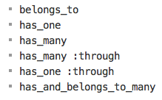
Associations Types

Slide 17

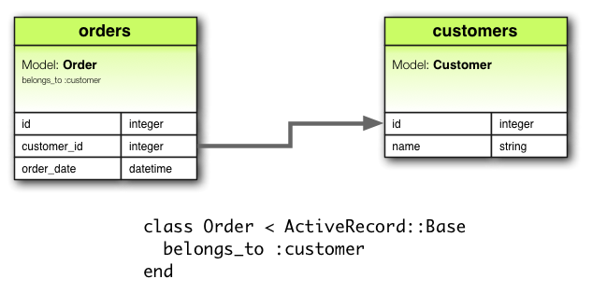
belongs_to

Slide 18

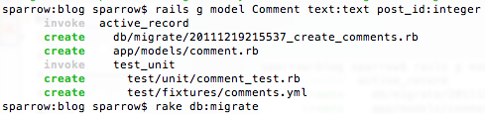


belongs_to

Slide 20

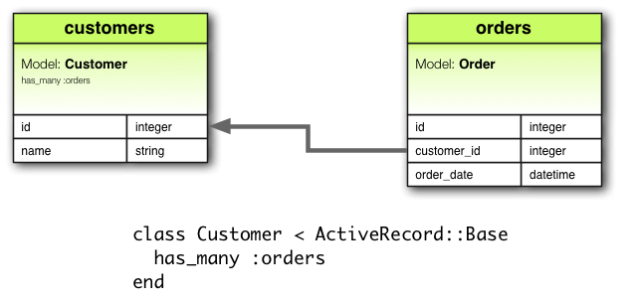
has_many

Slide 21


has_many

Slide 22

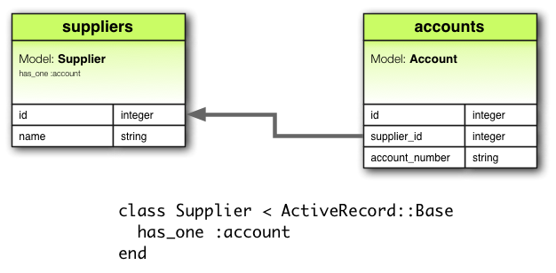
has_one

Slide 23



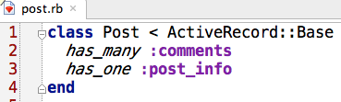
has_one

Slide 24
has_one

Slide 25

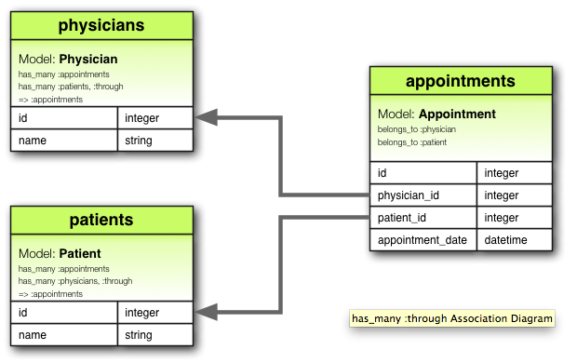

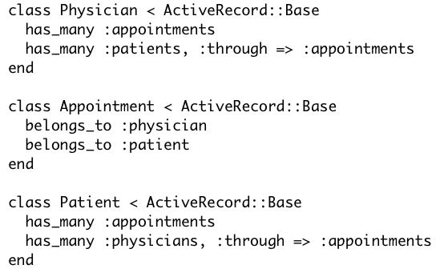
has_many :through

Slide 26

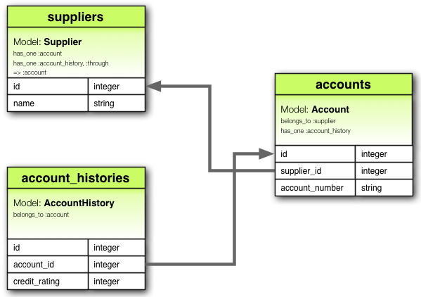

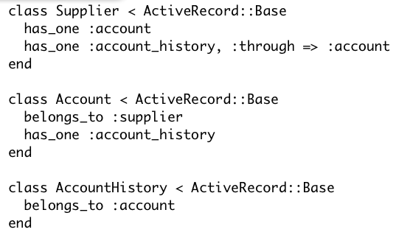
has_one :through

Slide 27

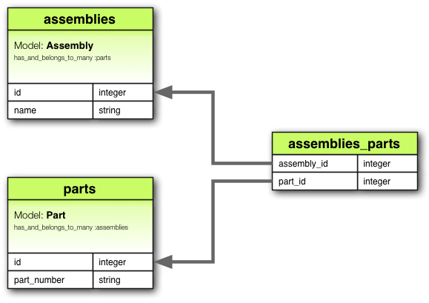

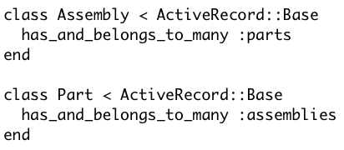
has_and_belongs_to_many

Slide 28

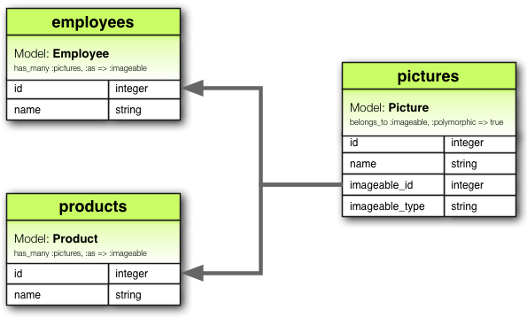

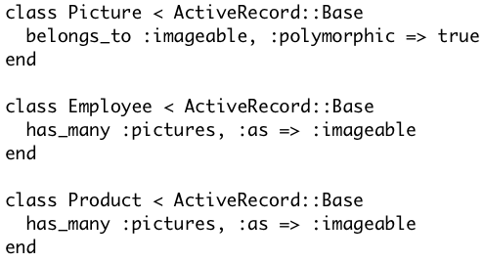
Polymorphic Associations

