Slide 1




Slide 2
Models
Validations

Slide 3

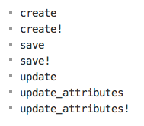
When Does Validation Happen?

Slide 4
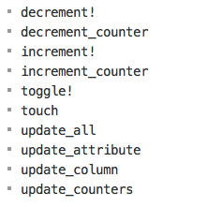
Skipping Validations

Slide 5



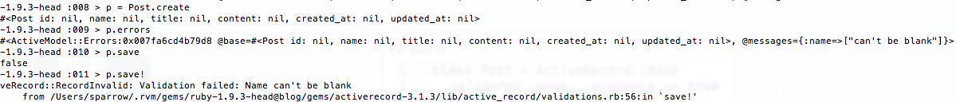
valid? and invalid?

Slide 6

errors[]

Slide 7
Helpers

Slide 8


Presence

Slide 9

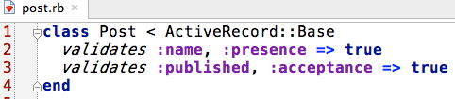
Checkbox validations

Slide 10

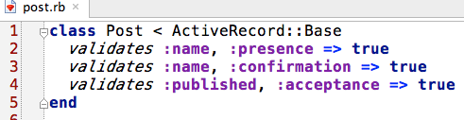

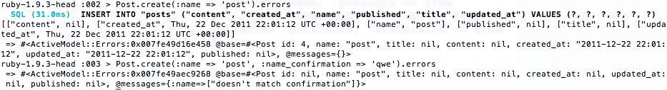
Сonfirmation

Slide 11

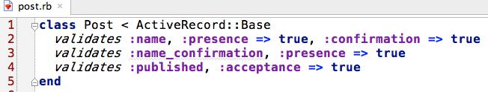
Сonfirmation

Slide 12

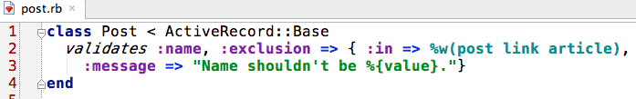
Exclusion

Slide 13


Format

Slide 14


Inclusion

Slide 15




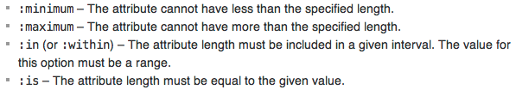
Length

Slide 16




Uniqueness
Scope

Slide 17

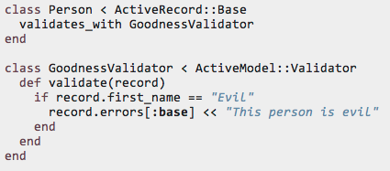

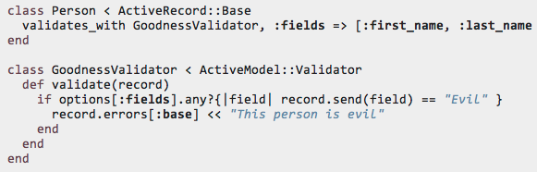
Validates_with

Slide 18

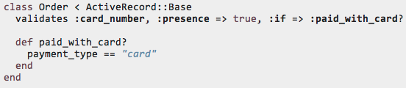




Conditional Validation
Symbol with :if and :unless
Symbol with :if and :unless
Symbol with :if and :unless

Slide 19

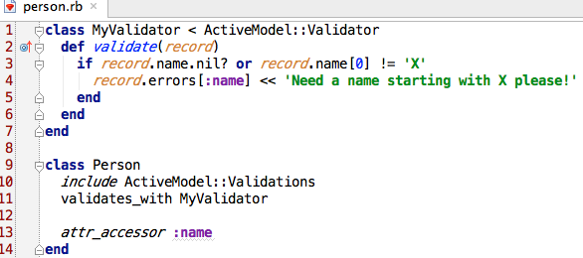

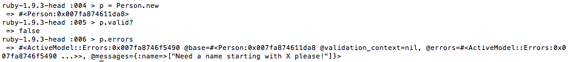
Custom Validators

Slide 20

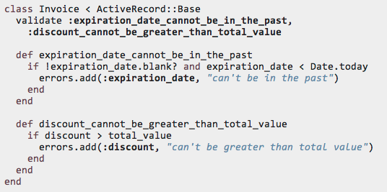
Custom Methods

Slide 21

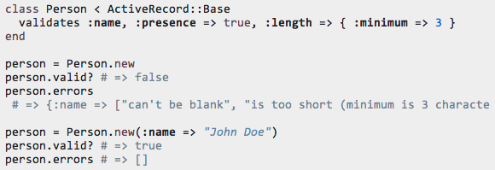

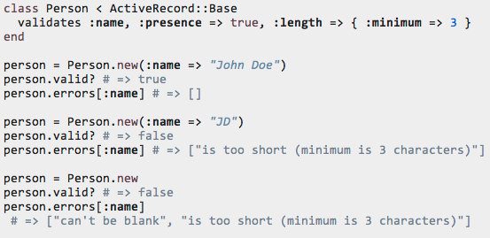
Validation Errors
errors
errors[]

Slide 22

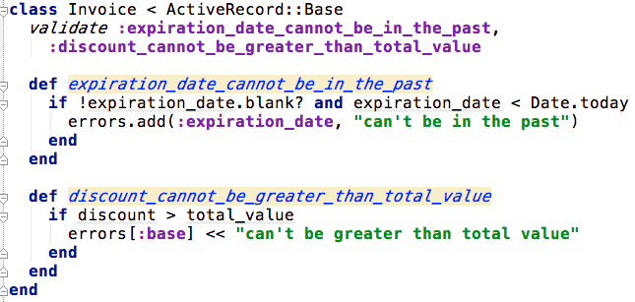

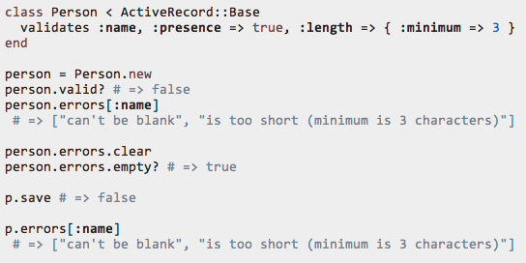
errors.add, errors[:base]
errors.clear

Slide 23

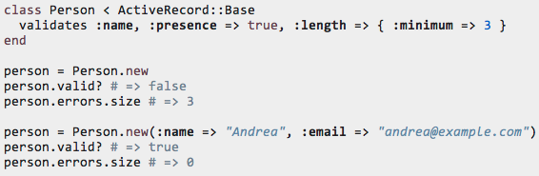
errors.size

Slide 24
Models
Callback

Slide 25

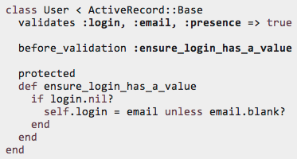

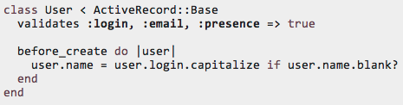
Registration

Slide 26



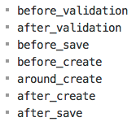
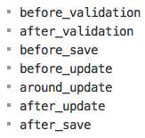

Creating an Object
Updating an Object
Destroying an Object
after_find
after_initialize

Slide 27


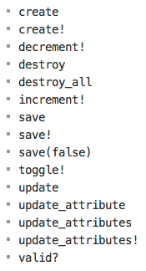
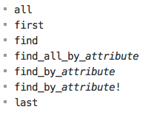
Triggering callbacks

Slide 28

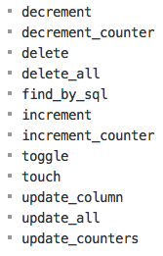
Skipping Callbacks

Slide 29






Conditional Callbacks
:if and :unless with a Symbol
:if and :unless with a String
:if and :unless with a Proc

Slide 30


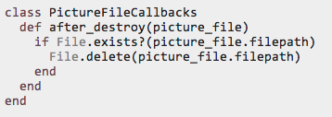
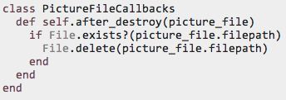




Callback Classes

Slide 31




Observers
app/models/user_observer.rb
config/application.rb

