Slide 1




Slide 2

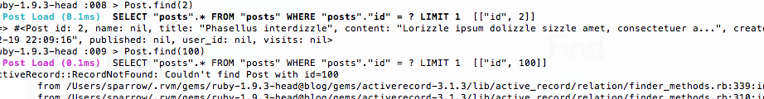

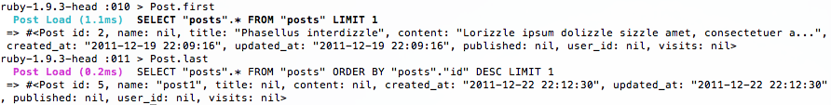
find
first, last

Slide 3

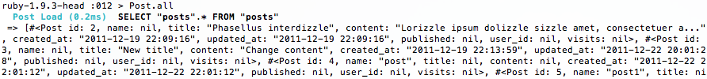

all
where

Slide 4
where

Slide 5


order

Slide 6
select

Slide 7
limit, offset

Slide 8
group

Slide 9
except, only

Slide 10

joins

Slide 11




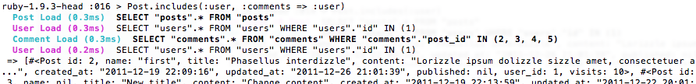
includes

Slide 12

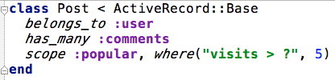
scope

Slide 13

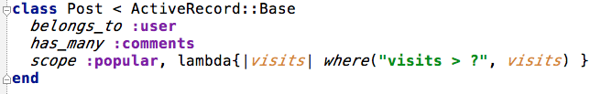


scope

Slide 14

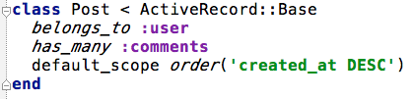
default_scope

Slide 15
unscoped

Slide 16

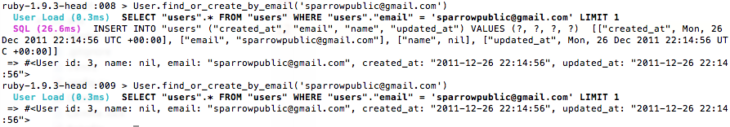


Dynamic finders

Slide 17

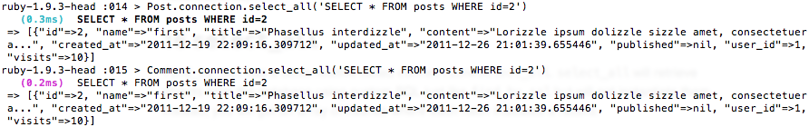
find_by_sql
select_all

Slide 18




exists?

Slide 19




count
average

Slide 20


minimum
maximum

Slide 21

sum

