Slide 1




Slide 2
routing

Slide 3

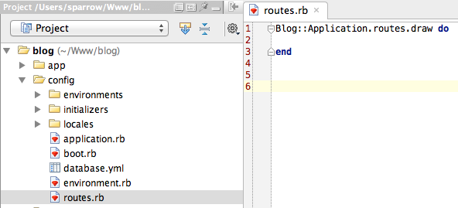

Slide 4



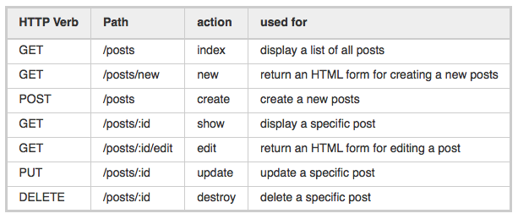
CRUD, Verbs, and Actions

Slide 5





Slide 6




Singular Resources

Slide 7

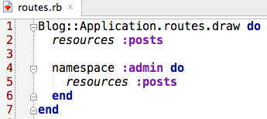

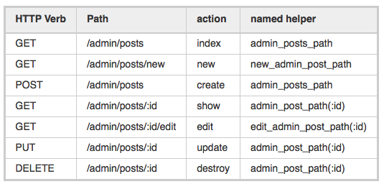
Controller Namespaces and Routing

Slide 8


Controller Namespaces and Routing

Slide 9

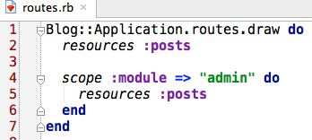



Slide 10

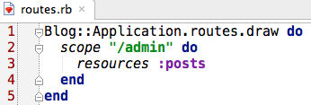

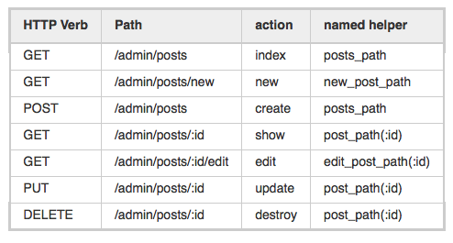
Route without a module prefix

Slide 11






Nested Resources

Slide 12

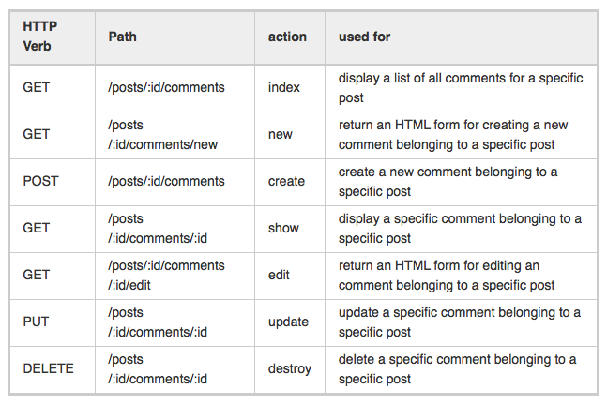
Nested Resources

Slide 13


Nested Resources

Slide 14

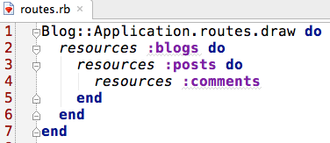

Nested Resources

Slide 15


Nested Resources
Creating Paths and URLs From Objects

Slide 16

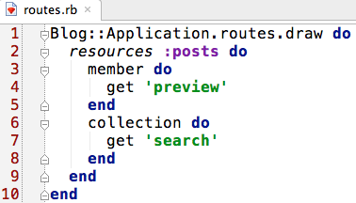


Adding More RESTful Actions

Slide 17











Defining

Slide 18


Naming Routes

Slide 19


Constraints

Slide 20




Route Globbing

Slide 21





Redirection

Slide 22



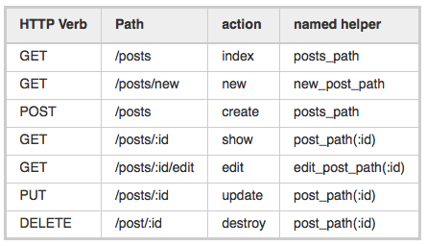
Specifying a Controller

Slide 23



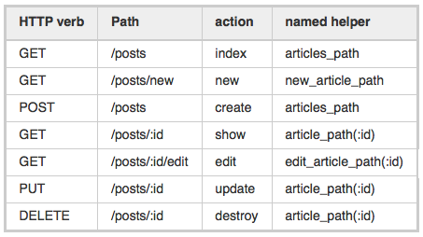
Overriding the Named Helpers

Slide 24




Restricting the Routes Created

Slide 25
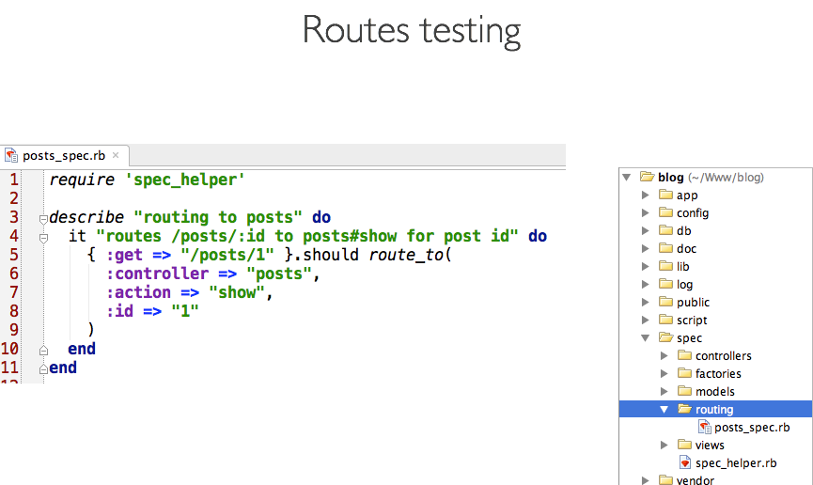

Slide 26
Controllers

Slide 27

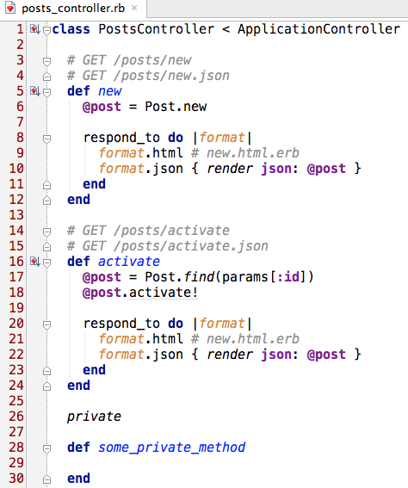
Methods and Actions

Slide 28

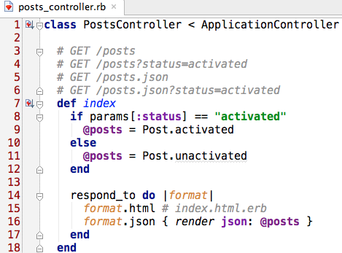
Parameters

Slide 29

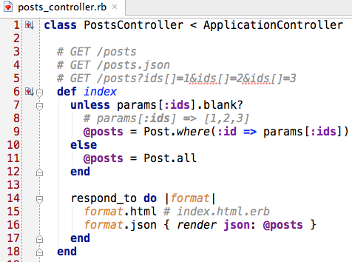
Parameters

Slide 30



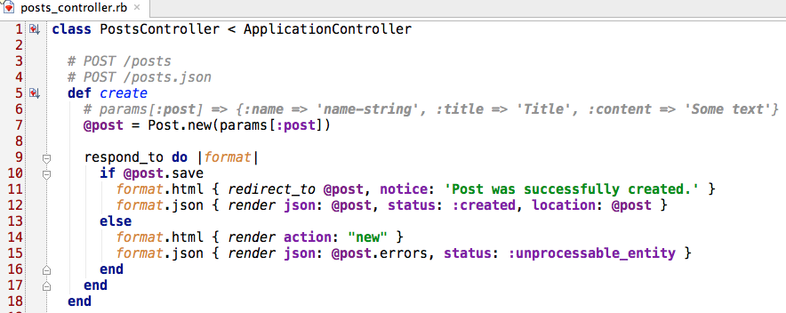
Parameters

Slide 31


Routing Parameters

Slide 32

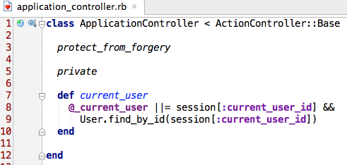
Session

Slide 33



Session

Slide 34


Session

Slide 35





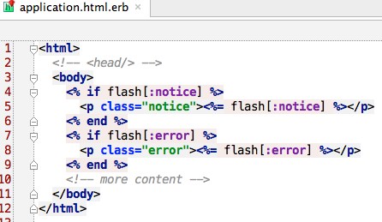
The Flash

Slide 36

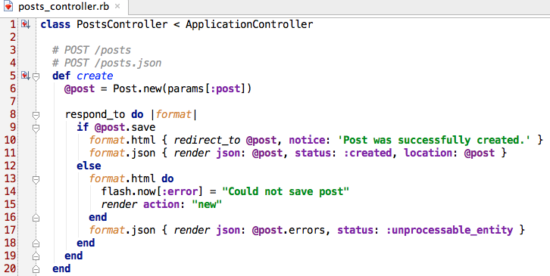
flash.now

Slide 37

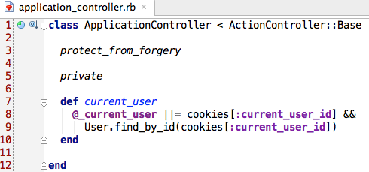
Cookies

Slide 38

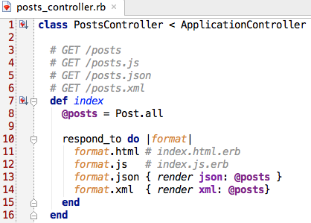
Rendering xml, js and json data

Slide 39

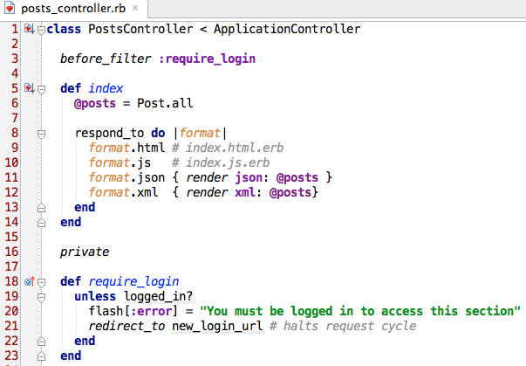


Filters

Slide 40

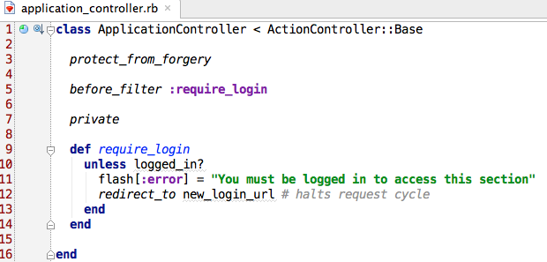
Filters

Slide 41

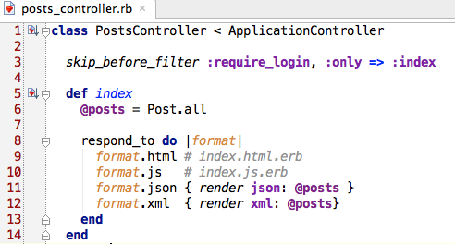
Skip filters

Slide 42
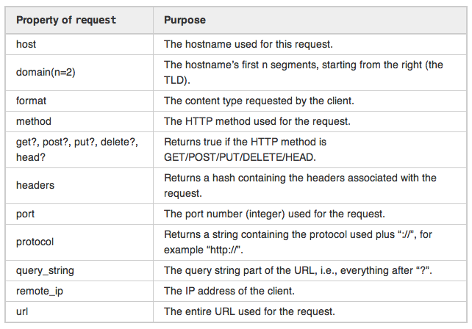
The request Object

Slide 43
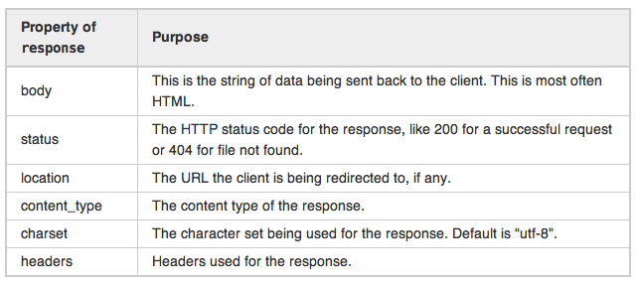
The response Object

Slide 44
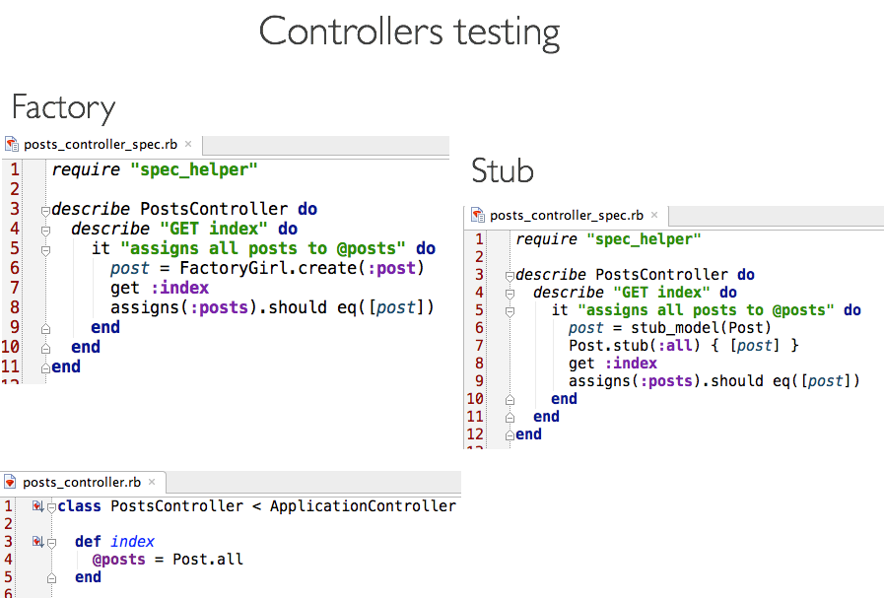

Slide 45
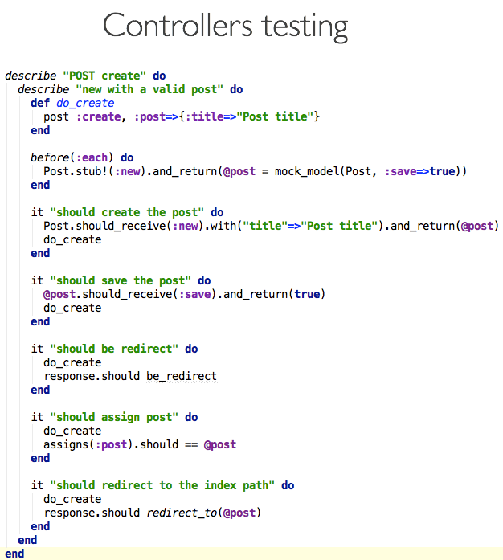

Slide 46
