Slide 1




Slide 2

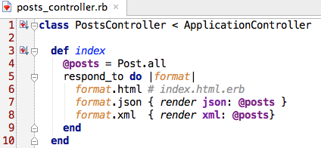
Default rendering

Slide 3
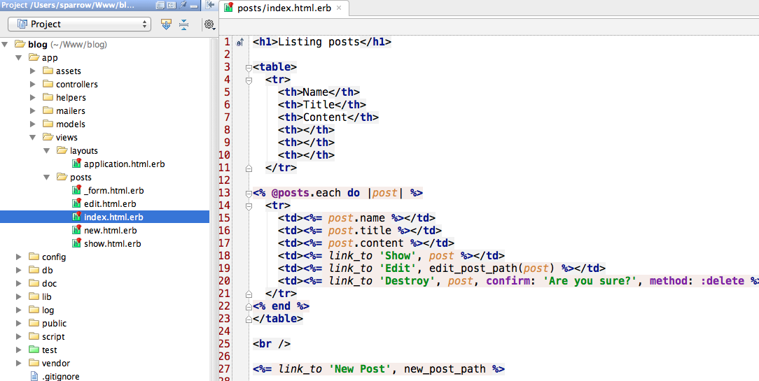
.erb

Slide 4
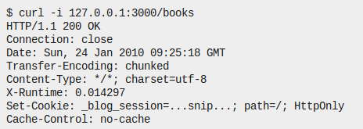
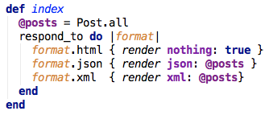
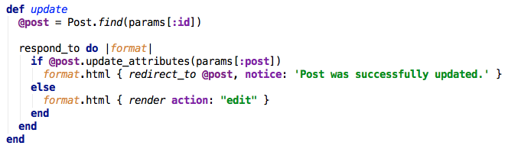
render
render :nothing => true
render :action =>:edit

Slide 5




render
render :template =>‘path/to/template’
render :file =>‘/path/to/file’
render :inline =>‘code’
render :text =>‘string’

Slide 6
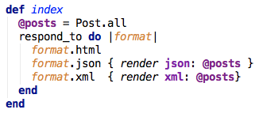
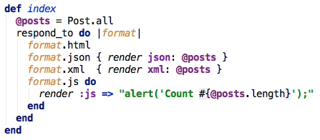
render
render :json => @object
render :xml => @object
to_json, to_xml
render :js => ‘JavaScript’

Slide 7
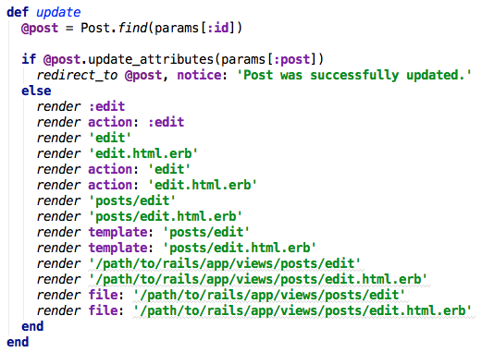
render

Slide 8
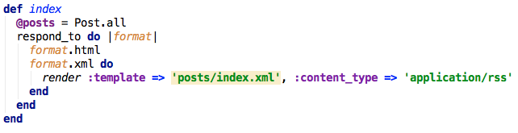
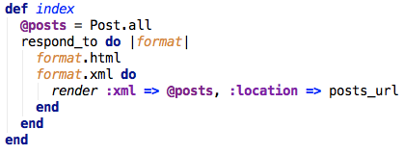

render’s options
content_type
status
location
layout

Slide 9
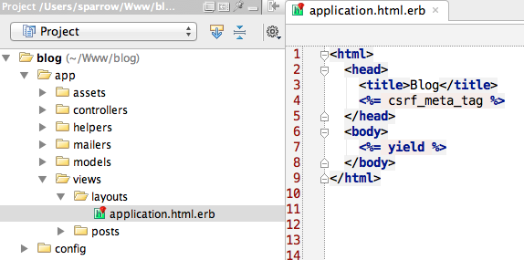
Layout

Slide 10
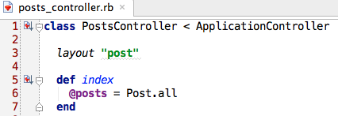
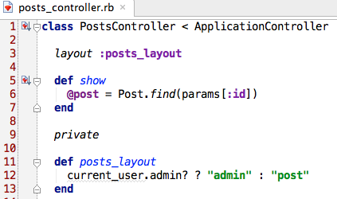
Layout

Slide 11

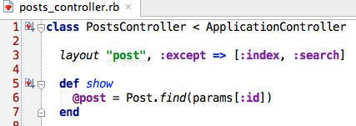

Layout

Slide 12


Layout Inheritance

Slide 13
redirect_to

Slide 14
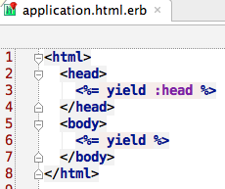
yield

Slide 15
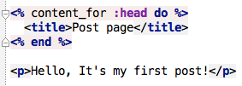
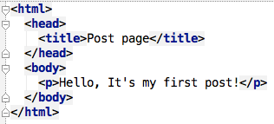
content_for

Slide 16
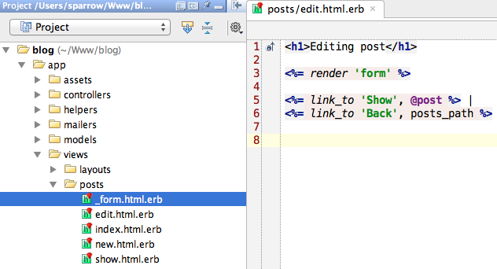
Partials

Slide 17
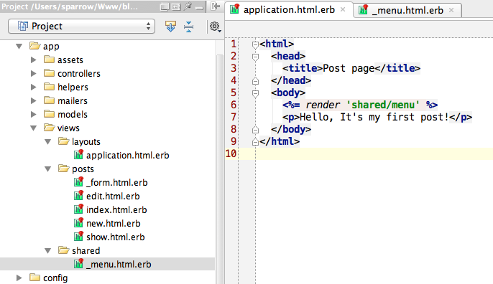
Partials

Slide 18
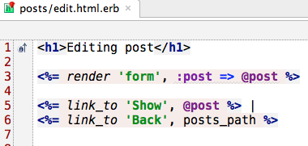
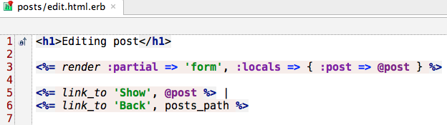
Partials

Slide 19
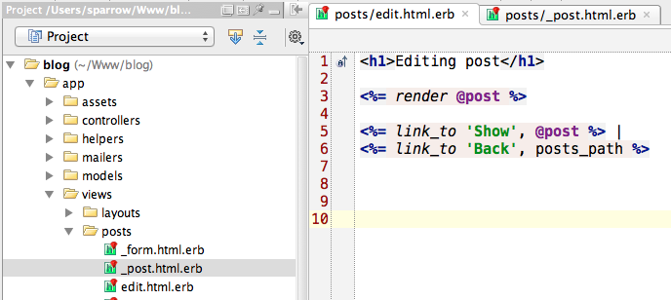
Partials

Slide 20
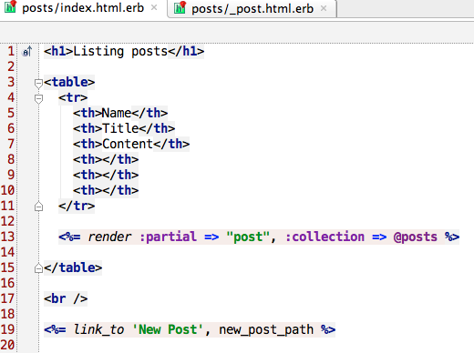
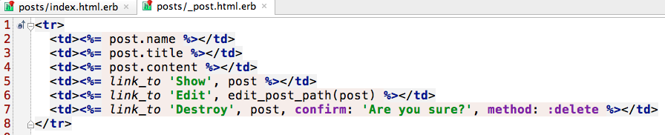
Collections

Slide 21
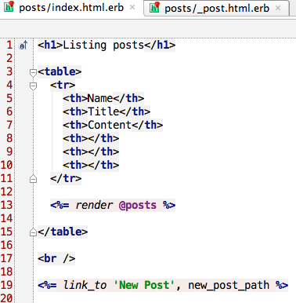
Collections

Slide 22
Collections

Slide 23
Collections, spacer_template

Slide 24


Form helpers

Slide 25

Form helpers, check_box_tag

Slide 26
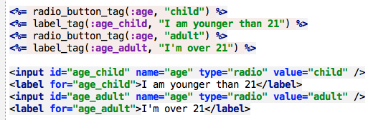
Form helpers, radio_button_tag

Slide 27
Form helpers, text_area_tag

Slide 28

Form helpers, password_field_tag

Slide 29

Form helpers, hidden_field_tag

Slide 30
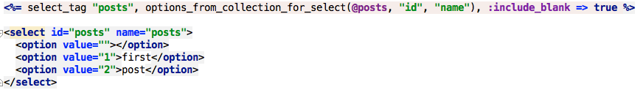
Form helpers, select_tag

Slide 31

Form helpers, search_field_tag

Slide 32

Form helpers, telephone_field_tag

Slide 33

Form helpers, url_field_tag

Slide 34

Form helpers, email_field_tag

Slide 35
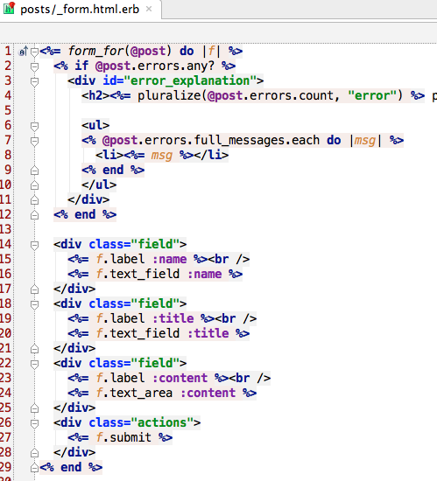
Form helpers

Slide 36

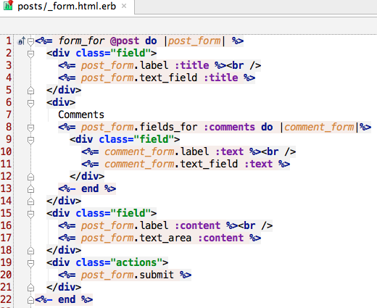
nested_attributes

Slide 37
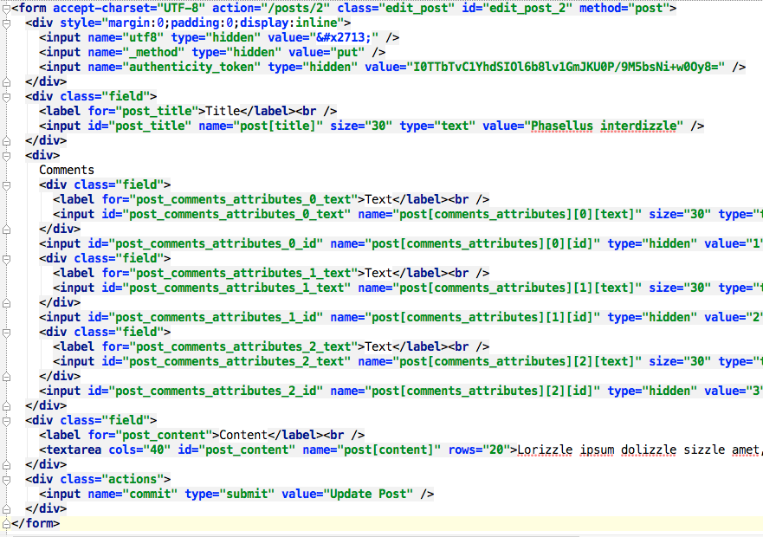
nested_attributes

Slide 38
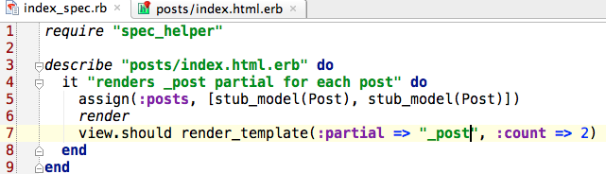
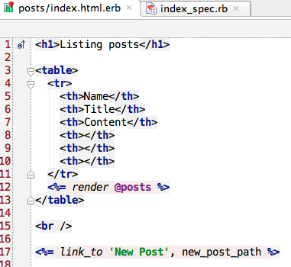
Testing Views

Slide 39
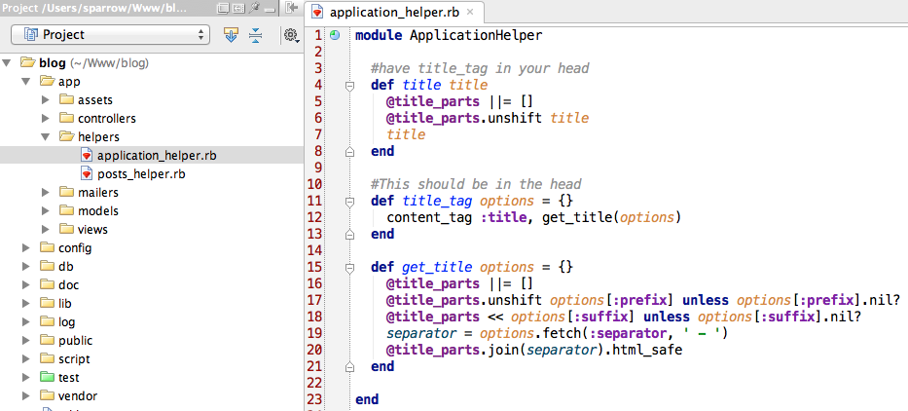
Helpers

Slide 40
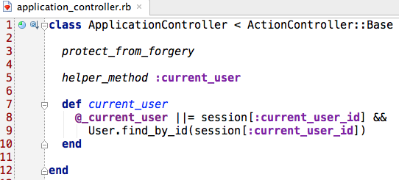
Helpers

Slide 41
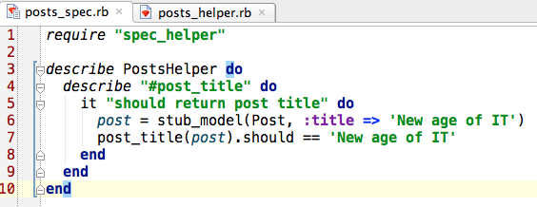
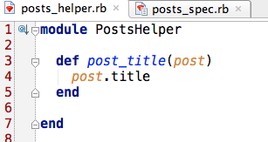
Testing Helpers

Slide 42
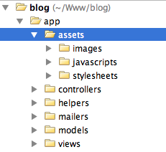
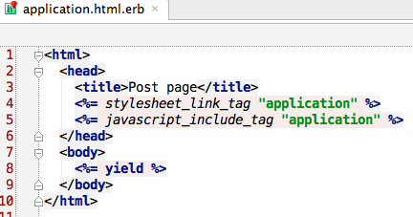
Asset pipeline

Slide 43
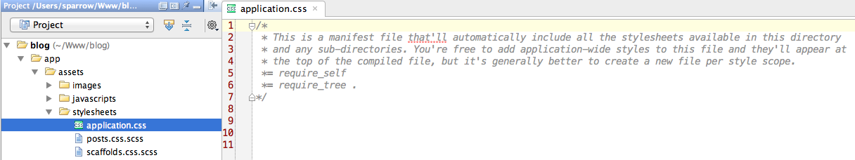
Asset pipeline

Slide 44
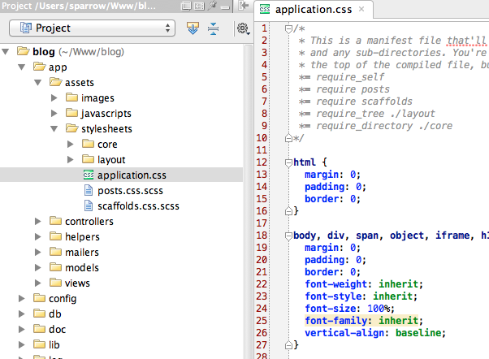
Asset pipeline

Slide 45
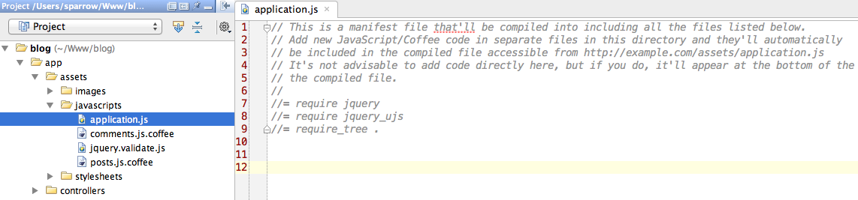
Asset pipeline

Slide 46
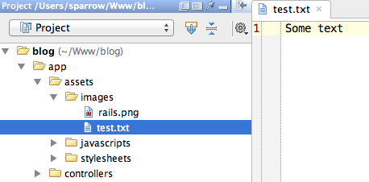
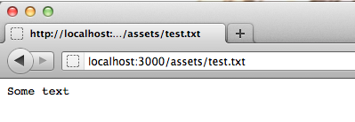
Asset pipeline

Slide 47
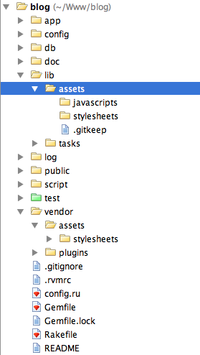
Asset pipeline

Slide 48
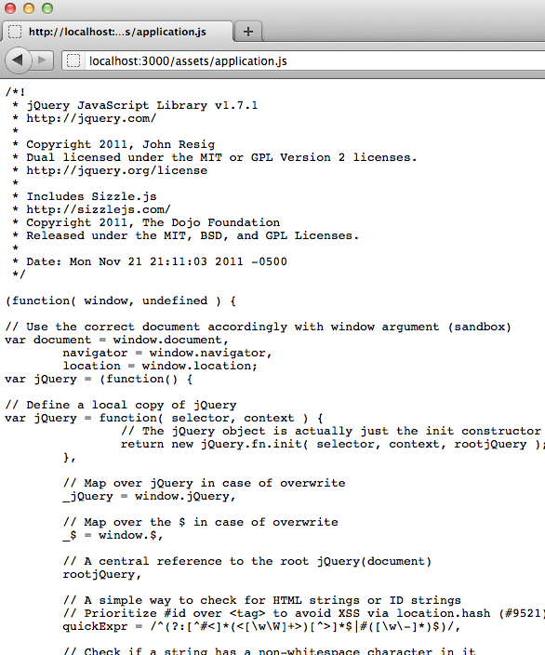
Asset pipeline

