Slide 1
Haml & Sass
{markup haiku} & {style with attitude}

Slide 2
Template languages
Haml generates .html
Sass generates .css
You can use one or both

Slide 3


Slide 4
The principles of Haml
Markup should be beautiful
Markup should be DRY
Markup should be indented
Structure should be clear

Slide 5



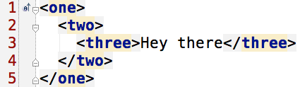
Element Name: %
Haml
HTML

Slide 6

Attributes: {}
Haml
HTML

Slide 7

Boolean Attributes
Haml
HTML

Slide 8

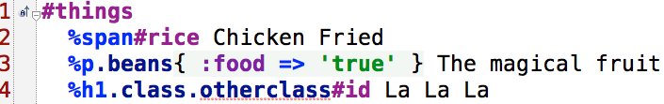

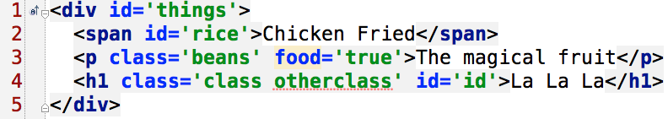
Class and ID: . and #
Haml
HTML

Slide 9
Doctype: !!!
XHTML 1.0 Transitional
!!!
<!DOCTYPE html PUBLIC "-//W3C//DTD XHTML 1.0 Transitional//EN" "http://www.w3.org/TR/xhtml1/DTD/xhtml1-transitional.dtd">
XHTML 1.0 Strict
!!! Strict
<!DOCTYPE html PUBLIC "-//W3C//DTD XHTML 1.0 Strict//EN" "http://www.w3.org/TR/xhtml1/DTD/xhtml1-strict.dtd">
XHTML 5
!!! 5
<!DOCTYPE html>

Slide 10

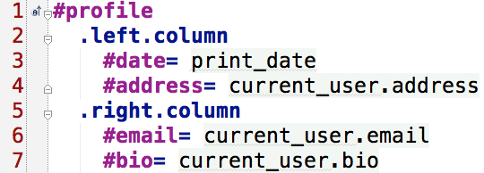

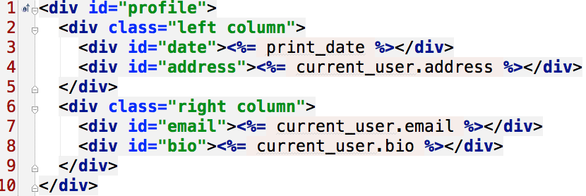
Haml vs HTML
Haml
HTML

Slide 11


Slide 12
Features
Fully CSS3-compatible
Language extensions such as variables, nesting, and mixins
Many useful functions for manipulating colors and other values
Advanced features like control directives for libraries
Well-formatted, customizable output

Slide 13


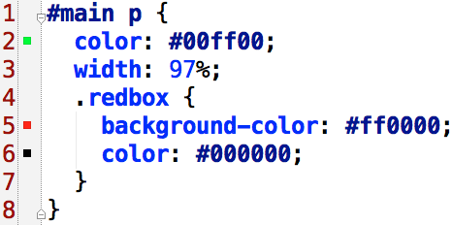
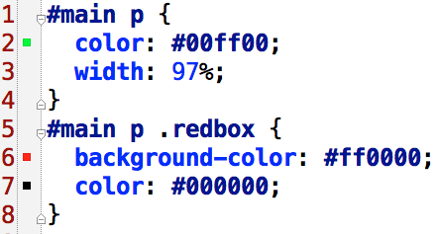
Nested Rules.
SCSS
CSS

Slide 14


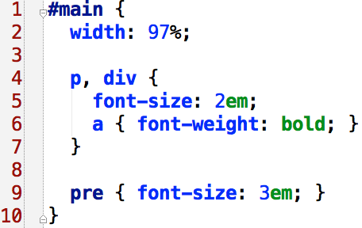
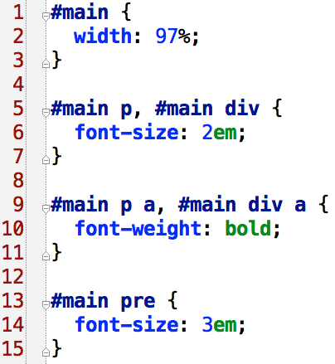
Nested Rules.
SCSS
CSS

Slide 15


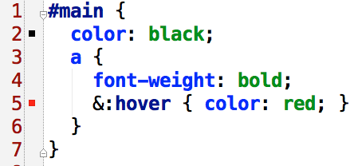
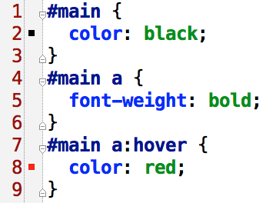
Referencing Parent Selectors: &.
SCSS
CSS

Slide 16


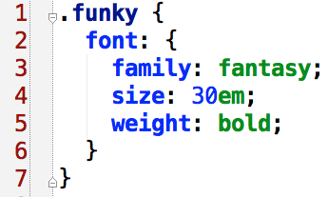
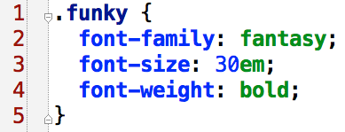
Nested Properties
SCSS
CSS

Slide 17


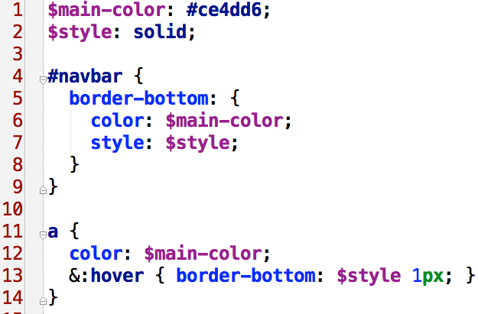
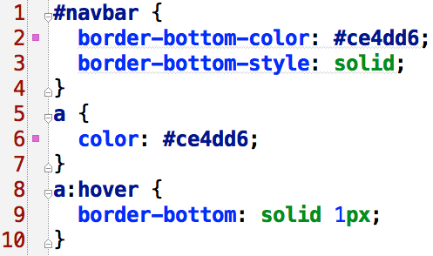
Variables
SCSS
CSS

Slide 18




Interpolation: #{}
SCSS
CSS

Slide 19


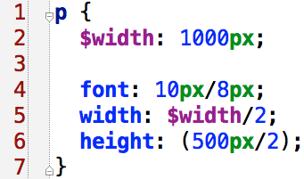
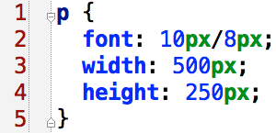
Number Operations
SCSS
CSS

Slide 20












Color Operations
SCSS
CSS

Slide 21


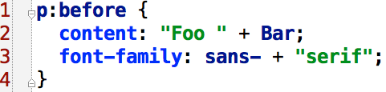
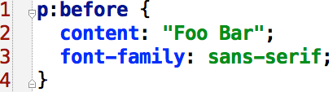
String Operations
SCSS
CSS

Slide 22




Functions
SCSS
CSS
http://sass-lang.com/docs/yardoc/Sass/Script/Functions.html

Slide 23


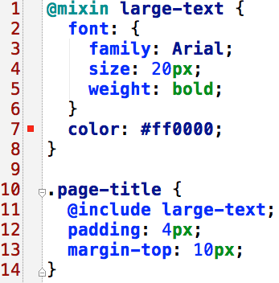
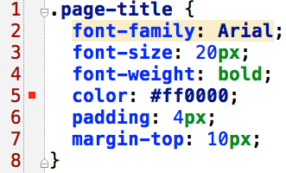
Mixins
SCSS
CSS

Slide 24


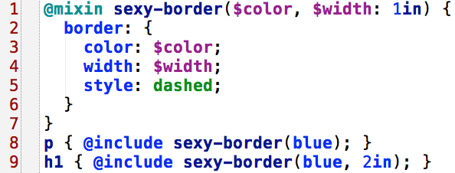
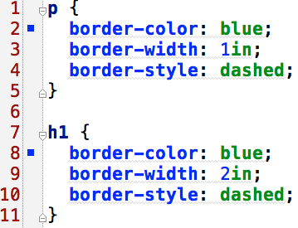
Arguments
SCSS
CSS

Slide 25


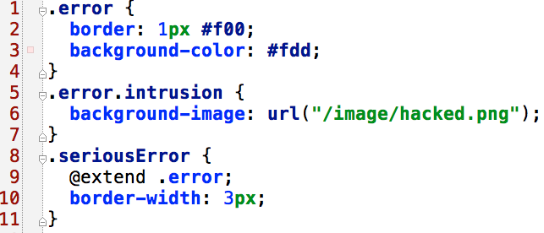
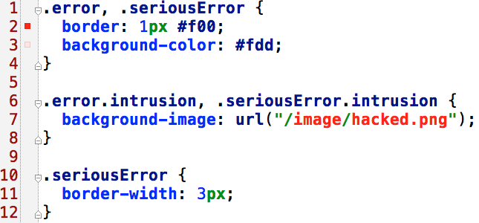
@extend
SCSS
CSS

Slide 26


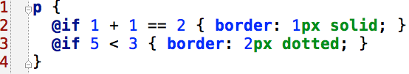



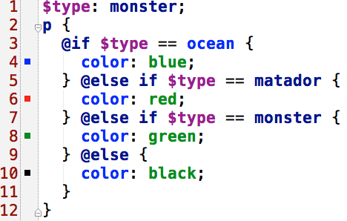

@if
SCSS
CSS

Slide 27



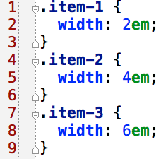
@for
SCSS
CSS

Slide 28

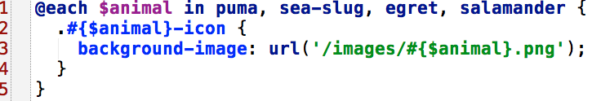

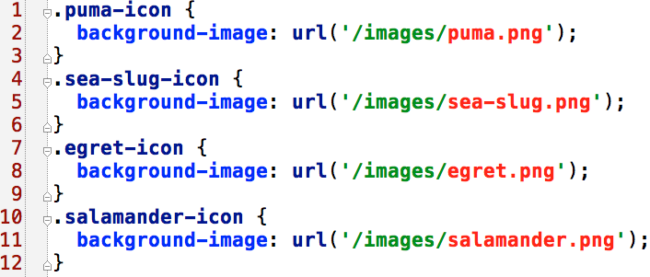
@each
SCSS
CSS

Slide 29


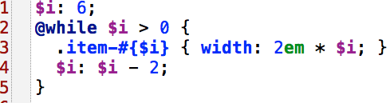
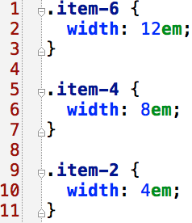
@while
SCSS
CSS

Slide 30


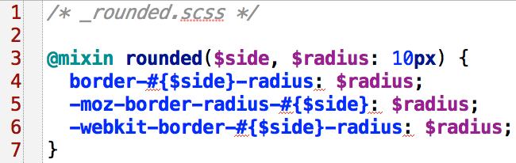
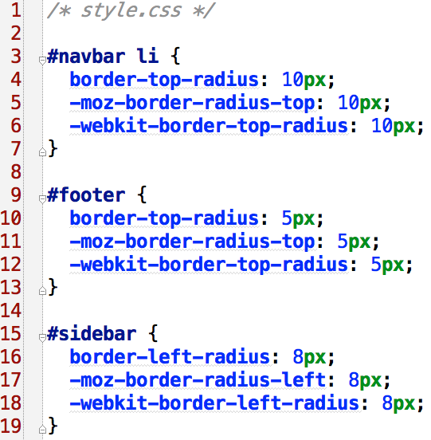

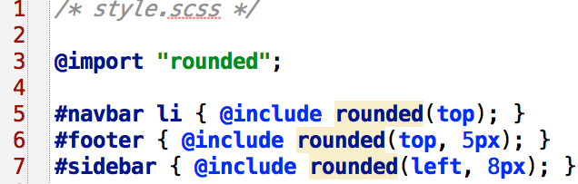
@import
SCSS
CSS

Slide 31


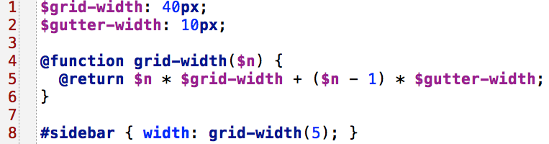

Function Directives
SCSS
CSS

Slide 32


Slide 33
Why designers love Compass
Experience cleaner markup without presentational classes
It’s chock full of the web’s best reusable patterns
Developing a personal framework is simple
Compass mixins make CSS3 easy
Download and create extensions with ease

Slide 34


Slide 35

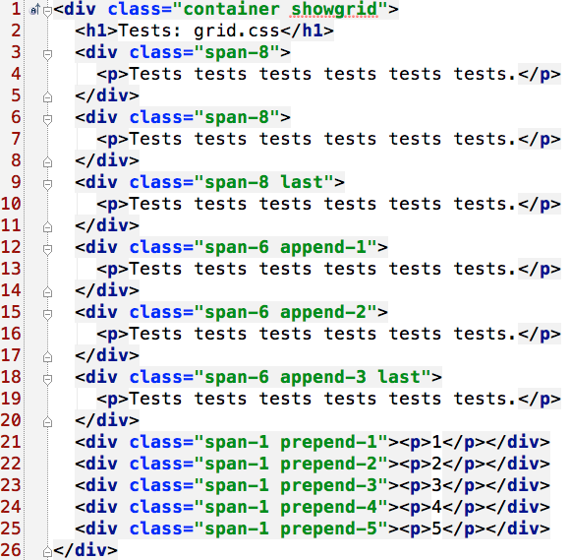

Slide 36

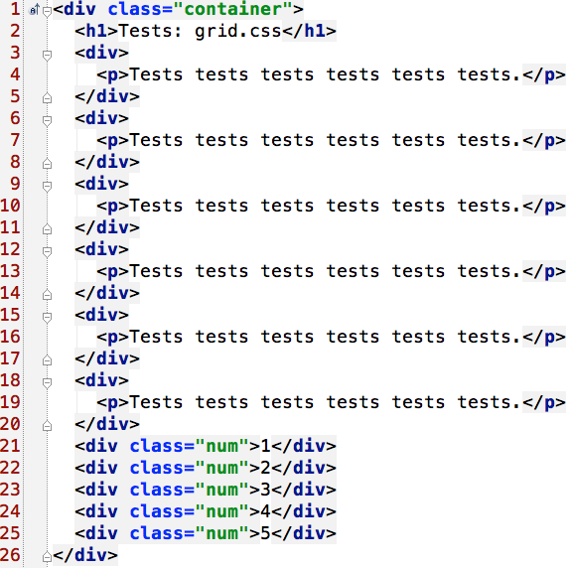

Slide 37


