Slide 1



IT Garage

Slide 2

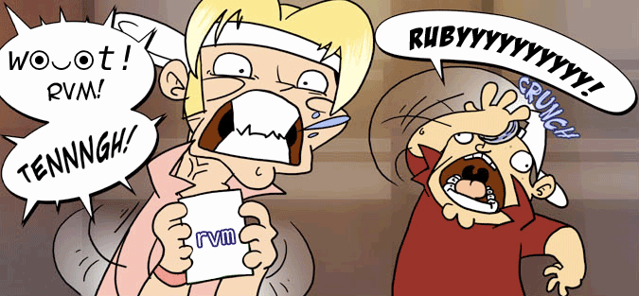




How to install and use

Slide 3

.rvmrc file

Slide 4



Slide 5


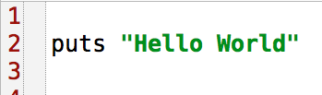
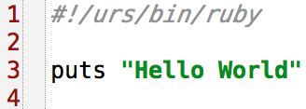


Hello world

Slide 6


Interactive Ruby

Slide 7

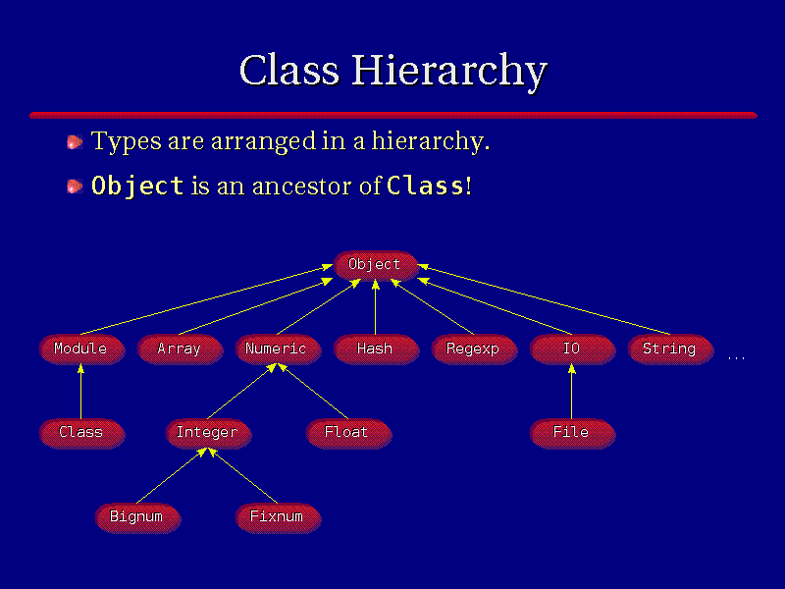
The Basic Types

Slide 8

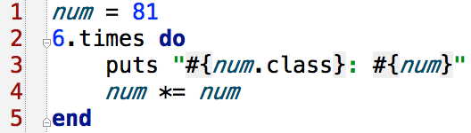


Numbers

Slide 9

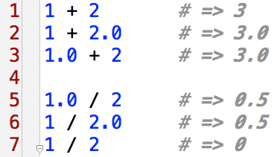
Numbers conversion

Slide 10

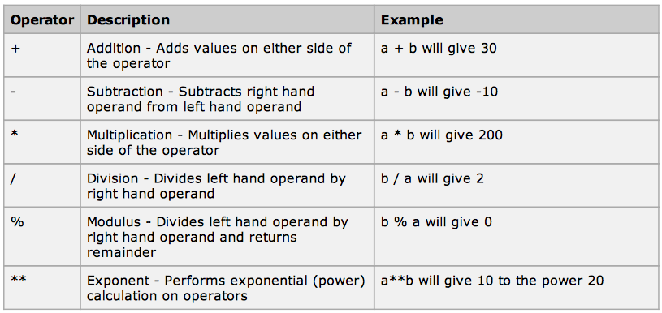
Ruby Arithmetic Operators

Slide 11

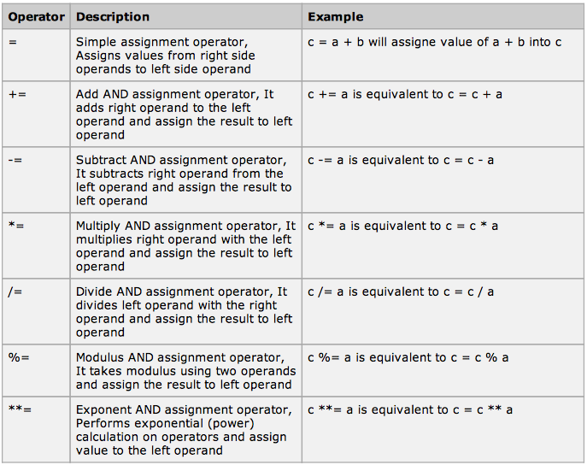
Ruby Assignment Operators

Slide 12
Numeric
http://www.ruby-doc.org/core-1.9.3/Numeric.html
Integer
http://www.ruby-doc.org/core-1.9.3/Integer.html
Float
http://www.ruby-doc.org/core-1.9.3/Float.html

Slide 13

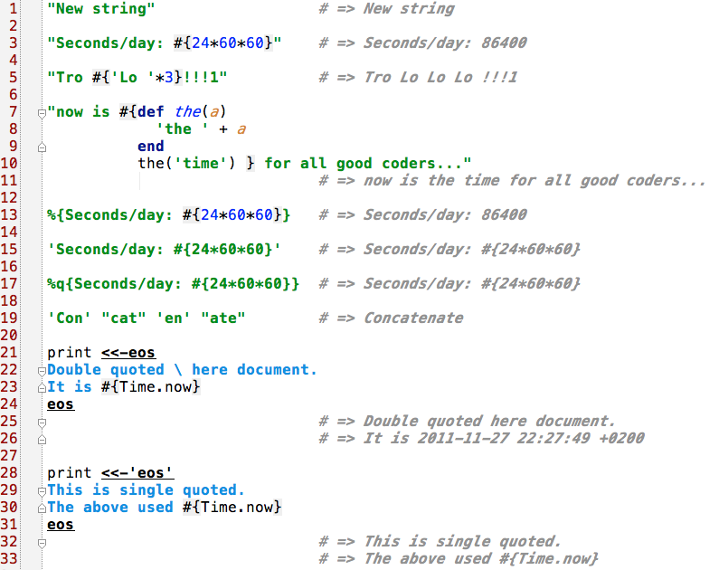
String

Slide 14
String
http://www.ruby-doc.org/core-1.9.3/String.html

Slide 15

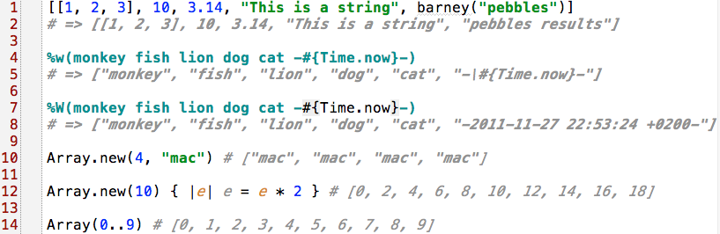
Arrays

Slide 16

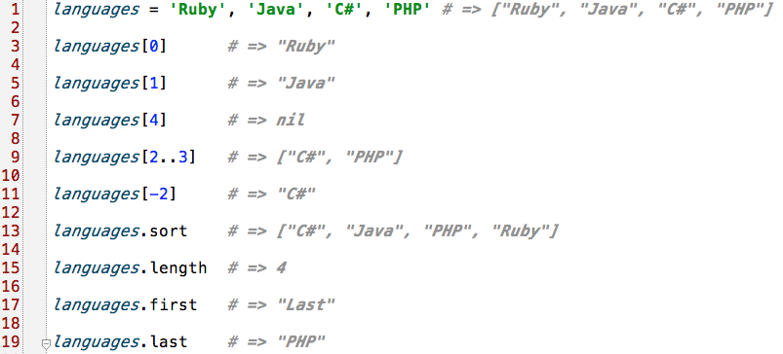
Arrays

Slide 17

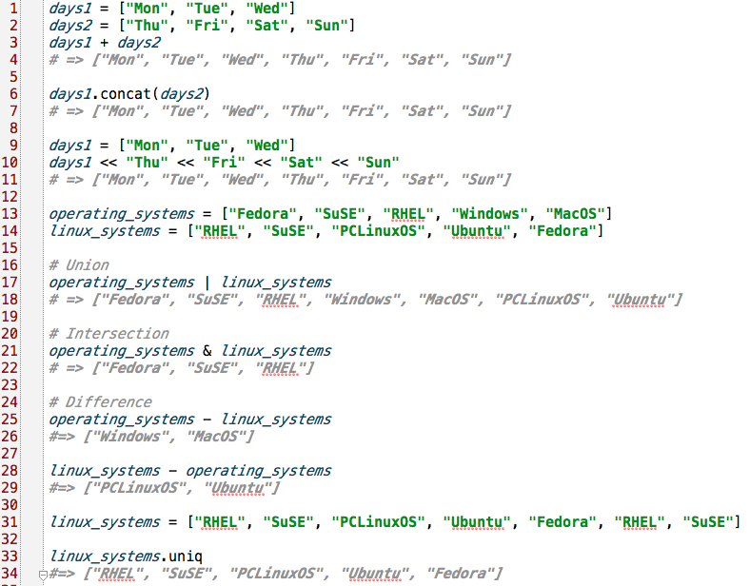
Arrays

Slide 18

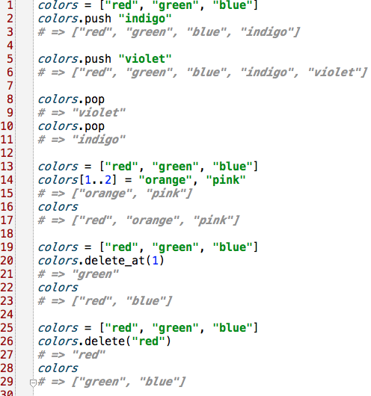
Arrays

Slide 19
Array
http://www.ruby-doc.org/core-1.9.3/Array.html

Slide 20

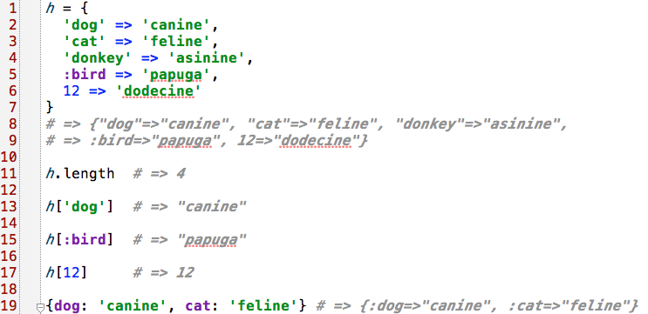
Hashes
http://www.ruby-doc.org/core-1.9.3/Hash.html

Slide 21

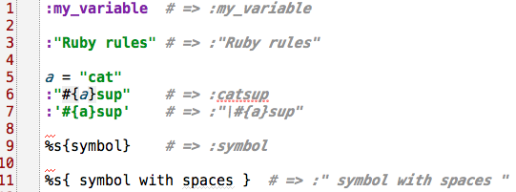
Symbol
http://www.ruby-doc.org/core-1.9.3/Symbol.html

Slide 22

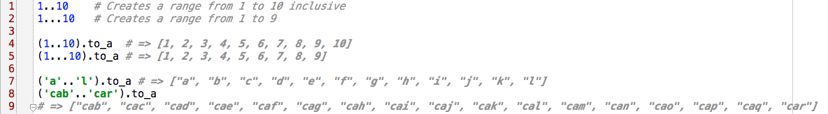
Ranges

Slide 23

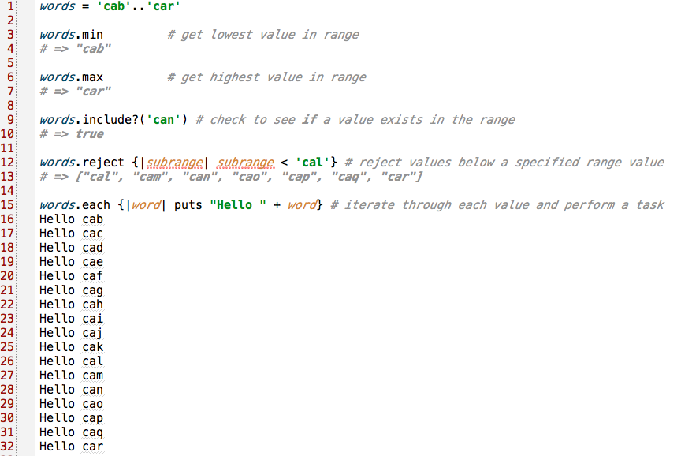
Ranges

Slide 24
Range
http://www.ruby-doc.org/core-1.9.3/Range.html

Slide 25

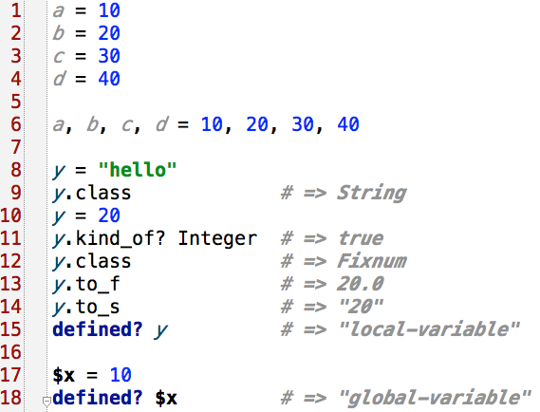
Variables

Slide 26

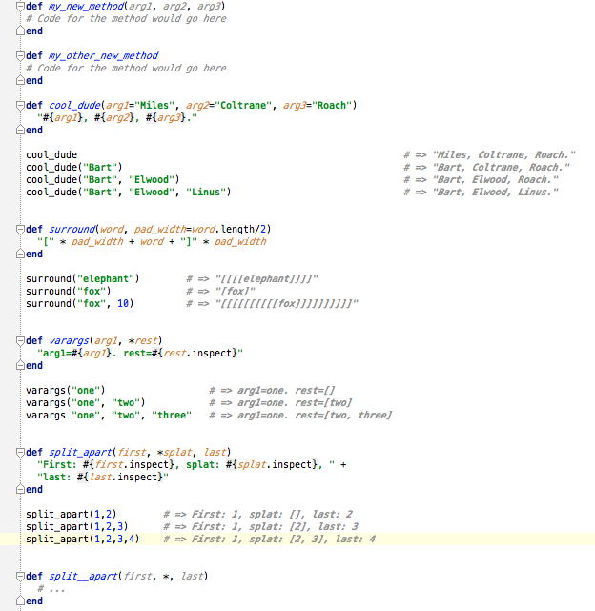
Methods

Slide 27

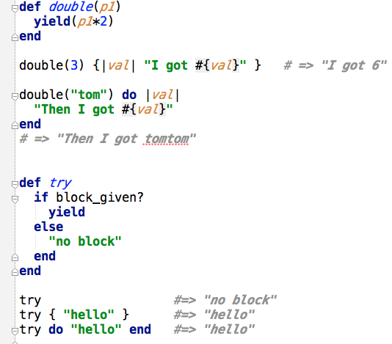
Methods and Blocks

Slide 28




Anonymous method

Slide 29

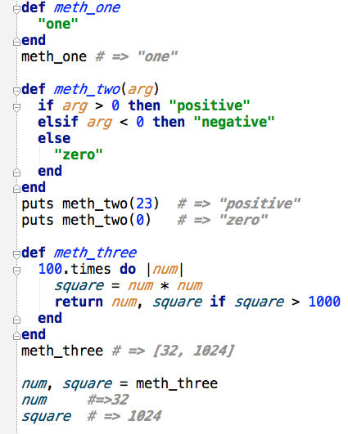
Method Return Values

Slide 30


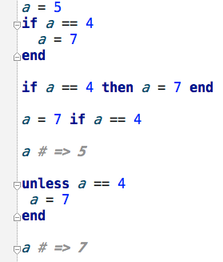
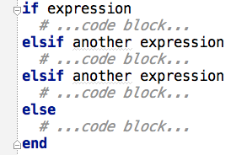
if expression
if - elsif - else expression

Slide 31



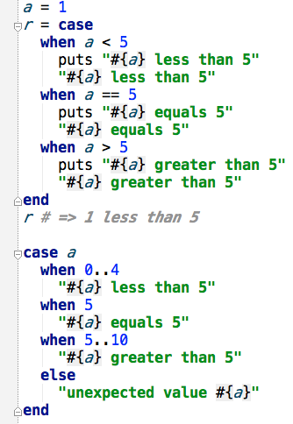
short-if expression
case expression

Slide 32


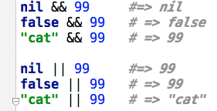
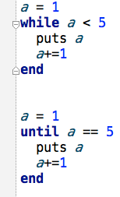
Or, And
Loops while, until

Slide 33

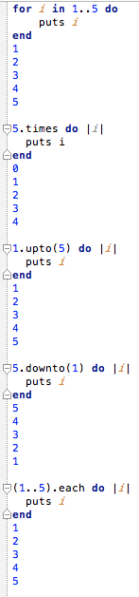
Loops

Slide 34

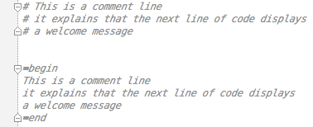
Comments

Slide 35

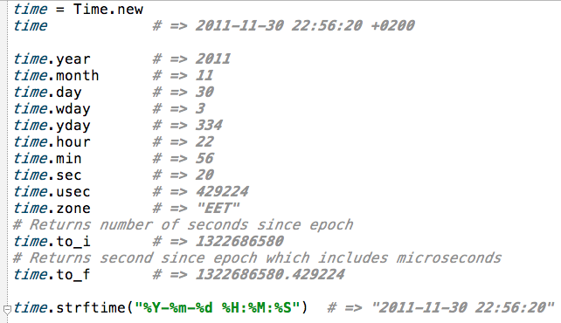
Time
http://www.ruby-doc.org/core-1.9.3/Time.html

Slide 36

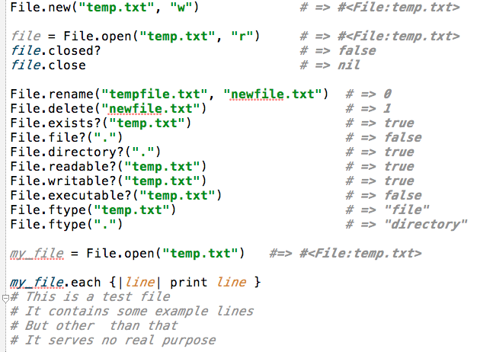
File
http://www.ruby-doc.org/core-1.9.3/File.html

Slide 37

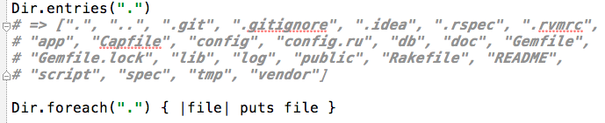
Dir
http://www.ruby-doc.org/core-1.9.3/Dir.html

Slide 38

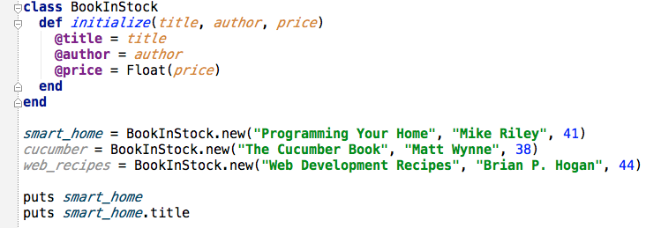

Classes, Objects

Slide 39

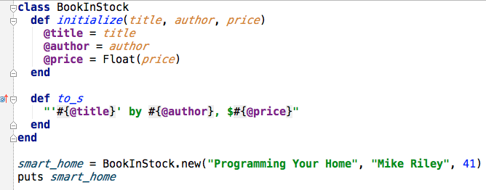


Classes, Objects

Slide 40


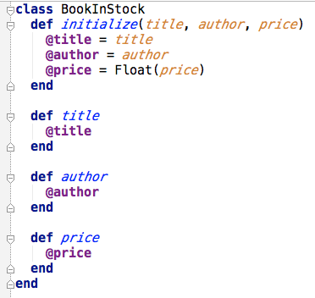
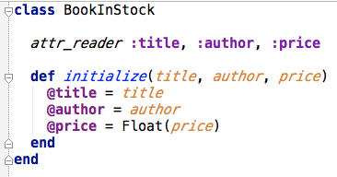




Classes, Objects

Slide 41


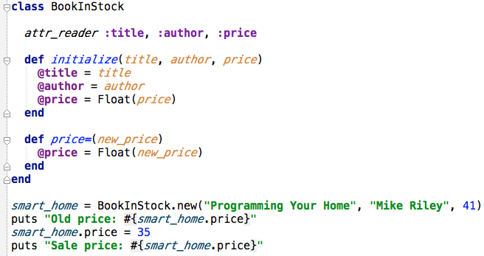
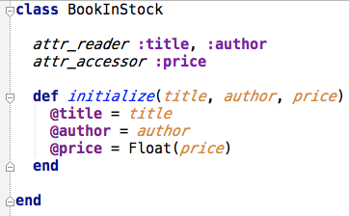


Classes, Objects

Slide 42

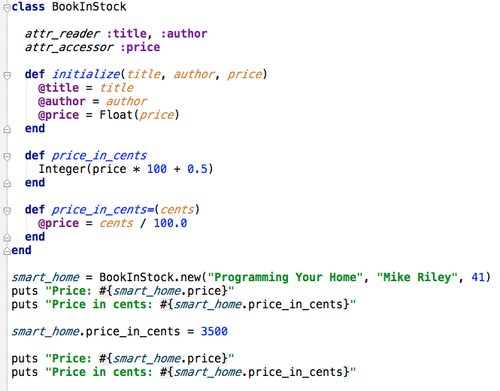


Classes, Objects, Virtual Attributes

Slide 43

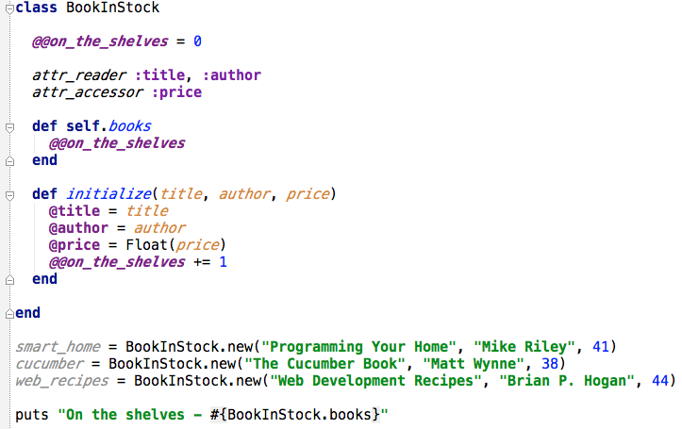


Class’s Attributes and Methods

Slide 44

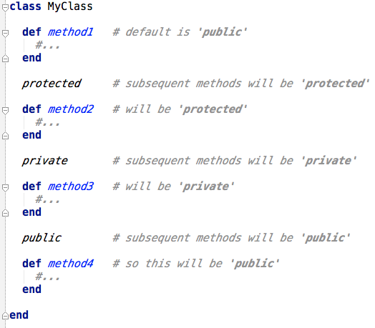
Classes, Objects, Access Control

Slide 45

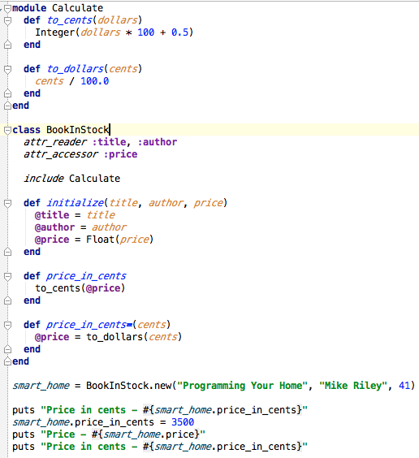


Mixins

Slide 46

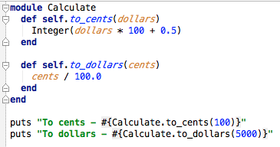


Module

Slide 47

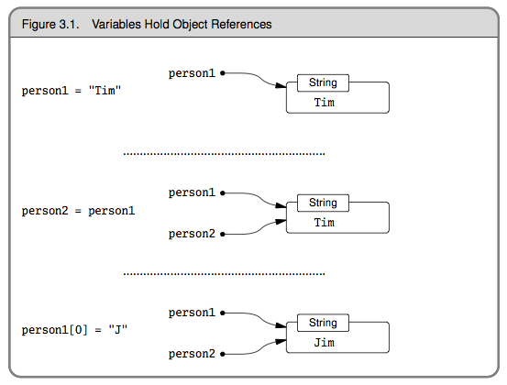
Classes, Objects, Variables

Slide 48



