Slide 1



Gem

Slide 2



Preparing environment
Installing bundler

Slide 3

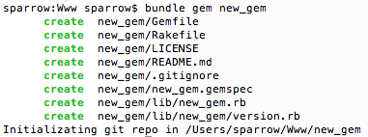

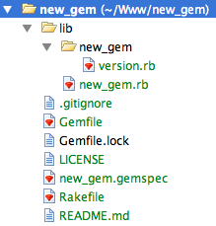
Creating gem with bundler
Gem structure

Slide 4

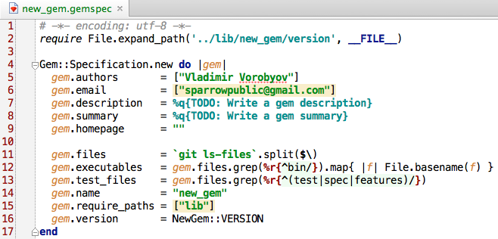

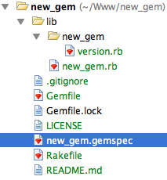
.gemspec file

Slide 5

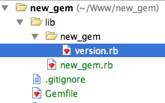


lib/new_gem/version.rb file

Slide 6


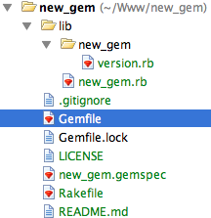
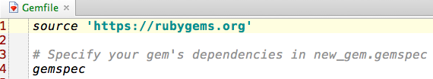

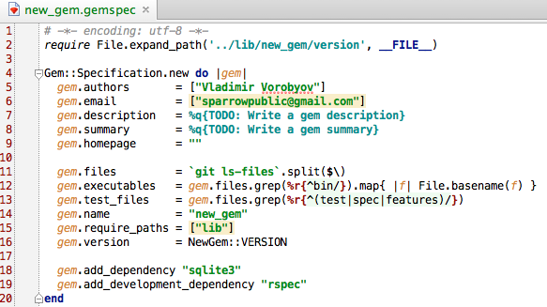
Gemfile

Slide 7


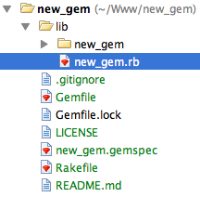
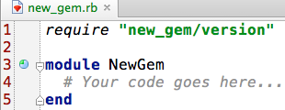
lib/new_gem.rb file

Slide 8


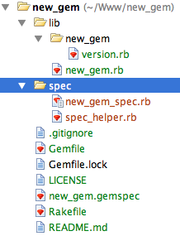
Testing
new_gem.gemspec
spec files

Slide 9



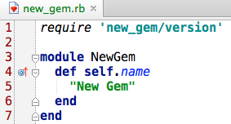

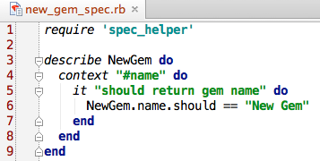


Testing

Slide 10



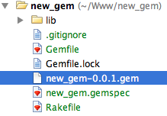




Build gem
Push gem to RubyGems.org
Push gem to RubyGems.org with rake

Slide 11


Great ideas

Slide 12



Console app
API
Social network

Slide 13



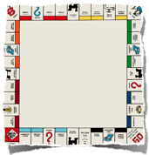
A Game
Card Games
Dice
Table games

Slide 14
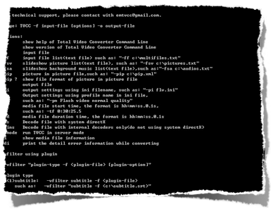
Console utility

Slide 15


