Slide 1



Slide 2
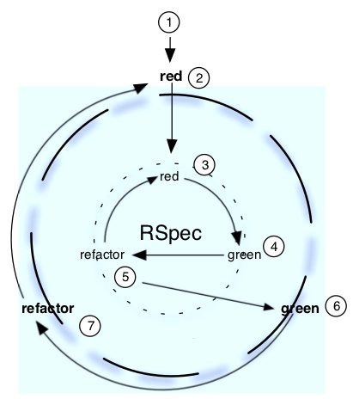
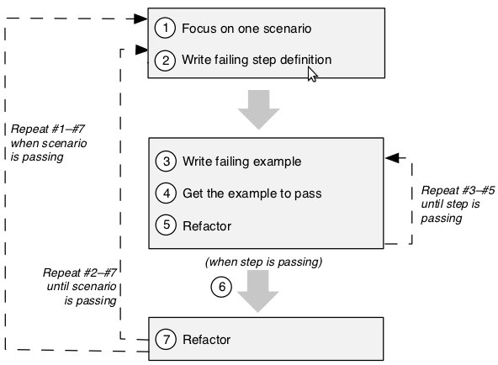
BDD cycle

Slide 3
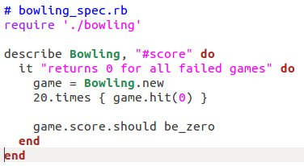
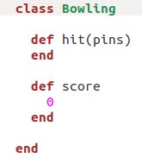
$ rspec bowling_spec.rb
./bowling_spec.rb:4:
uninitialized constant Bowling
$ rspec bowling_spec.rb
Bowling#score
returns 0 for all failed games
Finished in 0.007534 seconds
1 example, 0 failures

Slide 4
Setup (create data)
Expected value
Actual value
Verification: actual == expected
Cleanup (remove data if needed)

Slide 5
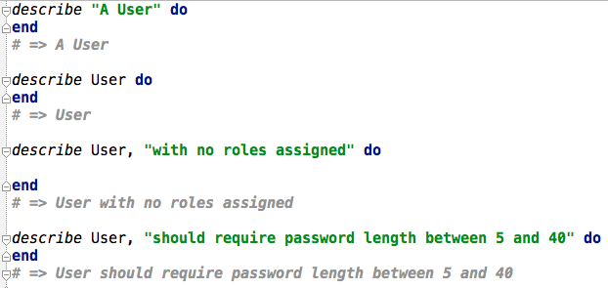
We use the describe( ) method to define an example group.
The describe() method takes an arbitrary number of arguments and an optional block, and returns a subclass of RSpec::Core::ExampleGroup.

Slide 6
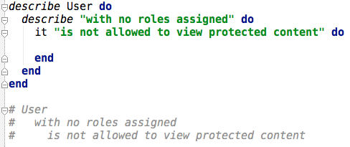
Nested example groups

Slide 7
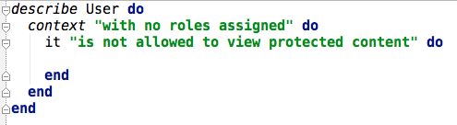
The context() method is an alias for describe()

Slide 8

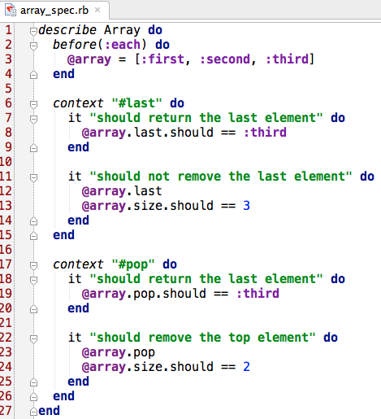



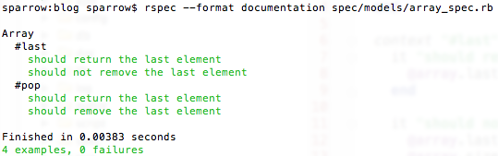
What’s it() All About?
The it() method takes a single String, an optional Hash and an optional block.
String with 'it' represents the detail that will be expressed in code within the block.

Slide 9
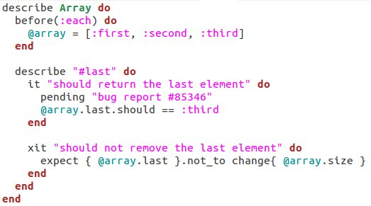
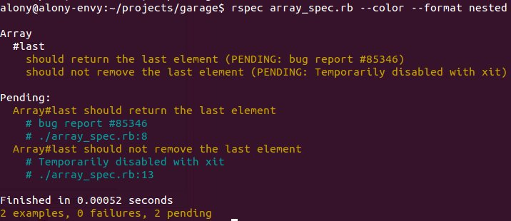
Pending

Slide 10
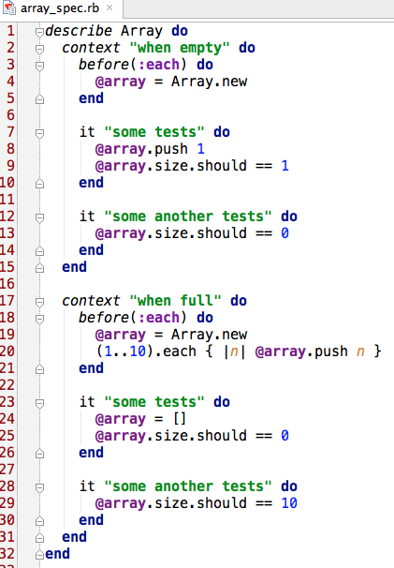

before(:each)

Slide 11
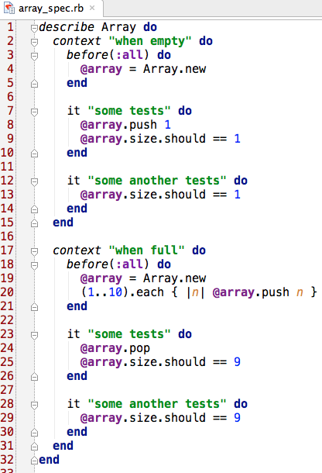

before(:all)

Slide 12
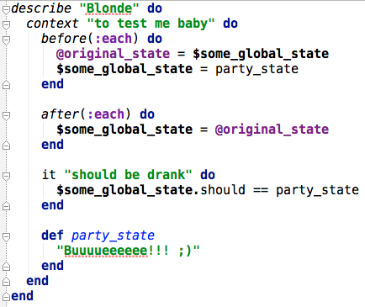
after(:each)
after(:all)

Slide 13
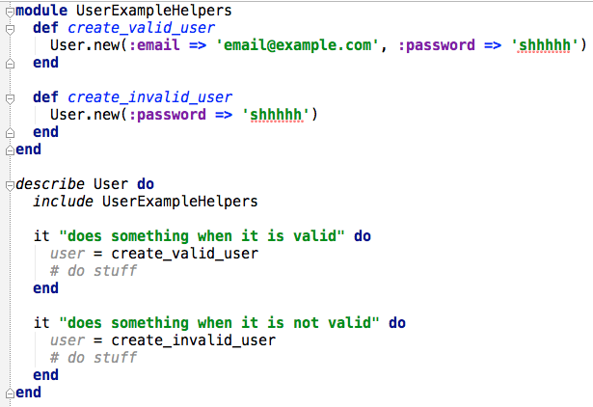

Sharing Helper Methods

Slide 14
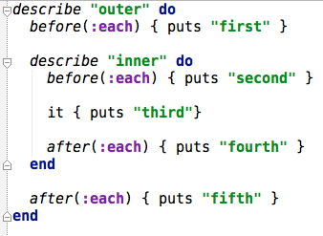
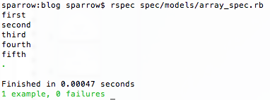
Nested Example Groups

Slide 15
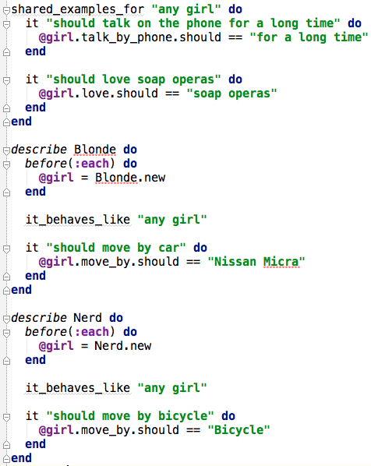
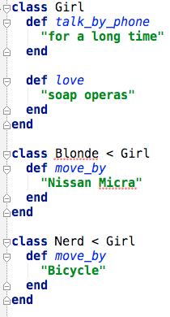
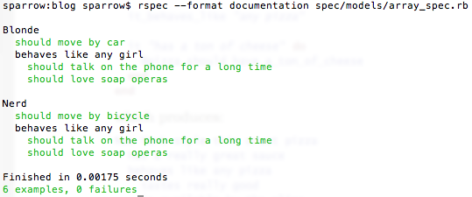
Shared Examples

Slide 16
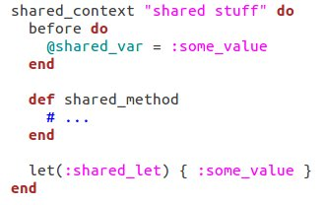
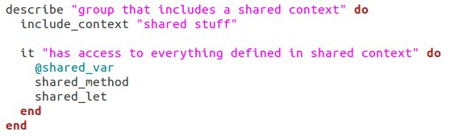
Shared Contexts

Slide 17
Expectations
obj.should == 5
obj.should eql(5)
Use ==
obj.should equal(5)
eql, ==
- compare values
equal, ===
- compare objects, classes
Do not use != with RSpec.
Use should_not instead.

Slide 18


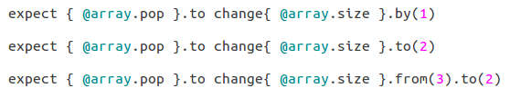
Changes
by( ), to( ), from( )

Slide 19
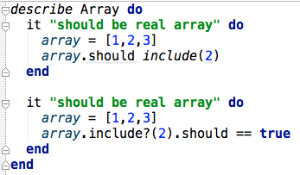
Include

Slide 20
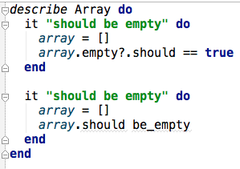
Be or not to be
How They Work
“be_” -> “?”
“be_empty” -> “empty?”
“be_blank” -> “blank?”
“be_true” -> “true?”

Slide 21

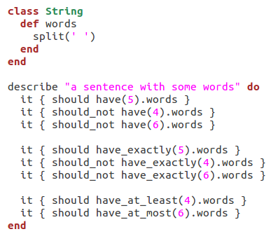

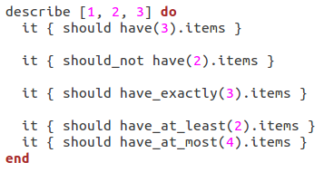
should have(number).named_collection__or__sugar

Slide 22



Slide 23
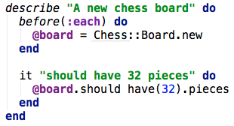

Specify

Slide 24


Subject

Slide 25
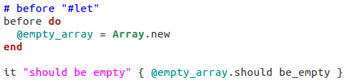

Let

Slide 26


double, stub, mock

Slide 27

Method Stubs

Slide 28
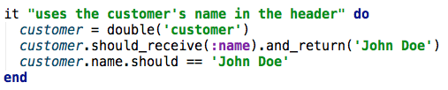
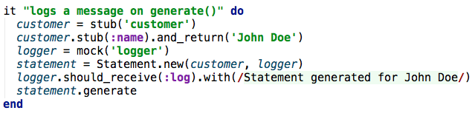
Method should_receive

Slide 29
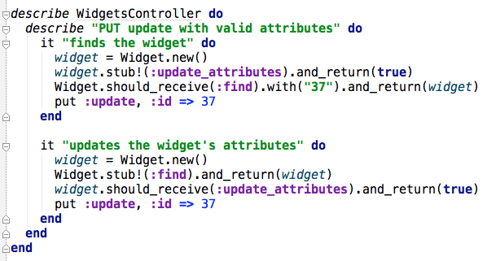
Method should_receive

Slide 30


More on Method Stubs

Slide 31
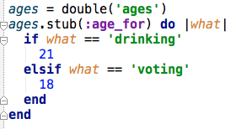
More on Method Stubs

Slide 32
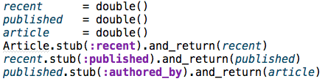
Stub Chain

Slide 33
Counts

Slide 34
Negative Expectation

Slide 35
Specifying Expected Arguments
If the expected argument is a Hash:

Slide 36
Throwing or Raising

Slide 37
Ordering

Slide 38
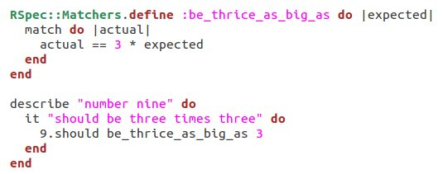
RSpec custom matchers

Slide 39
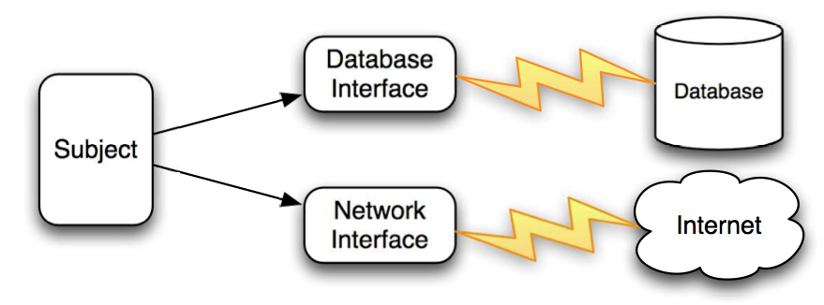
External Dependencies

Slide 40
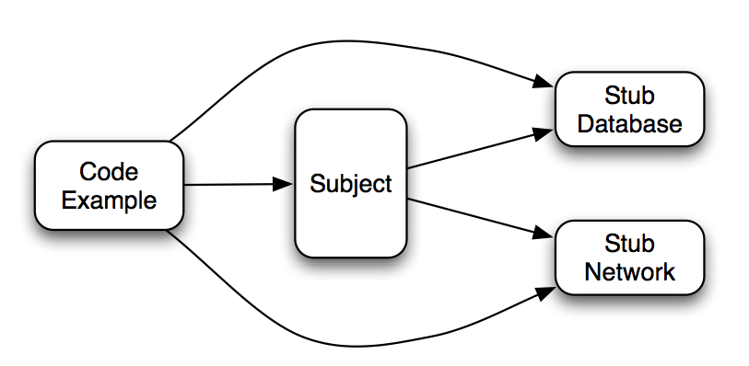
Stubbed Dependencies

Slide 41
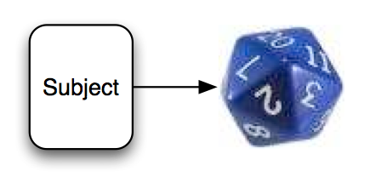
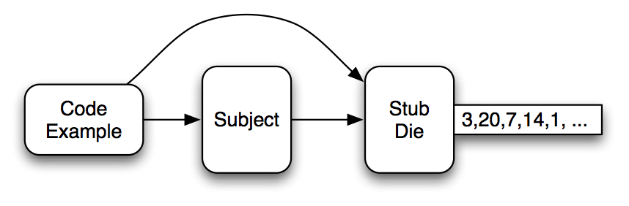
Dependency on a random generator

