Slide 1
Little presentation on Mtcars dataset

Slide 2
Everything is data...

Slide 3
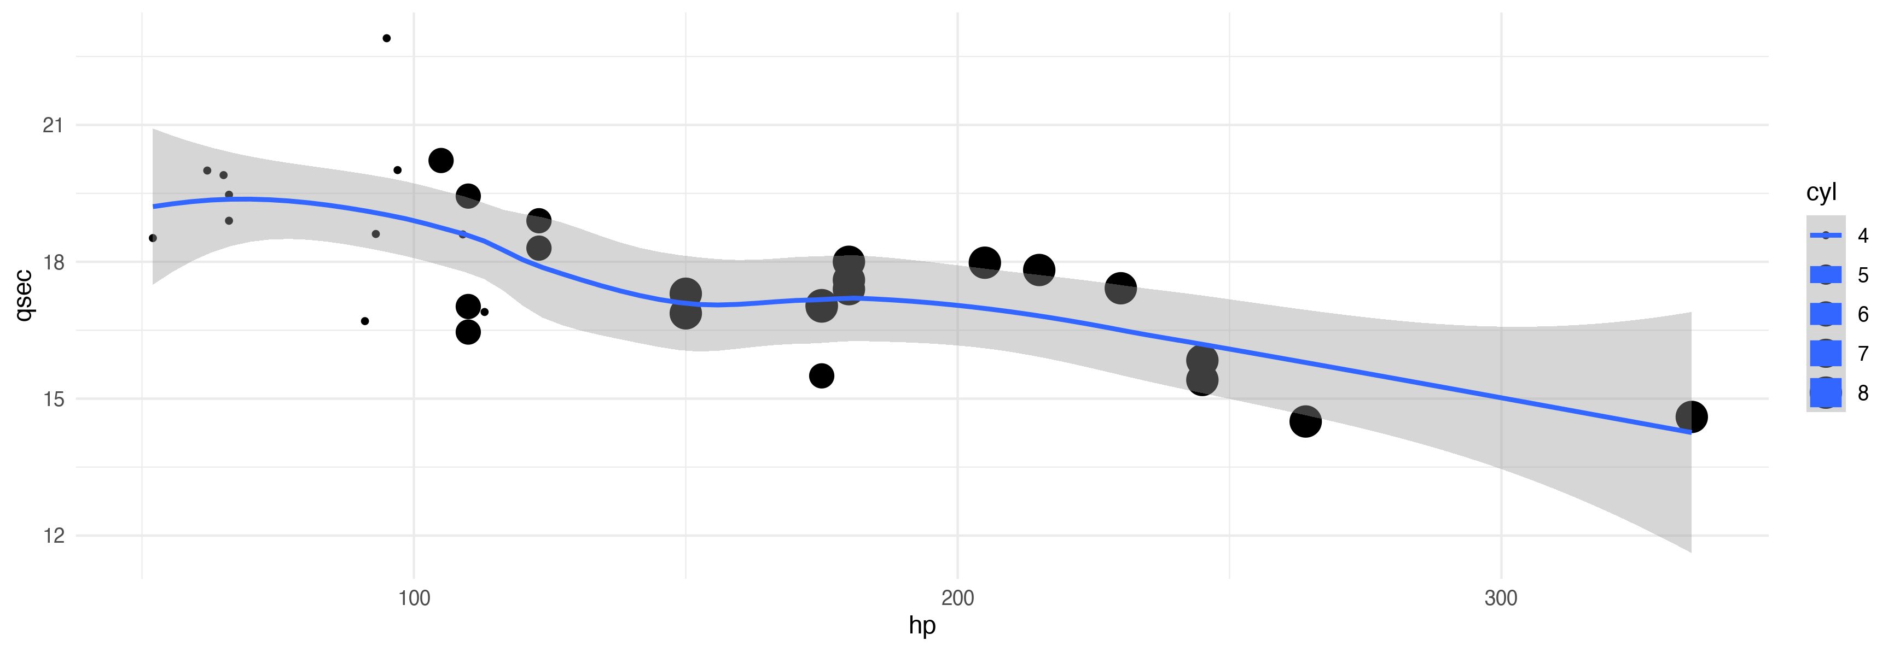
1/4 mile time dependence on Gross horse power

Slide 4
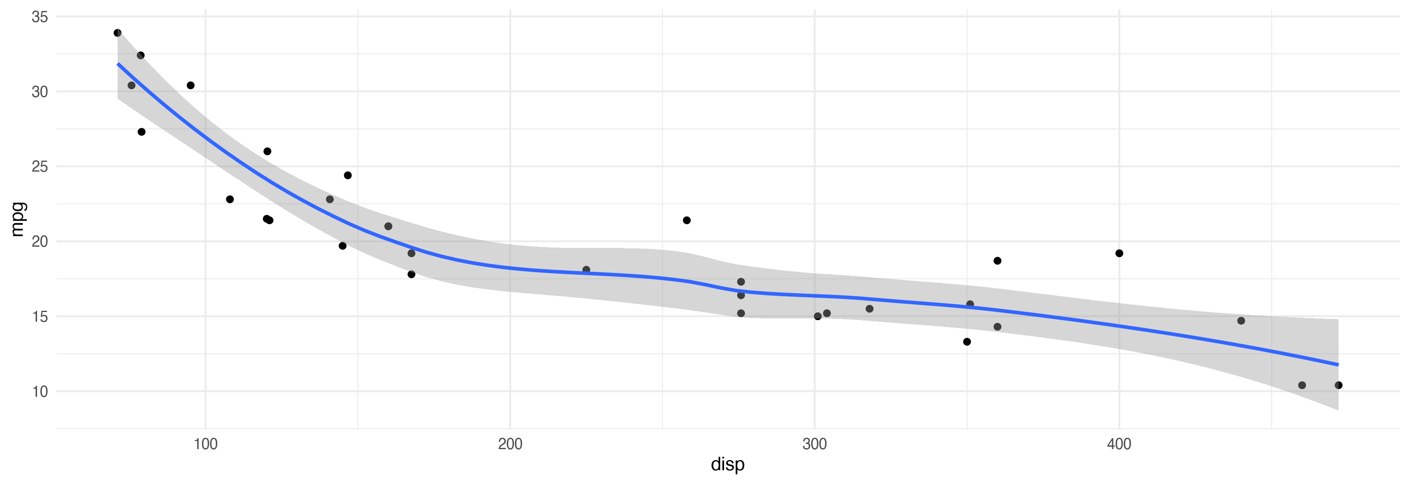
Miles/(US) gallon dependence on Displacement (cubic inches)

