Slide 1
DOORI
The Social Distancing Tracker
ZEROTH REVIEW

Slide 2
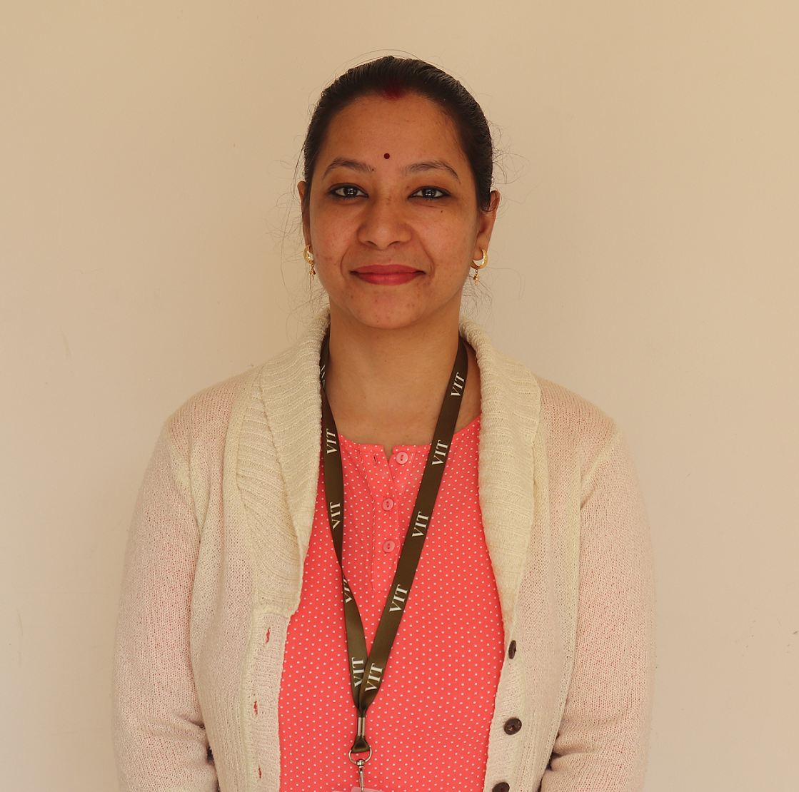
Project Guide
Dr. Abha Trivedi
Assistant Professor

Slide 3
Team Members
Shikhar Vashishtha – 19BCE10025
Vardaan Vishnu – 19BCE10063
Prantik Bhattacharjee – 19BCE10222
Prashant Chauhan – 19BCE10280

Slide 4
Introduction
In the current Covid-19 situation, it is very important to maintain social distancing in public places. The safety measures taken by the governments around the world have failed in front of the deadly first wave of Covid-19, due to lack of social distancing practice. Newer variants of the virus have emerged that are equivalent or more dangerous than the previous one. Thus, it becomes a monumental challenge to tackle the issue of social distancing in an overly populated country like India.
Hence, we come forward with our project, Doori, a social distancing tracker, based on Computer Vision. Our project’s main objective is to help authorities implement Social distancing in public places & offices.

Slide 5
Proposed work
Doori aims to combine Computer Vision to create a real-time social distance monitoring software.
It would be able to scan for environments in real-time for breach of bio-bubbles. The parameters will be flexible, so that the administrators can use them at their own behest.
It utilizes OpenCV library and YOLO v3(You only look once) for real-time object detection to detect humans.

Slide 6
Existing work with limitations
Social distancing trackers have emerged, due to their usefulness in ensuring proper WHO guidelines on COVID-19 be followed.
But softwares lack the integration of a mask detector in them, i.e. software available in the market are either mask detection focused, or they are focused on social distancing.
Both of these features are not integrated in a single package, since they have different requirements w.r.t. Their physical limitations.

Slide 7
Real Time Usage
Various daily life tasks have been automated with the help of computer vision (branch of AI). How our app can be used in real time scenario:
The algorithm can be used to analyze social distancing in a public area and carry out necessary actions to better deal with the pandemic.
Automating the task will lead to effective actions taken in a short time hence equipping us better to deal with the situation.

Slide 8
Hardware & software requirements
The Software requirements are:
OpenCV for Python
Hardware requirements include:
Camera
24x7 running System for seamless tracking and to run python script

Slide 9
Overall system architecture diagram
Apply object detection to detect all people (and only people) in a given image/frame.
Compute the pairwise distances between all detected people.
Based on these distances, check to see if any two people are less than N pixels apart.
Loop the entire process for all consequent frames.

Slide 10
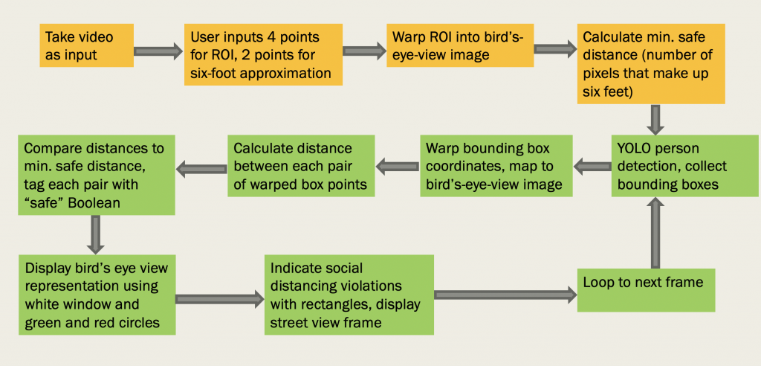

Slide 11
Thank You!

