Slide 1
DOORI
The Social Distancing Tracker
REVIEW 2

Slide 2
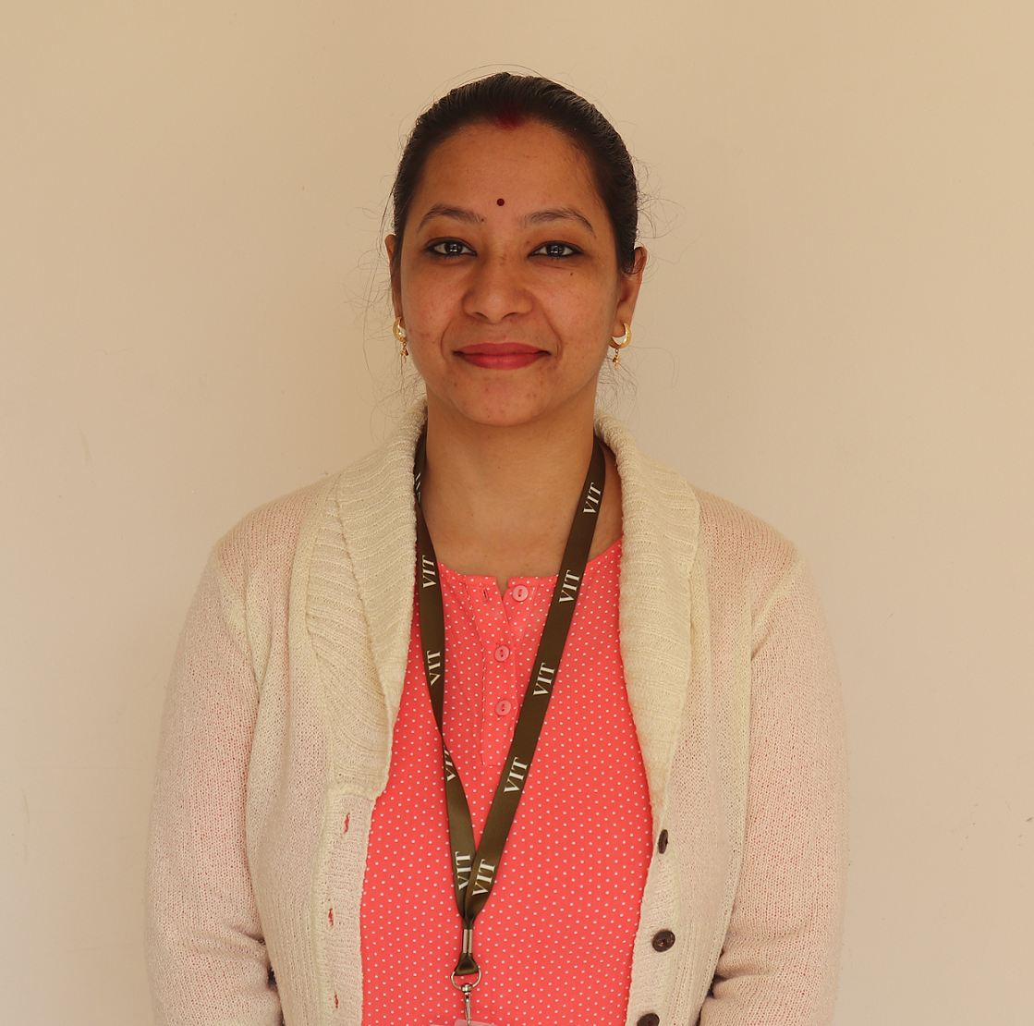
Project Guide
Dr. Abha Trivedi
Assistant Professor

Slide 3
Team Members
Shikhar Vashishtha – 19BCE10025
Vardaan Vishnu – 19BCE10063
Prantik Bhattacharjee – 19BCE10222
Prashant Chauhan – 19BCE10280

Slide 4
Objective & Problem Statement
In the current Covid-19 situation, safety measures taken by the governments around the world have failed in front of Covid-19, due to lack of social distancing practice.
Newer variants of the virus have emerged that are equivalent or more dangerous than the previous one. Thus, it becomes a monumental challenge to tackle the issue of social distancing in an overly populated country like India.
Doori aims to combine Computer Vision to create a real-time social distance monitoring software so that administrators can use them to locate breach of bio-bubbles. It uses OpenCV library and YOLO v3 for real-time human detection.

Slide 5
Hardware & software requirements
The Software requirements are:
OpenCV for Python
Hardware requirements include:
Camera
24x7 running System for seamless tracking and to run python script

Slide 6
Overall system architecture diagram
Apply object detection to detect all people (and only people) in a given image/frame.
Compute the pairwise distances between all detected people.
Based on these distances, check to see if any two people are less than N pixels apart.
Loop the entire process for all consequent frames.

Slide 7
Incorporating Corrections & Suggestions
ROI
Filming Angle
Camera Distortion
Not Constant
Bird’s-eye-view
Distortion
What’s important
Solves the problem
Venus has a beautiful name, but it is terribly hot
Constant Conversion Rate

Slide 8
How CV does Image Processing
Calibration
Remove Noise
OpenCv
Irrelevant Areas
Movements

Slide 9
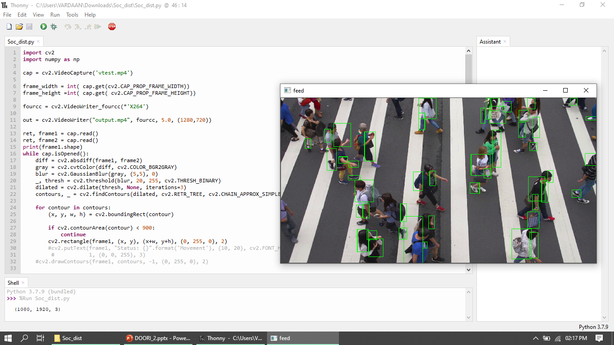
Demo

Slide 10
Future Improvements
Implement the same using Deep Learning & Artificial Intelligence, for better results.
Train our model using Machine Learning for better accuracy.
Implement an effective algorithm for Social Distance Tracking.

Slide 11
Thank You!

