Slide 1
Multi-Dimensional bin packing problem (GA + wisdom of crowds)
Daniella Arteaga Mendoza, Olivia Benner, Rinku deuja, Nate Eriksen, hannah winstead

Slide 2
Multi-dimensional bin packing
MDBPP: Assigns VMs (CPU, RAM, Storage) to physical servers
Goal: Minimize the number of servers used
Constraints: Server capacity cannot be exceeded in any dimension
Requires heuristics due to NP-complete nature for large-scale VM assignments
Real-world relevance: Poor VM placement = waste or overload = higher costs

Slide 3
Genetic Algorithm
Chromosome Representation: Each solution is a vector that assigns every virtual machine to a specific server
Population Initialization: Uses 8 different starting strategies to ensure diverse initial solutions (random assign., largest/smallest-first, best-fit decreasing, worst-fit, CPU-first heuristic, RAM-first heuristic, storage-first priority)
Fitness Function = 100 x server count +wasted resources
Genetic Operators: Tournament selection, custom crossover, multiple mutation types
Diversity Mechanisms: Immigration + adaptive mutation
Elitism: Top 10% preserved
Stopping Criteria: Algorithm ends after 50-100 generations or when no progress occurs after 30 iterations

Slide 4
Wisdom of crowds
Uses top 20 GA solutions to identify which VMs frequently work well when placed on the same server
Builds co-occurrence matrix showing how often VM pairs appear together
Generates 10 new solutions using affinity-based heuristic
Blends pattern scores with resource-fit scores
Produces GA-quality solutions at a fraction of the runtime

Slide 5
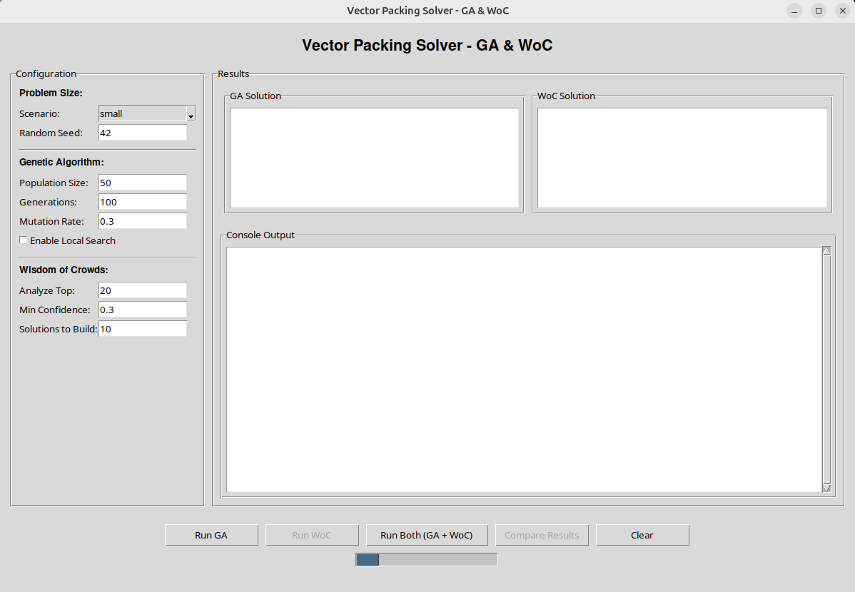
Test data & Setup
Used 4 dataset sizes to evaluate scalability: 20, 50, 100 and 200 VMs
VM resource has realistic CPU, RAM, and storage requirements
Server limits modeled after typical datacenter machines to ensure realistic constraints
GUI built in Tkinter for live visualization
Tracks runtime, server count, fitness and GA vs. WOC placement differences

Slide 6
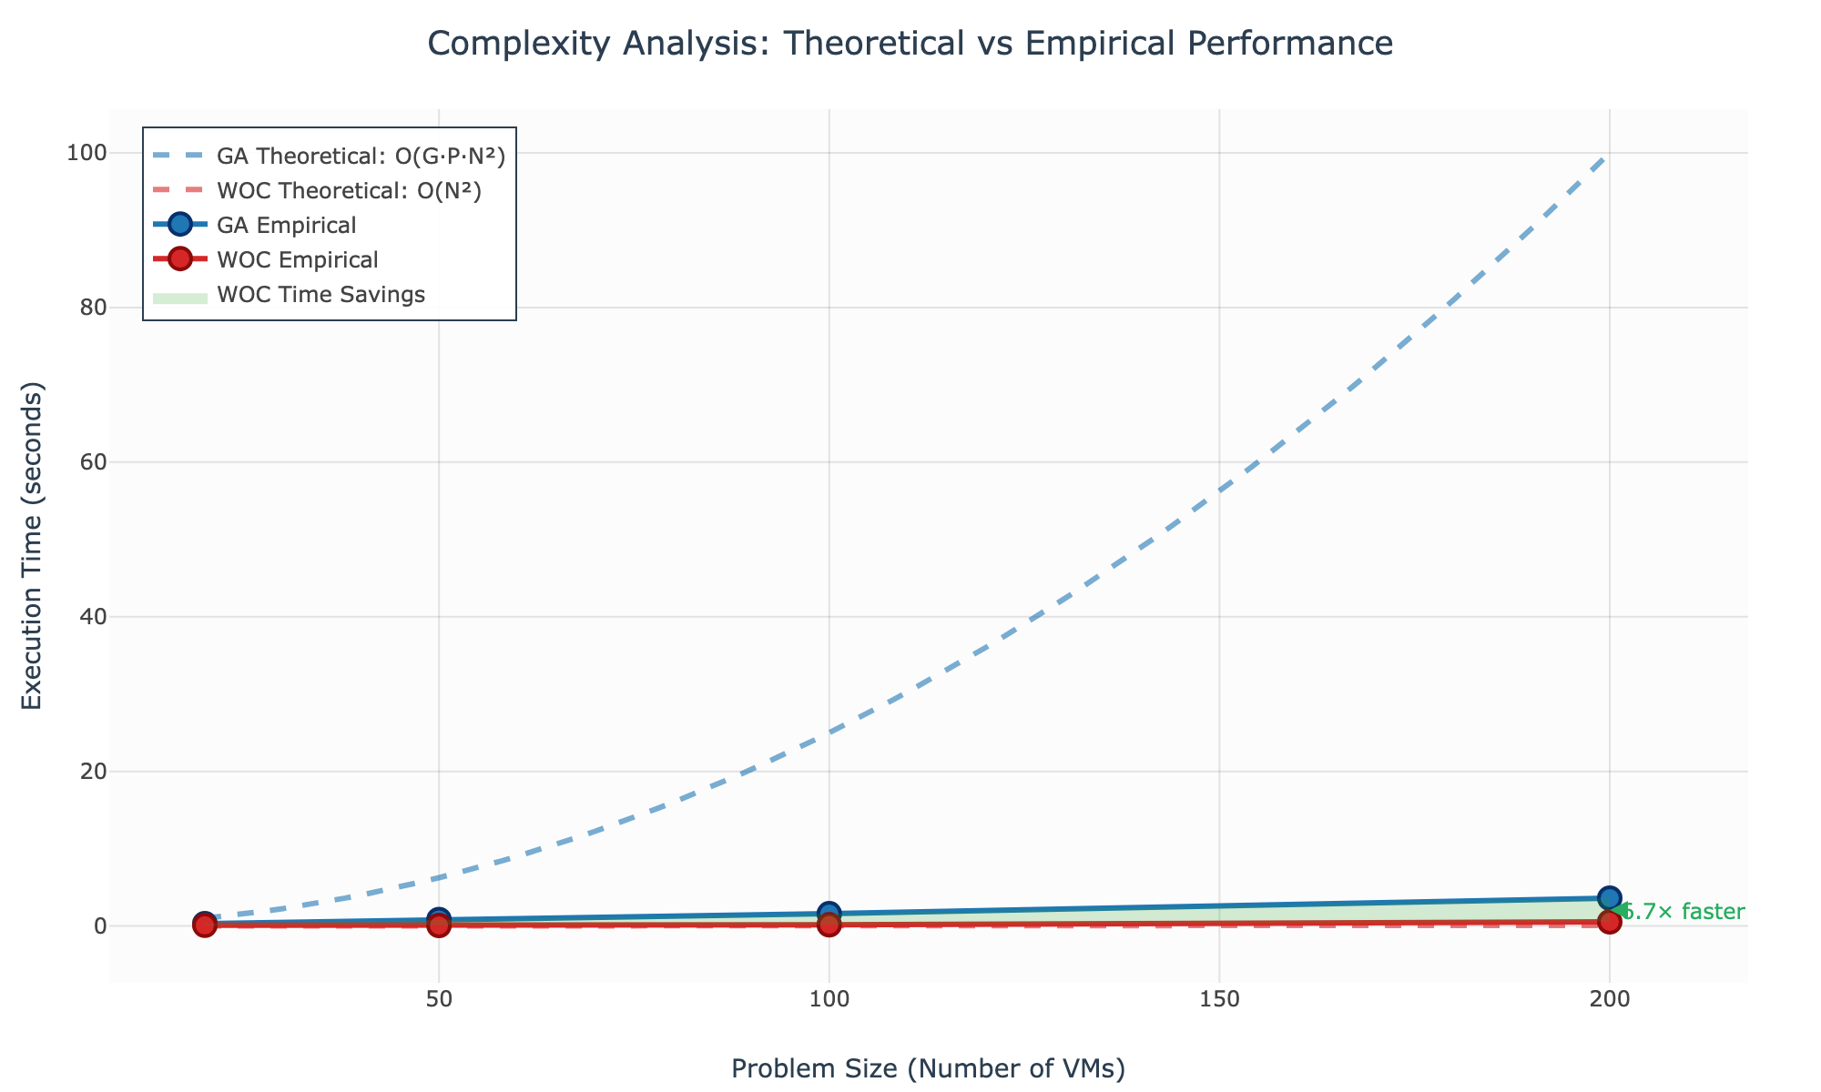
complexity
GA
Cost per generation: O(P x N²), dominated by crossover
Total runtime: O(G x P x N²)
Space complexity: O(P x N)
WOC
Pattern extraction + solution generation: O(N²)
Co-occurrence matrix dominated space: O(N²)
Much faster when GA generation count is large
• GA: O(G·P·N²) = O(50·50·N²) = O(2500·N²)
• WOC: O(N²) (Pattern Analysis + Solution Building)
• Ratio: GA/WOC ≈ 2500:1 for same problem size

Slide 7
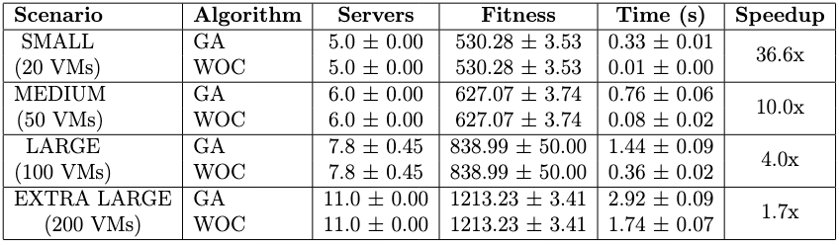
Results
Same solution quality for all dataset sizes (servers used, fitness)
WOC greatly reduces runtime:
  Small datasets: 36x faster
  Medium datasets: 10x faster
  Large datasets: 4x faster
  Extra-large datasets: 1.7x faster
Different VM placements can yield the same fitness verifying multiple near-optimal solutions
WOC maintains quality while reducing runtime

Slide 8
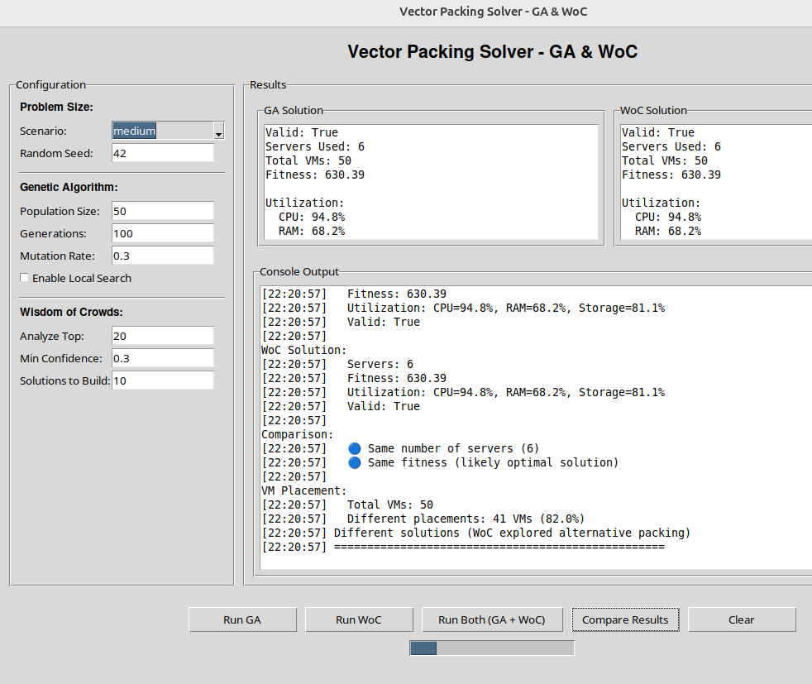
Key Findings
Hybrid GA + WOC approach matches GA’s solution quality while cutting execution time significantly
Speedup inversely proportional to problem size
The GA generates strong solutions early on, giving WOC high-quality patterns to learn from
WOC accurately identifies VM groupings, helping it recreate strong solutions quickly
Large datasets show high solution diversity (82-94% different placements), confirming many near-optimal configurations

Slide 9
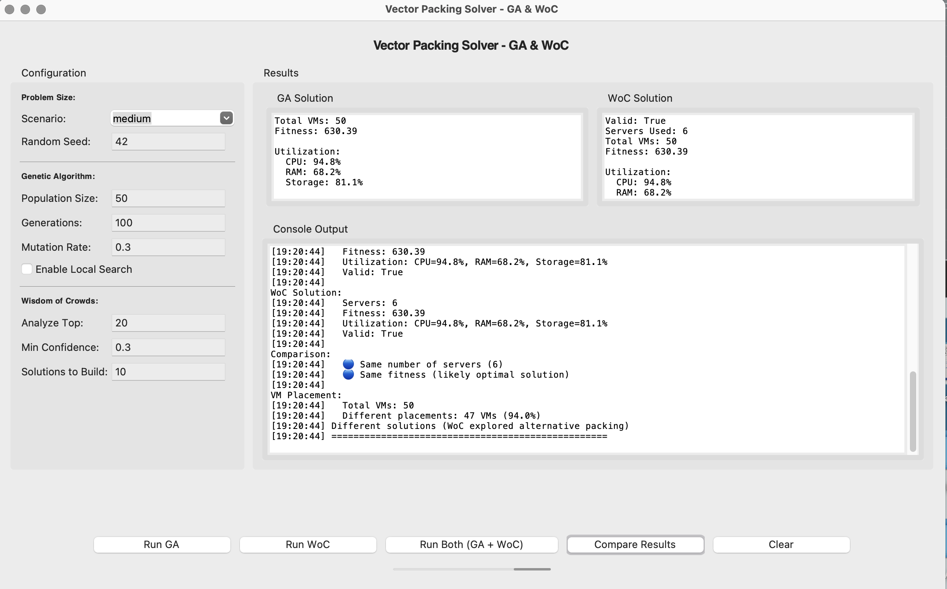
GUI IMPLEMENTATION
Built with Python Tkinter
Displays real-time logs of GA + WOC progress
Visualizes VM-to-server assignments
Allows easy comparison of GA vs WOC outcomes
Helps verify correctness and demonstrate performance improvements

Slide 10
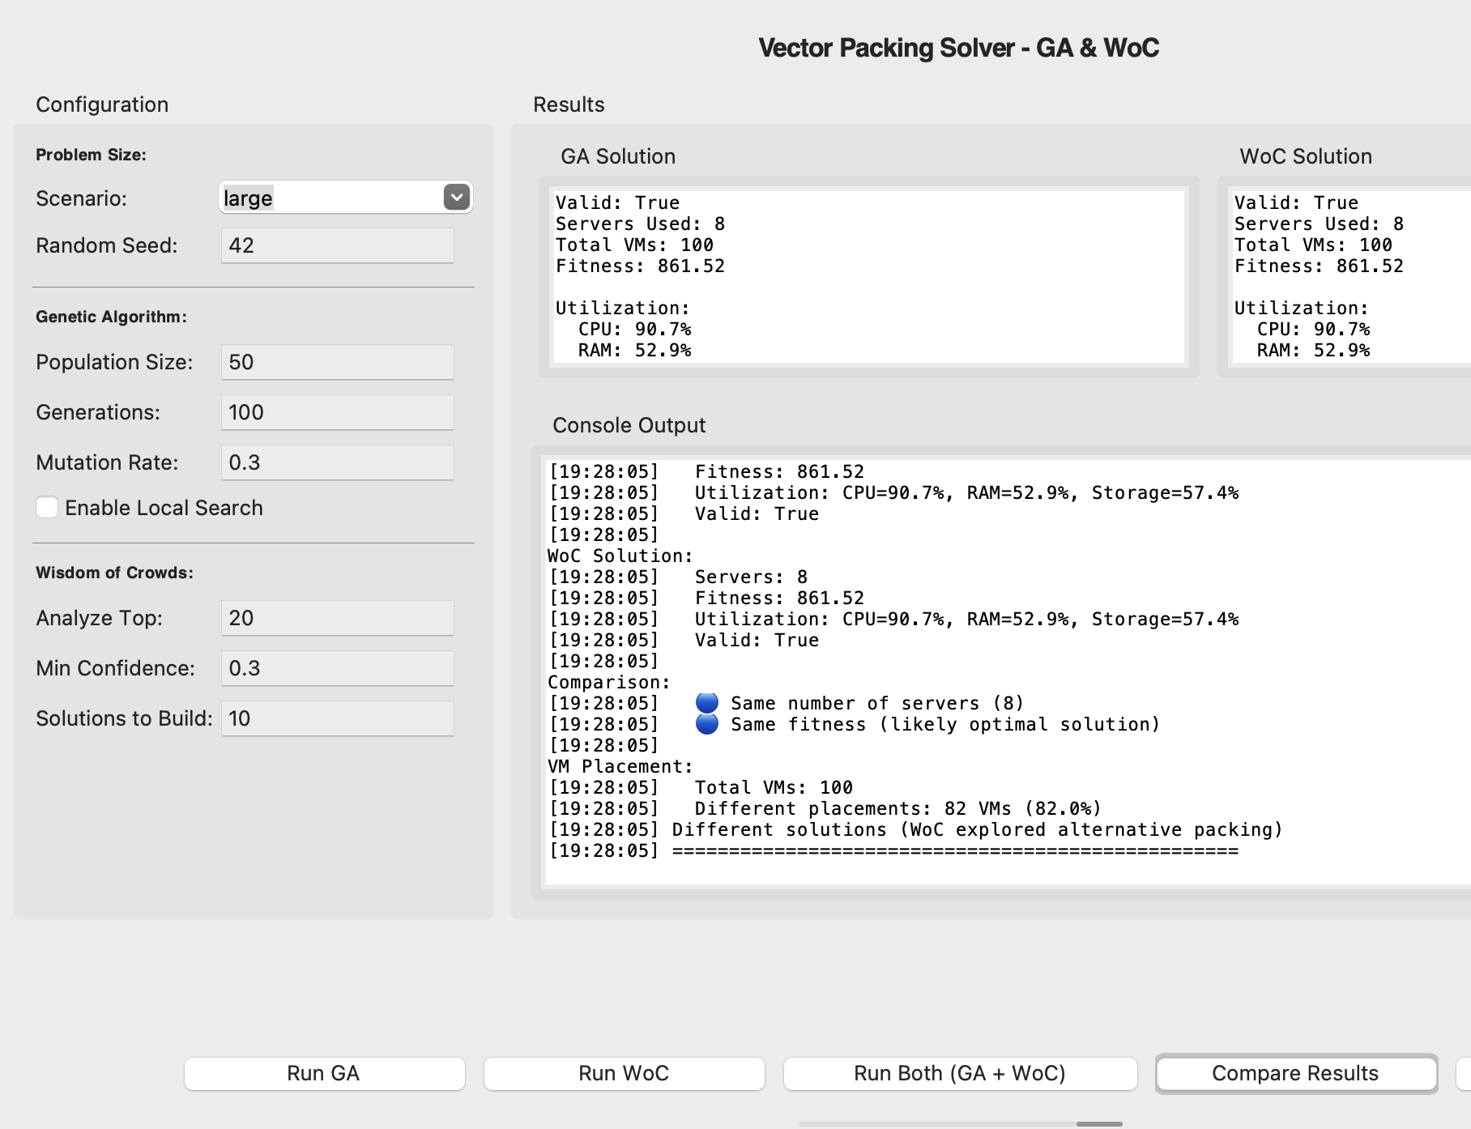
Analysis & interpretation
Runtime growth matches theoretical complexity predictions
WOC’s fixed O(N²) cost becomes increasingly beneficial as problem size grows
Early stopping + adaptive mutation reduce effective GA runtime
Pairwise VM frequency patterns reveal strong VM pairings and resource synergies
Hybrid approach balances exploration (GA) + exploitation (WOC)

Slide 11
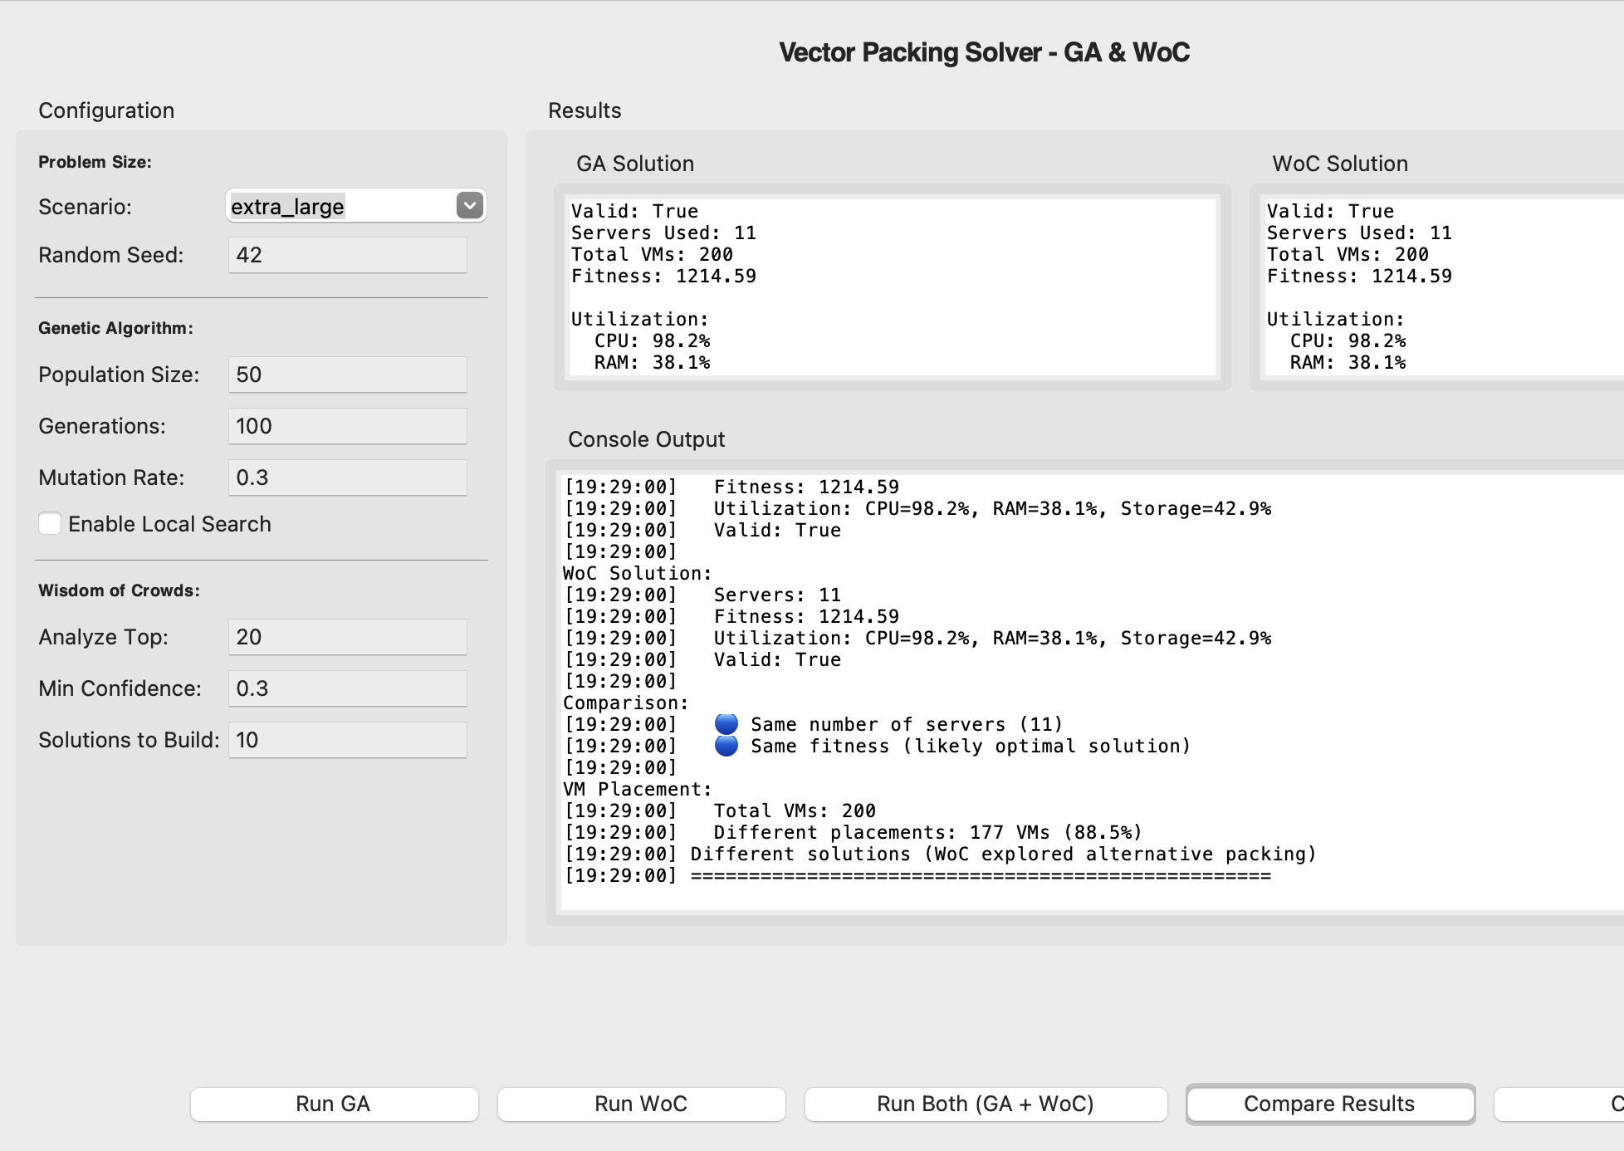
Tradeoffs & limitations
WOC’s memory and processing cost grow as O(N²), making it heavier on large VM counts
Speedups shrink at 200 VMs due to large pattern space
The hybrid approach adds development complexity due to extra pattern analysis & tuning
For very small problems, GA alone may be sufficient
Still strong benefits for 20-100 VM deployments

Slide 12
conclusion
Hybrid GA + WOC solves MDBPP efficiently
Achieves 1.7x to 36x faster runtime with same solution quality
Effective for real-world VM placement in cloud infrastructures
Uses learned VM placement patterns to speed up convergence toward optimal solutions
Promising for large-scale optimization & dynamic workloads

Slide 13
THANK YOU

