Slide 1
2025-05-27

Slide 2
Beyond Chatbots Intro to Agentic Applications
Simon Stone
Research Software Engineer for HPC and AI
Research Computing @ ITC, Dartmouth College

Slide 3
Introducing Research Software Engineering
Collaborative expertise in software engineering, designed to bridge the gap between innovative ideas and impactful outcomes. Our services include:
Grant Proposal Consulting to ensure accurate resource estimations and project feasibility.
Rapid Prototyping to refine concepts and explore solutions.
Ongoing Application Support and Application Rehabilitation for existing applications.
Open-Source Releases to share knowledge and contribute to the wider community.
Contact us today to discuss your project and discover how Research Software Engineering can be your trusted partner in innovation.

Slide 4
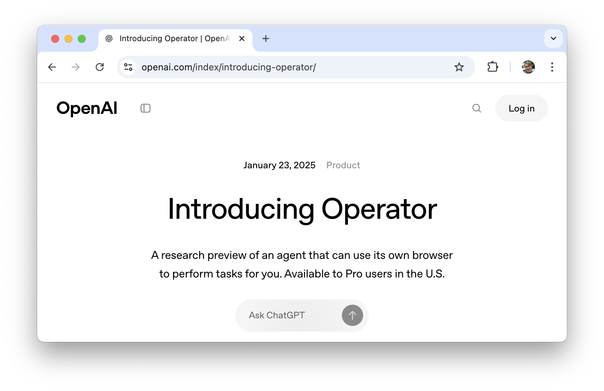
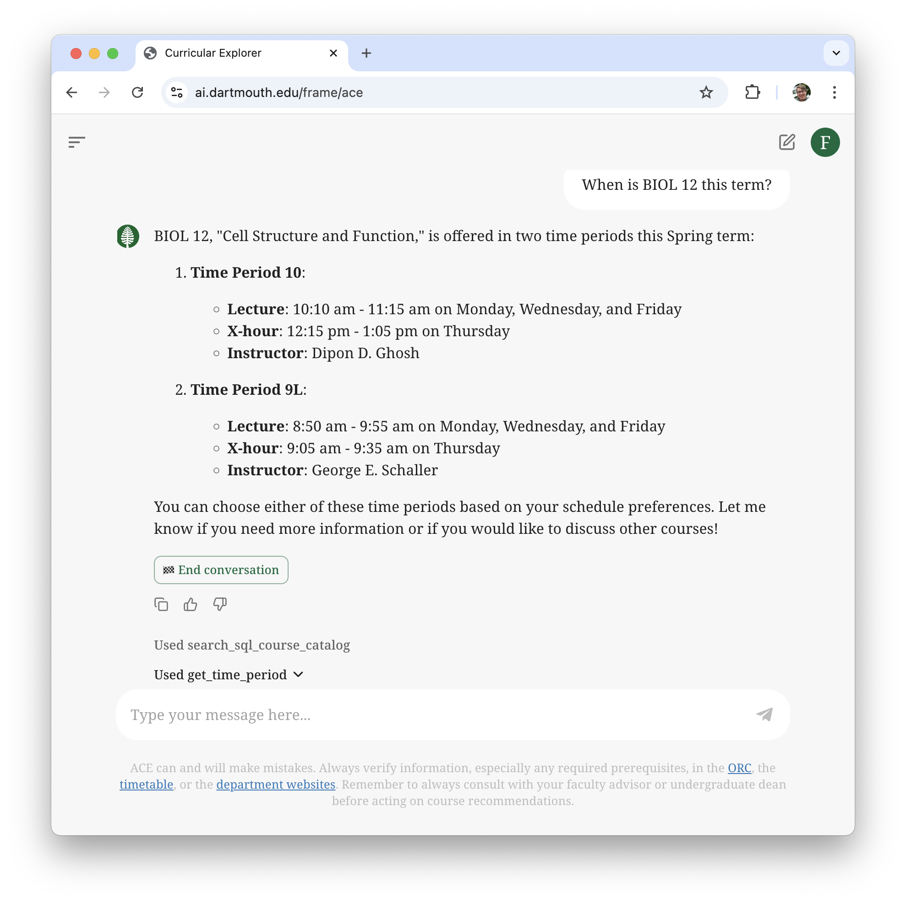
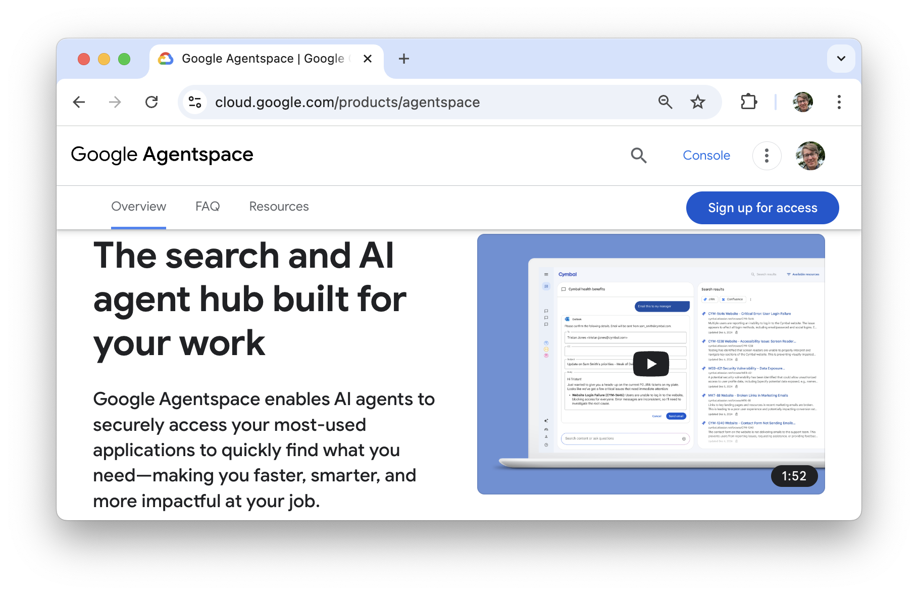
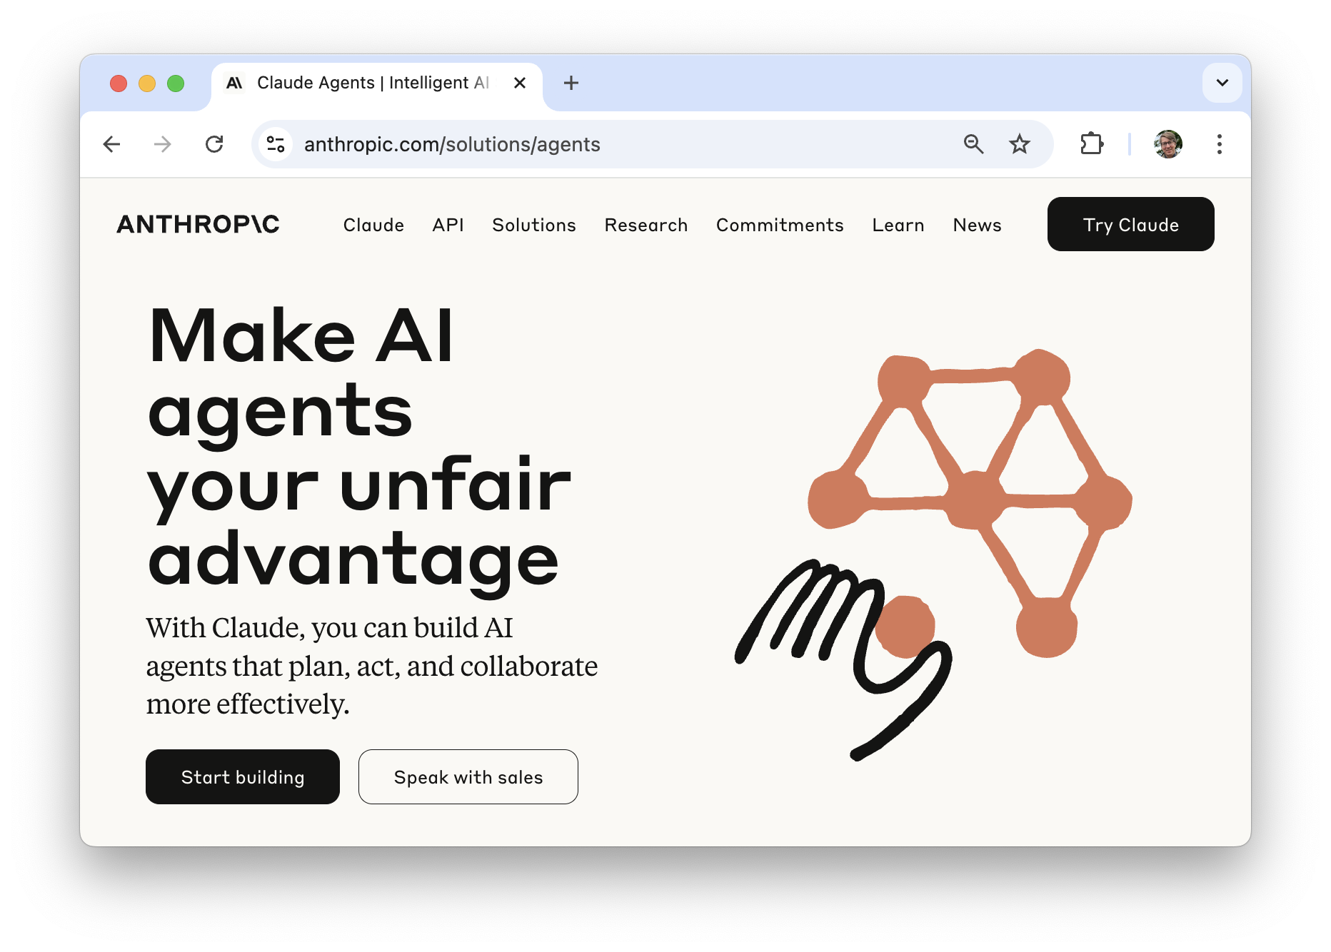

Slide 5
What we will cover in this session
What is Agentic AI?
How do AI Agents work?
What are their strengths and limitations?
How can I create my own agents?
What is next in Agentic AI?

Slide 6

Agentic Artificial Intelligence
Agentic Artificial Intelligence can act autonomously without human intervention
An AI Agent is a concept describing a system that can:
Decide on the next action(s) to take to achieve a stated goal
Execute those actions
Adapt to changes in its environment continue until the goal is achieved
Large Language Models (LLMs) have huge potential for AI Agents

Slide 7

Agentic Artificial Intelligence
Agentic Artificial Intelligence can act autonomously without human intervention
An AI Agent is a concept describing a system that can:
Decide on the next action(s) to take to achieve a stated goal
Execute those actions
Adapt to changes in its environment continue until the goal is achieved
Large Language Models (LLMs) have huge potential for AI Agents
Lumos
set_light(on=True)

Slide 8
Large Language Models and AI Agents
LLM can talk itself through the decision-making process
Decide on the next action(s) to take to achieve a stated goal
Execute those actions
Adapt to changes in its environment continue until the goal is achieved
LLM-generated code can be executed to perform actions
The result of the code can be described to the model as text (or image, if multimodal LLM)

Slide 9
Demo in Dartmouth Chat
Naïve approach: Let the model write all the code
Improved approach: Tell the model which functions it can call

Slide 10
The Agentic Loop
Plan
Execute
Reflect
Goal achieved
LLM
LLM or human
Code
“Human in the loop”

Slide 11
The Agentic Loop – LangGraph example

Slide 12
The Agentic Loop
Plan
Execute
Reflect
Goal achieved
LLM
LLM or human
Code or other agent
Code
“Human in the loop”

Slide 13
Multi-Agent Application

Slide 14



Slide 15
Thank you
dartgo.org/agentic-applications

