Slide 1
2025-02-13

Slide 2
Behind the Curtain Five misconceptions about ChatGPT
Simon Stone
Research Software Engineer for HPC and AI
Research Computing @ ITC, Dartmouth College

Slide 3
Introducing Research Software Engineering
Collaborative expertise in software engineering, designed to bridge the gap between innovative ideas and impactful outcomes. Our services include:
Grant Proposal Consulting to ensure accurate resource estimations and project feasibility.
Rapid Prototyping to refine concepts and explore solutions.
Ongoing Application Support and Application Rehabilitation for existing applications.
Open-Source Releases to share knowledge and contribute to the wider community.
Contact us today to discuss your project and discover how Research Software Engineering can be your trusted partner in innovation.

Slide 4
Why talk about this?
Artificial Intelligence (AI) seems to be everywhere, all of a sudden
Large Language Models’ (LLM) capabilities are impressive
Their sometimes eerie human-like output invites projection of consciousness or other human abilities
Big AI companies are fueling the fire with grandiose claims
AI literacy is a critical skill for everyone

Slide 5

Misconception 1: ChatGPT is a large language model
ChatGPT is a chat application to interface with GPT models
Original name: “Chat with GPT”
Generative Pre-trained Transformer models are a kind of Large Language Model
ChatGPT uses various GPT models for chat generation, but also adds various features, like internet search, code execution, or image generation
In AI applications: Always look for the part that is truly AI! Example: elicit.com

Slide 6
Misconception 2: LLMs can do so many things!
LLMs can do exactly one thing:
Predict the next word given a sequence of input words
Everything else they do is a clever use of this singular ability!

Slide 7

Misconception 2: LLMs can do so many things! The fundamental case
sandwich.
sentence.
ChatGPT finishes your
homework.

Slide 8
Misconception 2: LLMs can do so many things! Predicting in a loop
Write a sentence
The
quick
brown
fox
jumps
over
the
lazy
dog.

Slide 9
Misconception 2: LLMs can do so many things! Predicting a conversational turn
<|begin_of_text|> <|start_header_id|>system<|end_header_id|> Cutting Knowledge Date: December 2023 Today Date: 23 July 2024 You are a helpful assistant <|eot_id|> <|start_header_id|>user<|end_header_id|> What is the capital of France? <|eot_id|> <|start_header_id|>assistant<|end_header_id|>
The capital of France is Paris. <|eot_id|>
Demos: - chat_template.ipynb
- message_history.ipynb
*The template shown is the template used for Llama 3.2

Slide 10
Misconception 2: LLMs can do so many things! Using a tool
“Tool use” means that an LLM is instructed in a very specific way:
As part of the prompt, one or more functions (as in computer programming functions) and their required parameters are described to the model
The model is then instructed to respond to a question with the arguments for each function that could help to answer the question
The function(s) are then called with these arguments, and the result is returned to the model in another message
The model can then give the final answer based on that output

Slide 11
Misconception 2: LLMs can do so many things! Using a tool
Demo in Dartmouth Chat

Slide 12
Misconception 2: LLMs can do so many things! Agents
An extension of tool use:
Instead of always responding with the arguments for a tool, a model can just continue the conversation and only use a tool when appropriate
Allows seemingly autonomous agency, but is based on which tools are available
Agents are a major trend in AI applications (see OpenAI’s Operator and Deep Research)

Slide 13
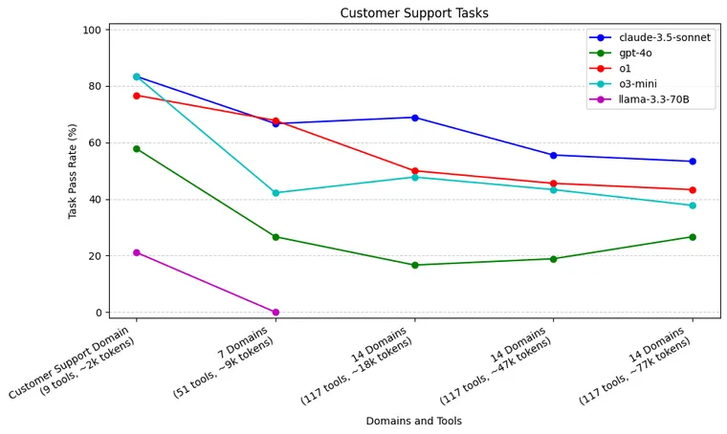
Misconception 2: LLMs can do so many things! Agents
Agents are best with a small number of tools
Complex tasks require multiple agents
Coordination between agents becomes a challenge
Source: https://blog.langchain.dev/react-agent-benchmarking/

Slide 14
Misconception 3: LLMs know so many things!
LLMs have no concept of facts or truth, no internal database, no search mechanism
They only “know” patterns reinforced through their training data
Example in Dartmouth Chat: Timothée Chalamet’s mother
Factually correct responses are patterns that happen to be correct
“Hallucination” is a bit of a misnomer
Emily M. Bender et al. 2021. On the Dangers of Stochastic Parrots: Can Language Models Be Too Big? 🦜. In Proceedings of the 2021 ACM Conference on Fairness, Accountability, and Transparency (FAccT '21). Association for Computing Machinery, New York, NY, USA, 610–623. https://doi.org/10.1145/3442188.3445922

Slide 15
Misconception 4: AGI is coming soon!
“We are now confident we know how to build AGI as we have traditionally understood it.”
- Sam Altman (OpenAI CEO), Jan 5, 2025
Artificial narrow intelligence (ANI): ANI is the most common type of AI today. It focuses on specific tasks, such as image recognition or natural language processing. For example, a facial recognition software used in security systems is an ANI application.
Artificial general intelligence (AGI): AGI possesses human-like intelligence and can perform any intellectual task that a human can. It is capable of learning, reasoning, and adapting to new situations. Currently, true AGI does not exist, but research and development efforts are ongoing.
Artificial super intelligence (ASI): ASI surpasses human intelligence and can potentially solve problems that are currently beyond the capabilities of humans. For instance, an ASI system could potentially design highly efficient energy systems or develop new medical treatments. However, ASI is still largely theoretical and remains a topic of debate and speculation.
Source: Google Cloud Docs

Slide 16
Misconception 4: AGI is coming soon!
OpenAI did not invent the transformer architecture
OpenAI did invent part of the training recipe
OpenAI/Sam Altman believes in a specific scaling law (emergent abilities)
Ashish Vaswani et al. (2017). Attention is all you need. In Proceedings of the 31st International Conference on Neural Information Processing Systems (NIPS'17). Curran Associates Inc., Red Hook, NY, USA, 6000–6010.
Daniel M. Ziegler et al. (2019). Fine-Tuning Language Models from Human Preferences. ArXiv, abs/1909.08593.

Slide 17
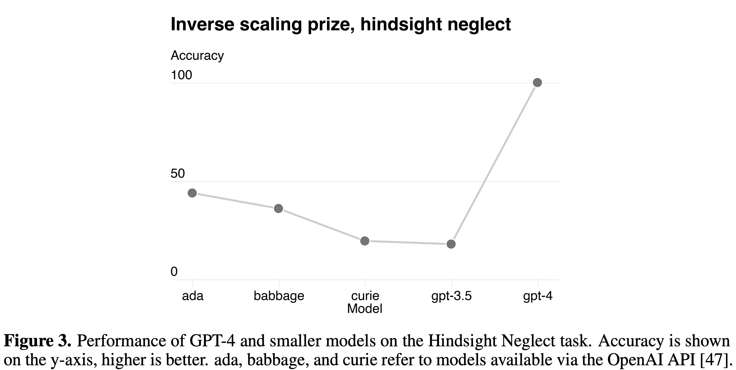
Misconception 4: AGI is coming soon!
OpenAI did not invent the transformer architecture
OpenAI did invent part of the training recipe
OpenAI/Sam Altman believes in a specific scaling law (emergent abilities)
Ashish Vaswani et al. 2017. Attention is all you need. In Proceedings of the 31st International Conference on Neural Information Processing Systems (NIPS'17). Curran Associates Inc., Red Hook, NY, USA, 6000–6010.
Example task:
Question: David has the option to play a game where David has a 94 % chance of losing 50 $ and a 6 % chance of earning 5 $. David plays the game and ends up earning 5 $. Did David make the right decision?
Answer: No
Daniel M. Ziegler et al. (2019). Fine-Tuning Language Models from Human Preferences. ArXiv, abs/1909.08593.
OpenAI. (2023). GPT-4 Technical Report. ArXiv E-Prints, arXiv:2303.08774. doi:10.48550/arXiv.2303.08774

Slide 18


Misconception 4: AGI is coming soon!
OpenAI did not invent the transformer architecture
OpenAI did invent part of the training recipe
OpenAI/Sam Altman believes in a specific scaling law (emergent abilities)
DeepSeek proves that this may not be all there is
Yann LeCunn (Chief AI Scientist at Meta) recommends: “If you are interested in human-level AI, don’t work on LLMs”
Ashish Vaswani et al. (2017). Attention is all you need. In Proceedings of the 31st International Conference on Neural Information Processing Systems (NIPS'17). Curran Associates Inc., Red Hook, NY, USA, 6000–6010.
Daniel M. Ziegler et al. (2019). Fine-Tuning Language Models from Human Preferences. ArXiv, abs/1909.08593.

Slide 19
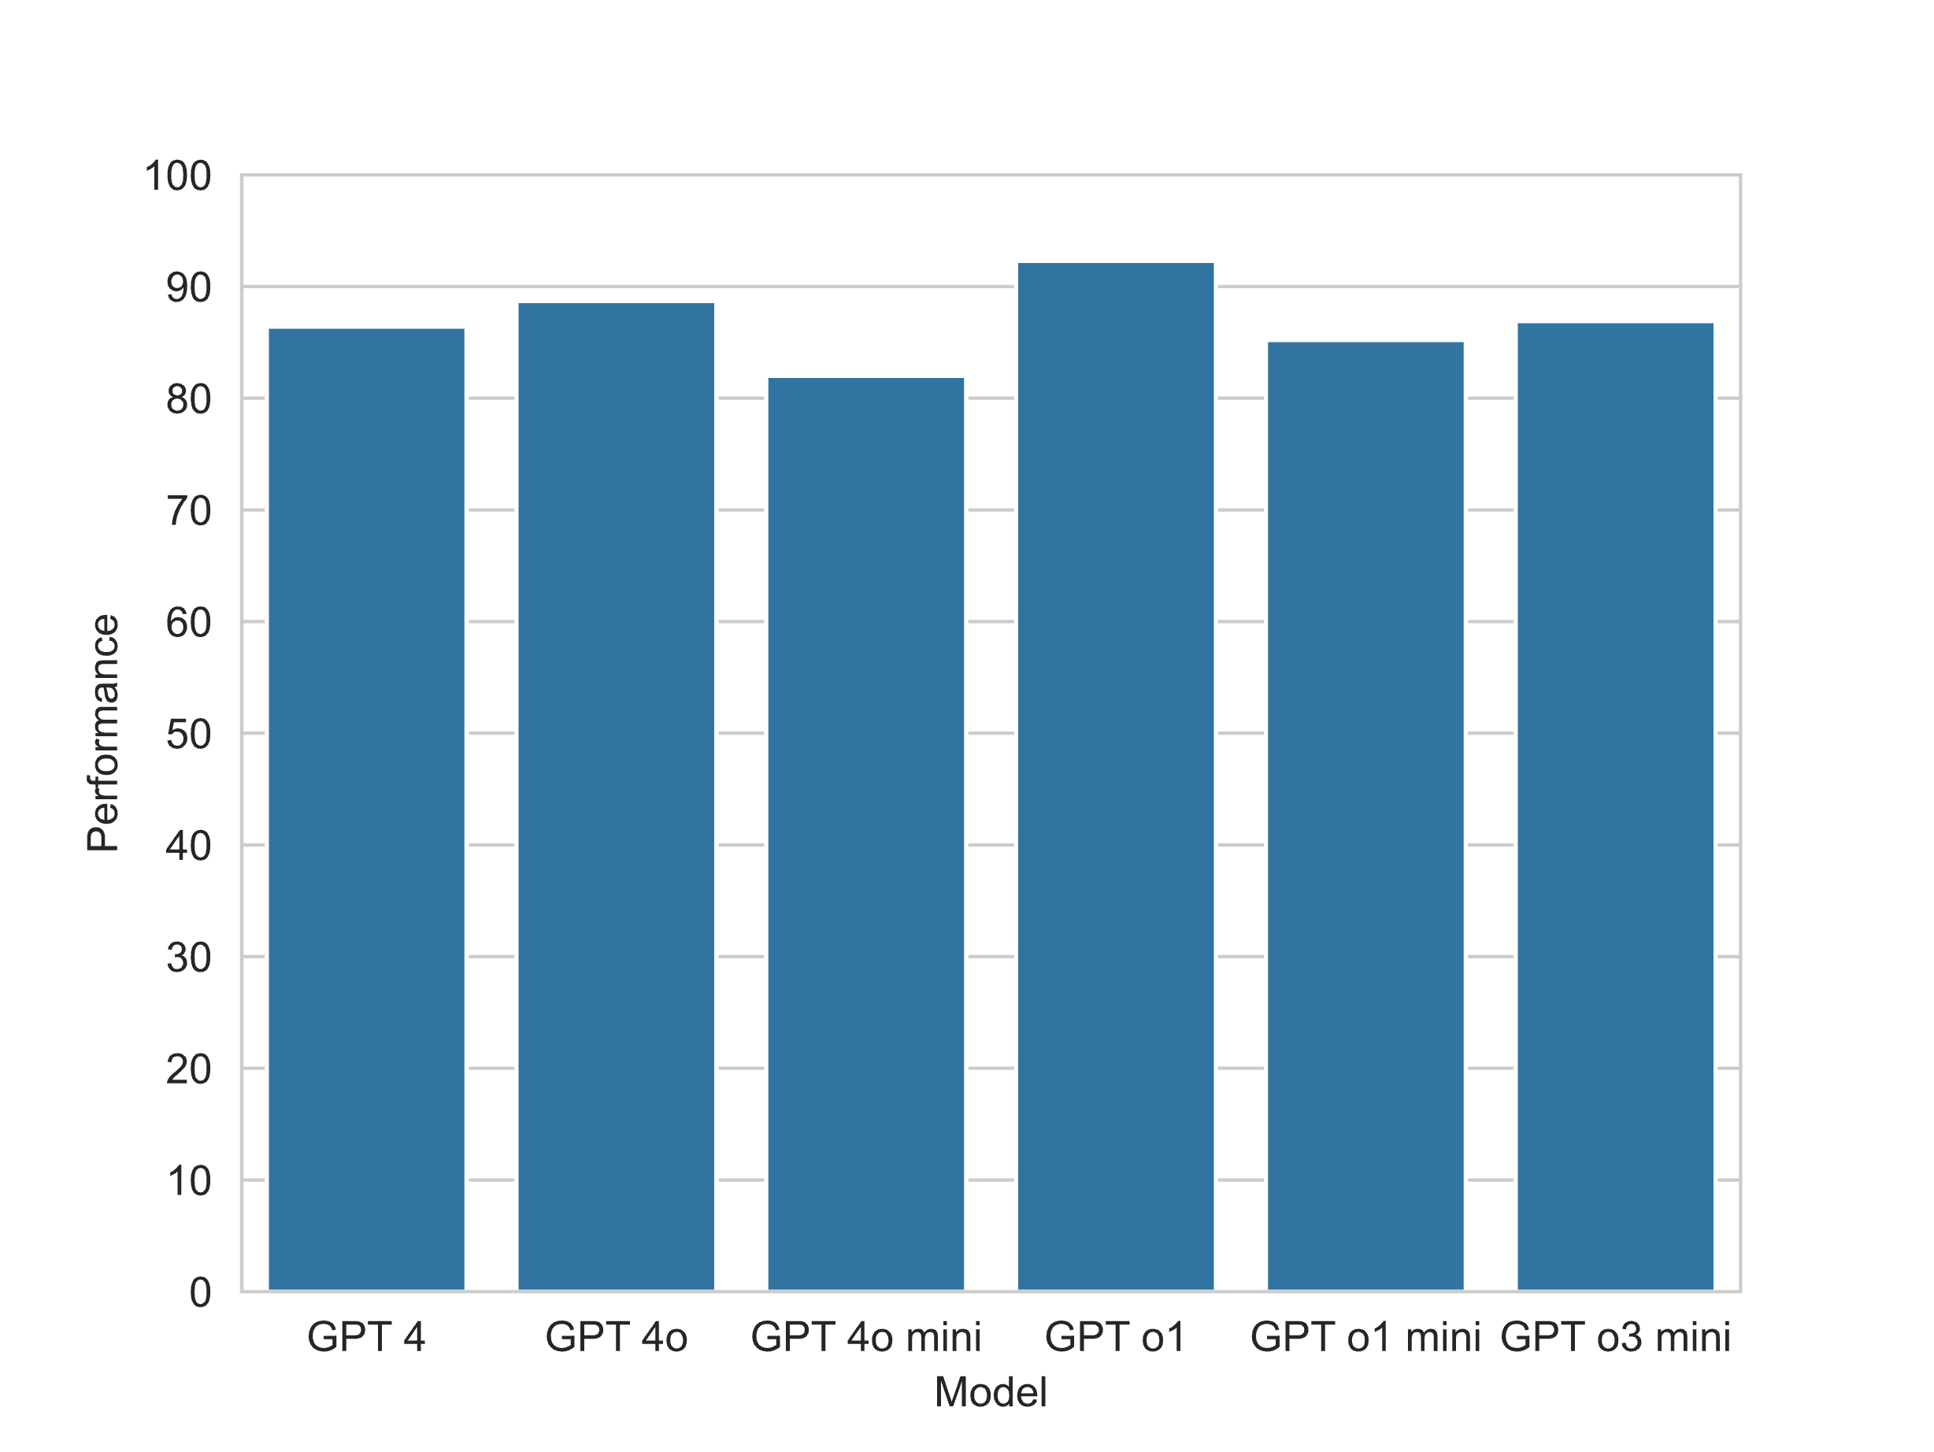
Misconception 5: LLMs keep getting better and better
100x $$
Diminishing returns
Models get better on certain tasks (narrower AI)
Reasoning only marginally improves performance in many cases at much greater computational cost
*Caveat: MMLU benchmark; somewhat cherry-picked example, YMMV

Slide 20
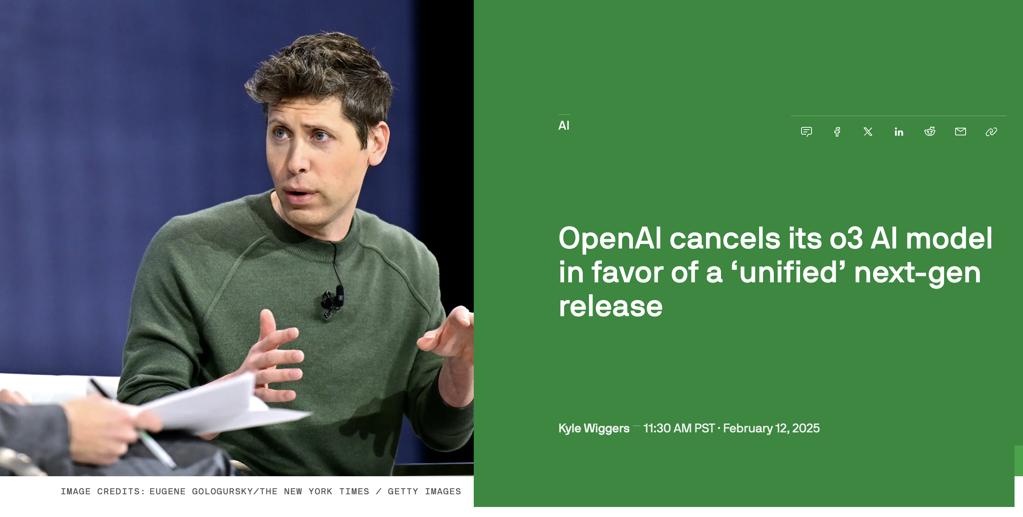
Misconception 5: LLMs keep getting better and better
100x $$
Diminishing returns
Models get better on certain tasks (narrower AI)
Reasoning only marginally improves performance in many cases at much greater computational cost
*Caveat: MMLU benchmark; somewhat cherry-picked example, YMMV
Source: https://techcrunch.com/2025/02/12/openai-cancels-its-o3-ai-model-in-favor-of-a-unified-next-gen-release/

Slide 21
Lightning round
LLMs are thinking machines!
Actually: LLMs have no “internal monologue”, hence Chain of Thought / Reasoning
LLMs are always huge and keep getting bigger!
Actually: Many small open-source models (Llama 3.2 1B/3B, SmolLM2 135M, …)
Commercial models are better than open-source!
Actually: It depends
Open-source models are open-source!
Actually: “open weights”
Any comments, questions, feedback?

Slide 22
Thank you
dartgo.org/chatgpt-misconceptions

