Slide 1
2025-03-10

Slide 2
AI in Qualitative Analysis CPDE Lunch & Learn
Simon Stone
Research Software Engineer for HPC and AI
Research Computing @ ITC, Dartmouth College

Slide 3
Introducing Research Software Engineering
Collaborative expertise in software engineering, designed to bridge the gap between innovative ideas and impactful outcomes. Our services include:
Grant Proposal Consulting to ensure accurate resource estimations and project feasibility.
Rapid Prototyping to refine concepts and explore solutions.
Ongoing Application Support and Application Rehabilitation for existing applications.
Open-Source Releases to share knowledge and contribute to the wider community.
Contact us today to discuss your project and discover how Research Software Engineering can be your trusted partner in innovation.

Slide 4
Why talk about this?
Artificial Intelligence (AI) seems to be everywhere, all of a sudden
Large Language Models’ (LLM) capabilities are impressive
A wave of new and shiny AI tools is flooding the scene
AI components are making their way into many analysis workflows and tools
AI literacy is a critical skill for everyone

Slide 5
Objectives of this talk
Explain how Large Language Models (de-)construct language
Show how AI can help explore qualitative data
Equip you with critical knowledge to assess new tools and techniques
Spark ideas and conversation

Slide 6
How Large Language Model’s (de-)construct language What can’t AI do?
LLMs can do exactly one thing:
Predict the next word given a sequence of input words
Everything else they do is a clever use of this singular ability!

Slide 7

How Large Language Model’s (de-)construct language The fundamental case
sandwich.
sentence.
ChatGPT finishes your
homework.

Slide 8
How Large Language Model’s (de-)construct language Predicting in a loop
Write a sentence
The
quick
brown
fox
jumps
over
the
lazy
dog.

Slide 9
How Large Language Model’s (de-)construct language Predicting a conversational turn
<|begin_of_text|> <|start_header_id|>system<|end_header_id|> Cutting Knowledge Date: December 2023 Today Date: 23 July 2024 You are a helpful assistant <|eot_id|> <|start_header_id|>user<|end_header_id|> What is the capital of France? <|eot_id|> <|start_header_id|>assistant<|end_header_id|>
The capital of France is Paris. <|eot_id|>
*The template shown is the template used for Llama 3.2

Slide 10
How Large Language Model’s (de-)construct language How Large Language Models construct language
How many words are in your response?
List them out in a numbered list.
There are 12 words in my response.
Sure, here are the words in my previous response listed in a numbered list:
1. There
2. are
3. 12
4. words
5. in
6. my
7. response.

Slide 11
How Large Language Model’s (de-)construct language LLMs lie? - It’s complicated
LLMs have no concept of facts or truth, no internal database, no search mechanism
They only “know” patterns reinforced through their training data
Example in Dartmouth Chat: Timothée Chalamet’s mother
Factually correct responses are patterns that happen to be correct
“Hallucination” is a bit of a misnomer
Emily M. Bender et al. 2021. On the Dangers of Stochastic Parrots: Can Language Models Be Too Big? 🦜. In Proceedings of the 2021 ACM Conference on Fairness, Accountability, and Transparency (FAccT '21). Association for Computing Machinery, New York, NY, USA, 610–623. https://doi.org/10.1145/3442188.3445922

Slide 12
How Large Language Model’s (de-)construct language How to find the next word?
The patterns in written language are learned from text data in a training phase
GPT 3.5, for example, has been trained on about 570 GB of texts or 300 billion words (English Wikipedia: 4.2 billion words)
This would still not be enough data if we were looking for examples of longer specific word sequences!

Slide 13
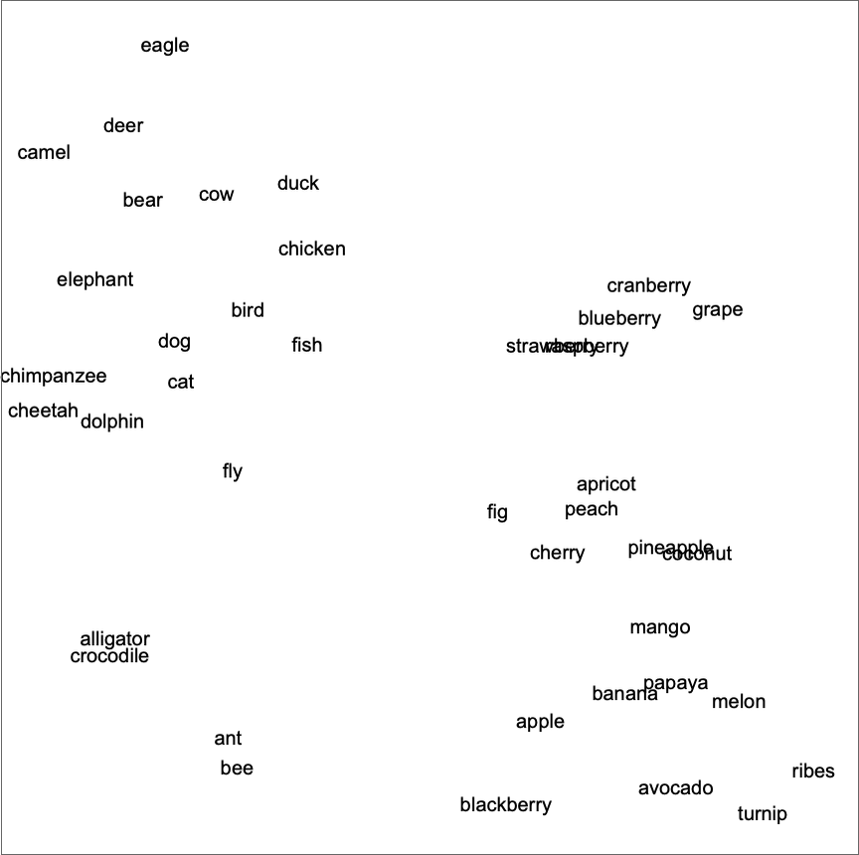
How Large Language Model’s (de-)construct language How to find the next word?
Two important “tricks” solve this problem:
The model learns to map every word into a numerical “meaning space”, where words with similar meaning are represented by similar numbers
That way the model can base the probability of the next word on sequences of similar words
GPT 3.5 uses 2048 dimensional embeddings (probably)
Source:
https://writings.stephenwolfram.com/2023/02/what-is-chatgpt-doing-and-why-does-it-work/
0 1 2 3 4
0 1 2 3 4

Slide 14


Background How to find the next word?
I am going to spend the summer in Germany. I want to go to Hamburg, Berlin, and Dresden. Write an itinerary for a two-week long trip.
I am going to spend the summer in Germany. I want to go to Hamburg, Berlin, and Dresden. Write an itinerary for a two-week long trip.
Hamburg
Berlin
Dresden
itinerary
two-week
Two important “tricks” solve this problem:
Words in “meaning space”
The model uses a mechanism called “attention” to emphasize the most important words in the sequence
These weights are learned during training
This structure is called a “transformer”
GPT: Generative Pre-trained Transformer
Sure, here's a possible itinerary for a two-week trip to Hamburg, Berlin, and Dresden:
Day 1-3: Hamburg
Explore the historic center of Hamburg and visit the impressive Elbphilharmonie concert hall
Take a boat tour of Hamburg's harbor and visit the International Maritime Museum

Slide 15
What can AI do for qualitative analysis?
Concept of “semantic similarity” very powerful
LLM’s are excellent at picking up patterns in language
Let’s look at an example!
By the way: All responses for the following demos were generated using Claude 3.7 Sonnet

Slide 16
Summary
Large Language Models are excellent text processors
Semantic embeddings are a useful tool to capture contextual information in text
Using a Human-in-the-Loop approach, AI holds a lot of potential to speed up and scale qualitative analysis

Slide 17
Discussion

Slide 18
Thank you
dartgo.org/cpde-talk

