Slide 1
2025-09-30

Slide 2
Freezing Time and X-Ray Vision Debugging Superpowers in Python
Simon Stone
Research Software Engineer for HPC and AI
Research Computing @ ITC, Dartmouth College

Slide 3
Introducing Research Software Engineering
Collaborative expertise in software engineering, designed to bridge the gap between innovative ideas and impactful outcomes. Our services include:
Grant Proposal Consulting to ensure accurate resource estimations and project feasibility.
Rapid Prototyping to refine concepts and explore solutions.
Ongoing Application Support and Application Rehabilitation for existing applications.
Open-Source Releases to share knowledge and contribute to the wider community.
Contact us today to discuss your project and discover how Research Software Engineering can be your trusted partner in innovation.

Slide 4
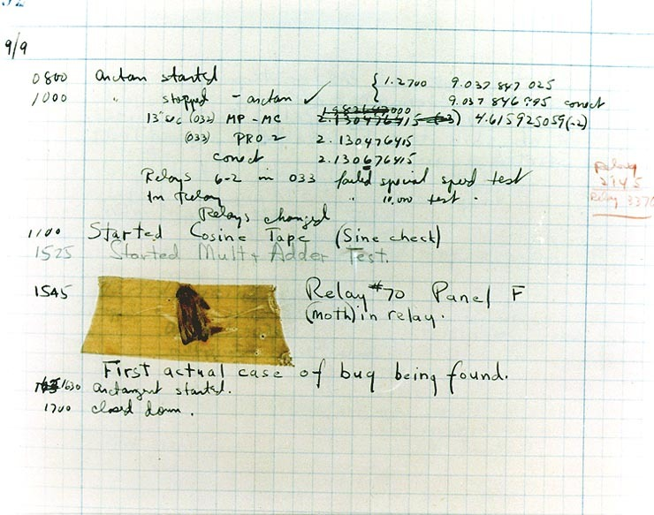
What is debugging?
Every programmer eventually hits an error in their program
Syntax errors, runtime errors, logic errors, …
“Debugging” is the process of systematically identifying and removing these bugs
Excerpt from Admiral Grace Hopper’s journal Source: https://dev.to/sylwiavargas/trivia-2-bugs-and-debugging-1ag5

Slide 5
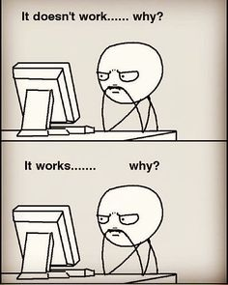
How to debug?
Just read the code?
print statements everywhere?
Write separate tests for everything?
Virtually every programming language has a special tool for this purpose called the “debugger”!

Slide 6
The Debugger (in Python)
A program that sits between your code and the Python interpreter
One such program comes with Python: pdb
Lightweight an
VS Code comes with its own implementation called debugpy

Slide 7
Why test your code?
If you don’t test, you are testing in production
Ensure desired behavior
Discover and squash bugs
Grow your codebase without breaking existing things
Tests document how your code can be used
Tests can help discover awkward interfaces or coupling

Slide 8
Test-Driven Development
Core flow:
Write tests first
Fail all tests
Implement the simplest code to pass all tests
Pass all tests
Refactor the implementation as needed
See also: “Code towards an interface”, Backward Design
Beck, K. (2003). Test-driven development : by example (1st edition). Addison-Wesley.

Slide 9
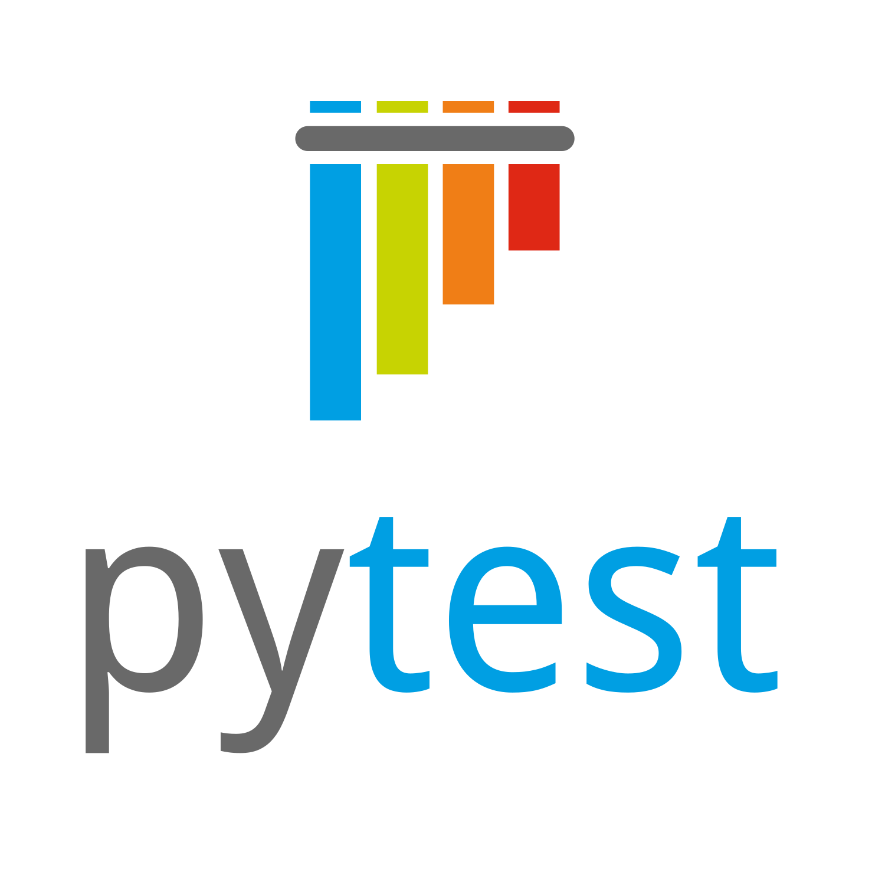
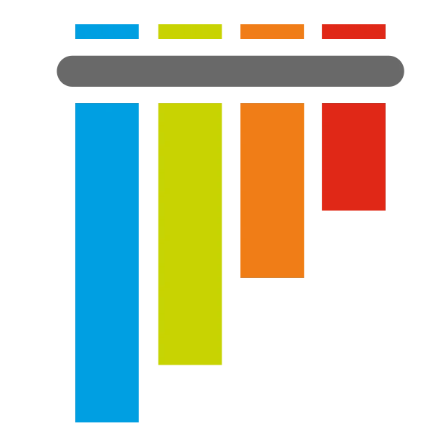
Why PyTest?
PyTest is an open-source testing framework for Python
Easy and unintrusive to write simple tests
Elegantly scales to more complex testing scenarios
A community standard

Slide 10
Let’s get started!
Hands-on

Slide 11

Summary
Tests are great!
PyTest lets you automate and scale testing in an unintrusive way
Test-Driven Development is a useful paradigm to thoughtfully grow your codebase

Slide 12

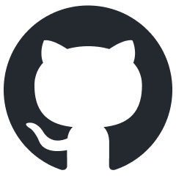
What’s next?
Explore the PyTest documentation
Automate testing with GitHub Actions
Learn about Mocking
Actually write (any kind of) tests!

Slide 13
Thank you
dartgo.org/intro-to-pytest

