Slide 1
2025-09-30

Slide 2
Freezing Time and X-Ray Vision Debugging Superpowers in Python
Simon Stone
Research Software Engineer for HPC and AI
Research Computing @ ITC, Dartmouth College

Slide 3
Introducing Research Software Engineering
Collaborative expertise in software engineering, designed to bridge the gap between innovative ideas and impactful outcomes. Our services include:
Grant Proposal Consulting to ensure accurate resource estimations and project feasibility.
Rapid Prototyping to refine concepts and explore solutions.
Ongoing Application Support and Application Rehabilitation for existing applications.
Open-Source Releases to share knowledge and contribute to the wider community.
Contact us today to discuss your project and discover how Research Software Engineering can be your trusted partner in innovation.

Slide 4
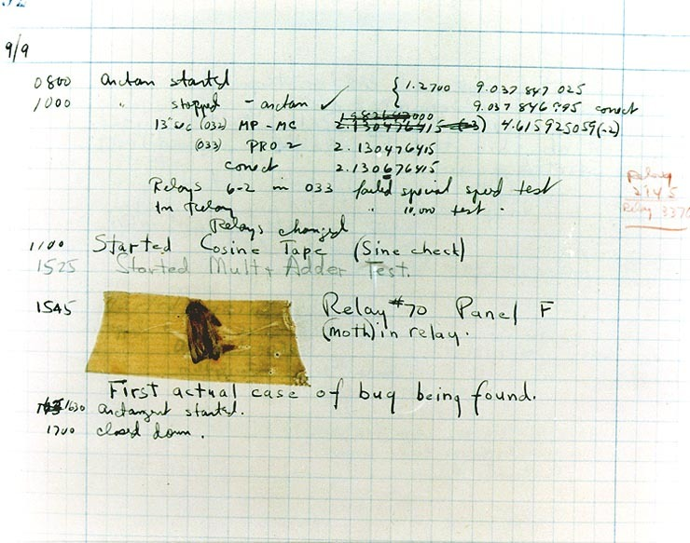
What is debugging?
Every programmer eventually hits an error in their program
Syntax errors, runtime errors, logic errors, …
“Debugging” is the process of systematically identifying and removing these bugs
Excerpt from Admiral Grace Hopper’s journal Source: https://americanhistory.si.edu/collections/object/nmah_334663

Slide 5

How to debug?
Just read the code?
print statements everywhere?
Write separate tests for everything?
Virtually every programming language has a special tool for this purpose called the “debugger”!

Slide 6


Superpowers granted by today’s workshop
Core debugging skills
Manage breakpoints: Freeze time!
Inspect variables: X-Ray vision!
Advanced debugging techniques
Use the debug console: Memory manipulation!
Analyze the call stack: Travel back in time!
Professional development practice
Integrate debugging into your regular coding workflow

Slide 7
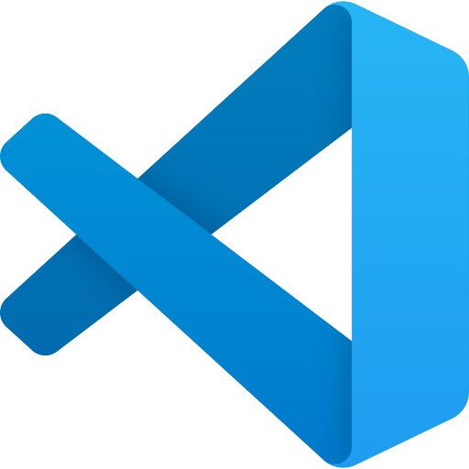
The Debugger (in Python)
A program that sits between your code and the Python interpreter
One such program comes with Python: pdb
Lightweight and runs anywhere Python runs
Command-line interface only and limited IDE integration
VS Code comes with its own implementation called debugpy
Rich visual interface and easy to use
Requires VS Code (or compatible editor)

Slide 8
The Debugger (in Python)
Debugger “attaches” to the Python process running your script
Can pause execution, inspect and manipulate variables, …
A remote control for running your code!

Slide 9
Let’s get started!
Hands-on

Slide 10
Summary
The debugger is awesome!
VS Code’s implementation of the debugger is very helpful!
The debugger takes the guesswork out of your error analysis

Slide 11
What’s next?
Debug, debug, debug!
Debug someone else’s code!
Learn to debug when using frameworks (Streamlit, Chainlit, FastAPI, …)
Learn to debug performance issues with profiling!
Learn to debug parallel programs!

Slide 12
Thank you
dartgo.org/debugging-in-python

