Slide 1
2026-09-03

Slide 2
RESTful APIs with Python A DevCouRSE Workshop
Tim Meehan, Simon Stone
Research Computing @ ITC, Dartmouth College

Slide 3
See APIs in action
https://dartgo.org/devcourse-api-demo

Slide 4
What is an API?
API stands for Application Programming Interface

Slide 5
What is an interface? (in software design)
A piece of software can be thought of in two parts:
How it does what it does (the implementation)
What the user of the software needs to put in and what they can get out (the interface)
The implementation rarely matters to a user
The interface is all we need to know to use the software
The implementation may change, as long as the interface stays the same
The interface is a contract between the program and the user

Slide 6
What is an interface? (in software design)
Interface
Example:
print(*objects, sep=' ', end='\n', file=None, flush=False)
Print objects to the text stream file, separated by sep and followed by end. sep, end, file, and flush, if present, must be given as keyword arguments.
All non-keyword arguments are converted to strings like str() does and written to the stream, separated by sep and followed by end. Both sep and end must be strings; they can also be None, which means to use the default values. If no objects are given, print() will just write end.
The file argument must be an object with a write(string) method; if it is not present or None, sys.stdout will be used. Since printed arguments are converted to text strings, print() cannot be used with binary mode file objects. For these, use file.write(...) instead.
Output buffering is usually determined by file. However, if flush is true, the stream is forcibly flushed.
Changed in version 3.3: Added the flush keyword argument.
Source: https://docs.python.org/3/library/functions.html#print
No imple-mentation details!
Description of the interface
Notification of a change in the “contract”

Slide 7
What is an API?
API stands for Application Programming Interface
It allows us to use someone else’s “code blocks” to build applications/programs/scripts
A good API hides implementation details
Specified by the required inputs and the promised outputs (the “contract”)
Commonly refers to web APIs in particular

Slide 8
Why (web) APIs?
Separation of concerns: Decouple logic (backend) from presentation (frontend)
Context independence: Build one API and use it in different contexts
Interoperability: Allow different services/stacks to talk to each other
Leverage ecosystems: Integrate third-party services
Scalability: Update or scale backend independently of frontend

Slide 9
RESTful APIs
REpresentational State Transfer (REST)
A way to structure network-based applications
An application is RESTful, if:
Resources are being transferred (e.g., a web page, images, list of names, sensor data, …)
The user interacts with the application using a limited set of actions
The application is stateless
I have data!
Can I have some?
Here you go!

Slide 10
RESTful APIs
REpresentational State Transfer (REST)
A way to structure network-based applications
An application is RESTful, if:
Resources are being transferred (e.g., a web page, images, list of names, sensor data, …)
The user interacts with the application using a limited set of actions
The application is stateless
Has resources
Stateless
Actions
request
response
HyperText Transfer Protocol (HTTP)
The protocol governing communication on the web
A (mostly) RESTful application

Slide 11
REST Actions <-> HTTP Methods
REST Action | HTTP Method | Example Endpoint | Purpose
Create | POST | /users | Create a new resource
Read | GET | /users/123 | Retrieve specific resource
Update | PUT | /users/123 | Update specific resource
Delete | DELETE | /users/123 | Remove specific resource
Verbs
Nouns

Slide 12
REST APIs and Databases
Resources are (typically) stored in SQL database tables
Database tables (“models”) can be different from what the API returns (“schemas”)
user_id | username | email | password
42 | balin | balin@moria.org | m3ll0n
Database
GET
{
"user_id": 42,
"username": "balin",
"email": "balin@moria.org"
}
API response

Slide 13
A word on “Statelessness”
Applications using RESTful APIs can have mutable state
Just the communication is stateless
Example: Pagination
Non-RESTful: “Give me the next page of results.”
RESTful: “Give me page 2 of the results for User 123.”
Each request must be self-contained
Each response must contain all information to continue (e.g., number of pages)

Slide 14
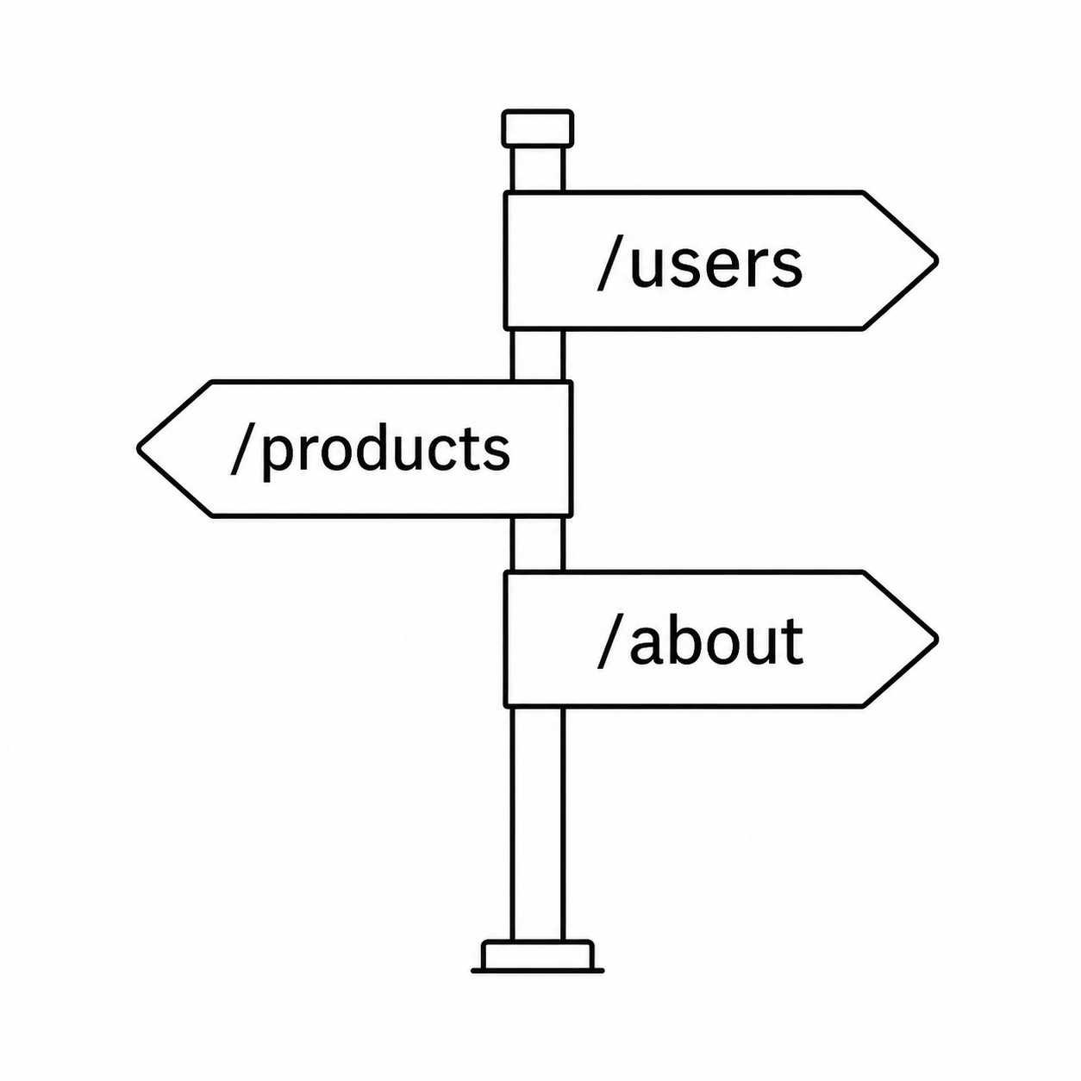
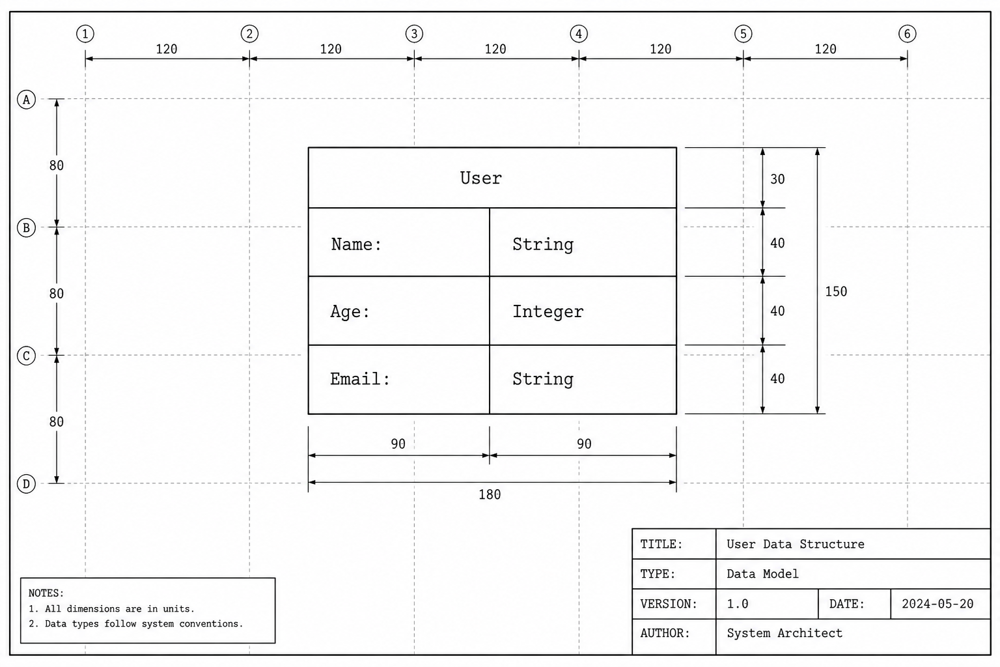


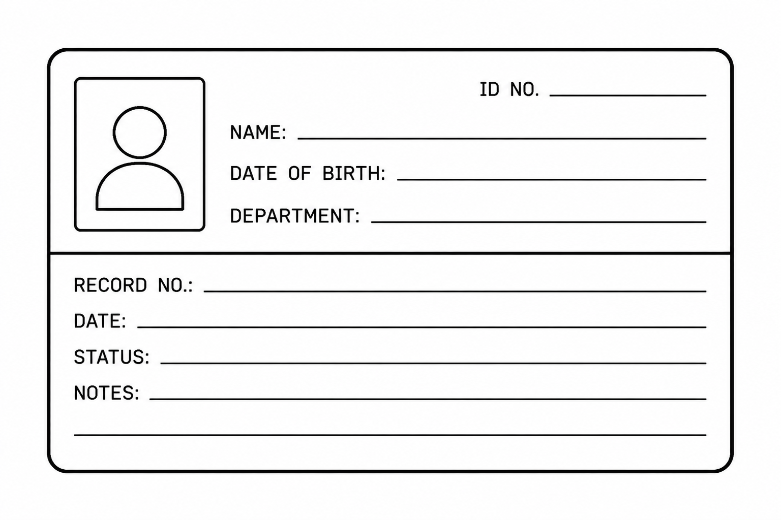
Life-cycle of a typical backend API request
?
!
Request
Router
Schema
Controller
Service
Model
Response
Database

Slide 15
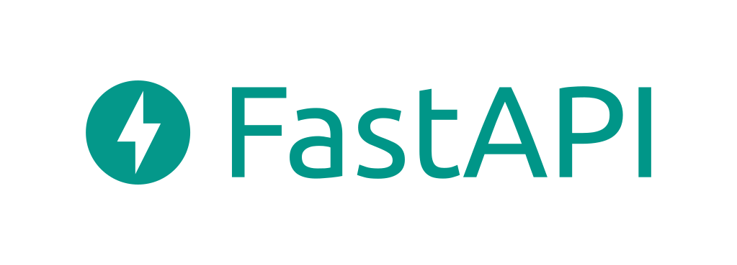


Implementing RESTful APIs in Python
Today’s stack:
FastAPI: Handling routers, controllers, HTTP request mapping
SQLModel: Handling schemas, models, and database I/O
Plain Python: Implementation of services
SQLite: database engine

Slide 16
Let’s get into it!

Slide 17
Thank you

