Slide 1
2026-09-17

Slide 2
Hands-on: RESTful APIs with Python
A DevCouRSE Workshop
Tim Meehan, Simon Stone
Research Computing @ ITC, Dartmouth College

Slide 3
REST Actions <-> HTTP Methods
REST Action | HTTP Method | Example Endpoint | Purpose
Create | POST | /users | Create a new resource
Read | GET | /users/123 | Retrieve specific resource
Update | PUT | /users/123 | Update specific resource
Delete | DELETE | /users/123 | Remove specific resource
Verbs
Nouns

Slide 4
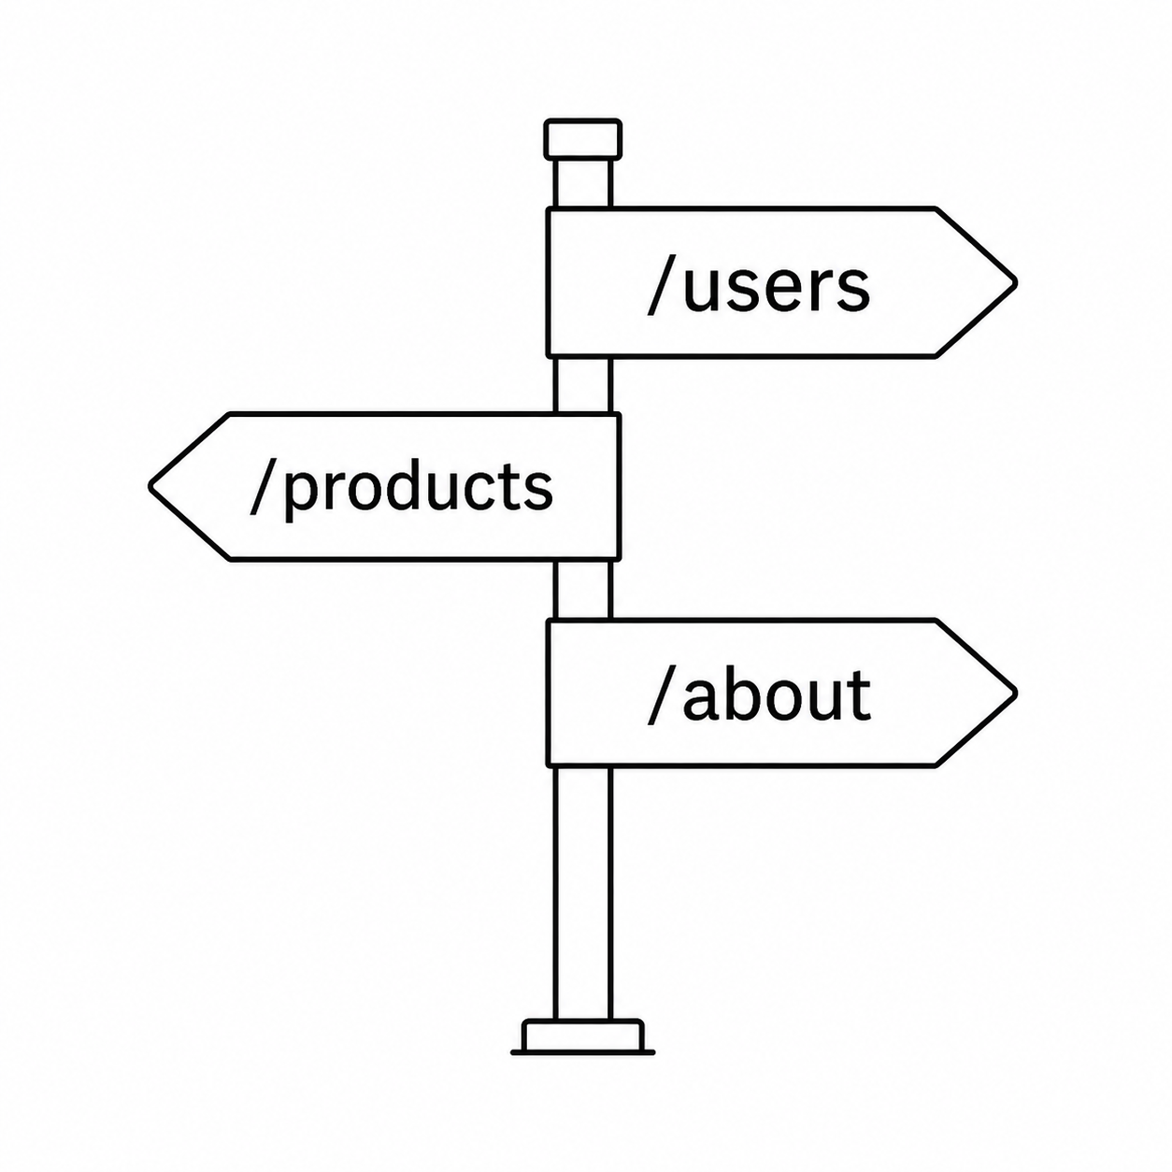
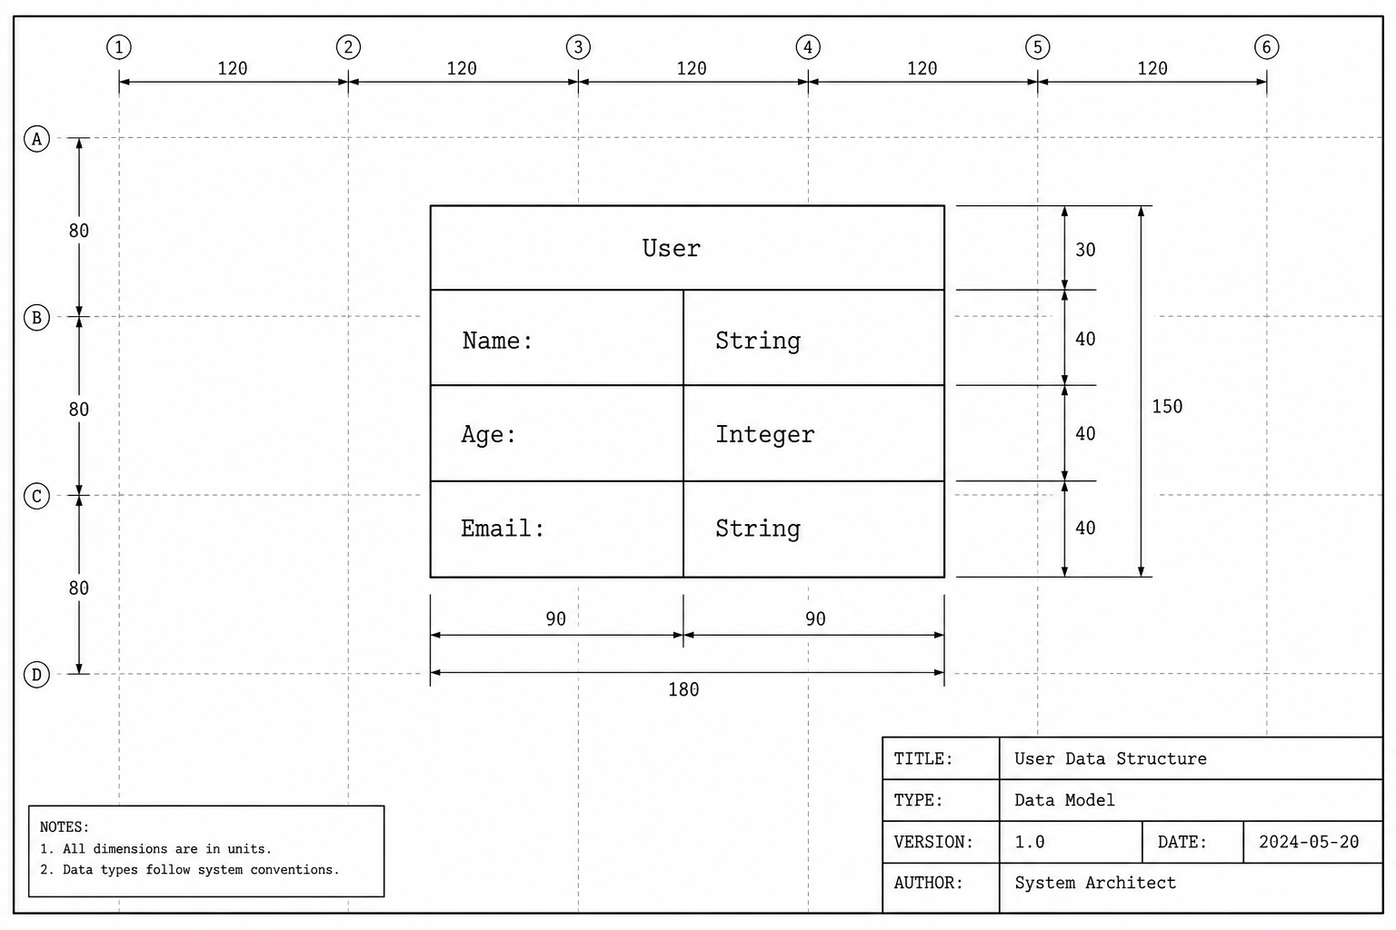


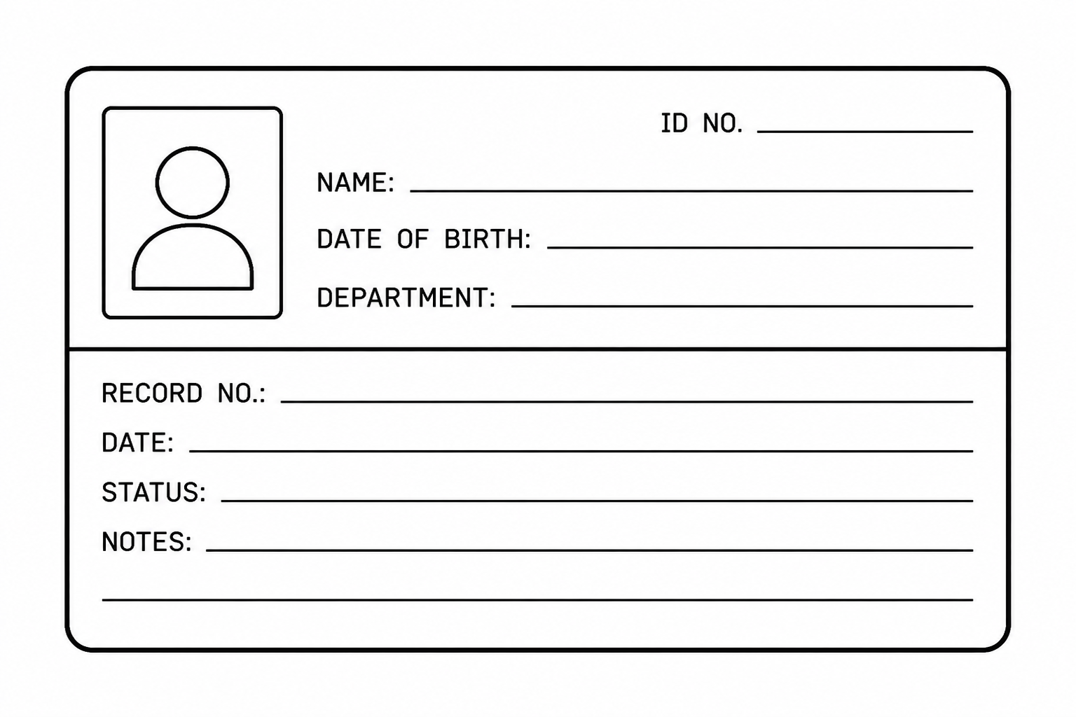
Life-cycle of a typical backend API request
?
!
Request
Router
Schema
Controller
Service
Model
Response
Database

Slide 5
Today’s Project:
Dartmouth Places
Name
Location
Description
Category
Noise Level
Outlets?
WiFi?
Capacity
Public?
Place
An API to manage a directory of places of interest at Dartmouth
List all Places
List a specific Place
Create a Place
Update a Place
Delete a Place
Only allow authenticated access

Slide 6

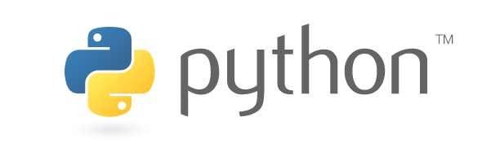

Implementing RESTful APIs in Python
Today’s stack:
FastAPI: Handling routers, controllers, HTTP request mapping
SQLModel: Handling schemas, models, and database I/O
Plain Python: Implementation of services
SQLite: database engine

Slide 7
Let’s get into it!

Slide 8

Setup
Clone repo (if you fork, fork all branches!):
https://github.com/dartmouth/devcourse-python-api-handson
In the project root: uv sync
A reference implementation of each step is in a separate branch

Slide 9
Step 0: Boilerplate

Slide 10
Step 1: Health check

Slide 11
Step 2: Places

Slide 12
Step 2: Places
No database yet!
In schemas.py:
  Define a Place schema
In routers/places.py:
  Create a list with a few mocked-up Place objects
  Create a route to return the whole list
  Create a route to return a Place in that list with a specific ID

Slide 13
Step 3: Database

Slide 14
Step 3: Database
In models.py:
  Turn Place schema into a model
In schemas.py:
  Add PlaceResponse and PlaceCreate schemas
In database.py:
  Add a function to create the database and tables
  Add a session factory function
In main.py:
  Call database creation function as part of the API app’s lifespan
In routers/places.py:
  Refactor /places and /places/{place_id} to use database
  Add route to create a Place
  Add route to update a Place
  Add route to delete a Place

Slide 15
Step 4: Auth

Slide 16
Step 4: Auth
In middleware/auth.py:
  Implement a function to verify a bearer token
Use dependency injection to protect endpoints:
  Protect the entire /places router
  Bonus: Protect only the routes that write to the database

Slide 17
Thank you

