Slide 1
2025-02-04

Slide 2
Streamlit Dashboards and Web Apps in Python for Everyone
Simon Stone
Research Software Engineer for HPC and AI
Research Computing @ ITC, Dartmouth College

Slide 3
Introducing Research Software Engineering
Collaborative expertise in software engineering, designed to bridge the gap between innovative ideas and impactful outcomes. Our services include:
Grant Proposal Consulting to ensure accurate resource estimations and project feasibility.
Rapid Prototyping to refine concepts and explore solutions.
Ongoing Application Support and Application Rehabilitation for existing applications.
Open-Source Releases to share knowledge and contribute to the wider community.
Contact us today to discuss your project and discover how Research Software Engineering can be your trusted partner in innovation.

Slide 4
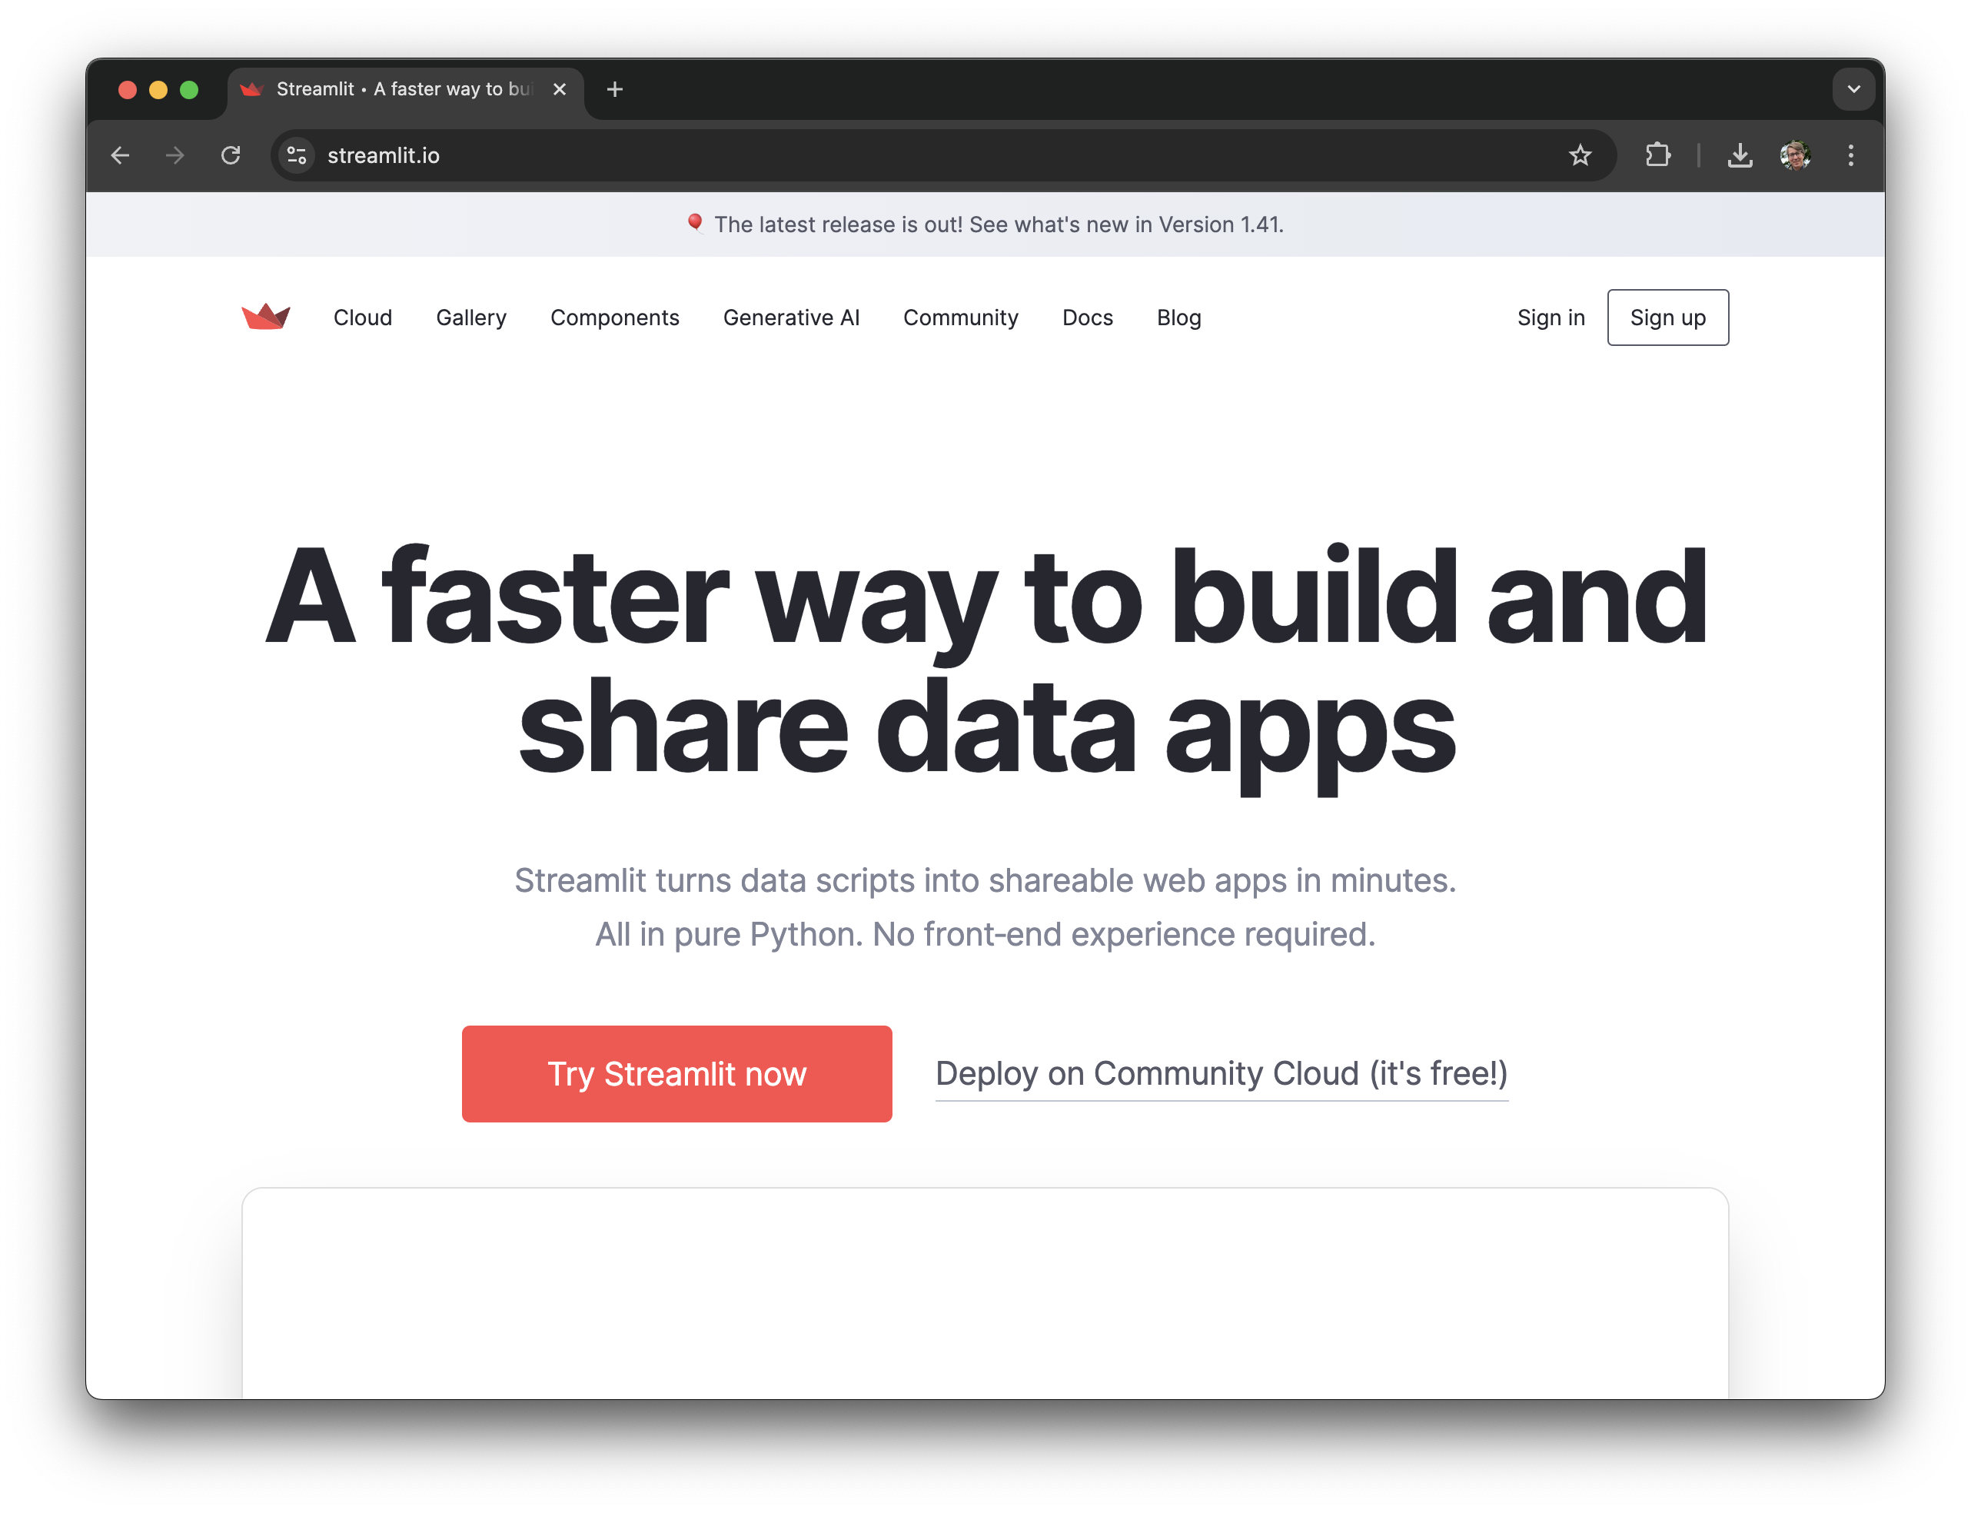

What is Streamlit?
Free and open-source library: streamlit.io

Slide 5

What is Streamlit?
Free and open-source library: streamlit.io
Python framework to write web apps and browser-based dashboards with minimal code
Favors rapid prototyping over deep customizations
Offers a large array of components from simple buttons to live webcam feeds

Slide 6
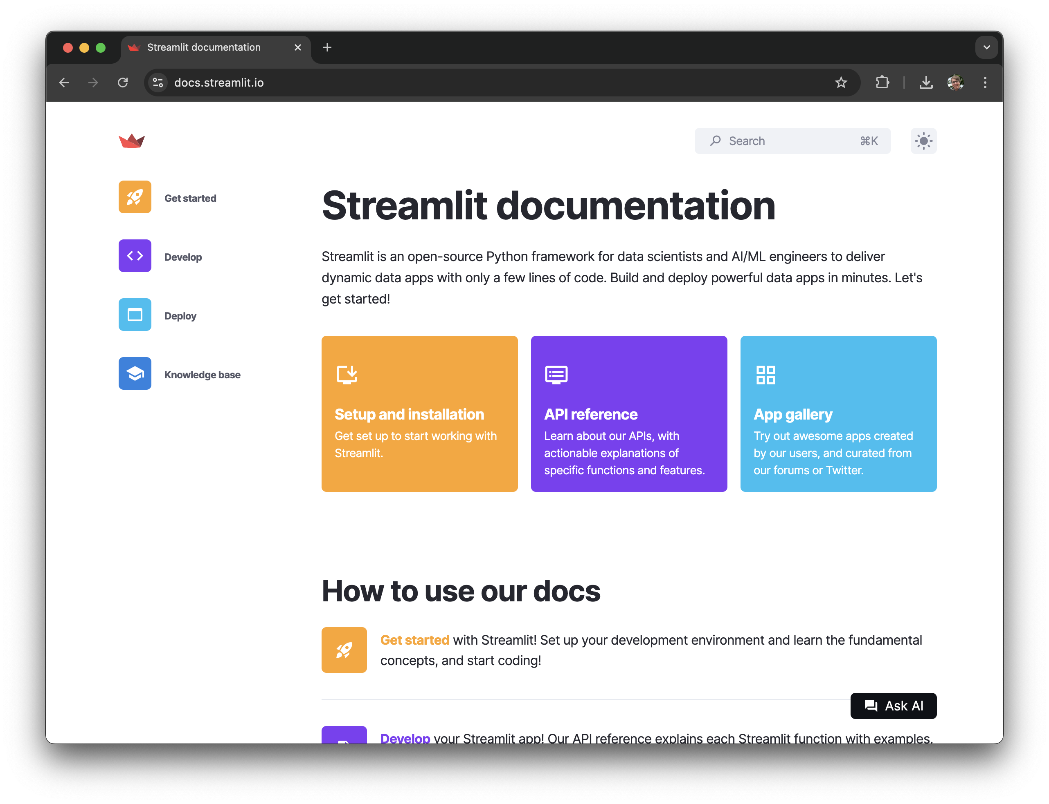
Why for Everyone?
Requires no web frontend development experience
Specifically geared towards data scientists and AI/ML applications
Great documentation with many helpful examples

Slide 7
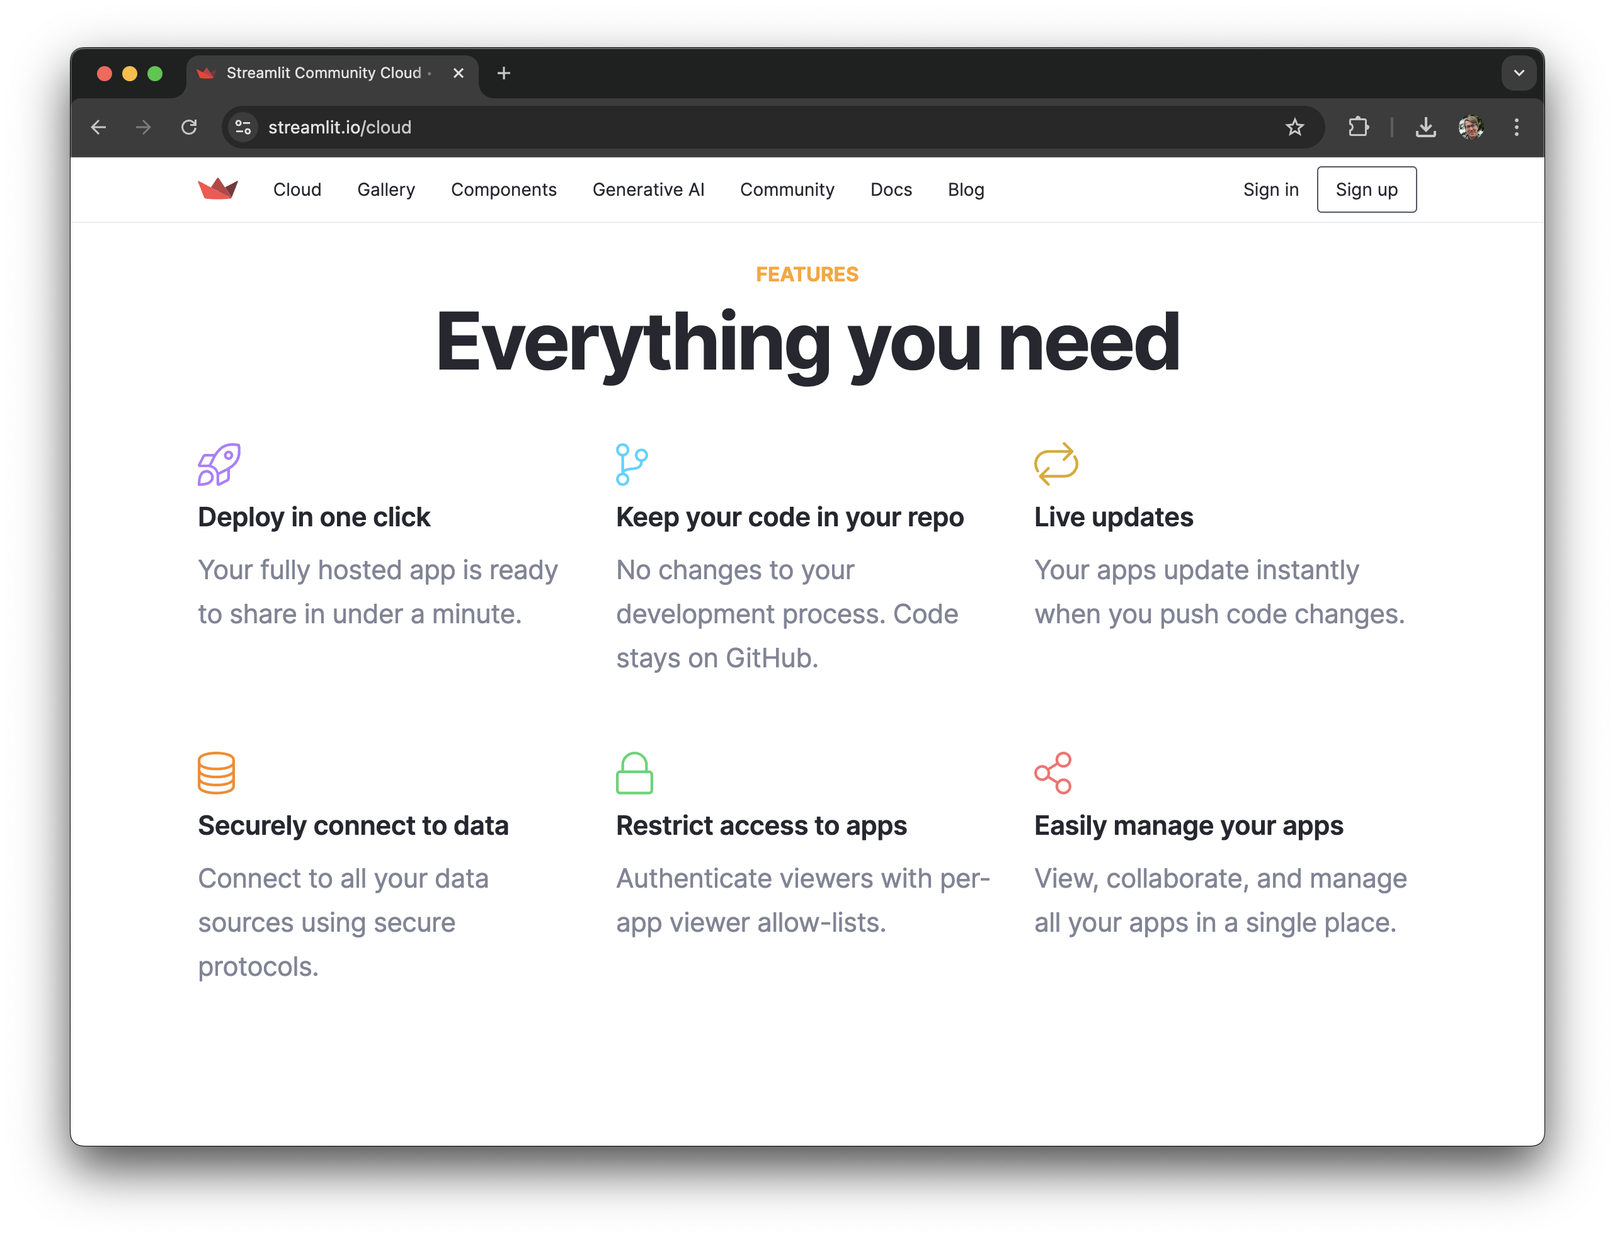
Why for Everyone?
Requires no web frontend development experience
Specifically geared towards data scientists and AI/ML applications
Great documentation with many helpful examples
The Streamlit Community Cloud lets you deploy and share your Streamlit apps for free with just a few clicks

Slide 8
Why for Everyone?
Requires no web frontend development experience
Specifically geared towards data scientists and AI/ML applications
Great documentation with many helpful examples
The Streamlit Community Cloud lets you deploy and share your Streamlit apps for free with just a few clicks

Slide 9
Dashboard demo
Full dashboard in 20-ish lines of code

Slide 10
What you will learn in this session
How to set up a Streamlit development environment
Understand Streamlit’s data and programming flow
Get to know some basic UI widgets
Learn about layout components
Understand the concept of session state in Streamlit apps
How to create a slick data dashboard

Slide 11


Recommended Development Environment
Visual Studio Code or a similar code editor
Python 3.9 or later
A current web browser (Google Chrome, Firefox, Microsoft Edge, Safari)
A GitHub repo (for Streamlit Cloud deployment)

Slide 12
Let’s get started!
Hands-on

Slide 13
Summary
Streamlit is great for rapid prototyping of web apps
Streamlit’s tight development loop makes for a pleasant experience
Streamlit’s catalog of components enables professional-looking, user-friendly interfaces
Streamlit’s concept of session state makes even more complex apps possible
Streamlit lacks deep customizability at a Javascript/CSS level (although hacky workarounds are possible)

Slide 14

What’s next?
Multipage apps
Connect to databases
Explore more built-in components, including chat elements!
Explore community-built add-on components
Get inspired by the App Gallery
Use Streamlit for your next project!

Slide 15
Thank you
dartgo.org/intro-to-streamlit

