Slide 1

Ketchup
What is it!?

Slide 2
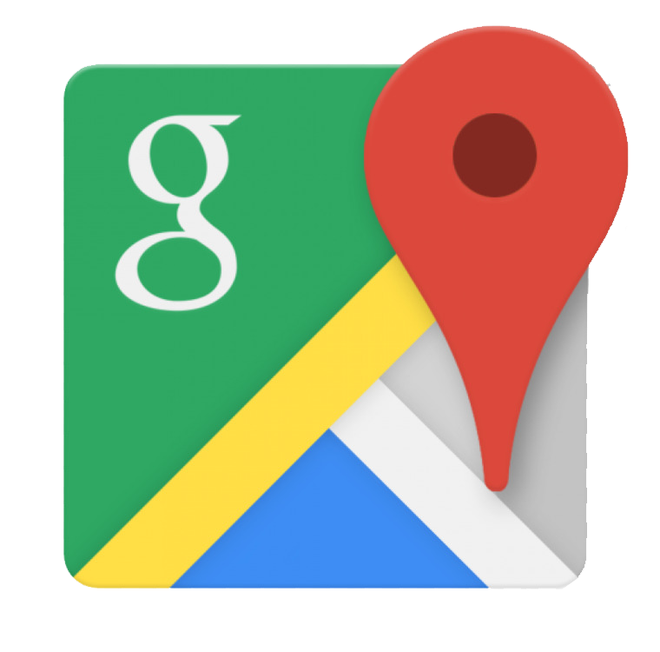

It’s an app that utilizes your location to find videos.
Your Geolocation is determined via Wi-Fi Positioning System. Ex. Georgia Tech Visitors Wi-Fi Network.
A Google Module will populate the landing page showing a 10 mile radius of your current location.
Within that module you’ll see Google pin drops. Those pin drops represent YouTube videos shot in that location.
Click on the pin drops.
A YouTube module will pop up and begin to play the video you selected via the Google pin drop.

Slide 3
Technology used
HTML
CSS
Bootstrap
jQuery
Google FireBase
API’s (YouTube / Google Maps
Photoshop

Slide 4
Team Members
Shannon Kendall
Google API, jQuery
Mark Hoefer
YouTube API, jQuery
Dhruv Patel
HTML, CSS, jQuery
Sam Terrazas
HTML, CSS, Bootstrap, jQuery

