Slide 1

Predicting Online Shoppers’ Purchasing Intention
Final Project Presentation
Applications in Data Science & Artificial Intelligence
Tamás Darvas, Ania Jaca Sanz de Arellano, Denis Cavanagh, Luiza Piletti, Harrison Nnaemeka Nnaji, Chingiz Saidov

Slide 2

Problem Statement
Most online shoppers don’t make purchases.
We aim to predict purchase intent using session data.
Goal: Enable real-time marketing interventions to improve conversion rates.

Slide 3

Dataset Overview
Dataset: UCI Online Shoppers Purchasing Intention
12,330 sessions with 18 features
Includes behavioral, technical, and temporal data

Slide 4
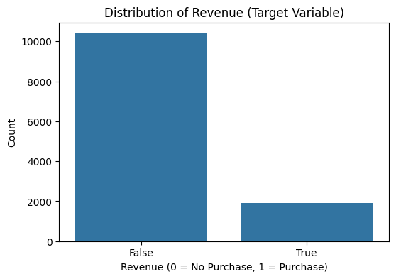
EDA – Class Imbalance
Only ~15.5% of sessions end in a purchase
Severe imbalance → model could bias toward predicting 'no purchase'
Justifies the use of SMOTE
This helps mitigate issues arising from class imbalance
Integrated into the pipeline to oversample the minority class

Slide 5
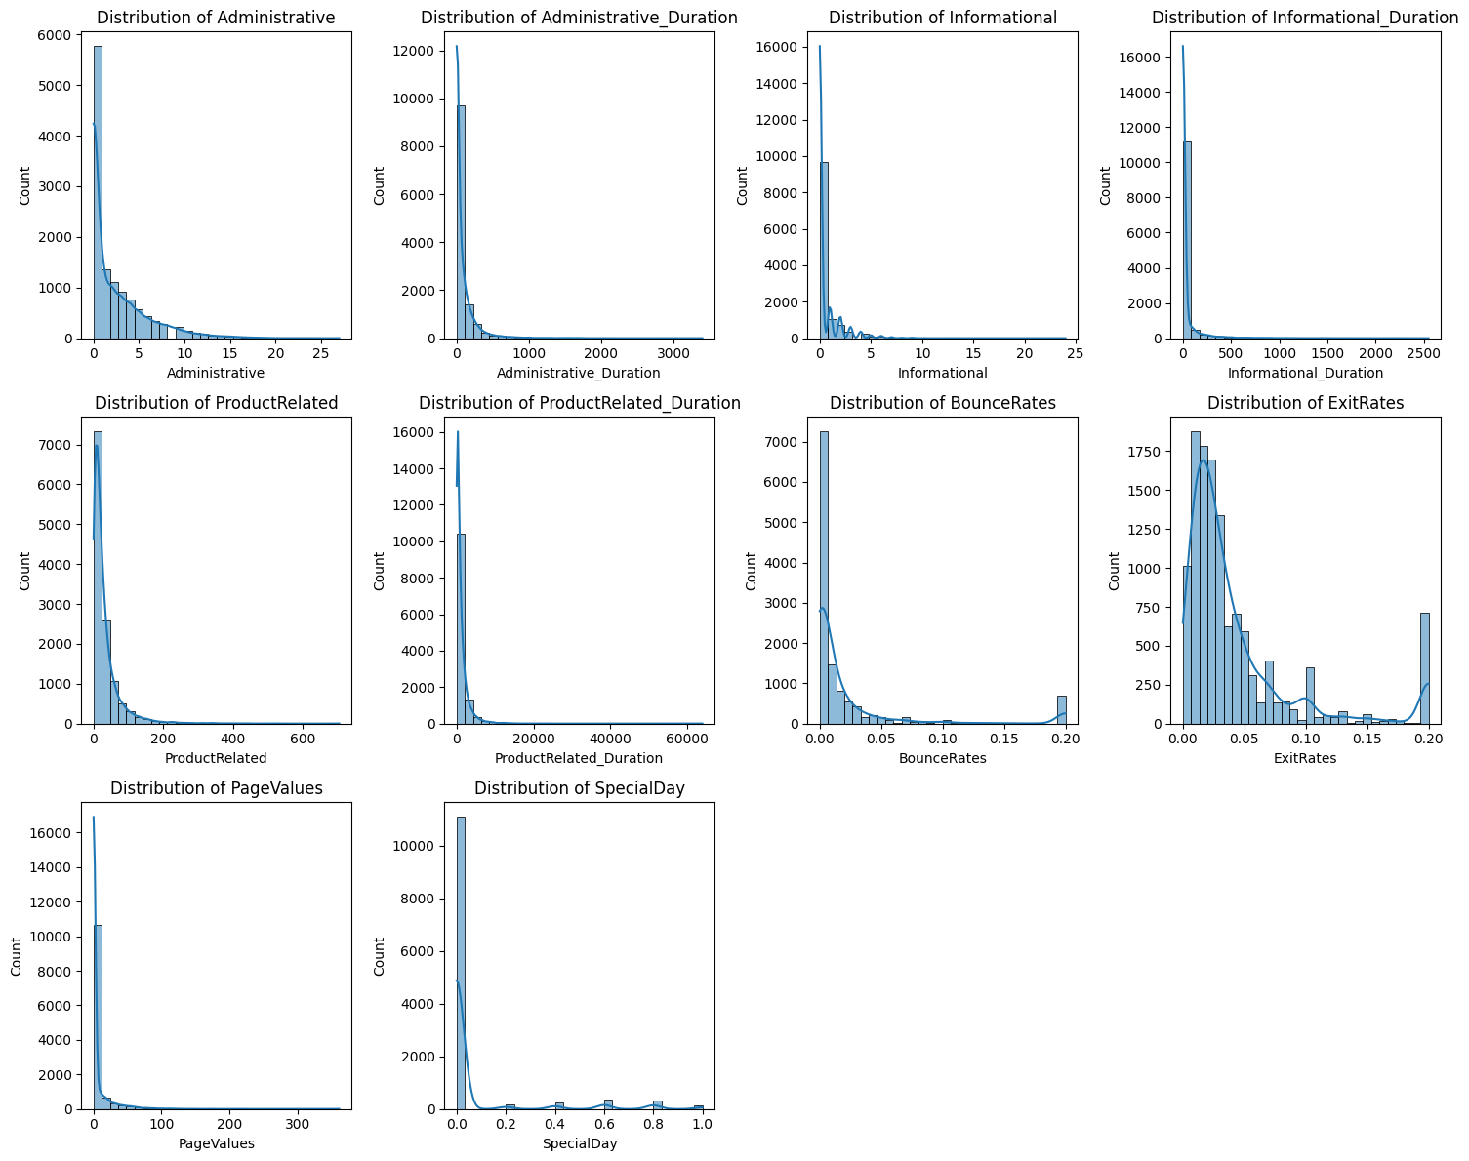
EDA – Heavily Skewed Distributions
Most numerical features (e.g. Administrative, informational, ProductRelated, and their durations), show a concentration of sessions at lower values, with a small subset extending to very high values

Slide 6
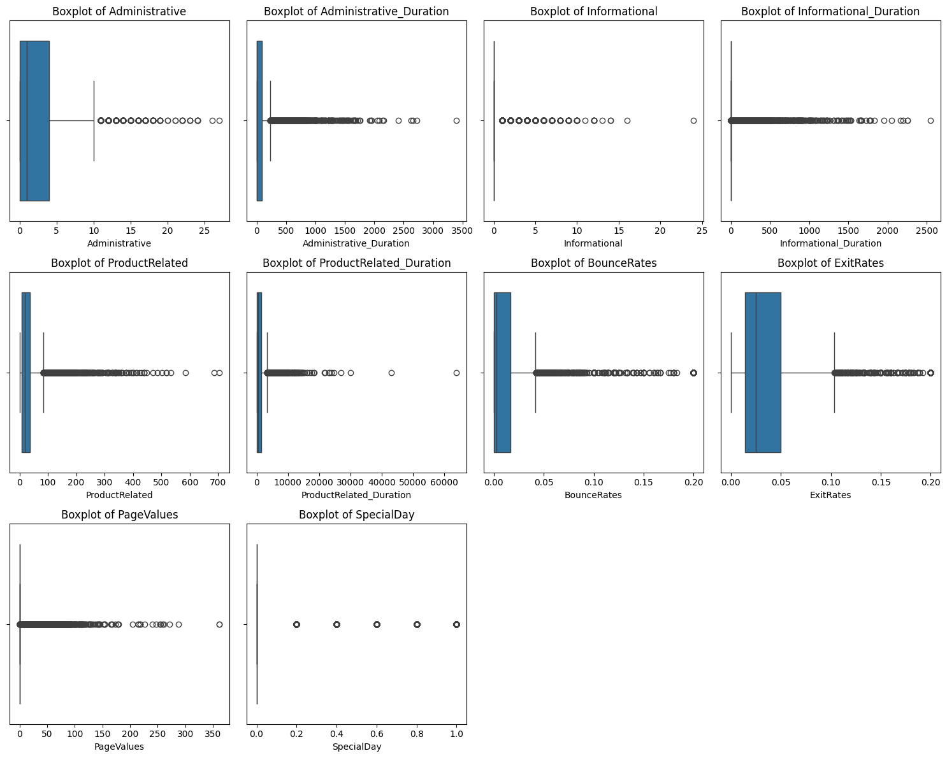
EDA – Outliers
Boxplots reveal that a few sessions exhibit exceptionally large numbers of page visits or durations
This leads to special consideration (robust scaling or outlier removal)
Given the skewness and outliers, transformations or robust methods may help improve model performance
Additionally, the sparsity in some features (e.g. PageValues) will require careful consideration

Slide 7
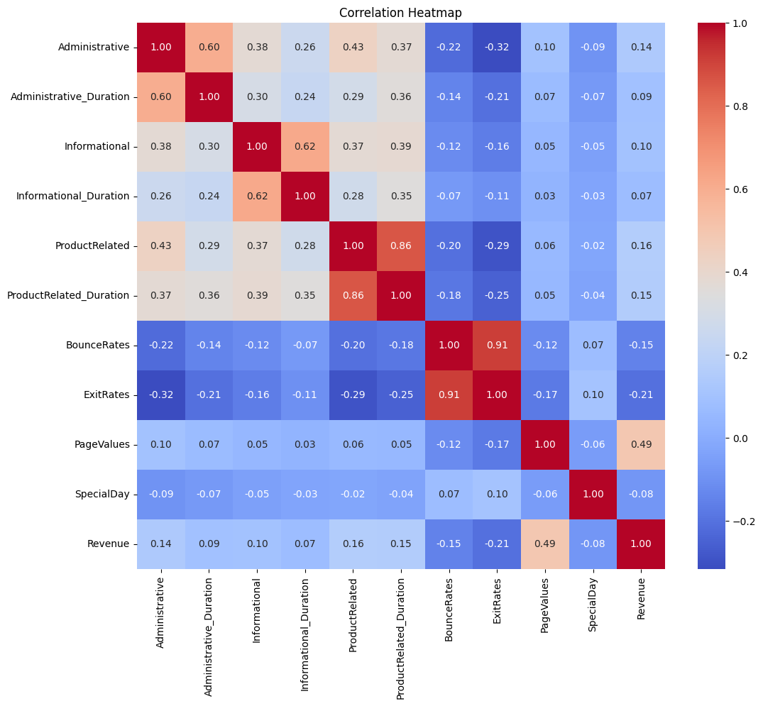
EDA – Correlation Strongest Predictor
PageValues shows the highest positive correlation with revenue
Sessions with higher page values are more likely to result in a purchase

Slide 8
EDA – Correlation Moderate Associations
ProductRelated and ProductRelated_Duration also exhibit moderate positive correlations with revenue
In line with intuition, browsing more product pages or more time on site indicates greater purchase likelihood

Slide 9
EDA – Correlation Negative Correlations
BounceRates and ExitRates have a negative relationship with Revenue
Also aligns with intuition, higher bounce rates suggest lower engagement
In short, EDA confirms our intuition that less engagement means less purchases, more engagement means more purchases

Slide 10
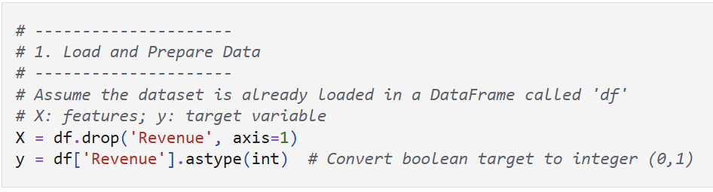
Data Preprocessing
We start by separating the dataframe into features x and the target y (revenue)
The target is converted to integers (0 or 1) for compatibility

Slide 11
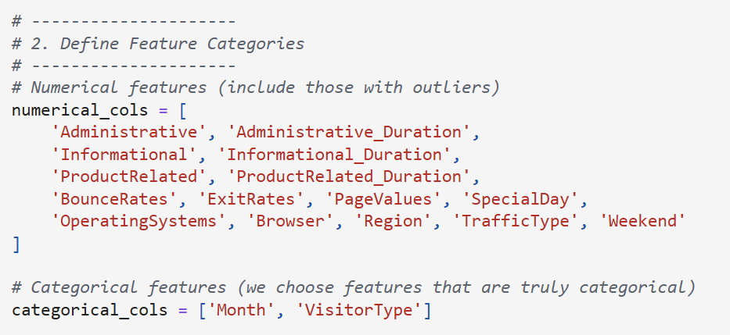
Data Preprocessing
Then we define feature categories
Numerical features such as page counts, durations etc. Many exhibit outliers, so we need to account for that
Categorical features such as month and visitortype. These will be one-hot encoded so that our models can interpret them properly

Slide 12
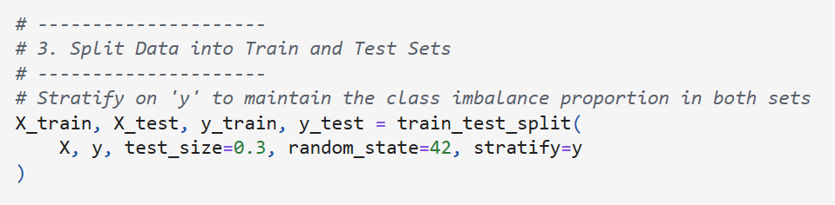
Data Preprocessing
Train/Test Split – stratification based on the target variable to ensure that both the training and test sets reflect the same class distribution as the overall dataset

Slide 13
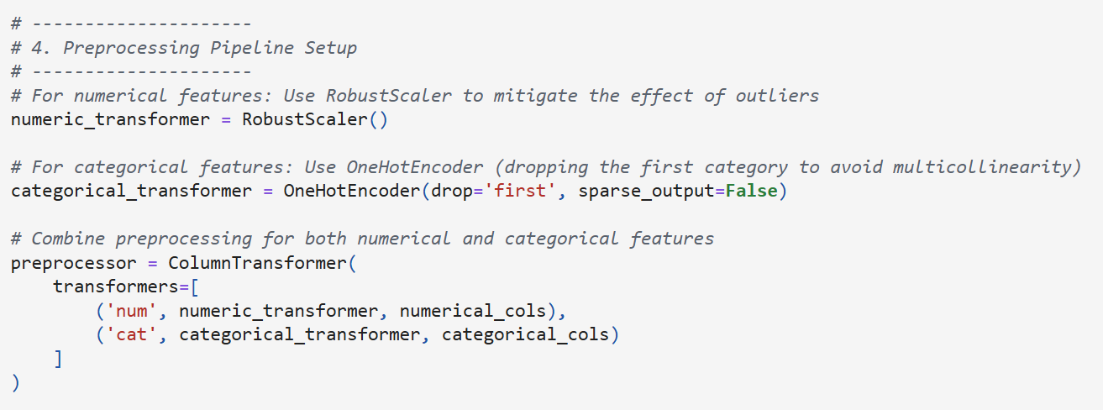
Data Preprocessing
Numerical Transformer (RobustScaler): This scaling method is less sensitive to extreme values (outliers) than standard scaling methods. It scales data based on the median and interquartile range.
Categorical Transformer (OneHotEncoder): Converts categorical variables into binary columns (dummy variables), which are easier for machine learning models to process. The parameter drop='first' is used to avoid multicollinearity.
ColumnTransformer: Combines the two transformers so that each set of features is processed appropriately in a single step.

Slide 14
Handling Class Imbalance
SMOTE was integrated into the pipeline to oversample the minority class in the training set, helping mitigate issues from the class imbalance
We use imblearn’s pipeline to chain preprocessing, SMOTE, and the classifier into one workflow
Model selection – we demonstrate with 2 models
Logistic Regression, a simple linear model for baseline comparisons
Random Forest Classifier, an ensemble method that can capture non-linear relationships and interactions between features
Model Fitting and Evaluation
After fitting the pipeline on the training data, predictions are made on the test set. We then evaluate the models using a classification report (which includes precision, recall, and F1 score), a confusion matric, and the ROC AUC score to assess performance, especially regarding the minority class
K-fold Cross Validation with GridSearchCV
We use GridSearchCV with 5-fold cross-validation to systematically search through specified hyperparameter combinations. For each combination, the data is split into 5 folds where 4 folds are used for training and 1 for validation. This process is repeated 5 times with different validation folds to get a robust estimate of model performance. The best hyperparameter combination is selected based on the average ROC AUC score across all folds.
Code on next slide

Slide 15
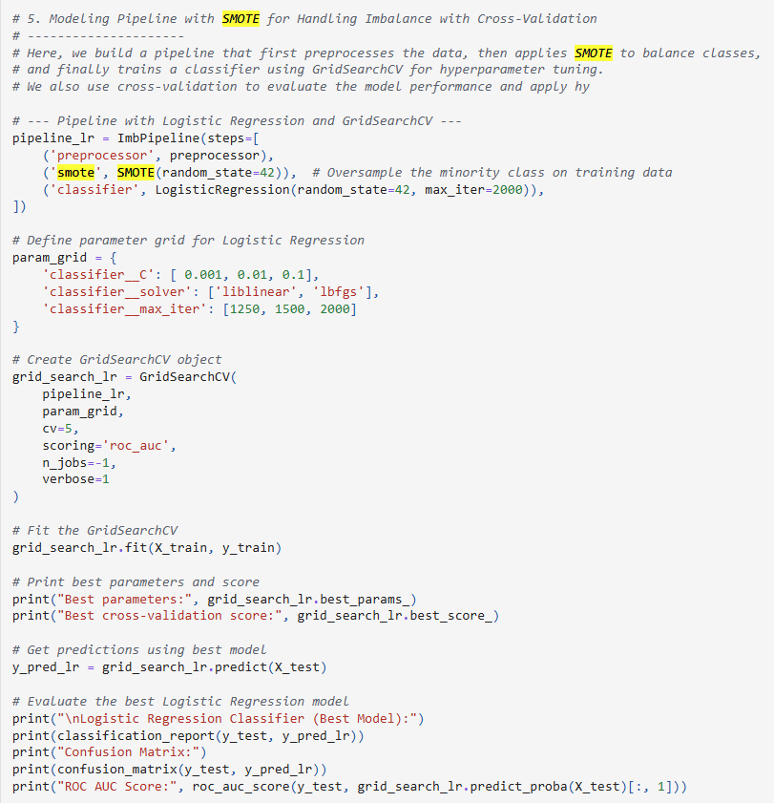
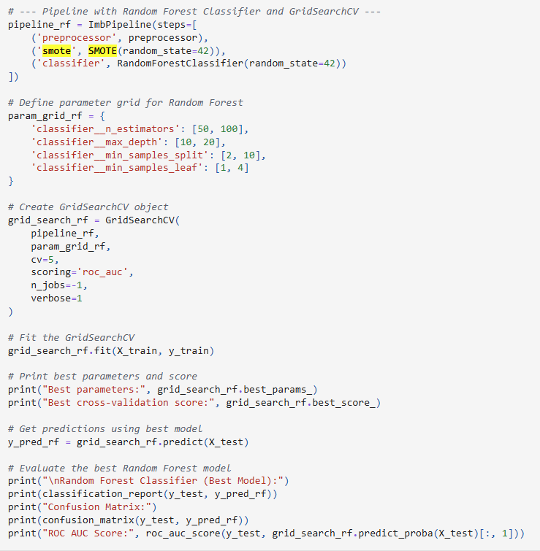
Handling Class Imbalance

Slide 16
Hyperparameter Tuning
The hyperparameter tuning with k-fold GridSearchCV refined our modeling pipelines for both Logistic Regression and Random Forest, leveraging SMOTE to address class imbalance. The grid search not only identified optimal parameter settings but also yielded improved cross-validated ROC AUC scores for both models.

Slide 17
Logistic Regression
Tuned Parameters:
C: 0.001
max_iter: 2000
solver: lbfgs
Performance:
Best cross-validation ROC AUC: ~0.907
On the test set, the classifier achieved an accuracy of 87% and a ROC AUC of ~0.897.
For the minority (purchase) class, precision was 56% and recall 73%, resulting in an f1-score of 63%.
The confusion matrix ([[2804, 323], [157, 415]]) indicates that while the model maintains high recall—capturing a significant portion of purchasing sessions—it also produces some false positives.
Impact:
Hyperparameter tuning ensured that the model was finely adjusted to maximize the ROC AUC. This tuning preserved its strength in identifying potential purchasers (high recall) while slightly improving overall stability.

Slide 18
Random Forest
Tuned Parameters:
n_estimators: 100
max_depth: 20
min_samples_split: 10
min_samples_leaf: 4
Performance:
Best cross-validation ROC AUC: ~0.932
On the test set, the model reached an accuracy of 89% and a ROC AUC of ~0.924.
For the purchase class, the precision was 63% and recall 70%, with an f1-score of 66%.
The confusion matrix ([[2895, 232], [172, 400]]) reflects a slightly more balanced performance, indicating a reduction in false positives compared to logistic regression.
Impact:
The tuning process enhanced the model’s overall discriminative power, as seen by the improved ROC AUC score. The optimized parameters contributed to a more conservative prediction approach, balancing between capturing true positives and minimizing false alerts.

Slide 19
Conclusion
Model Selection:
Logistic Regression remains advantageous when the goal is to maximize the detection of potential purchasers (i.e., higher recall), even though it accepts a higher rate of false positives.
Random Forest offers a more balanced performance with higher overall accuracy and improved ROC AUC, making it preferable when reducing false positives is critical.
Hyperparameter Tuning Impact:
The grid search with cross-validation systematically improved model performance by identifying the most effective parameter combinations.
The refined models are likely to offer more reliable predictions in a production setting, with the Random Forest model showing a slight edge in overall performance and stability.

Slide 20
Real World Use Cases
Business Applications
Predict purchase intent to trigger real time actions
Personalised discounts, product recommendations, cart nudges
Measuring Impact
Run A/B tests to evaluate conversion uplift and impact on revenue
Use precision/recall to balance user experience with effectiveness
Future Enhancements
Tune hyperparameters for improved accuracy
Experiment with advanced models (e.g. XGBoost, LightGBM)
Deploy in live environments in a controlled way and then build on real usage data

Slide 21
Appendix
The source code and all supporting material – including this presentation - are available under:
https://github.com/darvat/ecomm-shopping-analysis-opit

