Slide 1
A) PRIMS ALGO
Inputs:
Raw data
dist_metric object -
Distance metric(mutual reachability distance)
Leaf size
Outputs:
single_linkage_tree
result_min_span_tree

Slide 2
1. KD Tree – from sklearn
Inputs:
Raw data
dist_metric object -
Distance metric(mutual reachability distance)
Leaf size
Process:
Uses KD tree structure to calculate distance as per distance metric
Outputs:
Core distances

Slide 3
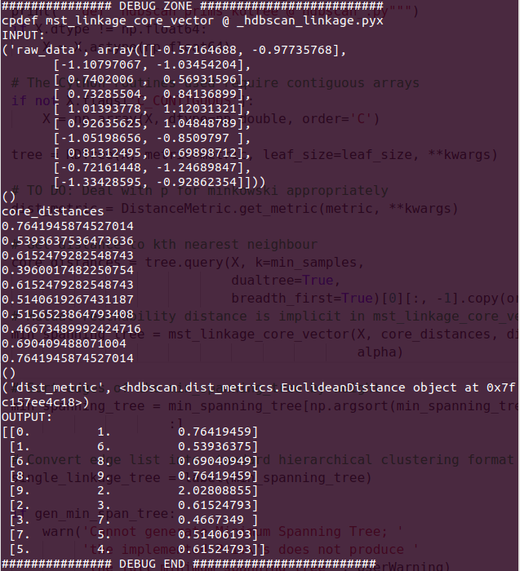
2. Minimum spanning tree
Inputs:
Raw data
Core distances
dist_metric object
Process:
Randomly picks a node and set it as current node
Finds the distance to every other point
Chooses the shortest distance and set current node as the connected node
Repeat step 2 and 3 till it reaches last node
Outputs:
Properly ordered one way route from start node to end following the shortest path -> the minimum spanning tree

Slide 4
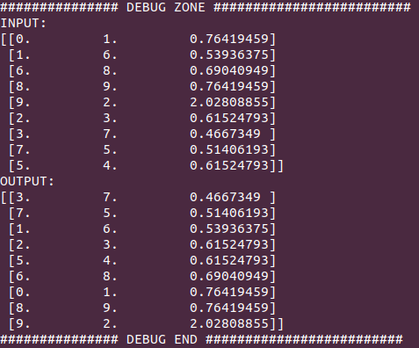
3. Sort edges of minimum spanning tree

Slide 5
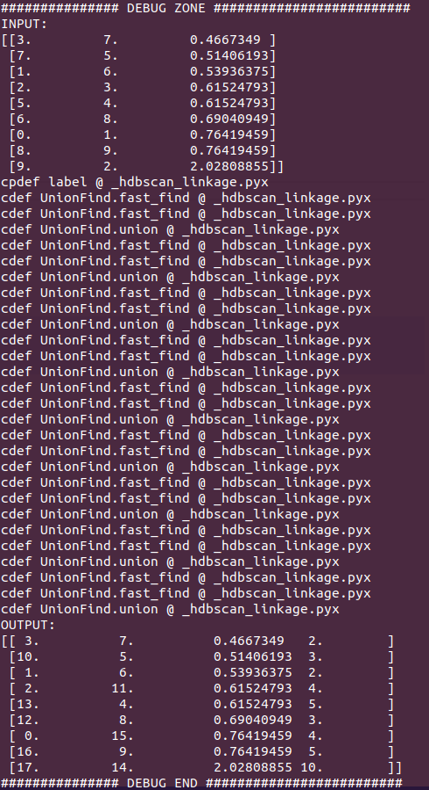
4. Convert edge list into standard hierarchical clustering format
Cpdef label
Inputs:
Minimum spanning tree
Process:
Cpdef label
Union find data structure
Outputs:
Single linkage tree

Slide 6
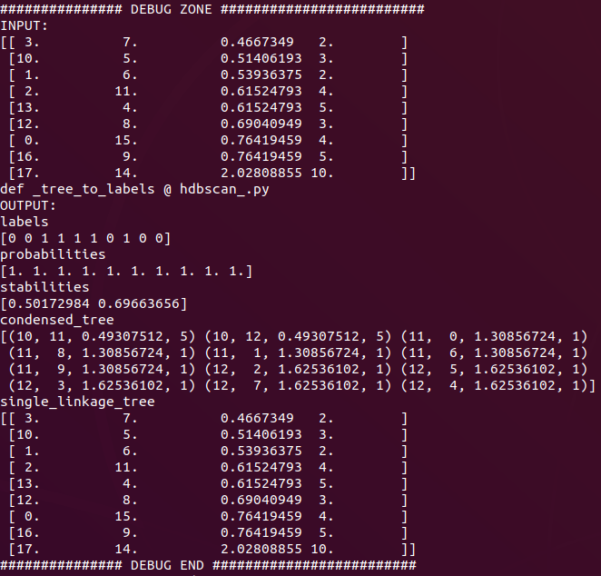
B) tree_to_labels
Inputs:
Single linked tree
Outputs:
labels,
probabilities,
Stabilities
condensed_tree
single_linkage_tree

Slide 7
1. condense_tree
Inputs:
Single linked tree
min_cluster_size
Process:
Uses KD tree structure to calculate distance as per distance metric
Outputs:
condensed_tree

Slide 8
2. compute_stability
Inputs:
Condensed tree
min_cluster_size
Process:
-
Outputs:
Stability dictionary

