Slide 1
A) PRIMS ALGO
Inputs:
Raw data
dist_metric object -
Distance metric(mutual reachability distance)
Leaf size
Outputs:
single_linkage_tree
result_min_span_tree

Slide 2
1. KD Tree – from sklearn
Inputs:
Raw data
dist_metric object -
Distance metric(mutual reachability distance)
Leaf size
Process:
Uses KD tree structure to calculate distance as per distance metric
Outputs:
Core distances

Slide 3
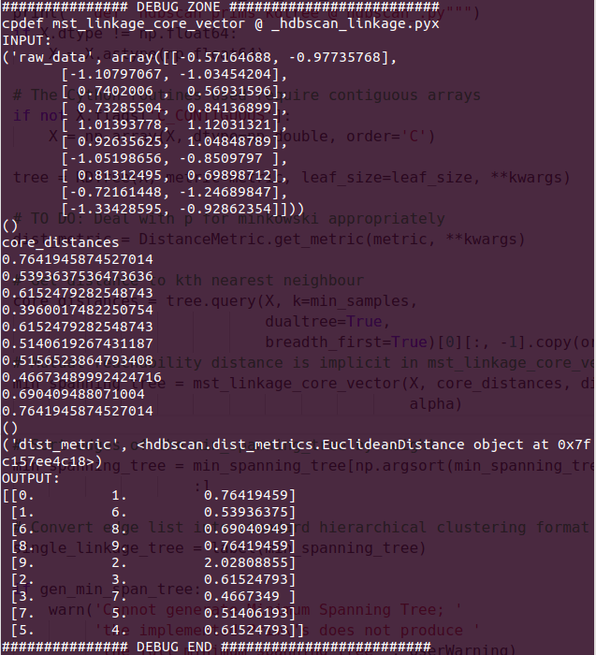
2. Minimum spanning tree
Inputs:
Raw data
Core distances
dist_metric object
Process:
Randomly picks a node and set it as current node
Finds the distance to every other point
Chooses the shortest distance and set current node as the connected node
Repeat step 2 and 3 till it reaches last node
Outputs:
Properly ordered one way route from start node to end following the shortest path -> the minimum spanning tree

Slide 4
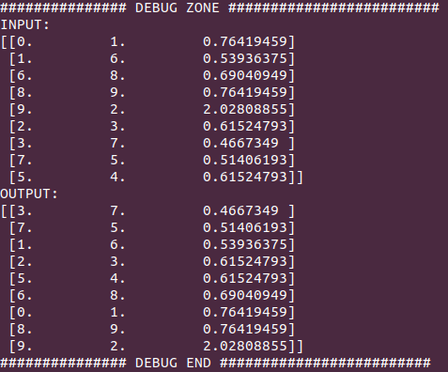
3. Sort edges of minimum spanning tree

Slide 5
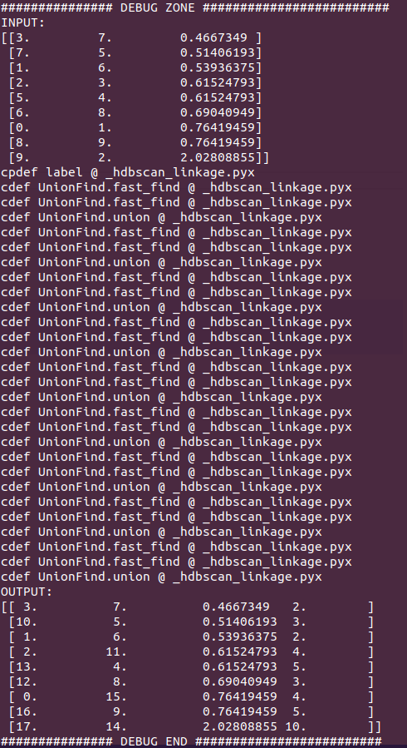
4. Convert edge list into standard hierarchical clustering format
Cpdef label
Inputs:
Minimum spanning tree
Process:
Cpdef label
Union find data structure
Outputs:
Single linkage tree

Slide 6
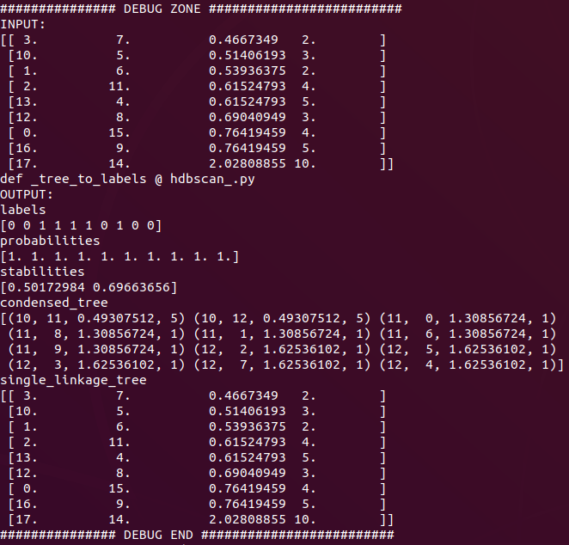
B) tree_to_labels
Inputs:
Single linked tree
Outputs:
labels,
probabilities,
Stabilities
condensed_tree
single_linkage_tree

Slide 7
1. condense_tree
Inputs:
Single linked tree
min_cluster_size
Process:
Uses KD tree structure to calculate distance as per distance metric
Outputs:
condensed_tree

Slide 8
2. compute_stability
Inputs:
Condensed tree
min_cluster_size
Process:
-
Outputs:
Stability dictionary

Slide 9
Main workflow
HDBSCAN
Prims algorithm
KD Tree
Minimum spanning tree
Sort the edges of the minimum spanning tree
Convert edge list into standard hierarchical clustering format
Union find
Trees to label
Condense tree
Compute stability
Get clusters

Slide 10
Written workflow
Hdbscan starts by getting all the points and storing them as a data structure called KDTree. The KDTree records the points and the mutual reachability distance of the points. This is done using a package form ScikitLearn. Then build the minimum spanning tree using the prim’s algorithm. A single shortest pathway is found using the info from the KDTree to check for distance. The distances(edges) are then sorted in increasing order.

